Slide 1
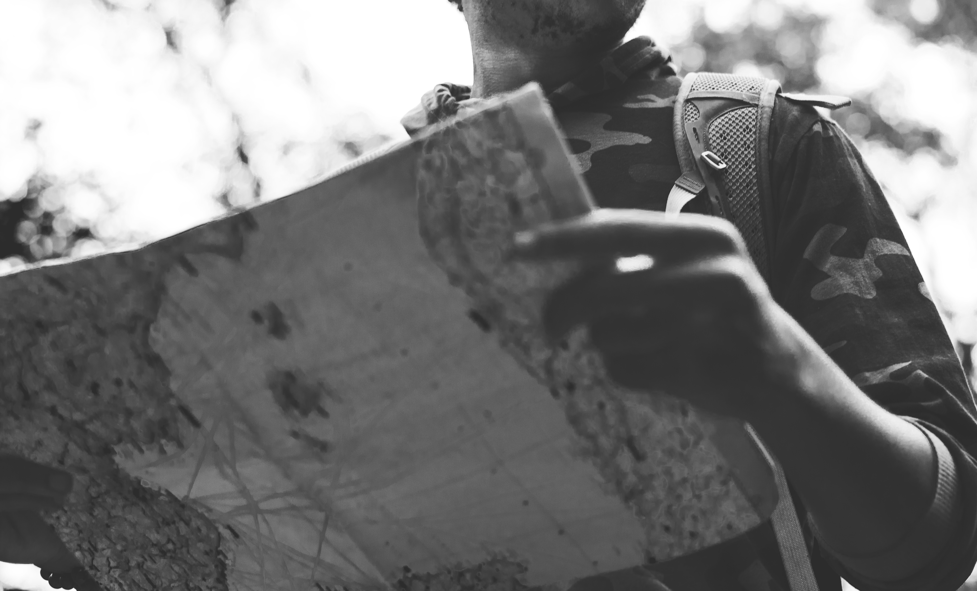
Session 2: How?
Leading in unpredictable environments
Notes:
The paper maps we use to rely on are less trustworthy - and we need tools that help us be more in touch with the dynamic world in which we live and work.

Slide 2
Providing a vision of abundant living and tending context.
Notes:
The paper maps we use to rely on are less trustworthy - and we need tools that help us be more in touch with the dynamic world in which we live and work.

Slide 3

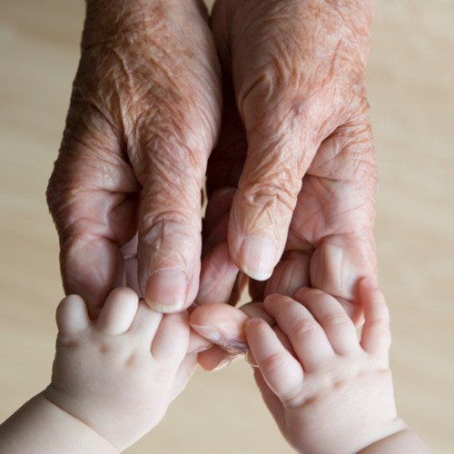
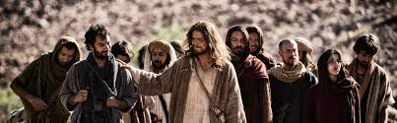

How do we steward
the future witness to the Christian faith?
Notes:
Congregations are called to steward the future witness to the Christian faith.
God’s love is steady and trustworthy, yet we live in highly dynamic context and the future does not look like the past.
This is a pivotal moment. We, the church, have the opportunity to hold tightly to the past or
Seek ways to join God’s movement in the world.
Our way forward is embracing God’s call for us and relying on God,

Slide 4
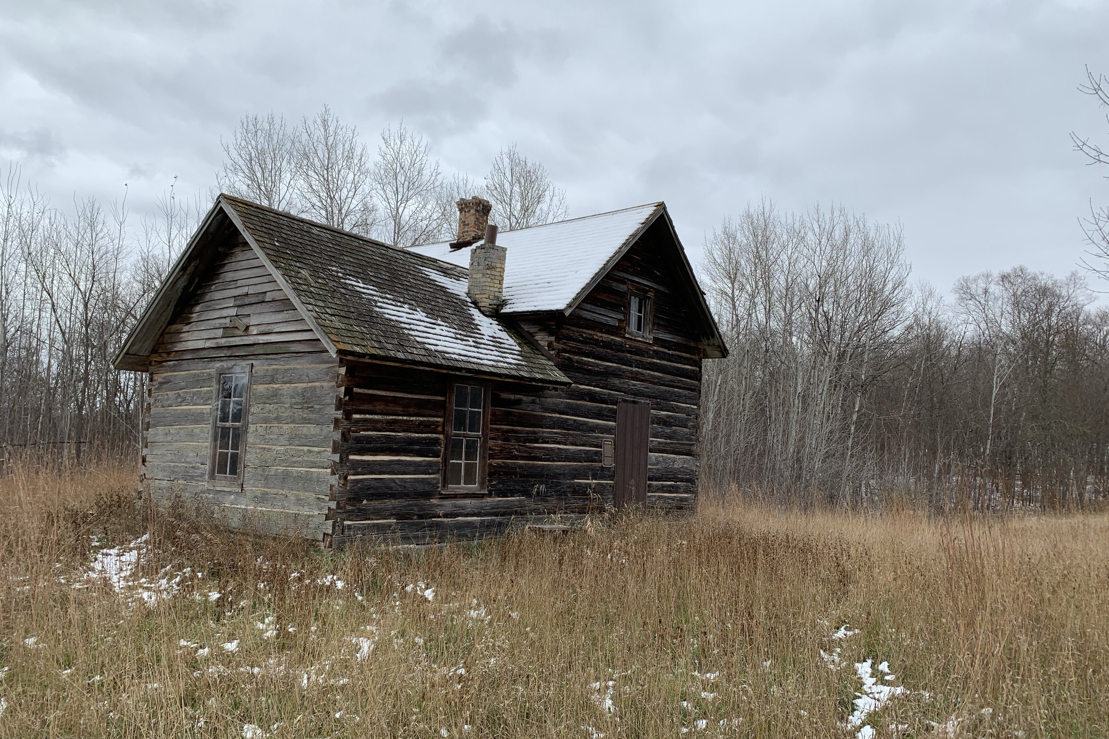
“The church as we know it is calibrated for a world that no longer exists.”
Scott Cormode
The Innovative Church, 1

Slide 5
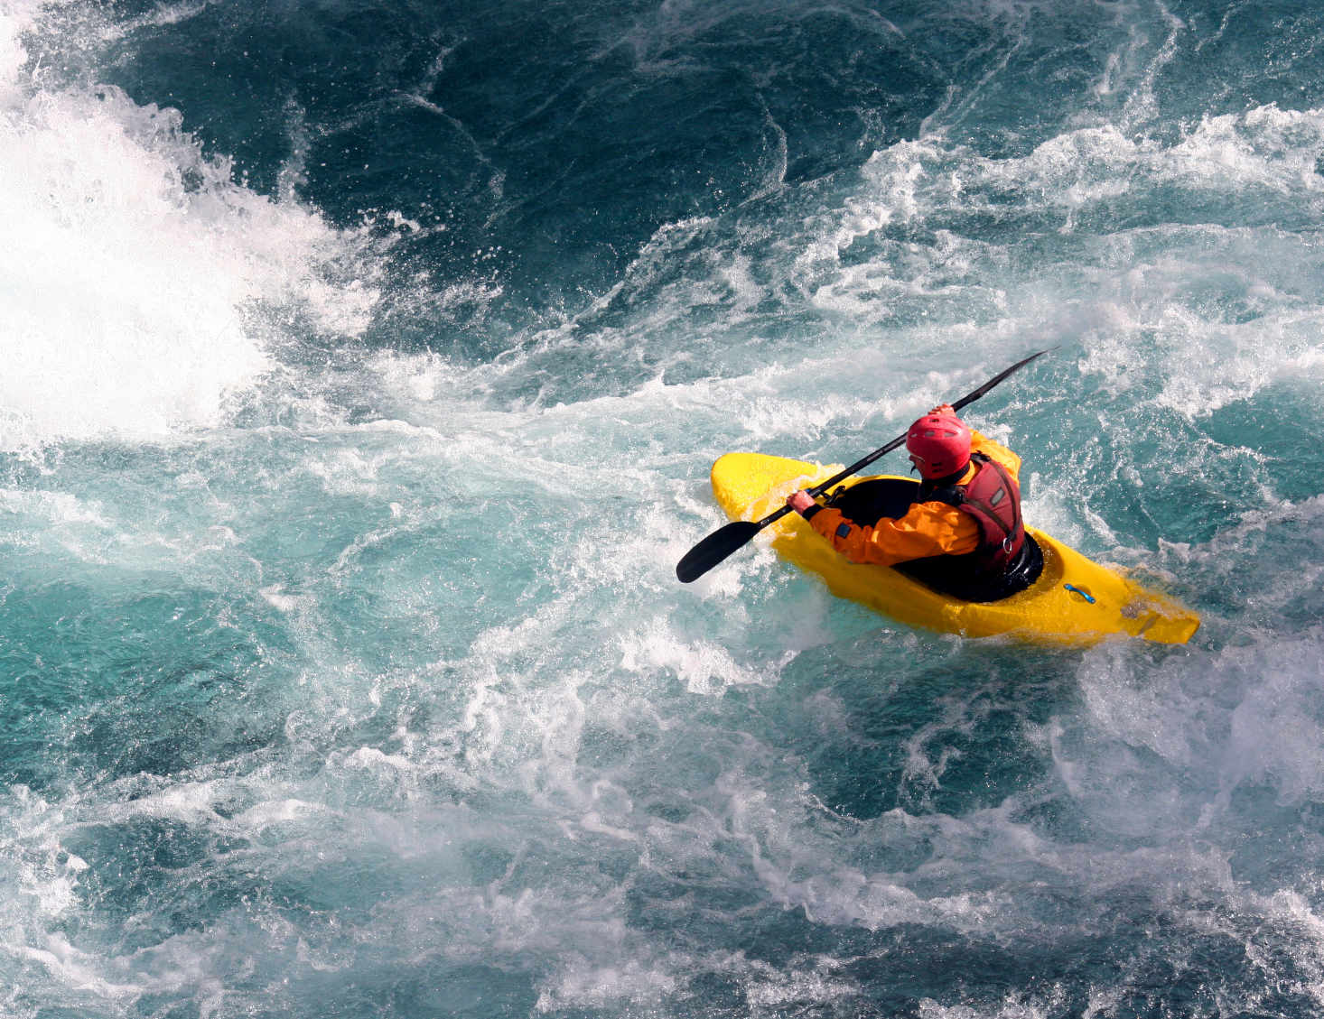
“For most of the church’s history, Christians had up to a century to recalibrate in the face of disruptive change…But now, sweeping changes are happening years apart. There is not enough time between changes before the next wave hits … we live in … a world of permanent white water.”
The Innovative Church, 2

Slide 6
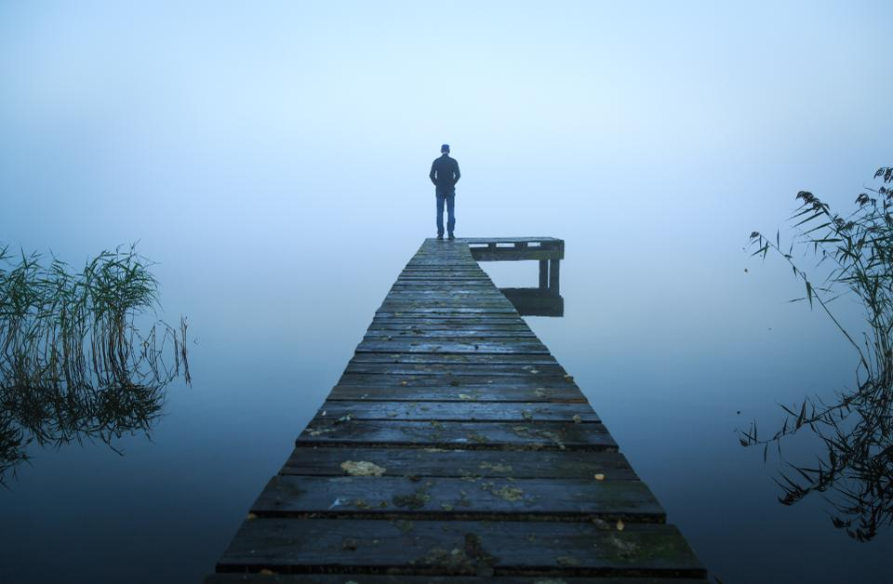
“We need a way to recalibrate in order to keep from getting out of touch with the needs of the world.
Cormode, The Innovative Church, 2

Slide 7
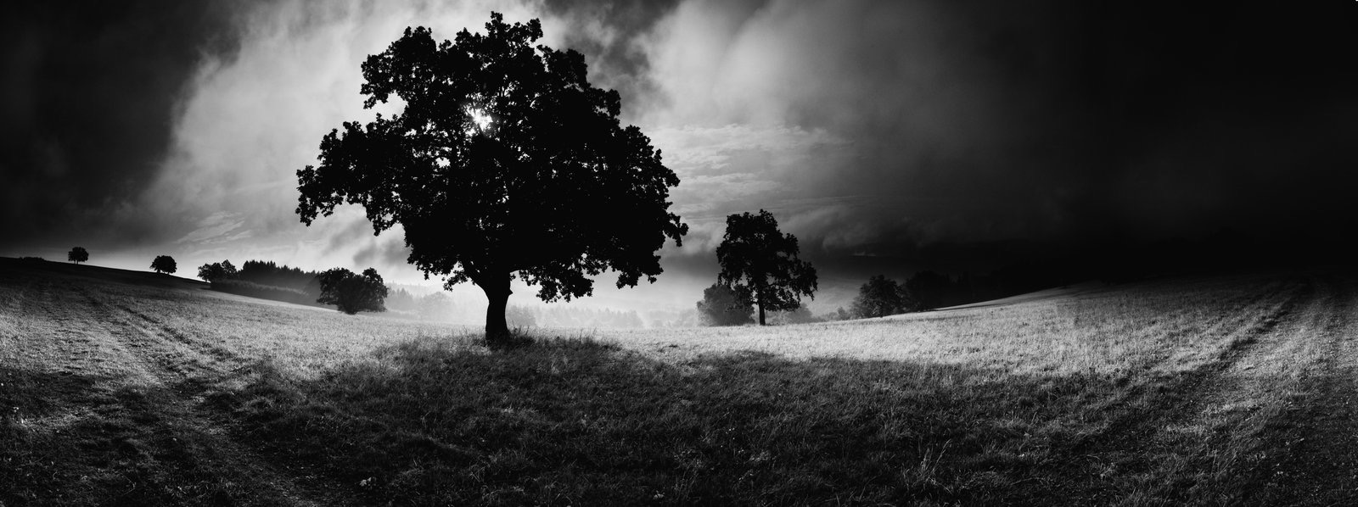
The environment around us
has changed.

Slide 8
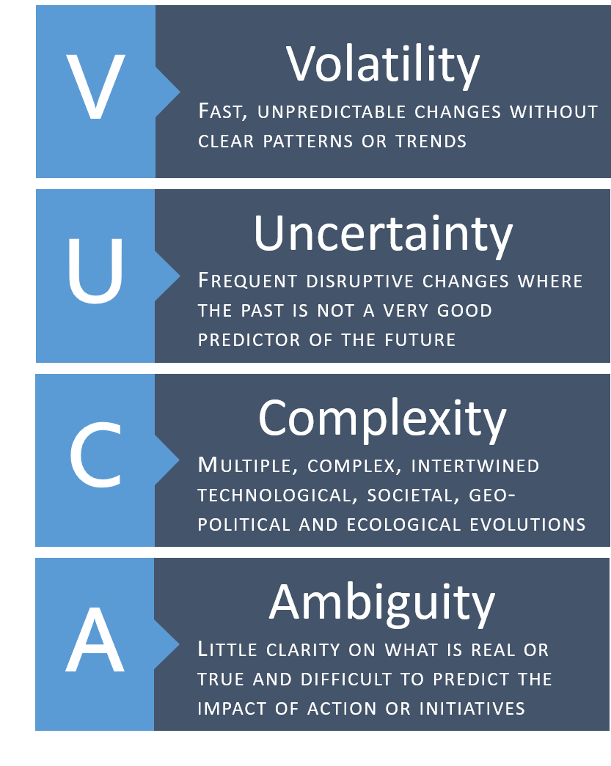
VUCA environment
6 Forces coming together:
Globalization
Technology
Digitalization
Individualization
Demographic Change
Environmental Crisis
Notes:
The future is no longer a good predictor of the past. This makes most of us uneasy, as most of us were raised in a different environment and our way of operating in the world is framed with a particular mindset that is accompanies with a particular set of skills and tools. Add to that, as church leaders we were our understanding of leadership and ministry are also placed within that environment and that way of seeing the world. And suddenly we find ourselves in unknown territory.

Slide 9
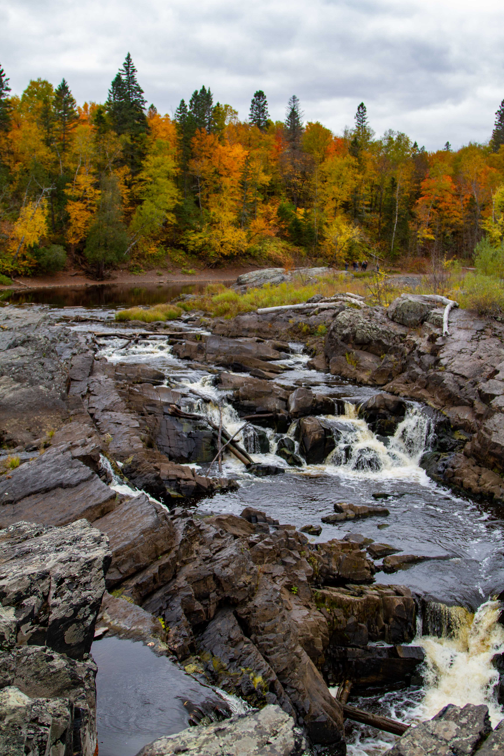
“This new normal is calling ministry leaders to recalibrate.
Leading in a VUCA environment requires a different perspective,
the ability to read contextual changes,
and new practices.”
Elton, Journeying in the Wilderness, 8

Slide 10

God’s love forms, informs, and transforms us as God-followers.
Grounded in God’s love, we love God and our neighbor
and direct our lives toward God’s promised future.
Congregations accompany people in discovering a Christian way of life in a dynamic world.
Notes:
Embracing God’s call for us we let God’s love orient our lives. For God’s love is what forms, informs, and transforms our lives. This love is steady and steadfast. In response to God’s love for us, we love God and our Neighbor
And God’s deepest desire is for all to live abundantly. And God promises a future we all things are made new.
Congregations simply accompany people in discovering a Christian way of life in this dynamic world.

Slide 11

What is God’s promised future?
What does a life oriented toward that future look like?
Abundant Living

Slide 12
Revelation 21
Then I saw a new heaven and a new earth; for the first heaven and the first earth had passed away, and the sea was no more. And I saw the holy city, the new Jerusalem, coming down out of heaven from God, prepared as a bride adorned for her husband. And I heard a loud voice from the throne saying,
  “See, the home of God is among mortals.
  He will dwell with them;
  they will be his peoples,
  and God himself will be with them
  he will wipe every tear from their eyes.
  Death will be no more;
  mourning and crying and pain will be no more,
  for the first things have passed away.”
And the one who was seated on the throne said, “See, I am making all things new.” Also he said, “Write this, for these words are trustworthy and true.” Then he said to me, “It is done! I am the Alpha and the Omega, the beginning and the end. To the thirsty I will give water as a gift from the spring of the water of life. Those who conquer will inherit these things, and I will be their God and they will be my children. But as for the cowardly, the faithless, the polluted, the murderers, the fornicators, the sorcerers, the idolaters, and all liars, their place will be in the lake that burns with fire and sulfur, which is the second death.”

Slide 13
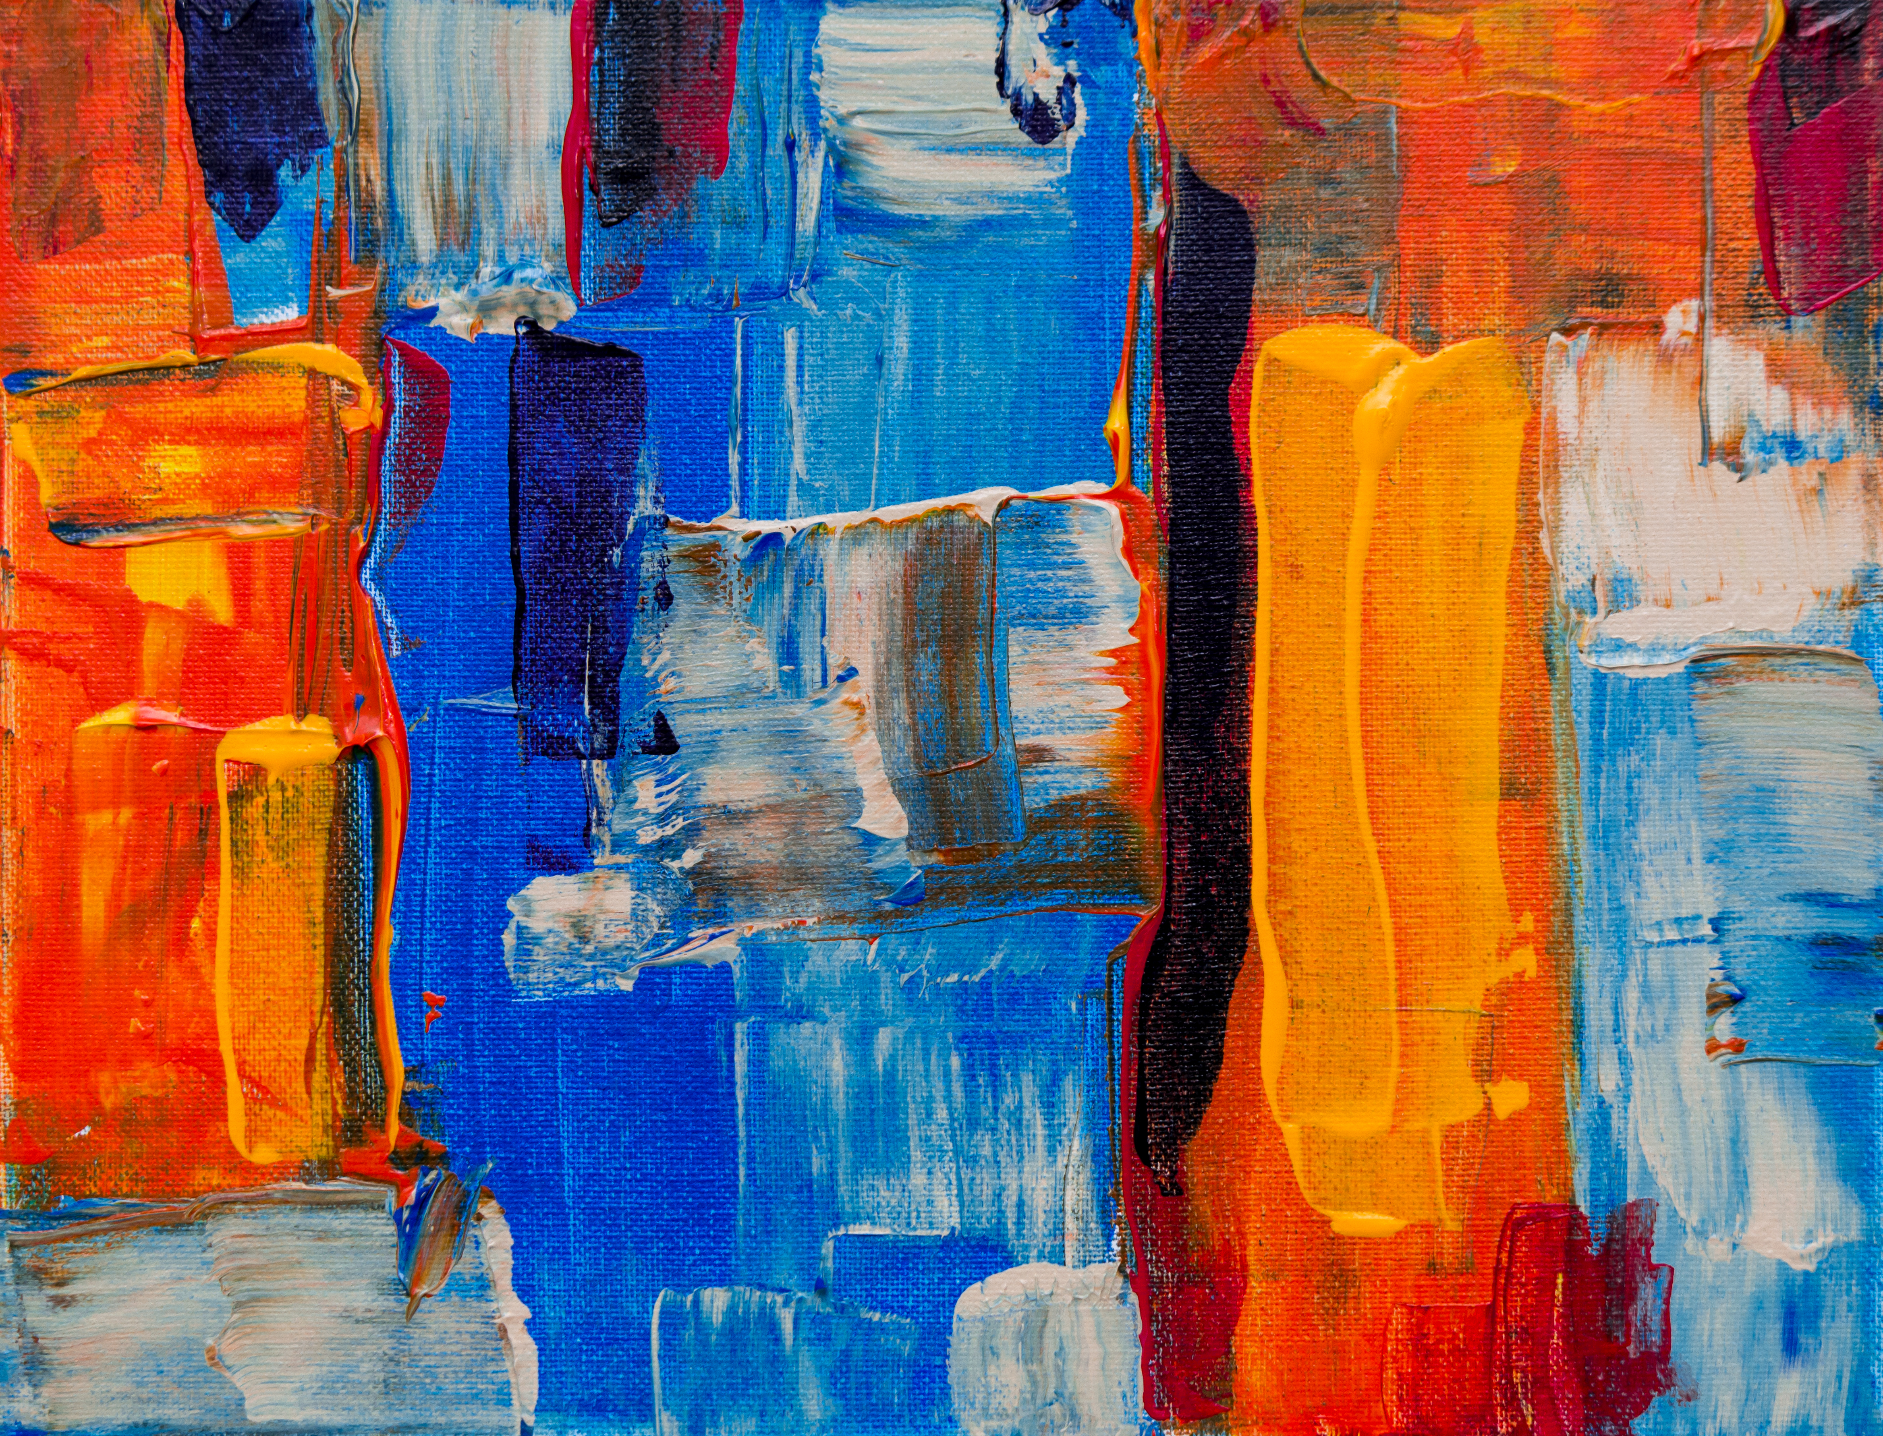
Need a Vision
“The narrative driving people of faith is abundant life. In the midst of today’s disruptions, God’s people need a vision for living abundantly. Accompanying people in discovering a Christian way of life requires cultivating a vision of abundant life that connects people’s everyday life with God’s promised future.”
Elton, Journeying in the Wilderness, 125

Slide 14
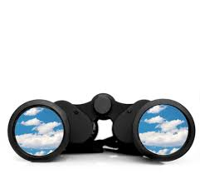
Sets our eyes on God’s Promised Future
God is about life, full and abundant life for all of creation, and for us.
God’s kingdom unfolding around us and God’s promised future breaks into our current time,
While God’s vision is real, we live in a “now and not yet” world.
God invites us to be co-creators of this future.
Notes:
God’s vision is a view of life that is abundant - there is enough for all to thrive. It is not scarcity, but love that when shared multiples.
God’s overflowing love flows through us into the world as we love and serve our neighbor.

Slide 15
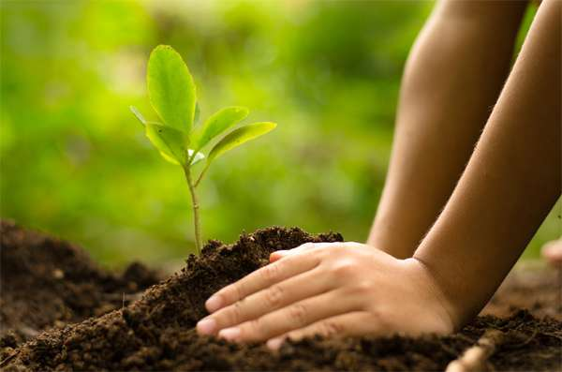
God is about life
“God’s first and last moves focus on life, with Christ’s resurrection as God’s signature on the world…God’s life force is wired into all living things. God sees potential for life in all aspect of the world, and God wants all of creation to live abundantly.
Life, not death, has the final word.”
Elton, Journeying in the Wilderness, 121

Slide 16
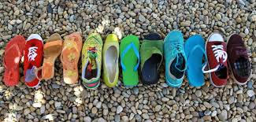
abundant life is a foretaste of God’s promised future
“Christians orient their everyday encounters toward God’s vision by striving for justice, serving all people, and sharing the Lord’s Supper, people of faith taste God’s future now. As hope displaces despair, love overcomes hate, and peace comforts troubled souls, the gap between God’s future and the world’s present struggle is reduced, and God’s people live as if God’s future is among us.”
Elton, Journeying in the Wilderness, 121-122

Slide 17

Now and not yet
“Faith provides meaning and gives us courage to face the world’s brokenness and enter deeply into the lives of others. Douglas John Hall says, ‘The whole purpose of faith is to free us for life…and to illumine the mean of what occurs to us.’ Being present and accompanying others in good and bad times manifests God’s love in the world.”
Elton, Journeying in the Wilderness, 80

Slide 18
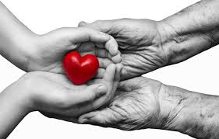
Co-creators
“Because God sees possibilities for life everywhere, we also trust in life’s creative and redemptive power. As we join God in creating, sustaining, and redeeming life, we participate in co-creating the future and living abundantly.”
Elton, Journeying in the Wilderness, 122

Slide 19
theology of abundance
“The Christian life is framed by a theology of abundance. Abundant living allows God’s grace and love to continually transform our lives…A theology of abundance changes how we see ourselves and the world.”
Elton, Journeying in the Wilderness, 122

Slide 20
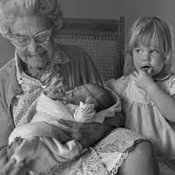
abundant living provides hope
“Faith reorients time. Revelation 21 is a word of hope for the present, grounded in the past with an eye toward the future…God is actively creating, sustaining, and reconciling the world, even when we do not see it…The world is not yet as God intends, but we can trust God will bring it to competition.”
Elton, Journeying in the Wilderness, 122

Slide 21
#livingabundant
How might we invite people to join God’s vision of living abundantly?
How might we make God’s vision visible?
What if the church were a movement of living abundantly?

Slide 22

- In uncertain times, how important is vision?
- What difference would a theology of abundance make in people’s lives?
- How might the church cultivate a vision for abundant life?
Small Group Sharing

Slide 23
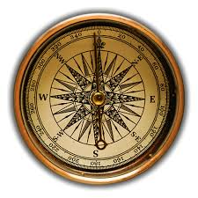
GPS for Faith
A navigational system for faith in highly dynamic environments:
Getting oriented - loving God and our neighbor
Setting a direction - toward God’s promised future
Two movements - gathering and scattering
Four commitments - gift, compass, witness, agent
Three sets of practices - sanctuary, campfire, outpost

Slide 24
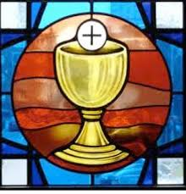


Session 3:
Next Faithful Steps
Behaving our way into a new reality

Slide 25
Identifying practices for anchoring and animating our life in the midst of uncertainty

Slide 26
9 Then Jesus[a] called the twelve together and gave them power and authority over all demons and to cure diseases, 2 and he sent them out to proclaim the kingdom of God and to heal the sick. 3 He said to them, “Take nothing for your journey: no staff, nor bag, nor bread, nor money—not even an extra tunic. 4 Whatever house you enter, stay there, and leave from there. 5 Wherever they do not welcome you, as you are leaving that town shake the dust off your feet as a testimony against them.”
Luke 9

Slide 27

“The Christian church’s identity stems from a peculiar series of events—the life, death, and resurrection of Jesus Christ.
In Jesus, God saved the world from within, not outside it…”

Slide 28
…As people who live post-resurrection, the cross is more than a one-time event.
It is an invitation into an alternative tradition, gospel, and lifestyle.”
Elton, Journeying in the Wilderness, 79

Slide 29
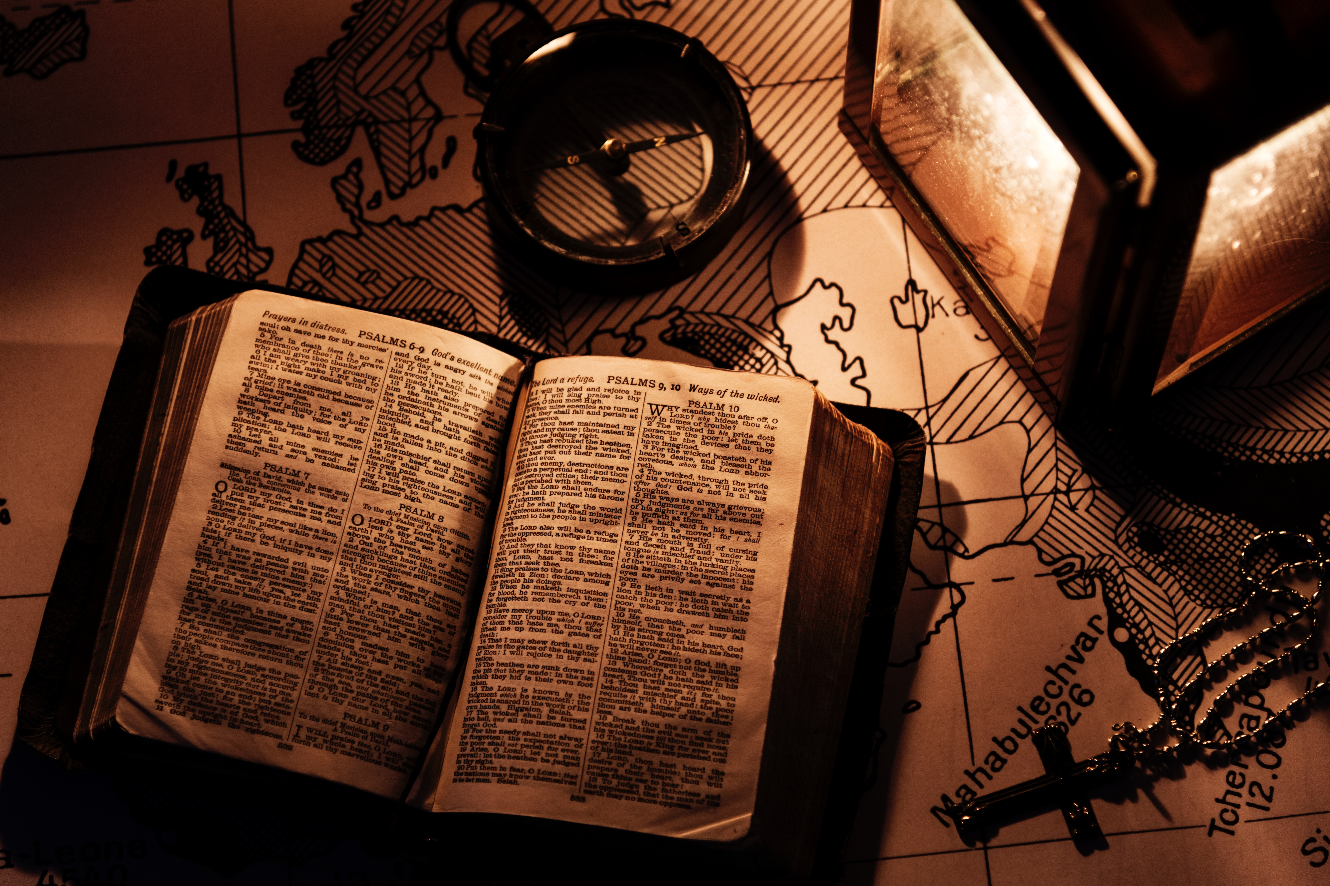
“As the church names the peculiar nature of faith and engages in the particularities of people’s lives, it accompanies people in discovering a Christian way of life and discerning the trail forward.”
Elton, Journeying in the Wilderness, 81

Slide 30
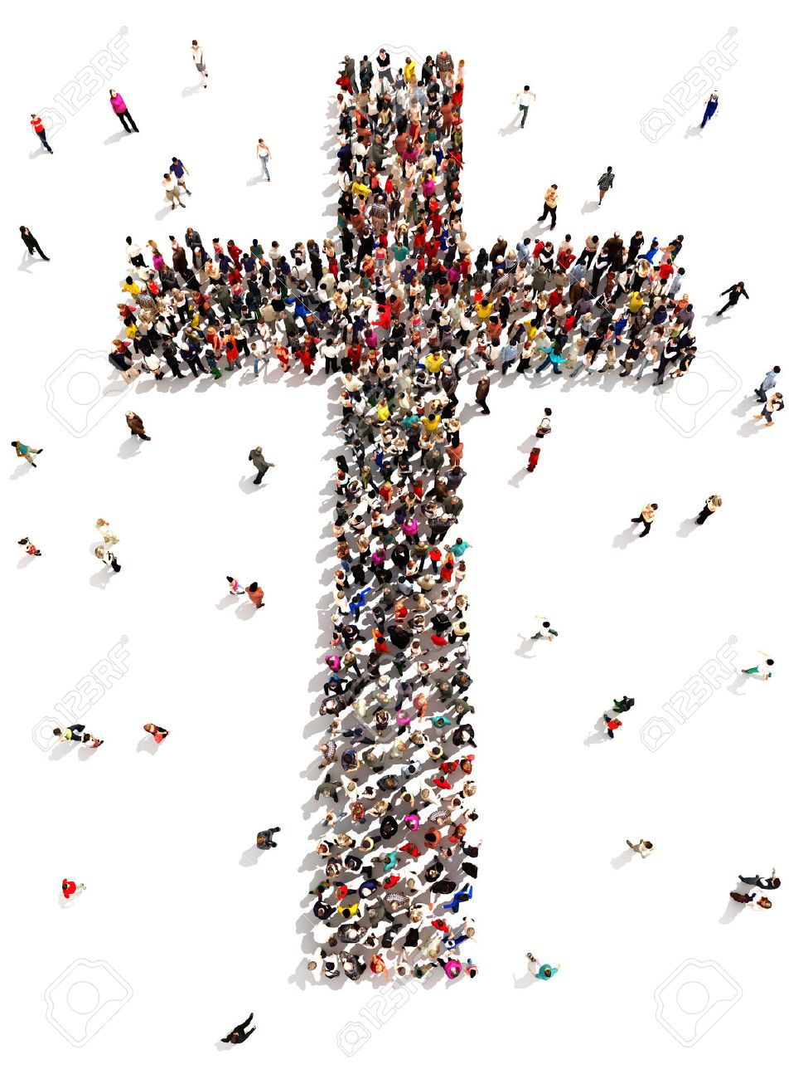
Cruciform Communities of Hope
Cruciform communities provide hope as they join people in the theological work of making meaning of their lives.
They embody a theology of the cross as they live in solidarity with the world and strive for the well-being of all.

Slide 31




4 commitments of faith
Gift of love
Guide for living
Witness to God’s Story
Agent of God’s love
Notes:
To these two movements we add four commitments that highlight the multi-multi-faceted nature of faith.

Slide 32

2 movements
orient our lives
Notes:
Gathering God’s beloved people as the body of Christ - faith forming and informing our lives.
Scattered in the world, God’s people are co-creators of God’s mission transforming the world.

Slide 33
Gathered in community we discover our identity and participate in Christian practices, encounter God’s story, and live in relationship with other people of faith.
Scattered in the world we participate in God’s mission of loving the world as we encounter difference, name pain and injustice, and love and serve others.
Notes:
Gathered in community we discover our identity and participate in Christian practices, encounter God’s story, and live with other people of faith.
Scattered in the world we participate in God’s mission of loving the world as we encounter difference, name pain and injustice, and love and serve others.
Most of our time, in the past, has been on our time gathered. Yet most of our lives are lived scattered in the world. AND faith, as a way of life, is about all of life, not just our time in Christian community.
What if we took rethought our time gathered as accompanying people of faith to discover a Christian way of life scattered? What difference would that make?

Slide 34
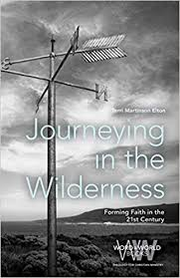
A practice-centered approach to faith integrates faith into everyday life. Over time, faith practices create a way of life. Easily recalibrated as circumstances change, faith practices allow Jesus followers to anchor their lives in God, make meaning of their lived experiences, and guide their relationships.

Slide 35


practice
Basketball or Yoga
Practice as preparation for “the real deal.”
Goal - mastery
or
Practice as “the real deal.”
Goal - participation

Slide 36
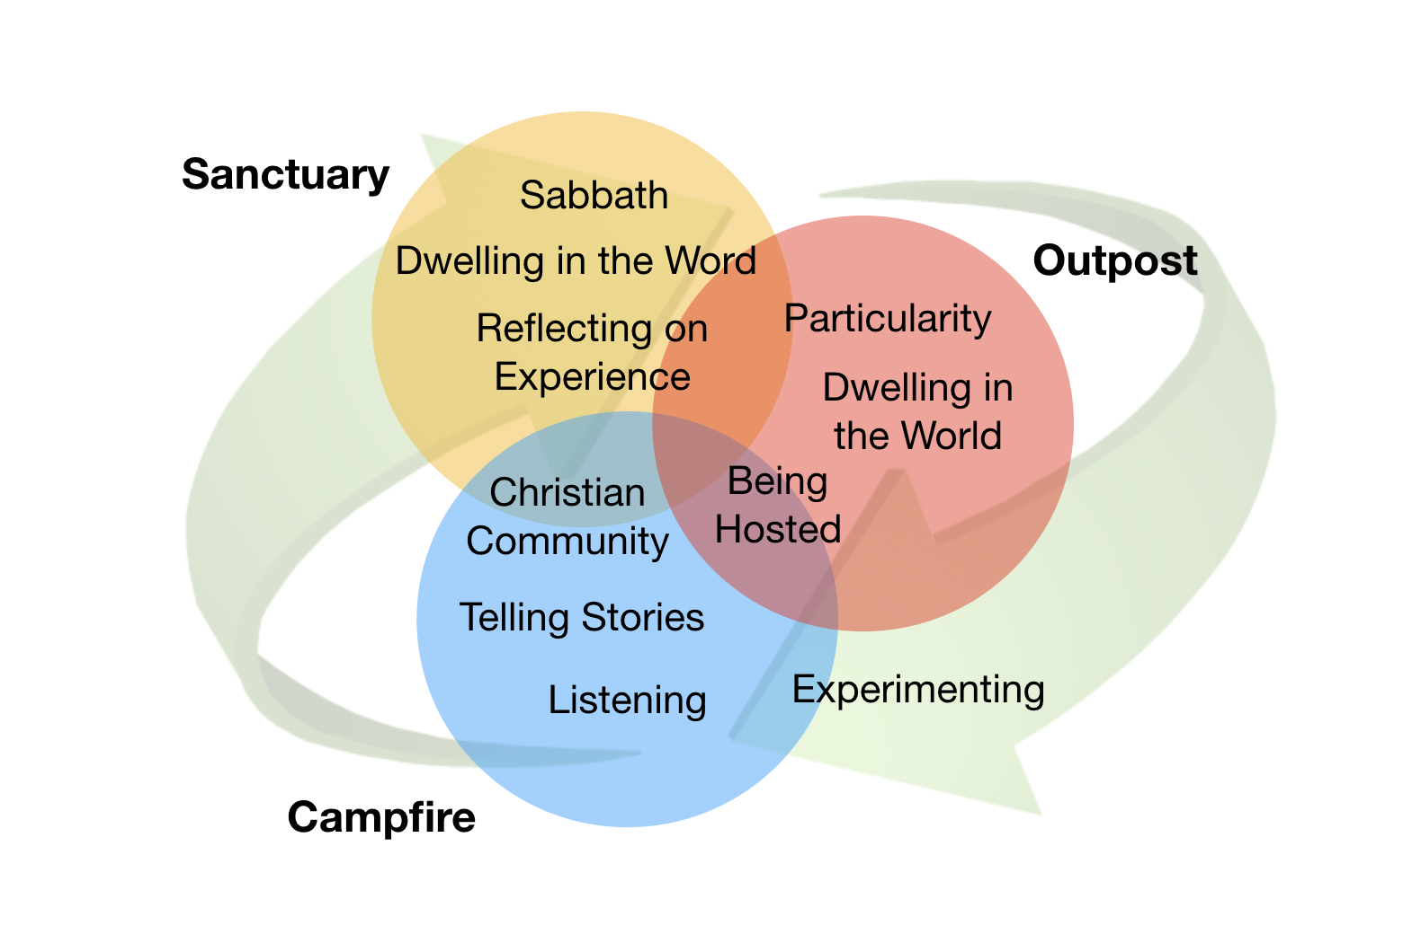

Slide 37
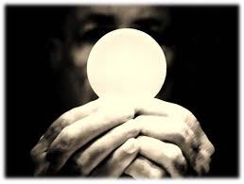
Sanctuary
Practices
Practices that focus on God, anchor God’s church, and transform human communities into the body of Christ.
Dwelling in the Word
Sacraments
Reflecting on God’s presence in everyday experiences
Sabbath
sacramental

Slide 38
Reflect on past week
Pick one day from this past week.
Write what was happening “around” that day.
Note what was happening “within you” that day.
What brought you joy?
What made you angry?
What wore you out?
What gave you energy?
How were you joining God in loving the world?
How did others share God’s love with you?
“To understand our relationships and daily encounters, we must develop the ability to reflect and set aside time to do it.”
Elton, Journeying in the Wilderness, 38

Slide 39
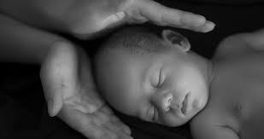
Campfire
Practices
Practices that cultivate meaningful community, open friendships and embody God’s love.
Open Friendships
Listening
Telling Faith Stories
incarnational

Slide 40
Tell a story using one of the following prompts.
Most impactful worship experience.
A memory from confirmation.
Role faith played at a funeral or wedding.
Most memorable faith formation experience.
The impact of a faith mentor or role model.
Describe role of faith as a child.
First memory of a faith community.

Slide 41
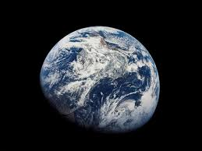
Outpost
Practices
Being Hosted
Vocation
Dwelling in the World
Experimenting
Practices for loving the world dispersed within it.
missional

Slide 42
Experimenting
What is one idea that has captured your imagination?
How might you play with that idea in the next week?
Who might you talk with?
How might that idea connect to a current challenge you are facing?
What would you need to experiment?
What would you hope to learn?

Slide 43

3 sets of practices
Sanctuary
Campfire
Outpost
Notes:
Accompanying people in faith as a way of life of faith is the role the local church plays in forming faith. As we center our lives around these 3 sets of practices we join God’s activity and discern our way forward.

Slide 44
- What practices guide your life of faith?
- How might ministry tend to both the gathering and scattering aspects of our lives?
- How could these three types of practices help your congregation “practice” their way into the future? What practices do you have in each category?
Small Group Sharing

Slide 45
GPS for Faith
A navigational system for faith in highly dynamic environments:
Getting oriented - loving God and our neighbor
Setting a direction - toward God’s promised future
Two movements - gathering and scattering
Four commitments - gift, compass, witness, agent
Three sets of practices - sanctuary, campfire, outpost

Slide 46
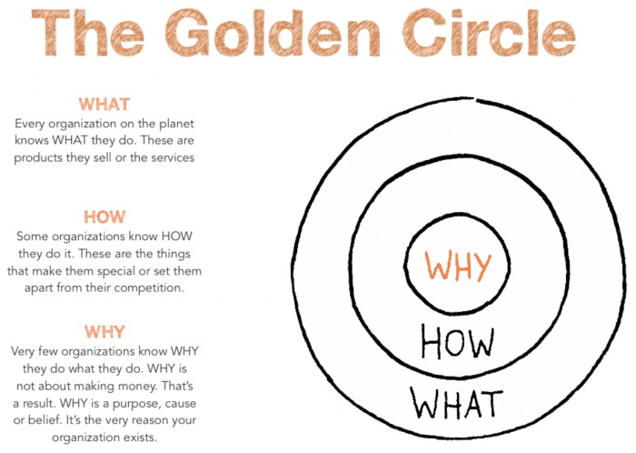

Why
How
What

Slide 47
Congregations are called
to steward the future witness to the Christian faith.
Notes:
Congregations are called to steward the future witness to the Christian faith.
God’s love is steady and trustworthy, yet we live in highly dynamic context and the future does not look like the past.
This is a pivotal moment. We, the church, have the opportunity to hold tightly to the past or
Seek ways to join God’s movement in the world.
Our way forward is embracing God’s call for us and relying on God,

Slide 48

We steward the future witness of the Christian faith.

Slide 49
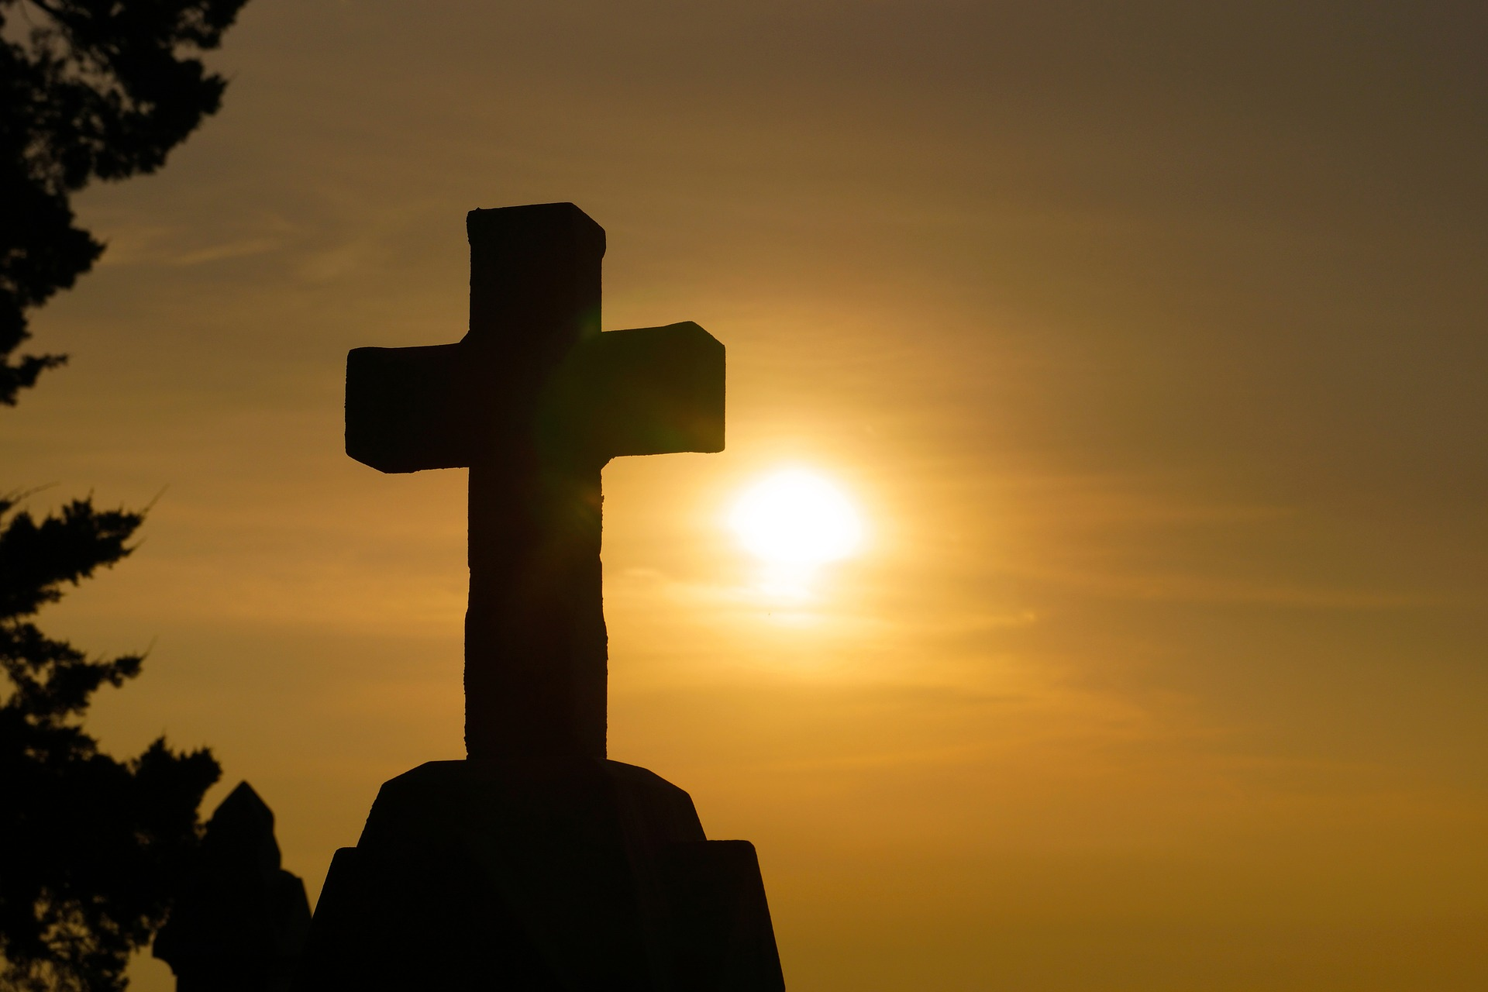
Jesus sent the disciples out instructing them to take nothing with them.
Bring the Good News and heal.
Enter homes where you are welcome.
Move on when you are not.

Slide 50
Jesus sent them to the places he intended to go.
Know - there will be disruption AND
you go with Christ’s blessing, power, and authority.

Slide 51
The mission is not our, it is God’s.
Practices are sturdy.
God’s future is promised.
God’s love transforms.

Slide 52
What is distracting from the Why of ministry?
How might you reimagine aspects of ministry?
What practices might you experiment with? What practices might you let go of?

Slide 53
As you prepare to head home,
review to the list of things you laid down yesterday.
Review your Why, How, and What.
What two things will you leave with?

Slide 54
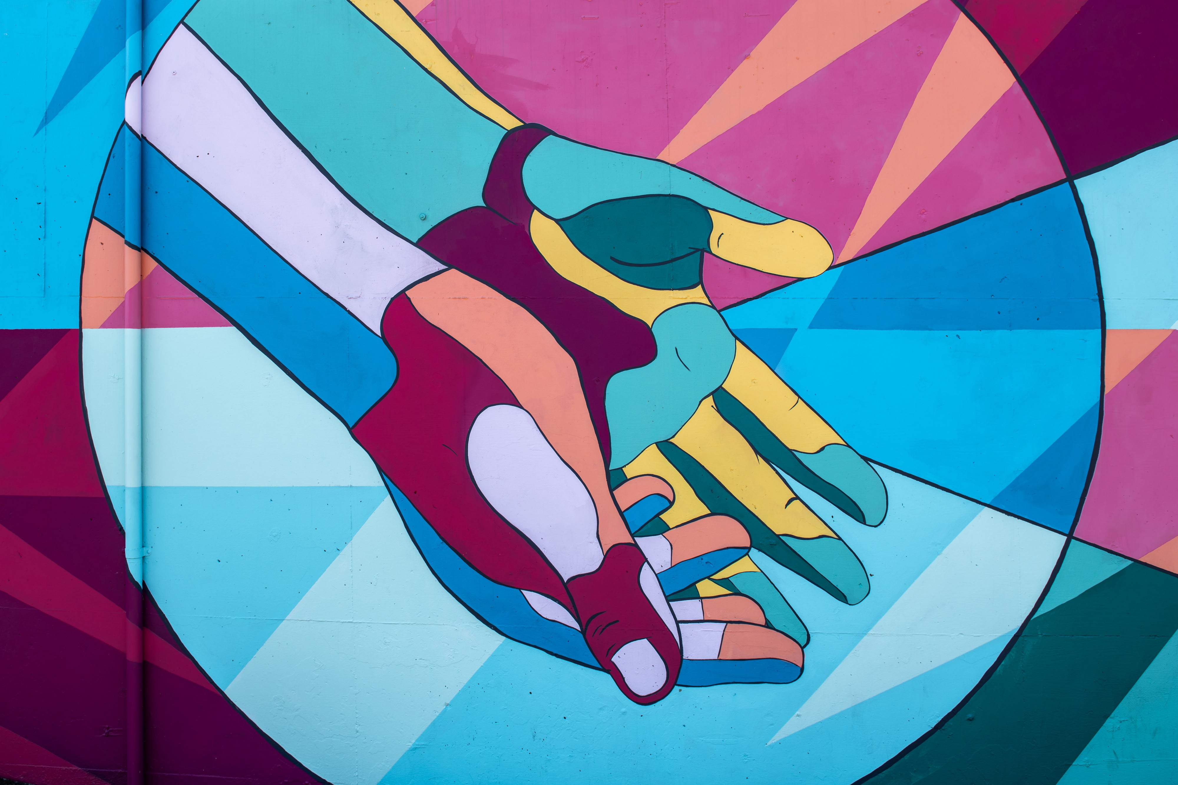

May the Lord bless you
and keep you
May the Lord’s face shine upon you and be gracious unto you.
May the Lord lift his countenance upon you and give you peace.
What framework supports this calling?
Notes:
The paper maps we use to rely on are less trustworthy - and we need tools that help us be more in touch with the dynamic world in which we live and work.

