Slide 1



Luther Seminary
Community Forum
The Challenges Facing the Church
March 3, 2020
November 2021

Slide 2
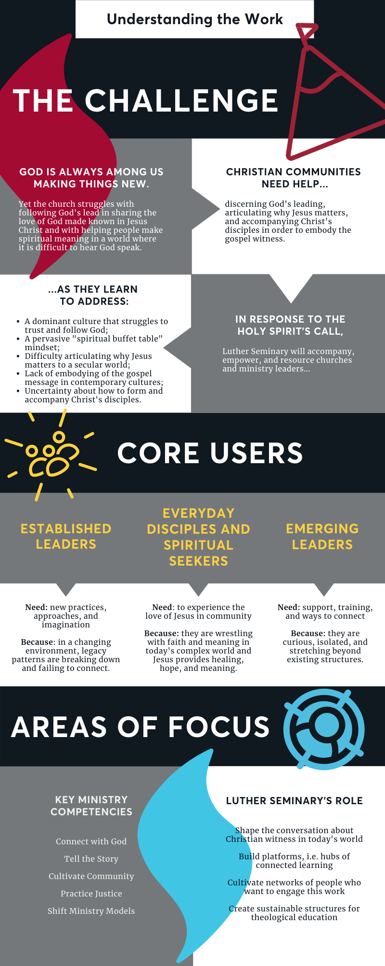

Our Why
Discuss:
Reflect on the main challenge you see congregations facing today.
In a sentence or two, share how you would describe the challenge congregations face.

Slide 3
Our Why
Discuss:
Reflect on both different audiences and the competencies leaders needs to address that challenge you named.
Does these three “user” groups fit your context? Why or why not?
Name 1 or 2 competency each group needs.

Slide 4

What?
Luther Seminary is facilitating listening sessions in order to gain a deeper understanding of the challenges and opportunities facing the church today.
To date, over twenty Luther Seminary staff and faculty have facilitated six listening sessions, three in July and three in October 2021. Sessions gathered the following group of leaders:
church leaders with various roles around the country (21)
leaders of color (10)
rural ministry leaders (25) and
lay leaders (10).
In total, sixty-six leaders participated, with the majority representing the Evangelical Lutheran Church in America (ELCA).
Notes:
2 national groups = 21
1 leaders of color = 10
2 rural ministry = 25
1 lay leaders = 10

Slide 5
Findings
Most urgent needs of the church
Leaders had a robust view of church leadership that included ministerial character, ministerial competence, and capacity for leading change. All three areas have urgent needs!
Discuss:
Pick of the three areas: Ministerial character, ministerial competence, and capacity for leading change...
within that area, name the 3-5 things most critical for leading in the church today.

Slide 6
Findings
Most urgent needs of the church in the next three to five years are:
leading adaptive change faithfully with a missional imagination
tending the spiritual and mental well-being of current leaders
equipping lay leaders
developing new and different leaders
rethinking core aspects of ministry
Discuss:
Do these five themes resonate with what you hear from congregational leaders? Is there anything you would add?
Which of the five is most urgent in your context?

Slide 7
Findings
Most urgent needs of the church in the next three to five years are:
leading adaptive change faithfully with a missional imagination
COVID disrupted current patterns and denial of societal shifts, exposed congregation’s identity and uncertainties, and accelerated the decline of membership models and programmatic approaches to forming faith.
Congregations that have tied ministry to a particular model of church are facing identity crisis. This is particular true in rural settings. There is a need to rediscover and articulate congregation’s distinctive calling.
There is need to imagine new ways of being church, especially in rural contexts. Resources, support, and stories that embody the emerging future could help congregations move forward with hope.

Slide 8
Findings
Most urgent needs of the church in the next three to five years are:
leading adaptive change faithfully with a missional imagination
Leaders need guidance, skills, and support for navigating the massive changes local churches face so they remain faithful to their calling and imaginative about engaging their contexts.
Leaders want congregations to know why they exist, to learn how to navigate change, permission to experiment, help getting congregations to become learning communities, and to increase their capacity for listening deeply.
One participant said: ”We need to expand our imagination as to what church leadership looks like.”
Leaders know God is calling them into a new future and are unsure how to lean into that calling. Thriving puts Christ’s mission at the center grounding and shaping ministry.

Slide 9
Findings
Most urgent needs of the church in the next three to five years are:
tending the spiritual and mental well-being of current leaders
One participate said this: “Support mental health. Leaders are tired and burned out.” Burnout and exhaustion stem from: dealing with unresolved grief, navigating unprecedented change, and leading deeply divided communities. Leaders must tend to their own spiritual and mental wellbeing so they can lead adaptive change and remain curious about what God is doing in their midst.
Lay leaders see themselves as leaders. They too want to grow spiritually and as a ministry leader. Don’t assume lay leaders have a biblical foundation and know how to pray. Mentors, training, and resources were ways lay leaders could be enriched.
There is also a need for congregations to rediscover meaningful relational connections. Cultivating communities where their questions are addressed and they can discover and use their gifts is extremely important.

Slide 10
Findings
Most urgent needs of the church in the next three to five years are:
equipping lay leaders
There is a need to expand clergy-centric models to include various forms of shared leadership. The root of this challenge includes expanding the church’s vision of leadership to involve lay leaders working closely with rostered leaders around a common calling/purpose.
All Christians have calling, and therefore are leaders. Why are we not tending those callings and empowering everyone to live into and out of those callings?
One lay leader highlighted that the church is the people, so pastors and lay leaders must partner together to lead ministry.
The fact that there is no “lay leader manual” is both a blessing and a curse for lay leaders (and pastors).

Slide 11
Findings
Most urgent needs of the church in the next three to five years are:
developing new and different leaders
There is need for different types of leaders; some specific leaders included bivocational leaders (both clergy and lay) and leaders with multi-ethnic competencies (including, but not exclusively, multilingual).
Looking to the future, ministry capacities will include bringing others into leaders, developing church and community partnership, community organizing and church planting skills, and an entrepreneurial spirit. One leader of color said this,”Church should not be an institution, but a movement.” Ministries of justice and reconciliation as well as experimenting with new ministry models were noted as significant. As the work of ministry shifts, so will its leadership.

Slide 12
Findings
Most urgent needs of the church in the next three to five years are:
rethinking core aspects of ministry
Rethinking how local churches create community, understand stewardship and financial wellness, form faith, evangelize, and participate in social outreach will be necessary moving forward.
Cultivating meaningful relationships is foundational to the work of the church, and digital technology is now part of ministry moving forward.
Ministry must connect faith with everyday life, help people make meaning of Jesus in their lived experience, and communicating Christianity in everyday language. Being honest about the challenges people face, both personally and communally will be critical.
Resources—buildings, people, and/or finances—are gifts to steward, and collaboration/networking is becoming increasingly important.

Slide 13
What did we learn?
The church has a desire for new imagination about who and what the church can be in this ailing world.
Many church members and leaders are stuck and have a desire to lean into new models of ministry where lay people are empowered to grow disciples that share the Gospel of Jesus Christ with our hurting world and serve/lead out of their particular giftedness.
To move forward, leaders need support, relationships need tending, and faith needs to be translated into everyday life for all people.
There is a need to return to discovering why Jesus matters.

Slide 14
What did we learn?
Future ministry leaders need practices that ground (and tend) them spiritually and mentally as they lead others in discovering the difference faith makes in the world and in their lives.
Cultivating community, especially amidst deep division, is critical, as is empowering others.
Because the church of the future does not look like the past, ministry leaders need competencies related to adaptive leadership, faithful innovation, exploring new ministry models, and capacities for practicing justice and reconciliation.

Slide 15
Questions
What did you hear?
what resonated? what didn’t? what would you add?
If you were to focus on one theme or learning,
what would it be? why?
What aspect of this work aligns with your calling and gifts?
how might you participate in moving God’s church into the future?
What do you need to learn to lead well in this time?
what are ways you can go about learning? who are people you can learn with and from?

