Slide 1

Lament, Promise, and Neighbors
Practicing our Way into the Future
Notes:
Lament, Promise, and Neighbors: practicing our way into the future
In times of uncertainty, practices ground and guide our lives. This session will introduce 3 distinct practices that keep us faithful to the past, provide meaning in this moment, and propel us into the future.

Slide 2
The Practice of Lament

Slide 3

Writing Laments
Share your lament with others.

Slide 4
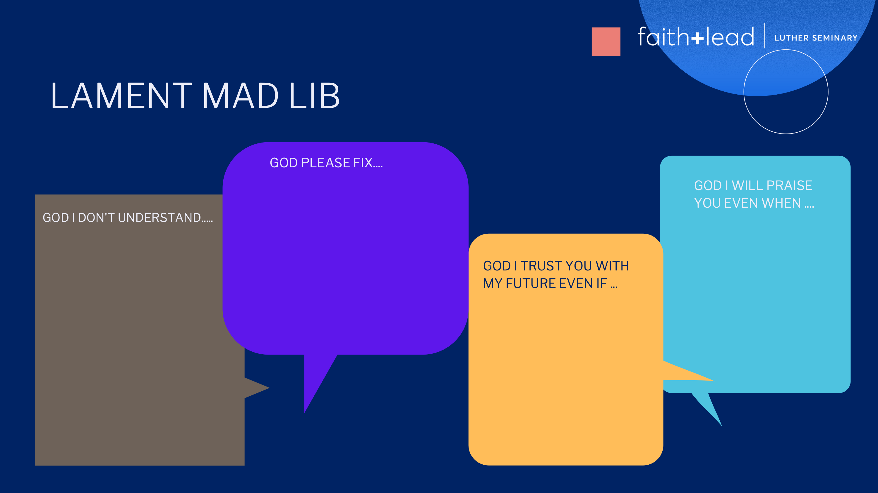
Lament

Slide 5
The Practice of Testifying to God’s Promise

Slide 6
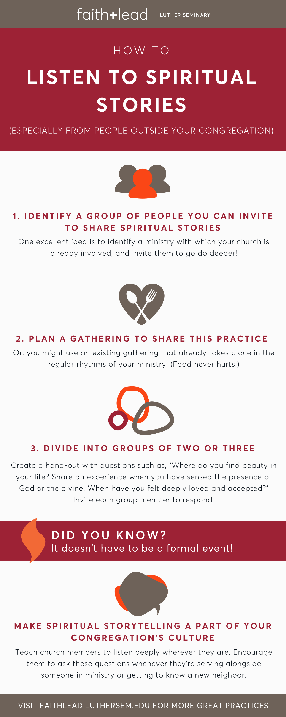
Telling Stories
Three minutes per person on these two prompts:
Tell of a time when you experienced hope.
And how was God present.

Slide 7


Slide 8
The Practice of Dwelling in the World

Slide 9

Neighbor
Being curious about our neighbors.
Take 5 minutes to interview your partner.
Ask about:
Hobbies
Their family
Their best friend
Pets
A passion
A place you’d like to visit
A memory from when you were a kid
A time you got into trouble
Describe your neighborhood.
What do you like about your community?
What troubles you about your city/town?
What would you do with $1 million?

Slide 10
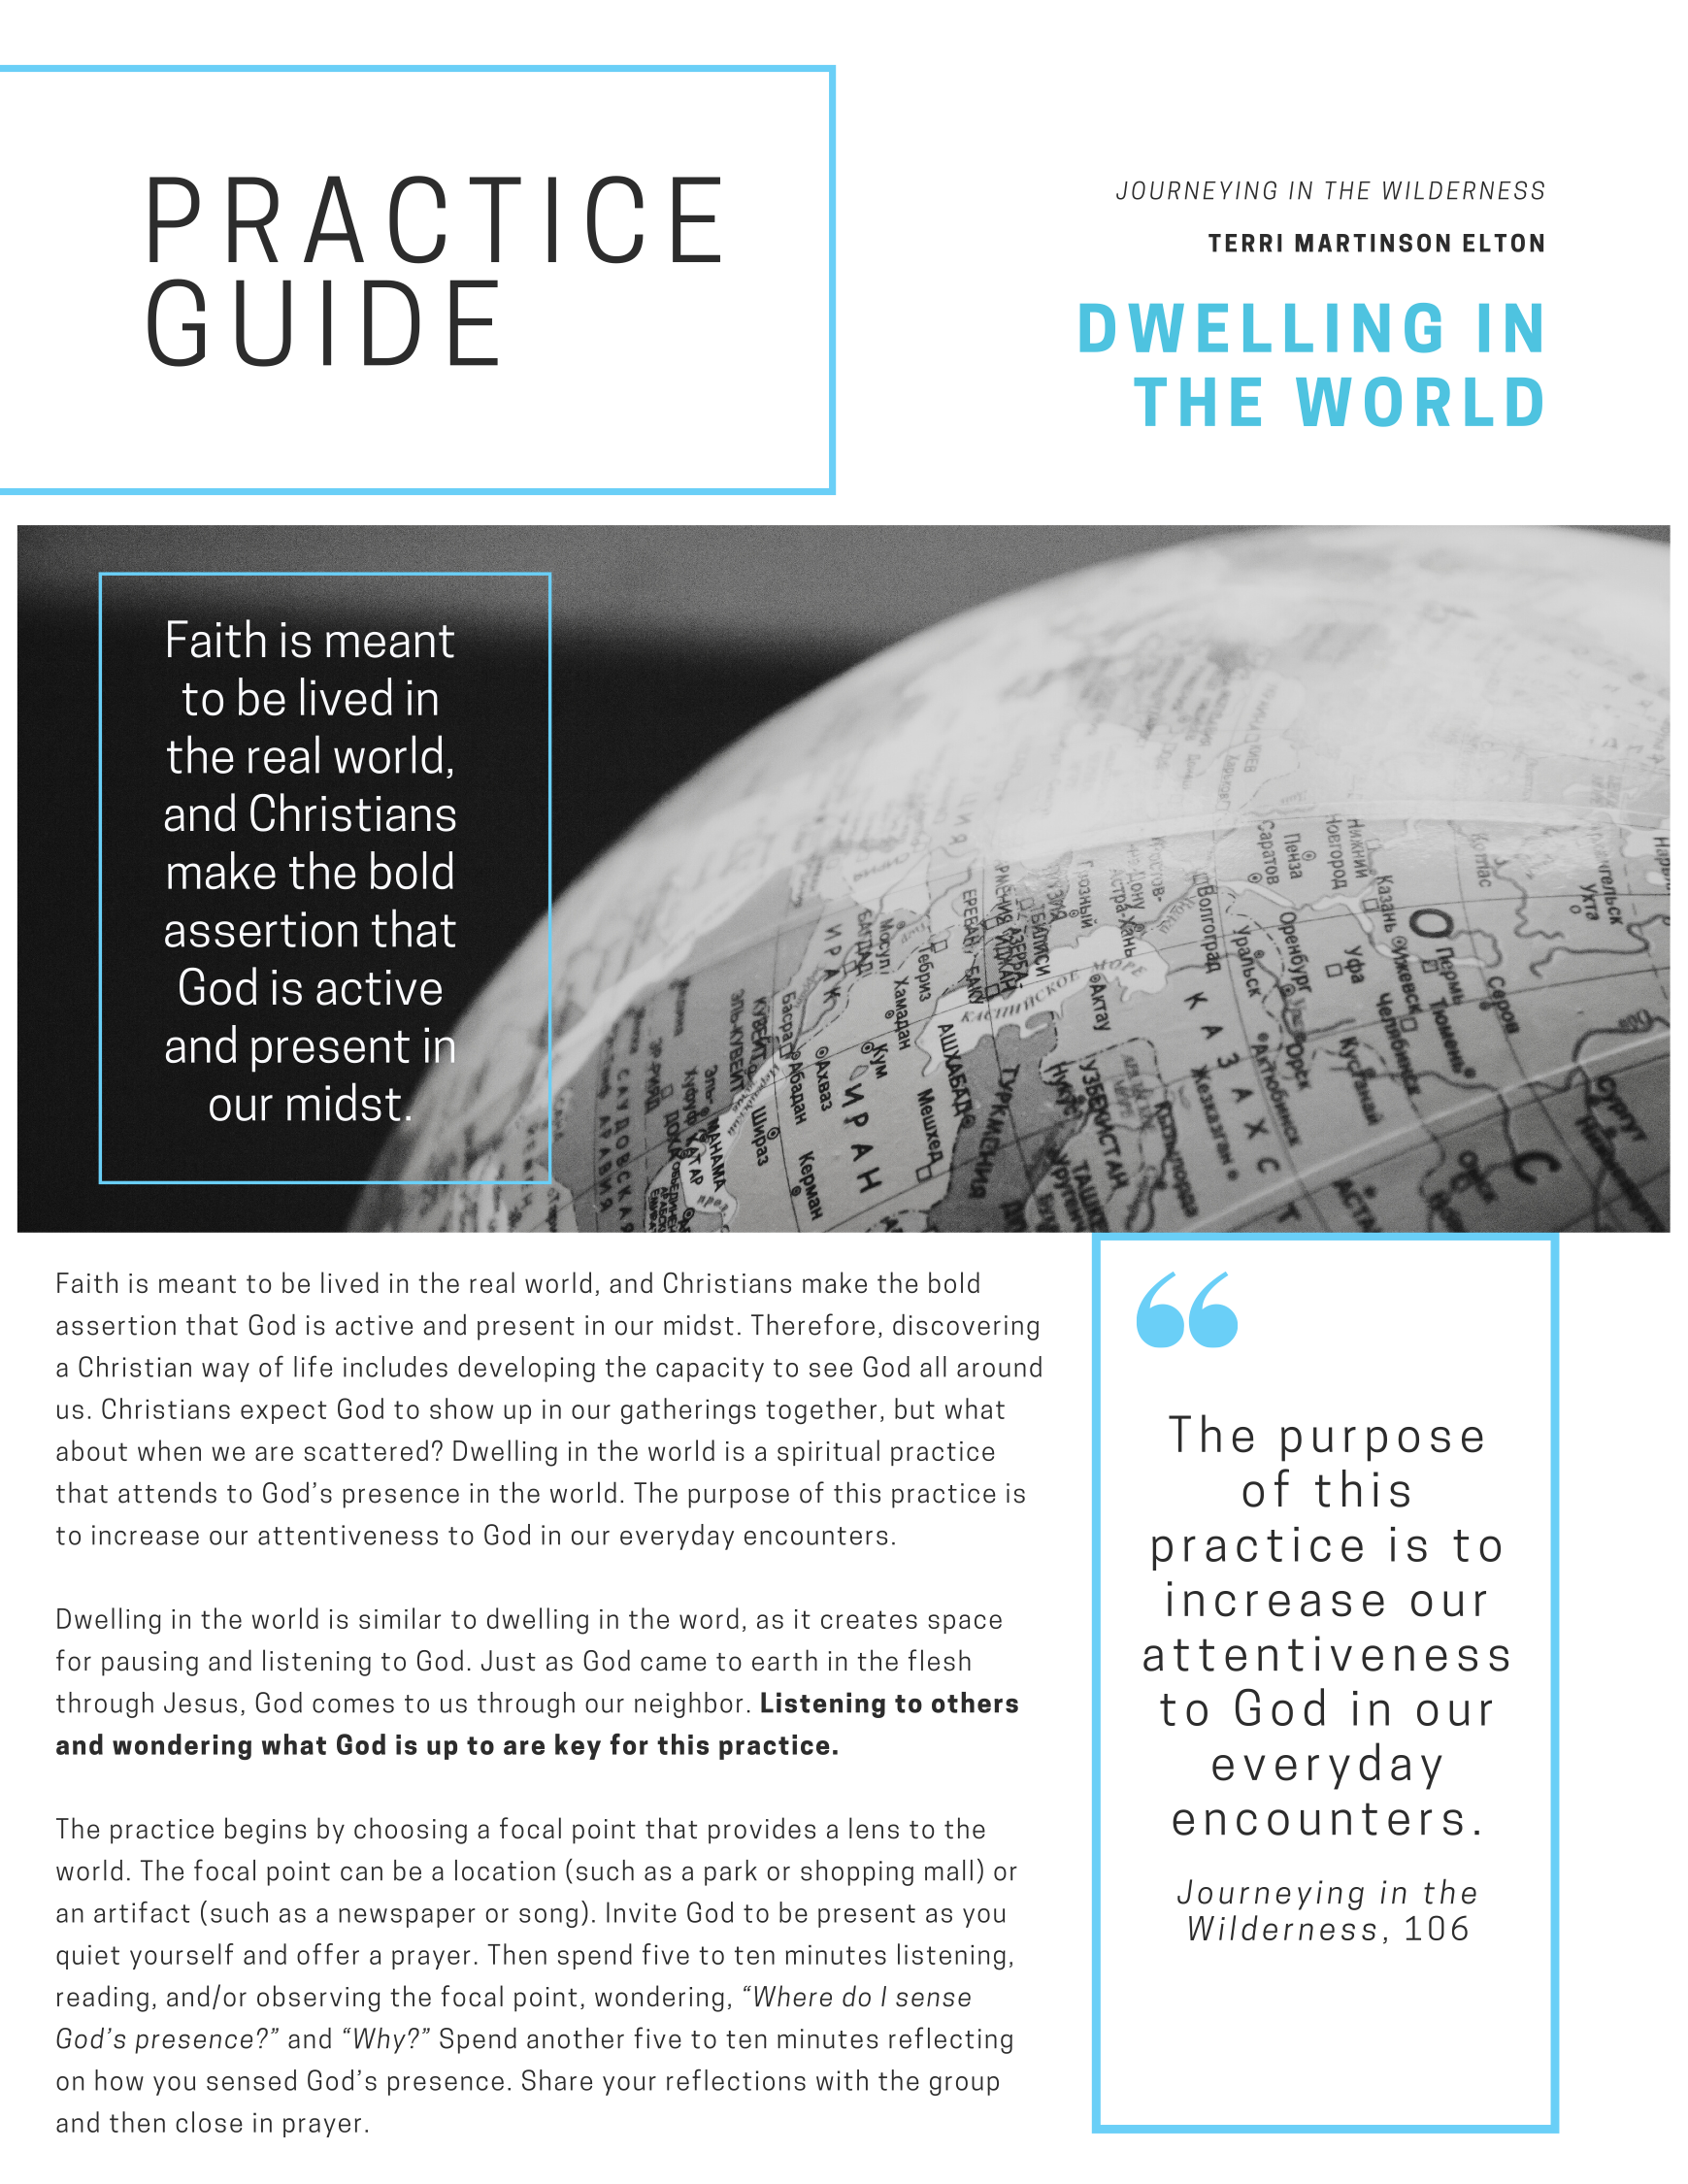

Slide 11
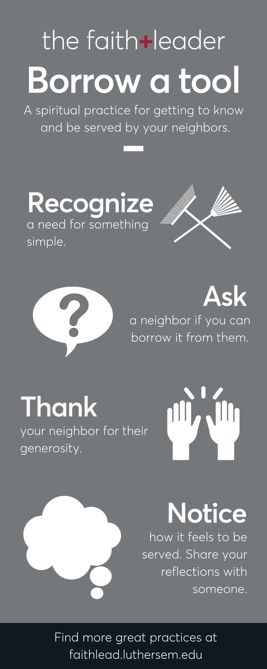

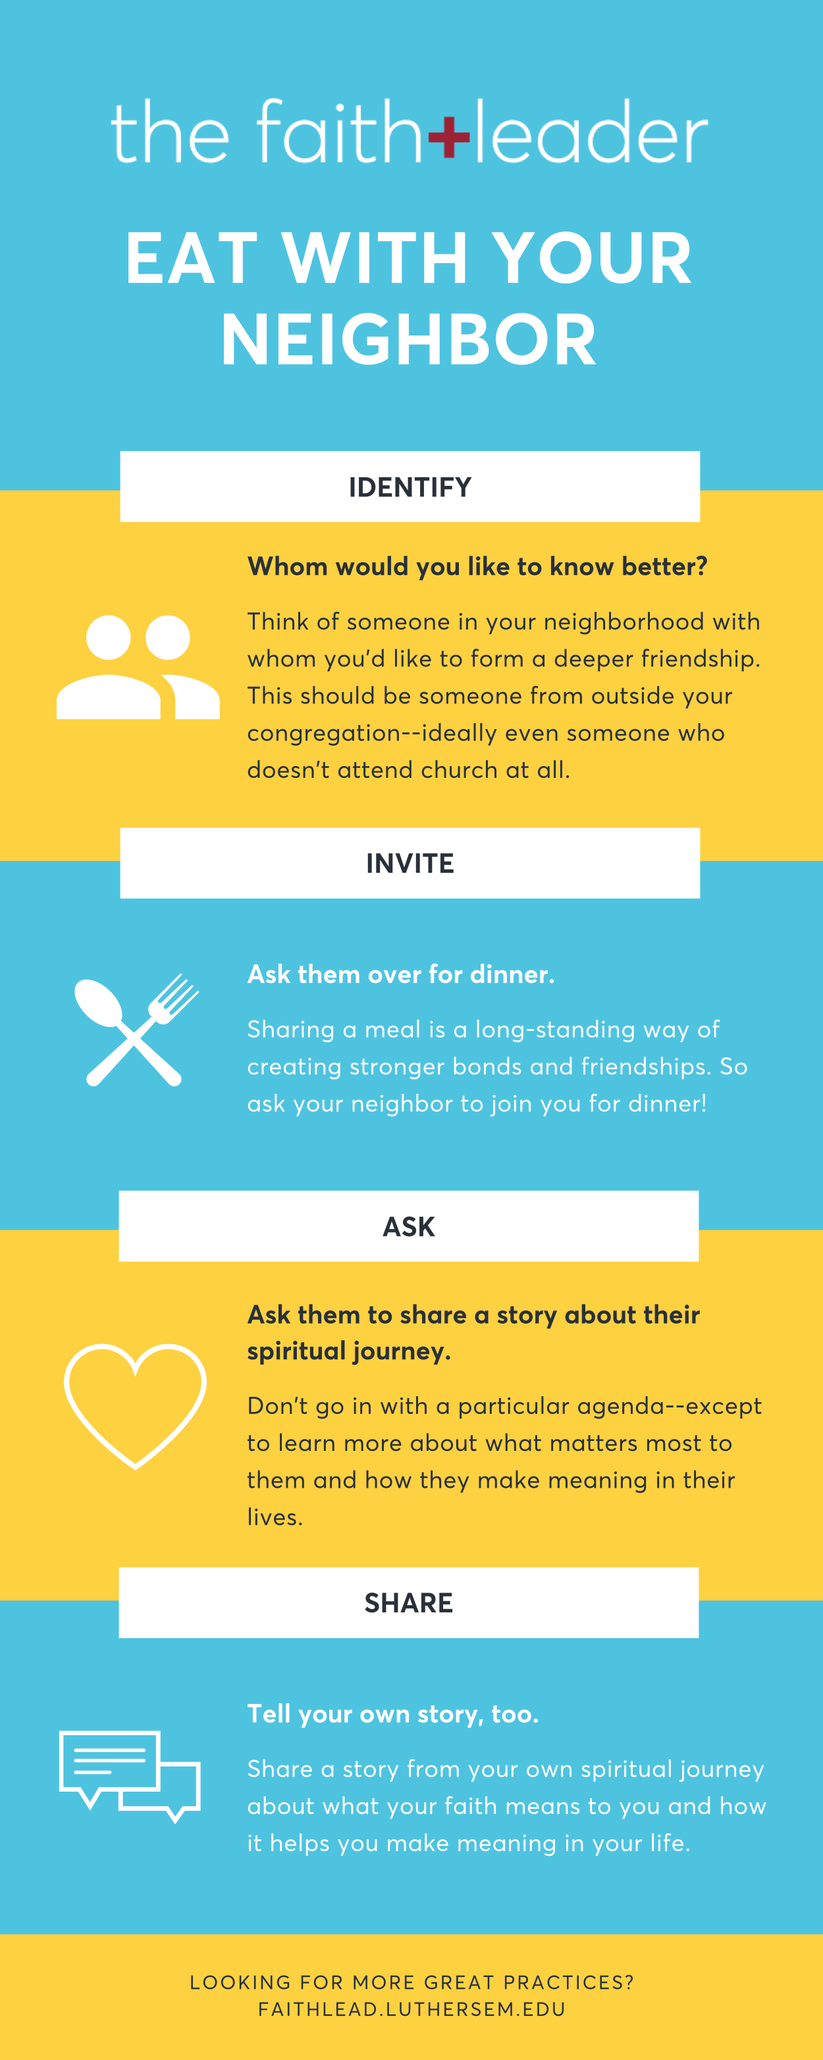

Slide 12
