Slide 1
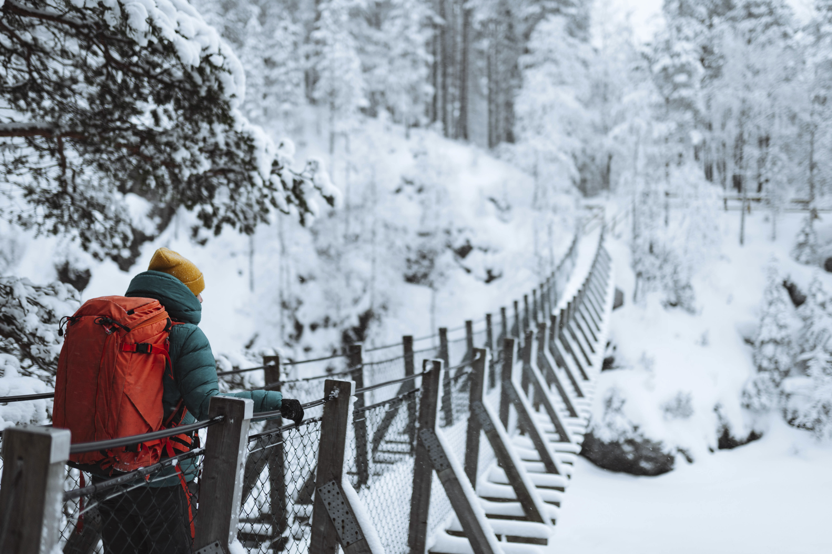
Finding Stability in Wilderness Times
Terri Martinson Elton
Notes:
Finding Dynamic Stability in Wilderness Times
We are living in a season of uncertainty and ambiguity. Today the past is not a good predictor of the future, our “way of doing things” has (and continues to be) disrupted, and contextual factors increasingly add complexities to the challenges we face. Just like Google Maps has replaced Rand McNally’s paper atlases, leaders need “GPS-like” capacities for faithfully navigating the ministry that provides dynamic stability.

Slide 2
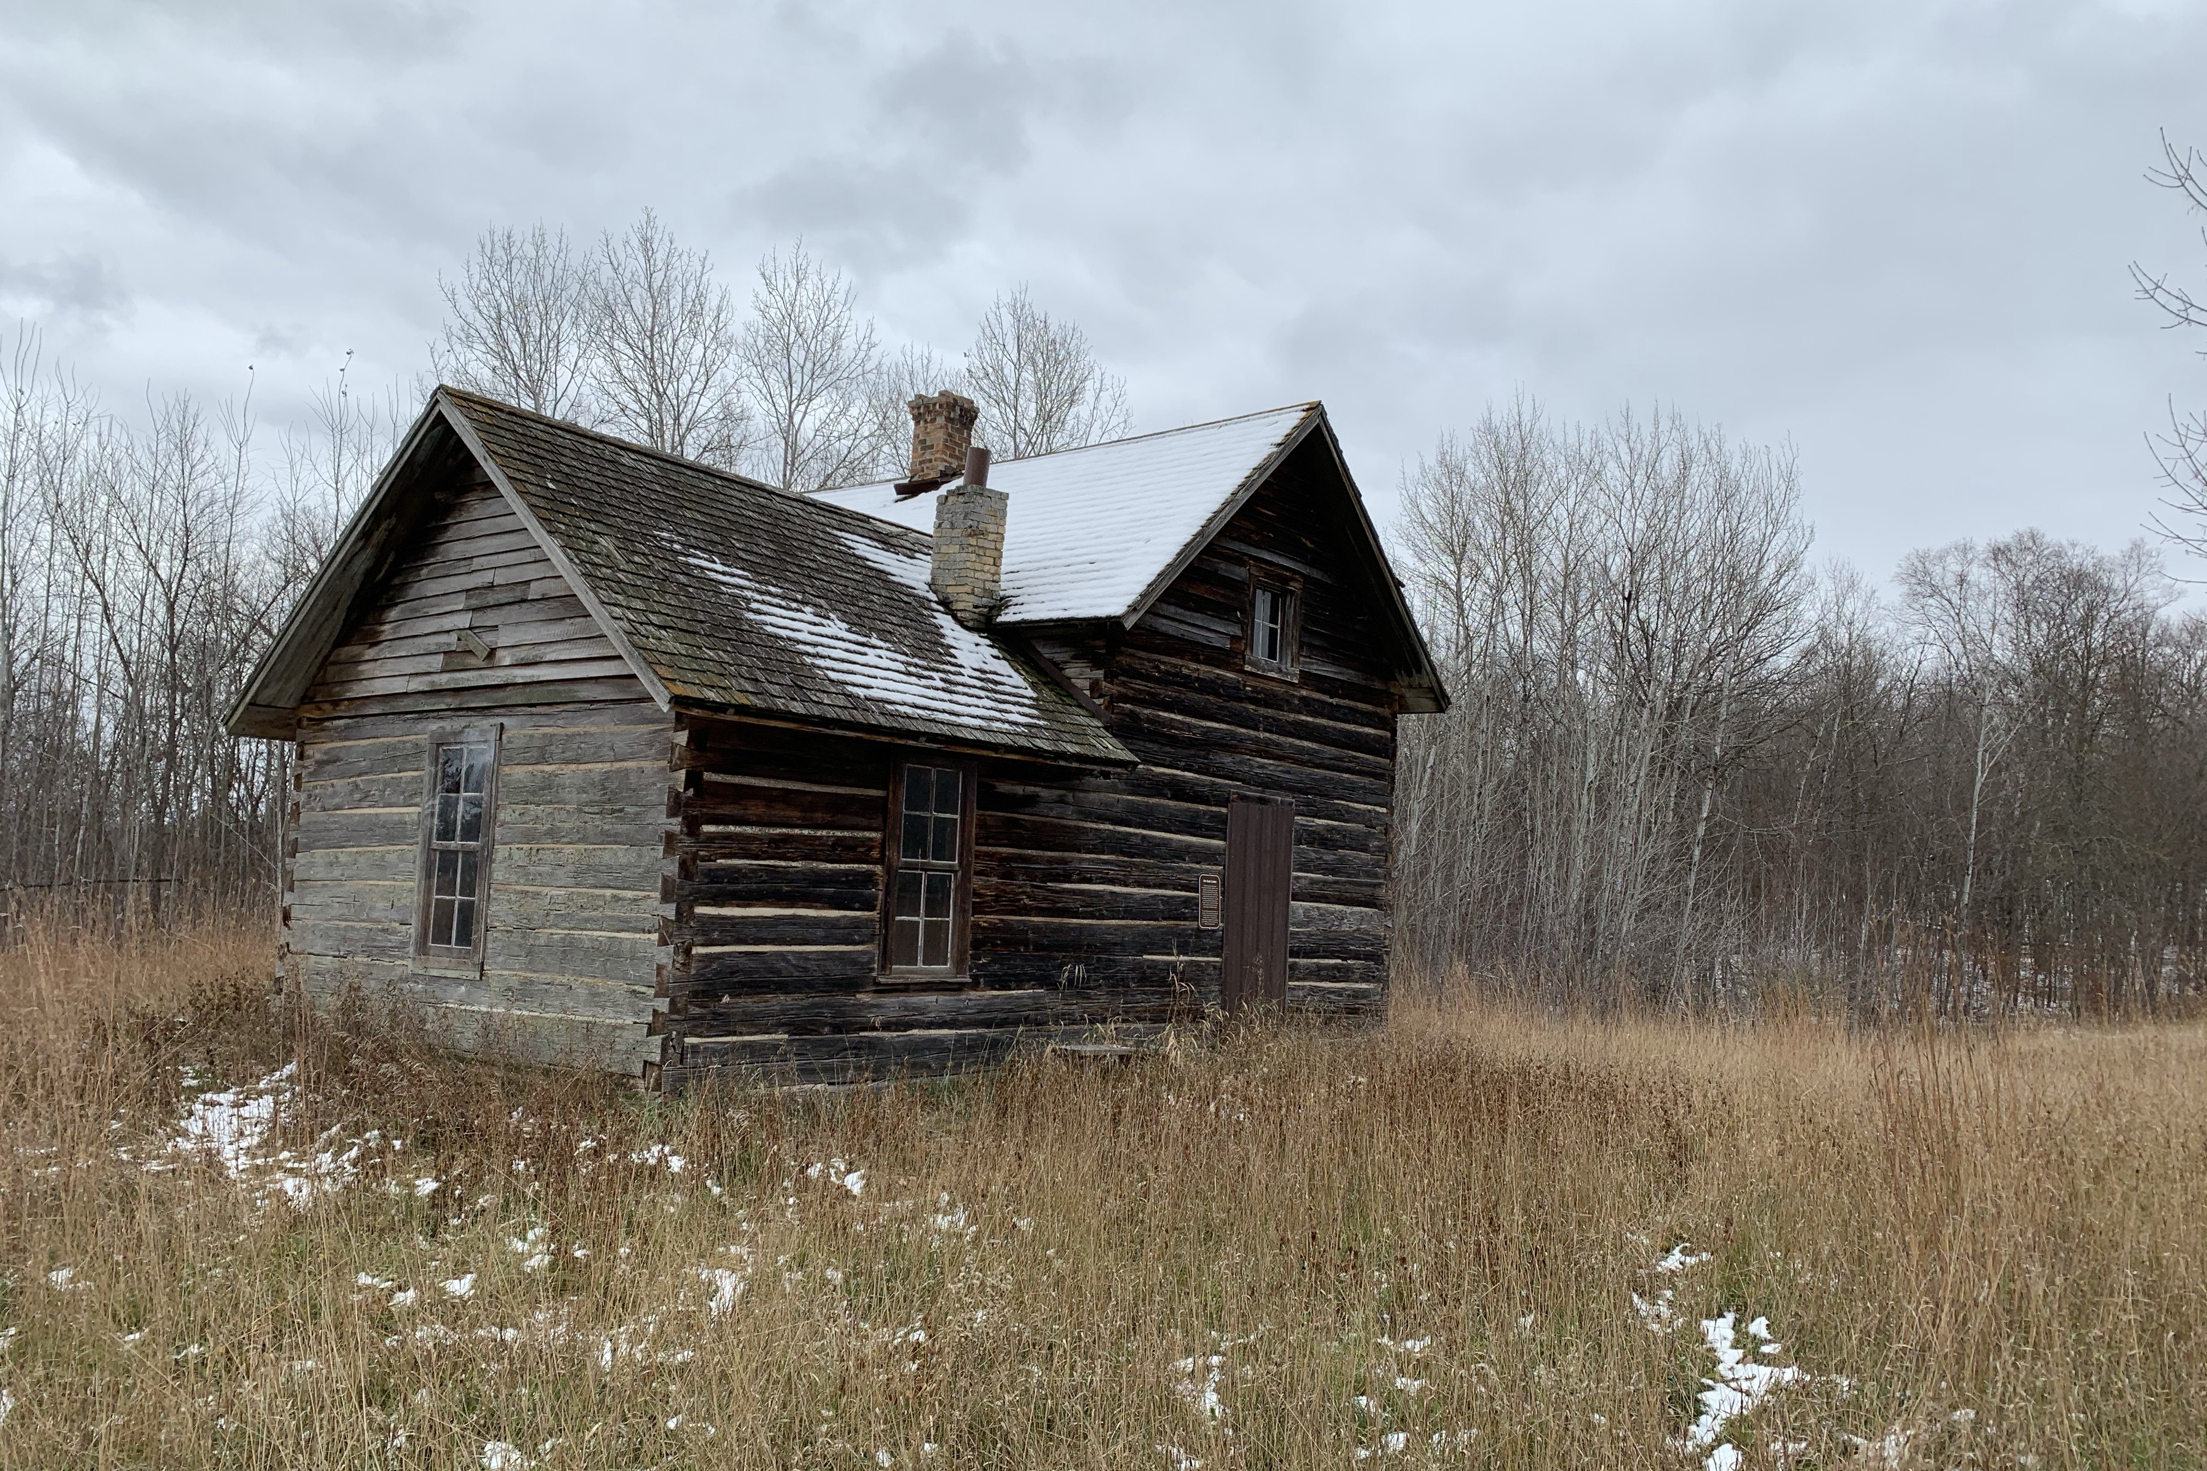
“The church as we know it is calibrated for a world that no longer exists.”
Scott Cormode
The Innovative Church, 1

Slide 3
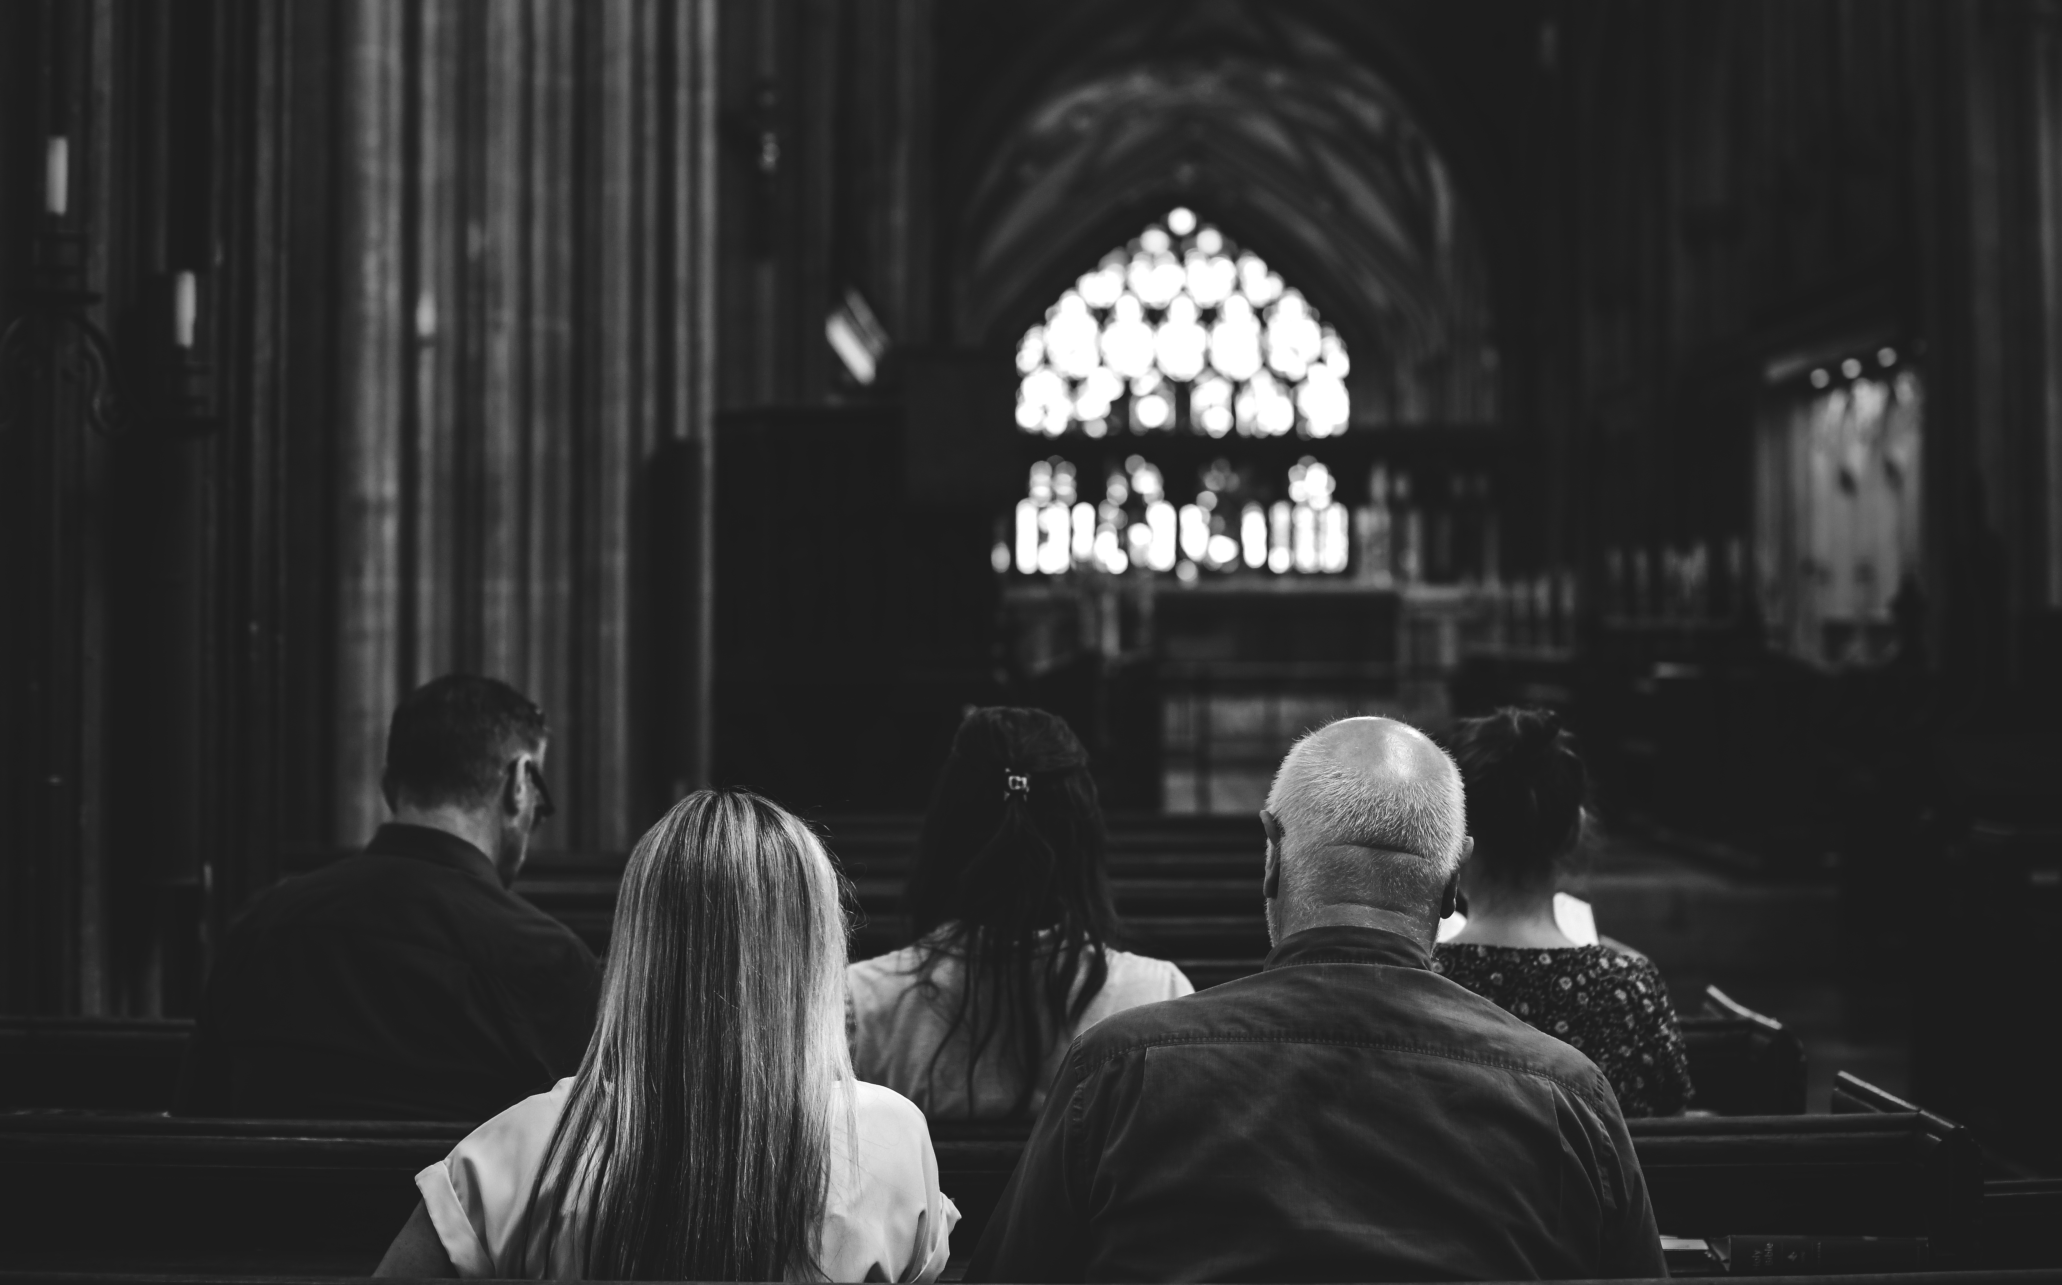
“The basic assumptions about time, money and community - about membership, Bible study, and ecclesiology - have all changed.

Slide 4
But congregations act the way they did before …[everything] changed, and congregations often wish the world would go back to the way it once was.”
The Innovative Church, 1-2

Slide 5
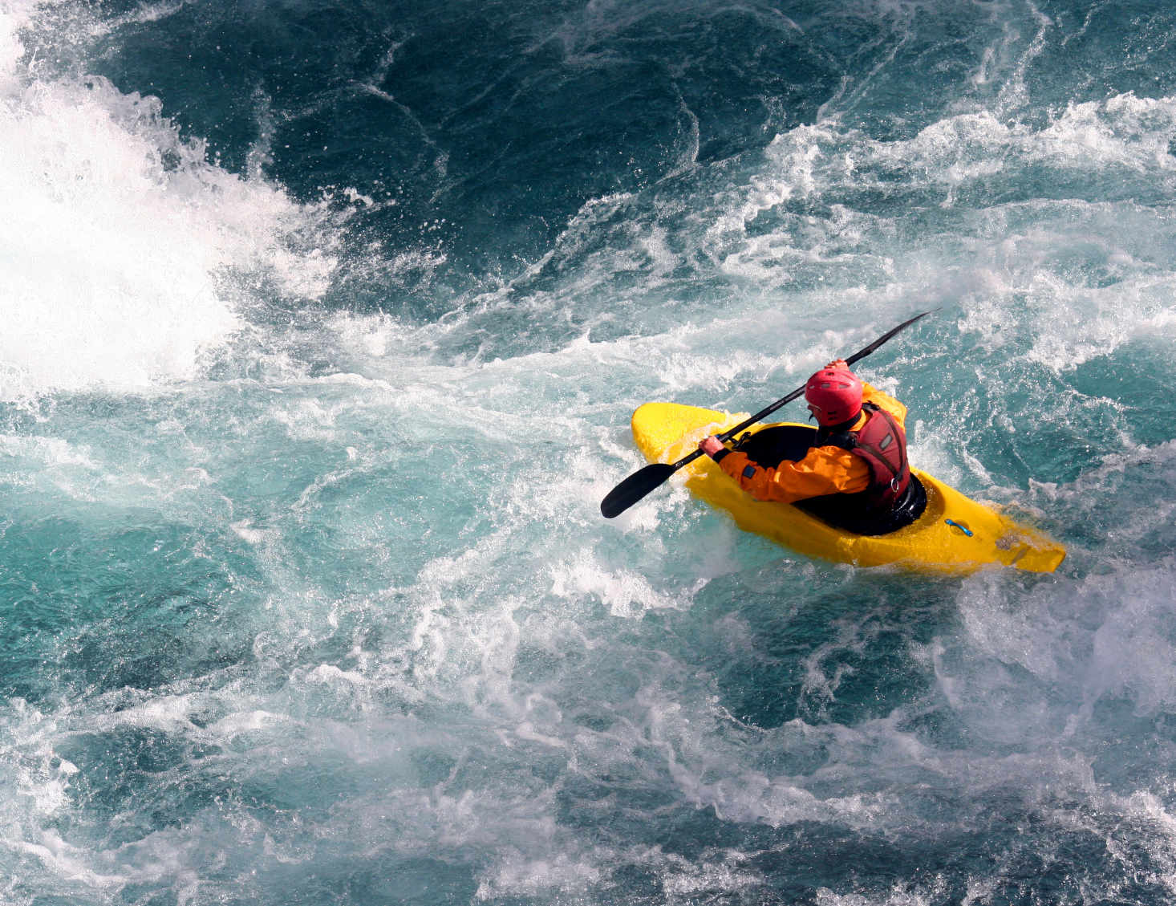
“For most of the church’s history, Christians had up to a century to recalibrate in the face of disruptive change…But now, sweeping changes are happening years apart. There is not enough time between changes before the next wave hits … we live in … a world of permanent white water.”
The Innovative Church, 2

Slide 6
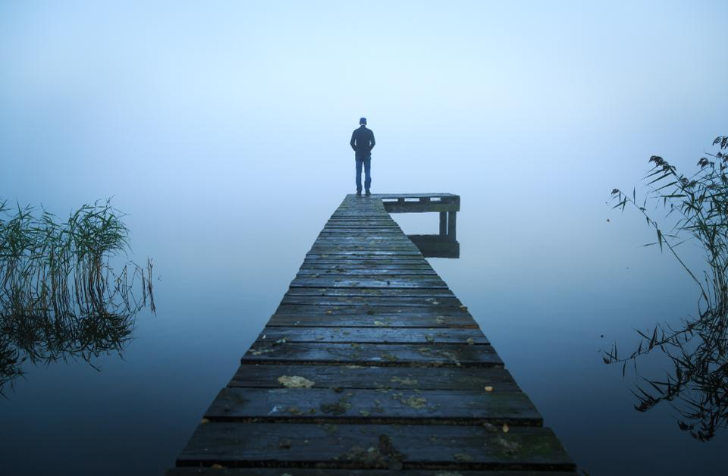
“We need a way to recalibrate in order to keep from getting out of touch with the needs of the world.
The Innovative Church, 2

Slide 7
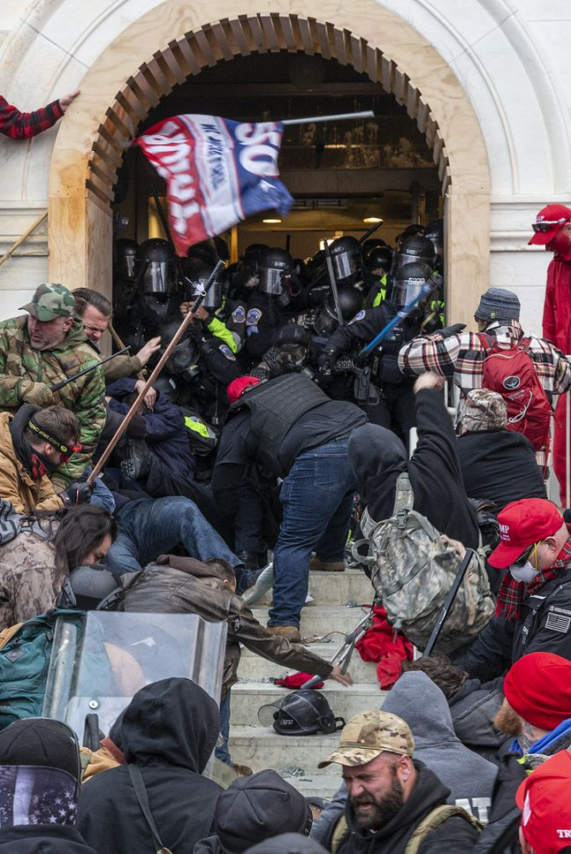
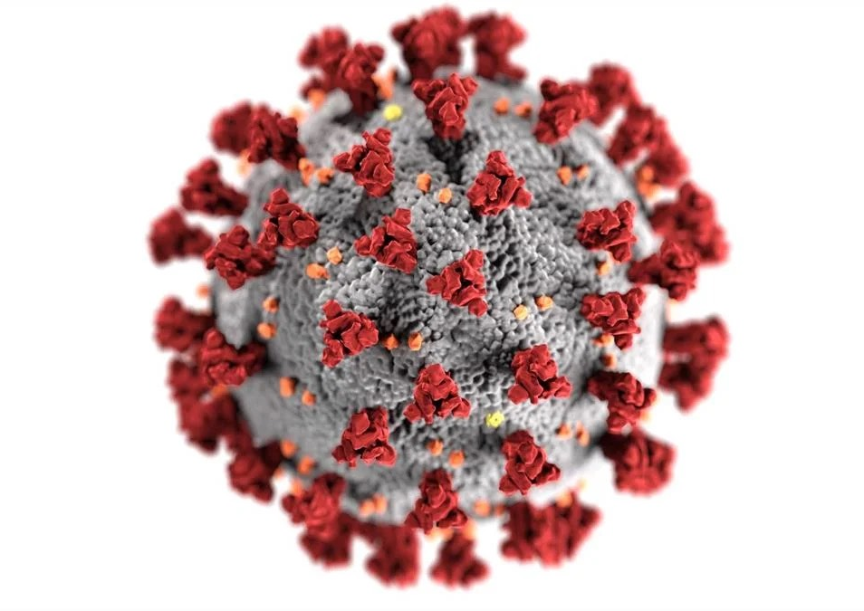
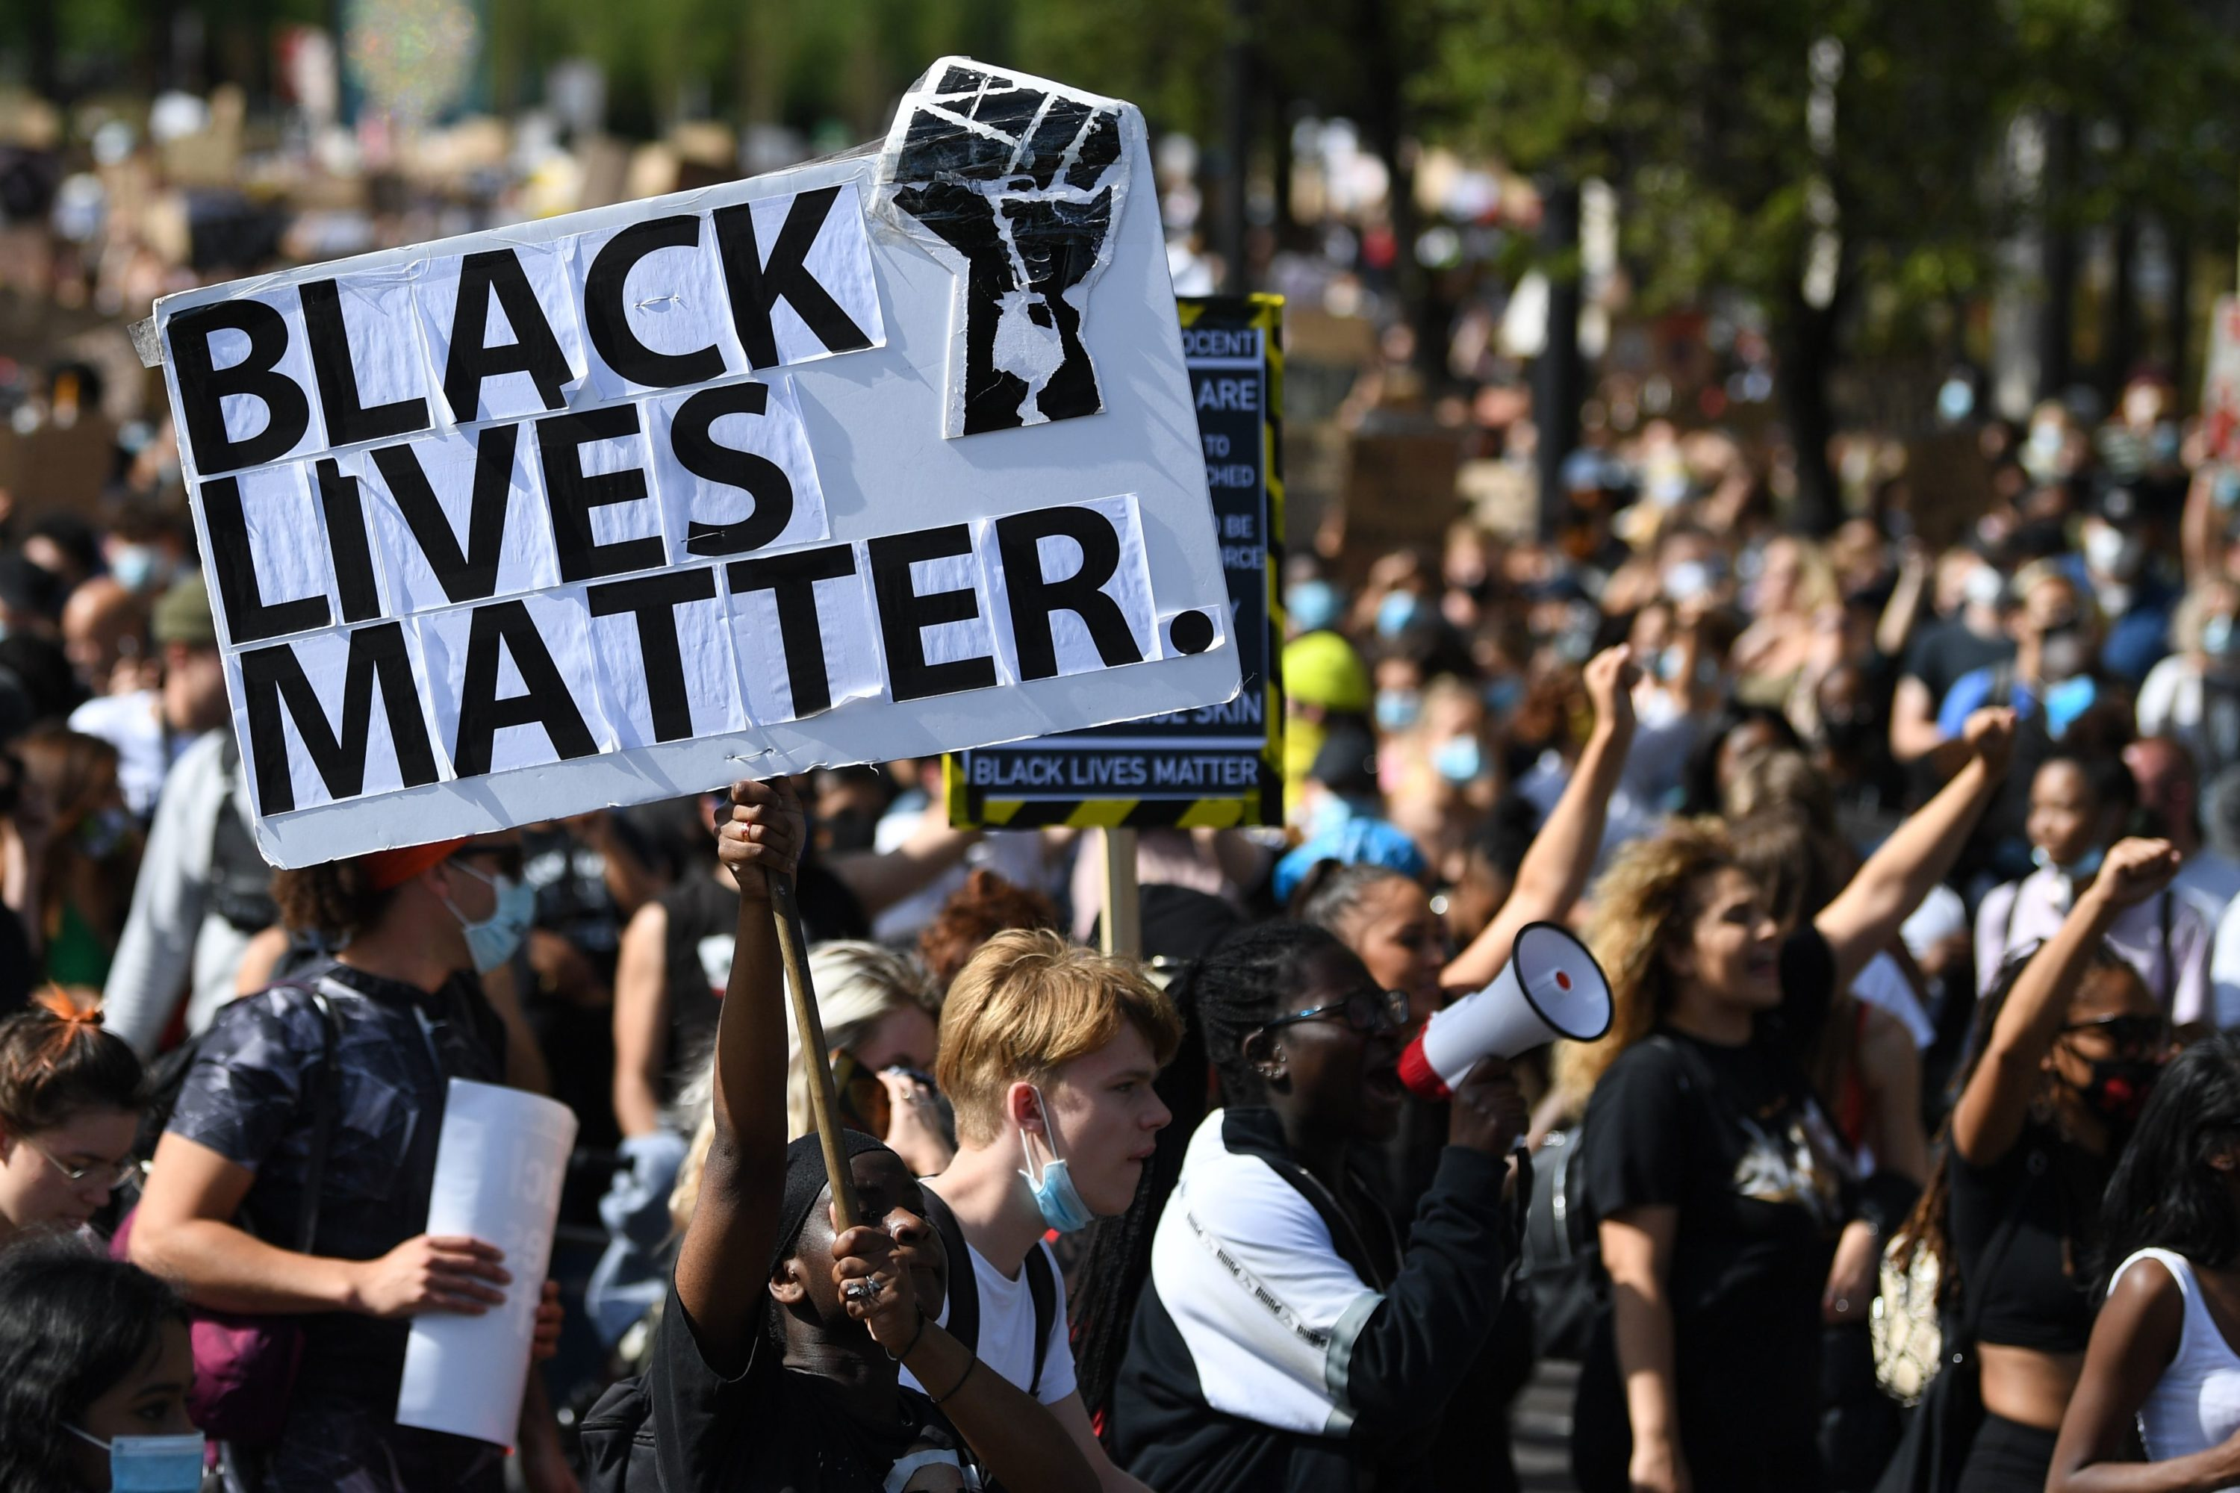
BEFORE
2020-2021

Slide 8
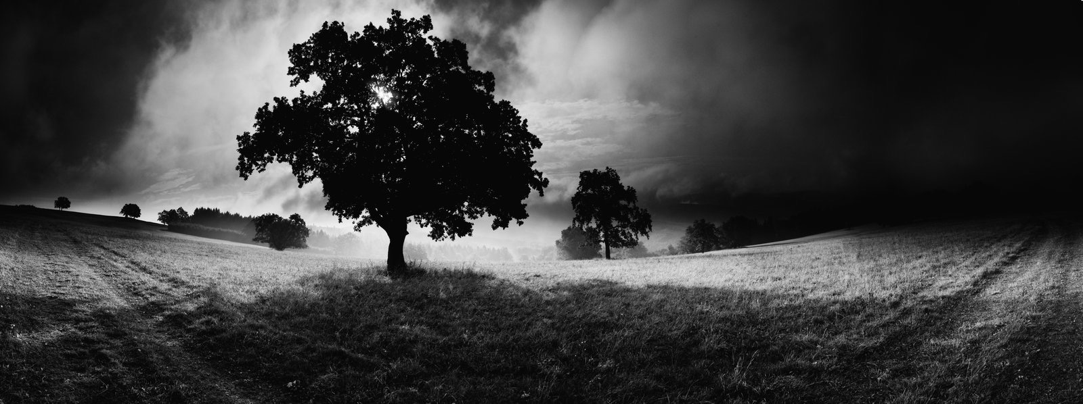
The environment around us
was changing.

Slide 9
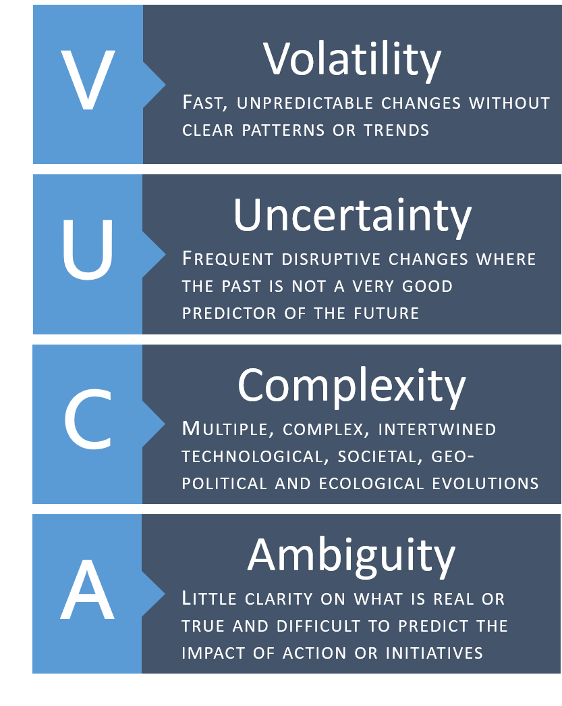
VUCA environment
6 Forces coming together:
Globalization
Technology
Digitalization
Individualization
Demographic Change
Environmental Crisis
Notes:
The future is no longer a good predictor of the past. This makes most of us uneasy, as most of us were raised in a different environment and our way of operating in the world is framed with a particular mindset that is accompanies with a particular set of skills and tools. Add to that, as church leaders we were our understanding of leadership and ministry are also placed within that environment and that way of seeing the world. And suddenly we find ourselves in unknown territory.

Slide 10
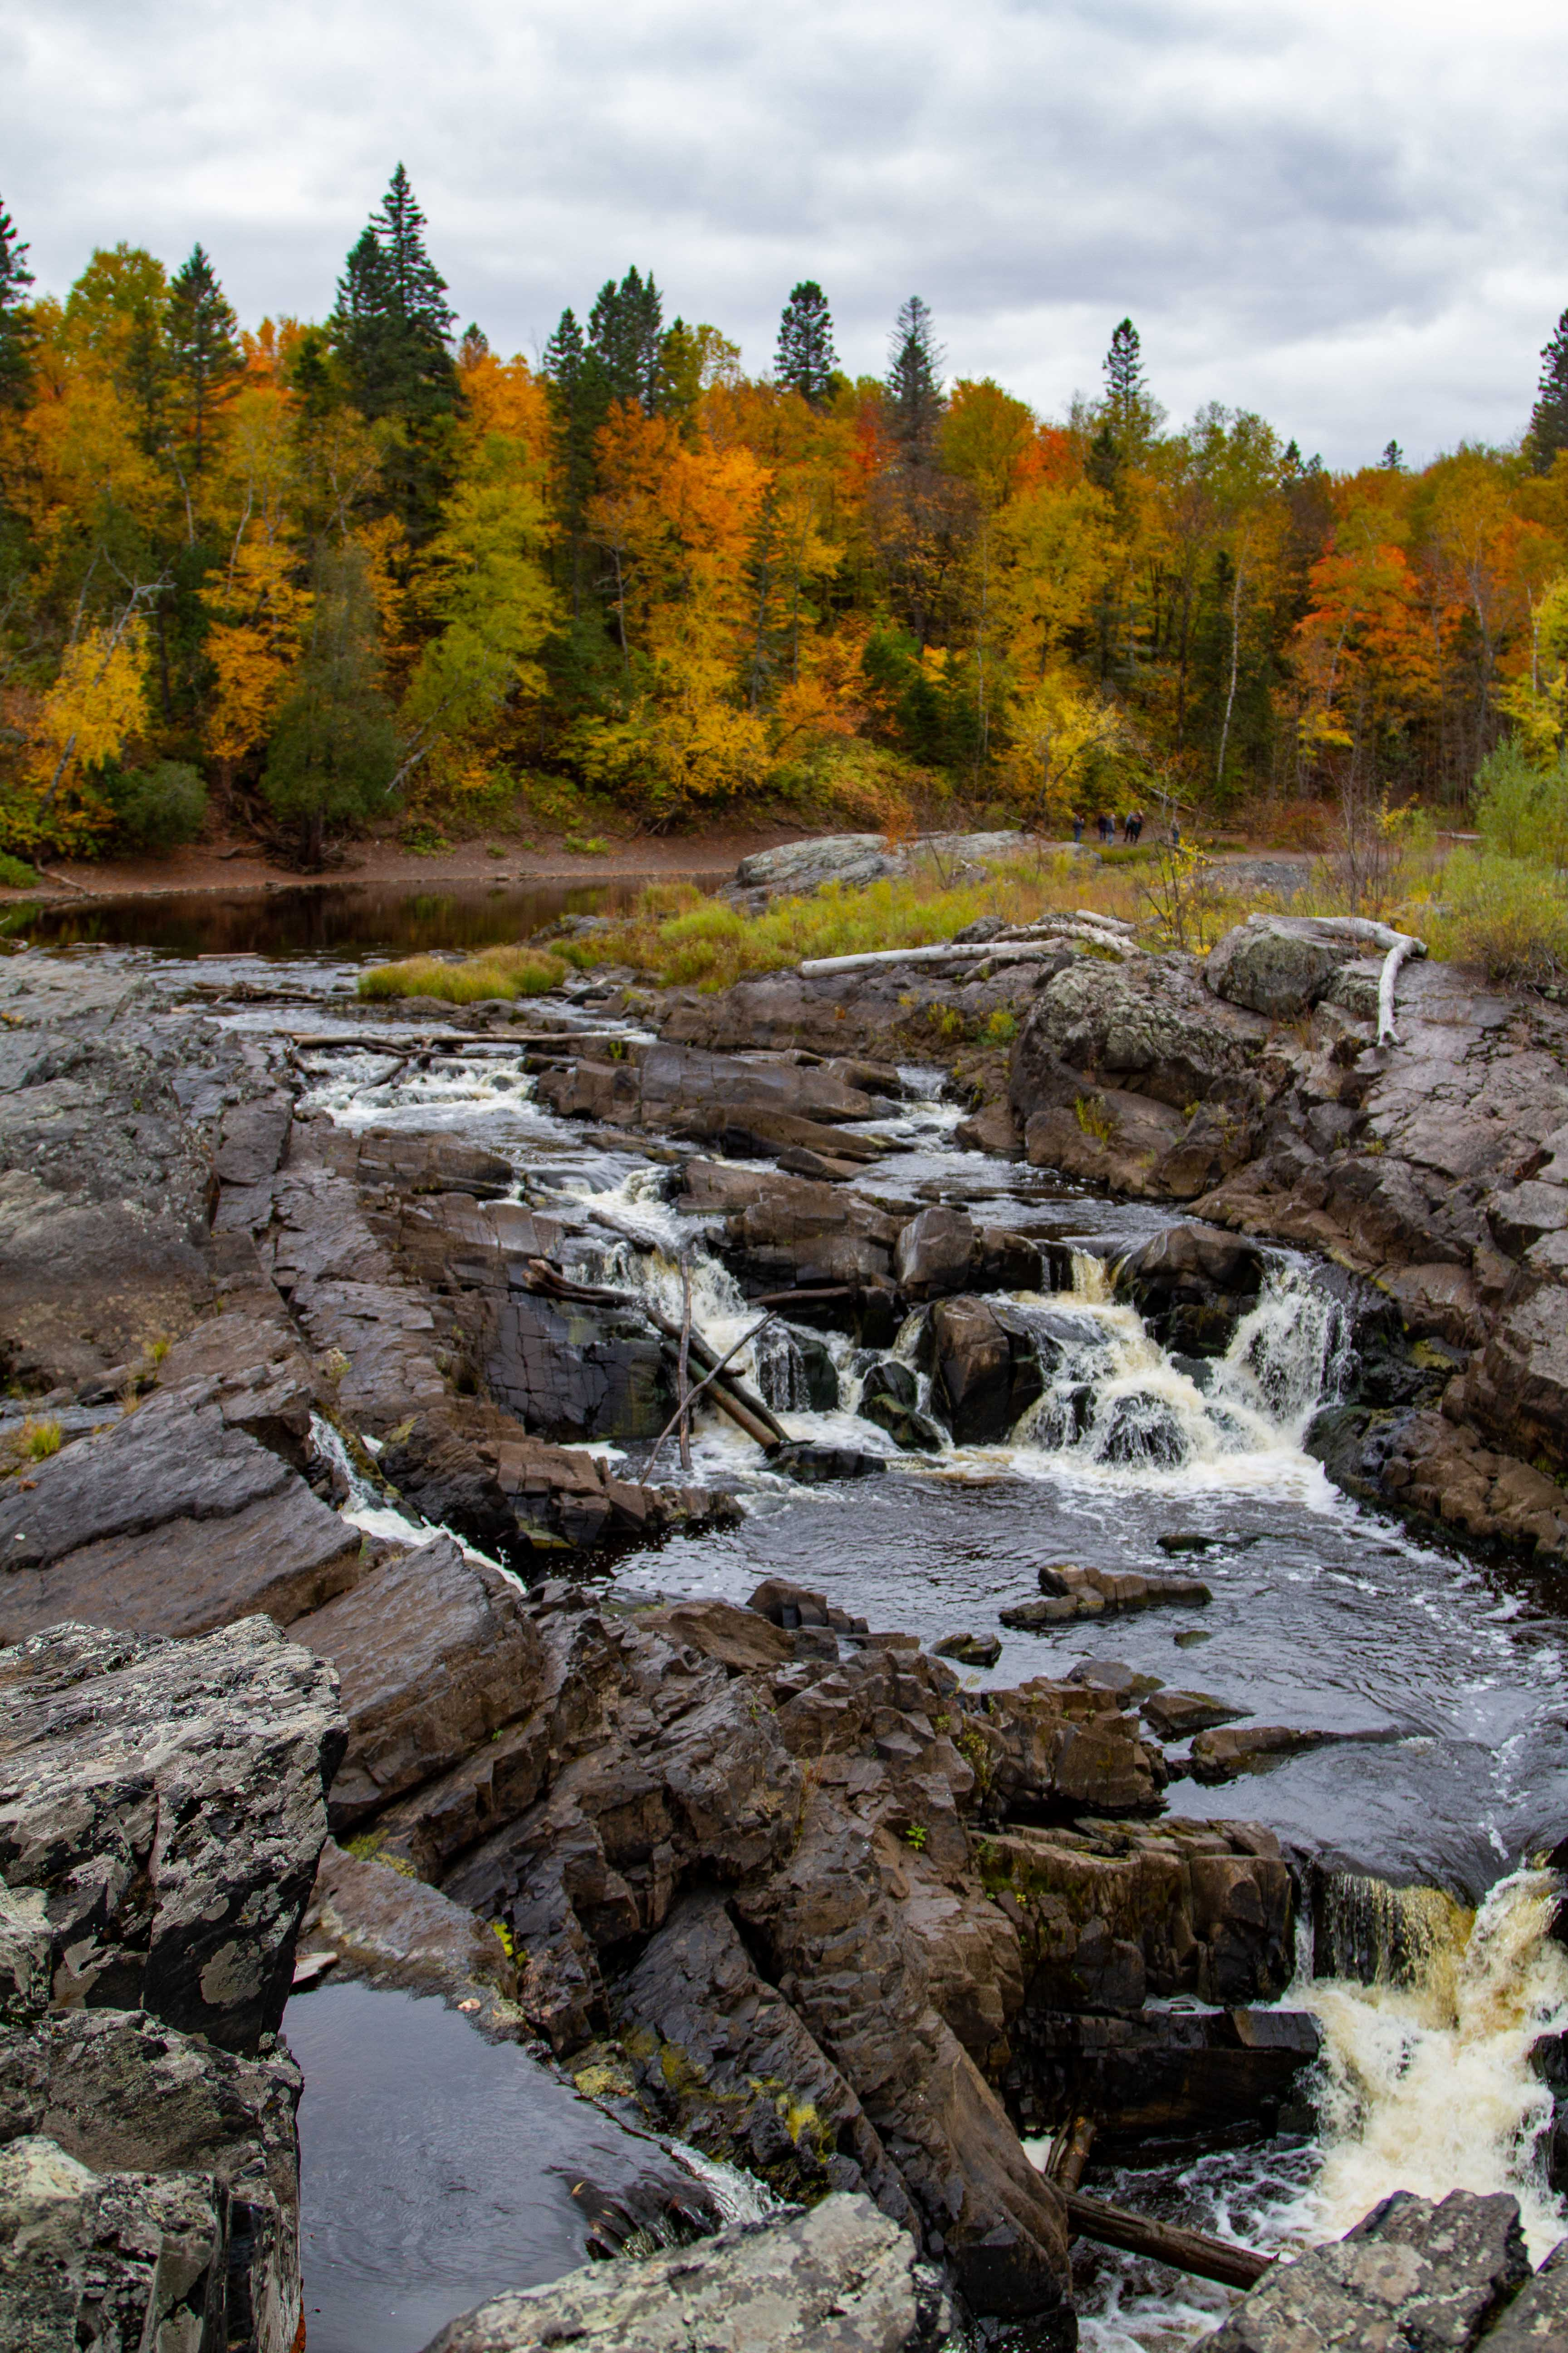
“This new normal is calling ministry leaders to recalibrate.
Leading in a VUCA environment requires a different perspective,
the ability to read contextual changes,
and new practices.”
Elton, Journeying in the Wilderness, 8

Slide 11
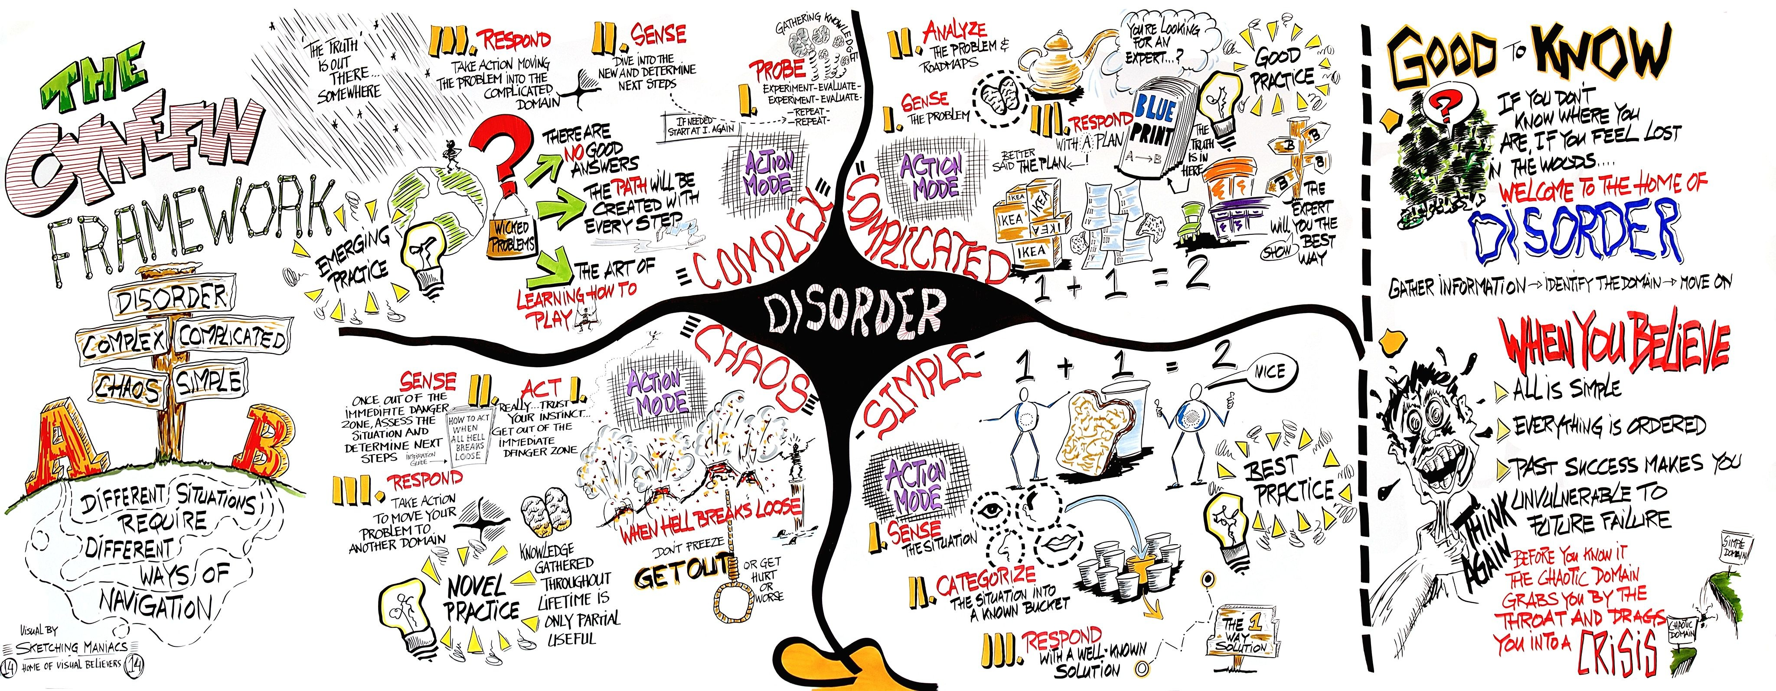
complexity
Notes:
Most of the challenges we face today have moved from simple and complicated to complex and chaotic. How do we find our way?

Slide 12
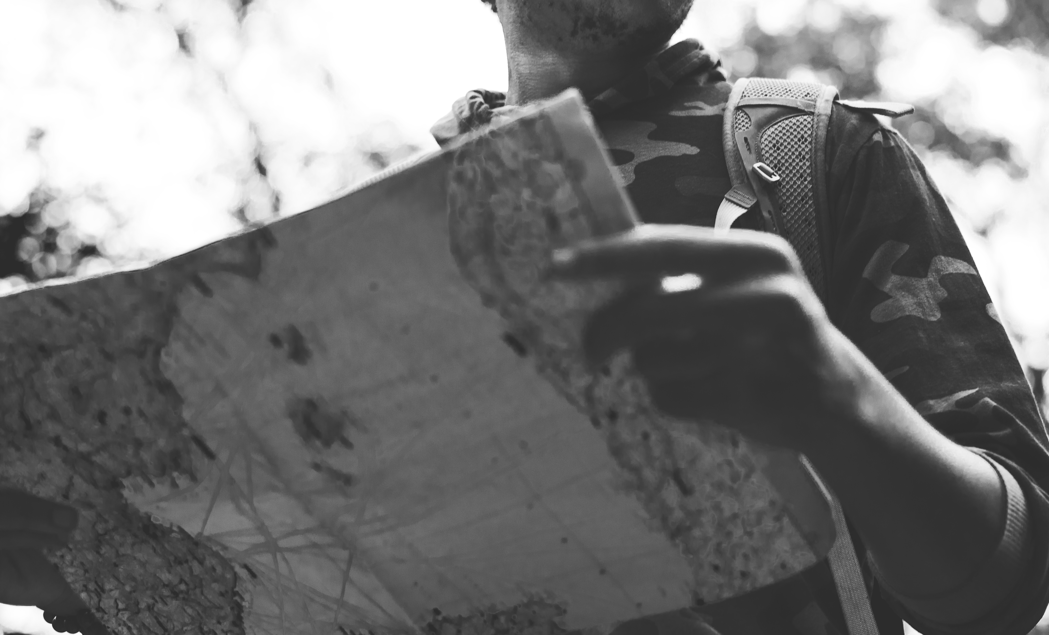
Notes:
The paper maps we use to rely on are less trustworthy - and we need tools that help us be more in touch with the dynamic world in which we live and work.

Slide 13

dynamic stability
Thomas Friedman
there is a gap between the
rate of change and people’s ability to adapt.
This gap leaves people with a feeling of loss and
a desperate need for navigational help and sense-making.

Slide 14

Meaning-making
“Meaning-making is theological work
that happens at the intersection of
our understanding of God and
our lives experience.”
Elton, Journeying in the Wilderness, 168

Slide 15
dynamic stability
Friedman says stability comes when we learn to
work with the fluid, ever-changing environment.
Friedman, Thanks for Being Late, 199
Notes:
This dynamic stability is similar to that of navigating a boat.

Slide 16

New Navigational System

Slide 17

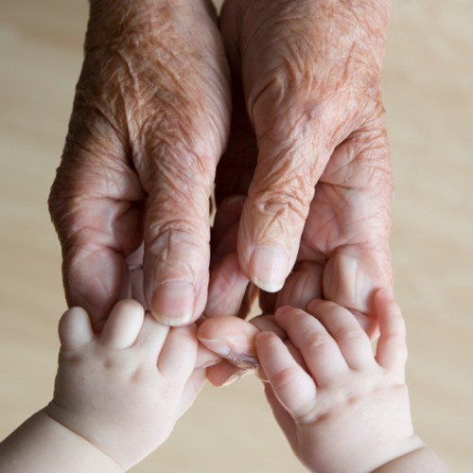
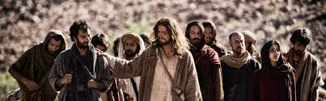

Our calling
is to steward the future witness to the Christian faith.
Notes:
Congregations are called to steward the future witness to the Christian faith.
God’s love is steady and trustworthy, yet we live in highly dynamic context and the future does not look like the past.
This is a pivotal moment. We, the church, have the opportunity to hold tightly to the past or
Seek ways to join God’s movement in the world.
Our way forward is embracing God’s call for us and relying on God,

Slide 18

God’s love forms, informs, and transforms us as God-followers.
Grounded in God’s love, we are called to love God and our neighbor
and our lives are directed toward God’s promise future.
Congregations accompany people in discovering a Christian way of life in a dynamic world.
Notes:
Embracing God’s call for us we let God’s love orient our lives. For God’s love is what forms, informs, and transforms our lives. This love is steady and steadfast. In response to God’s love for us, we love God and our Neighbor
And God’s deepest desire is for all to live abundantly. And God promises a future we all things are made new.
Congregations simply accompany people in discovering a Christian way of life in this dynamic world.

Slide 19
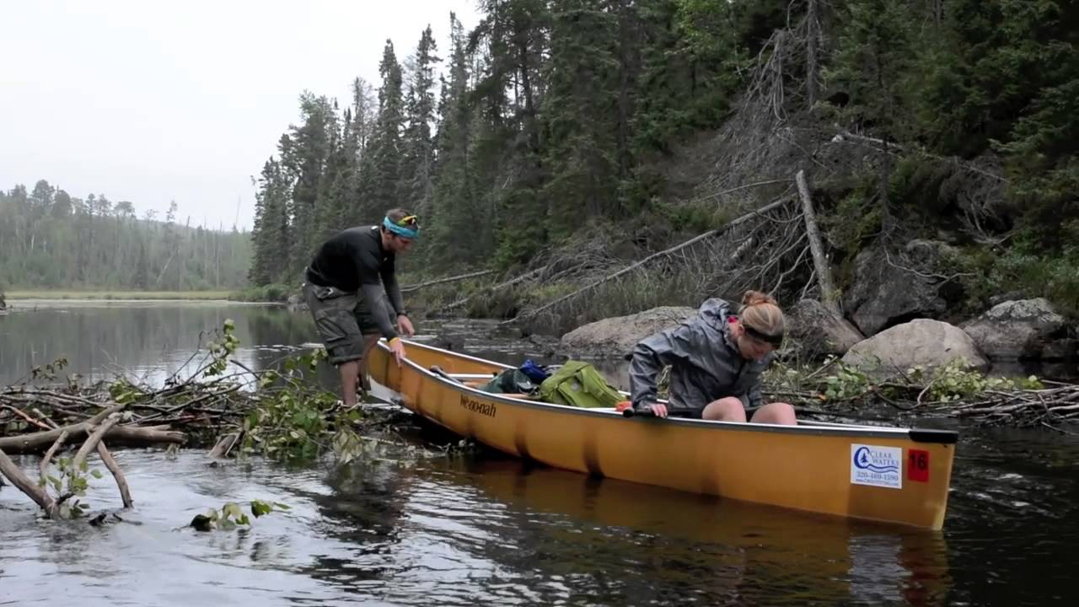
Navigating the Wilderness
Capacities for setting direction and getting oriented
Notes:
How do we navigate this wilderness territory filled with uncertainty and complexity?

Slide 20

God’s Vision
Sets the Direction
God is about life, full and abundant life for all of creation, and for us.
God’s kingdom unfolding around us about about God’s promised future breaking into our current time,
While God’s vision is real, we live in a “now and not yet” world.
God invites us to be co-creators of this future.
Notes:
God’s vision is a view of life that is abundant - there is enough for all to thrive. It is not scarcity, but love that when shared multiples.
God’s overflowing love flows through us into the world as we love and serve our neighbor.

Slide 21

2 movements
orient our lives
Notes:
Gathering God’s beloved people as the body of Christ - faith forming and informing our lives.
Scattered in the world, God’s people are co-creators of God’s mission transforming the world.

Slide 22
Gathered in community we discover our identity and participate in Christian practices, encounter God’s story, and live in relationship with other people of faith.
Scattered in the world we participate in God’s mission of loving the world as we encounter difference, name pain and injustice, and love and serve others.
Notes:
Gathered in community we discover our identity and participate in Christian practices, encounter God’s story, and live with other people of faith.
Scattered in the world we participate in God’s mission of loving the world as we encounter difference, name pain and injustice, and love and serve others.
Most of our time, in the past, has been on our time gathered. Yet most of our lives are lived scattered in the world. AND faith, as a way of life, is about all of life, not just our time in Christian community.
What if we took rethought our time gathered as accompanying people of faith to discover a Christian way of life scattered? What difference would that make?

Slide 23

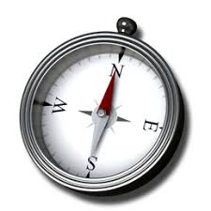


4 commitments of faith
Gift of love
Guide for living
Witness to God’s Story
Agent of God’s love
Notes:
To these two movements we add four commitments that highlight the multi-multi-faceted nature of faith.

Slide 24
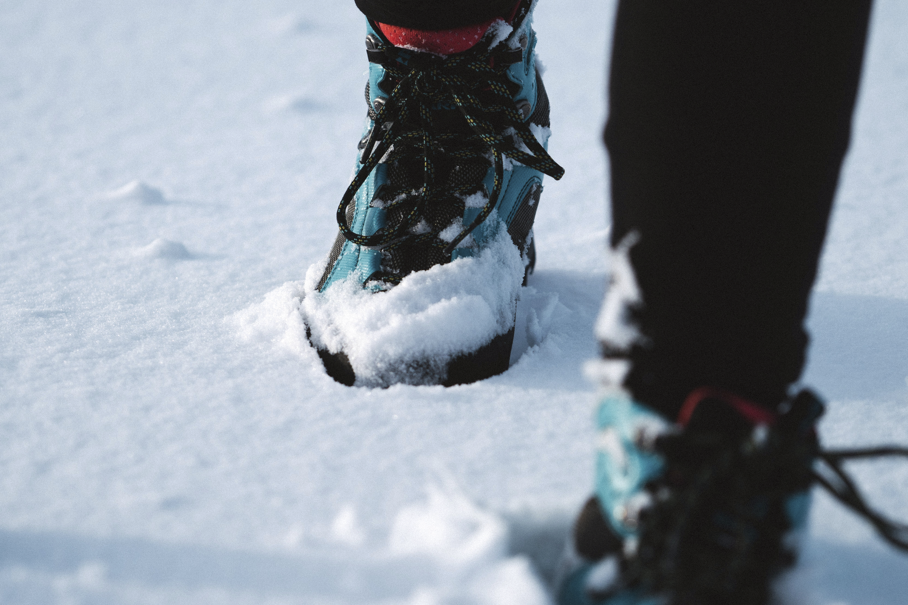
Practice-centered
“practices provide the scaffolding for faith to form, inform, and transform our lives.”
Notes:
“A practice-centered approach to forming faith is a GPS-like system that can automatically recalibrate as circumstances change. In this approach, practices provide the scaffolding for faith to form, inform, and transform our lives.” 172.

Slide 25
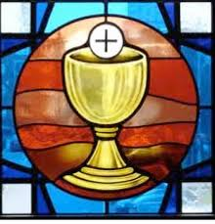

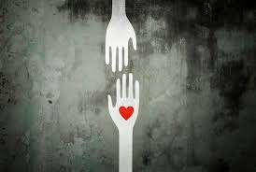

3 sets of practices
sacramental
incarnational
missional

Slide 26
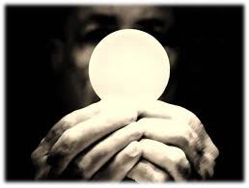
Sanctuary
Practices
Dwelling in the Word
Sacraments
Reflecting on Experience
Sabbath
sacramental

Slide 27
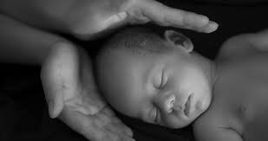
Campfire
Practices
Open Friendships
Listening
Telling Faith Stories
incarnational

Slide 28
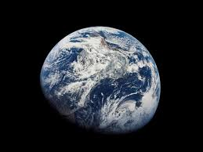
Outpost
Practices
Being Hosted
Vocation
Dwelling in the World
Experimenting
missional

Slide 29
3 sets of practices
Sanctuary
Campfire
Outpost
Notes:
Accompanying people in faith as a way of life of faith is the role the local church plays in forming faith. As we center our lives around these 3 sets of practices we join God’s activity and discern our way forward.

Slide 30

- How is your congregations stewarding the future witness to the Christian faith?
- In what ways is your congregation accompanying people in discovering a Christian way of life in today’s dynamic world?
- Could these three sets of practices help your congregation “practice” your way into the future? What practices do you have in each category?
Small Group Sharing

