Slide 1

Beyond Entrance, Endorsement, and Approval
Reimagining our Call to Steward Leaders
Terri Martinson Elton March 2021

Slide 2

Multiple Hats

Slide 3


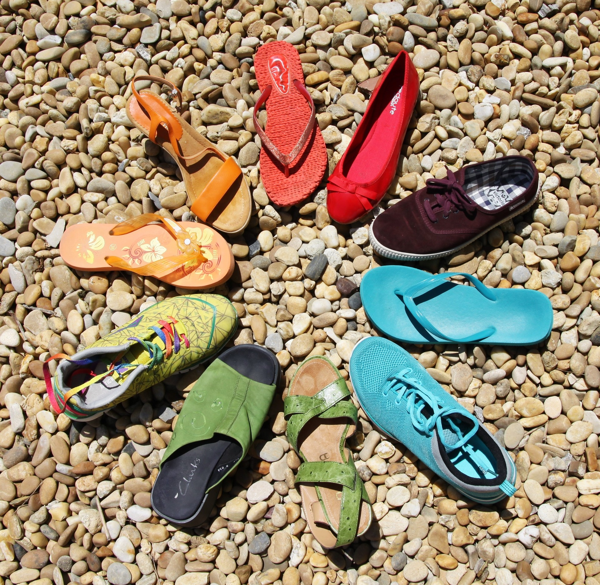

Slide 4

Write down your questions.

Slide 5
Why?
are we here

Slide 6
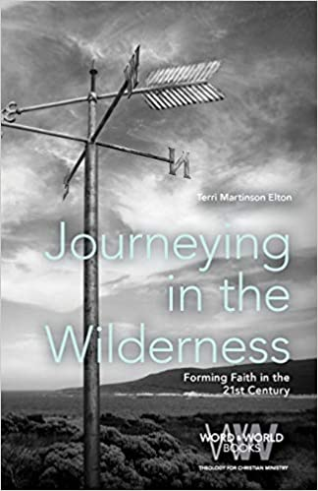
to steward the future witness of the Christian faith

Slide 7
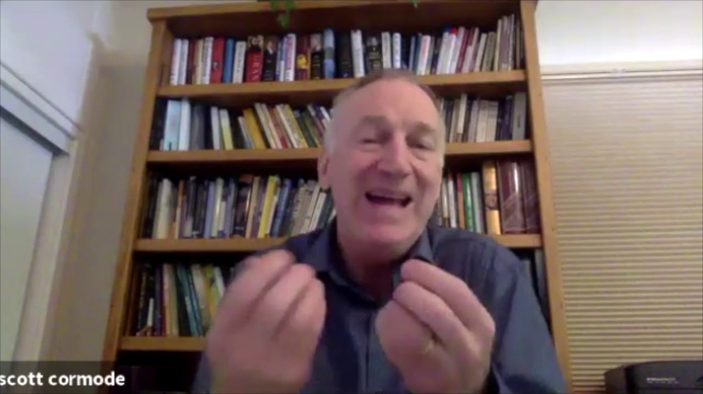


Slide 8
to accompany people in discovering a Christian way of life

Slide 9

The ELCA, according to the candidacy manual,
is committed to the intentional identification and support of those whom God has given the gift of missional imagination and the ability to provide leadership in the church. (Page 8 of Candidacy Manual, 2021)

Slide 10
The process of candidacy, as stated in the manual, is:
meant to be a welcoming and joyful time for people discerning how to serve through the church. It is a formalized – yet personally and relationally focused – journey that assists people in discernment for church leadership, whether they ultimately become rostered or serve in other lay roles within the church. Discernment is a life-long process, which continually assesses how God may be calling a person into a unique ministry. It is a means to determine who might serve as a rostered minister in a Word and Sacrament or Word and Service ministry, as well as who might serve in a variety of lay leadership roles in the church or in the world. The candidacy process will succeed when people graciously discover, through the nurturance of mentors, congregations, and others, how and where to serve according to the Spirit’s leading. (Page 8 of Candidacy Manual, 2021)

Slide 11
Candidacy =
stewards of stewards

Slide 12
These stewards as mission-oriented leaders who
  are rooted in the gospel
  knowledgeable, passionate, and able to articulate the faith and confessional teachings of the ELCA and
  through the church, participate in God’s mission of love, redemption, justice, and reconciliation.
(Page 9 of Candidacy Manual, 2021)

Slide 13
How can our why
anchor and free us?

Slide 14
How?
do we do this

Slide 15

Candidacy is an
interdependent process
And synods work with congregations, seminaries, candidacy staff, and, of course, candidates.
Synod’s play a key role -
they act on behalf of congregations and the whole ELCA -
to review to accompany candidates who have discerned a calling.
Each partner has a distinctive role in the process as they also cooperate with the other partners.

Slide 16
dispersed model of leadership
participatory process and
shared responsibility

Slide 17
Synod candidacy committees are
hubs, intersections, guides and leaders, in the candidacy process.

Slide 18
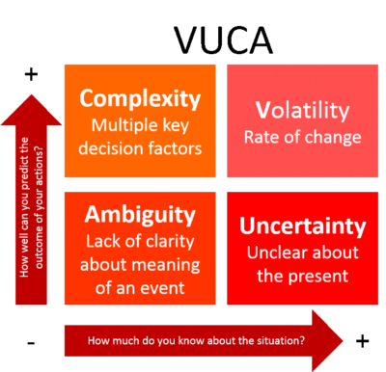
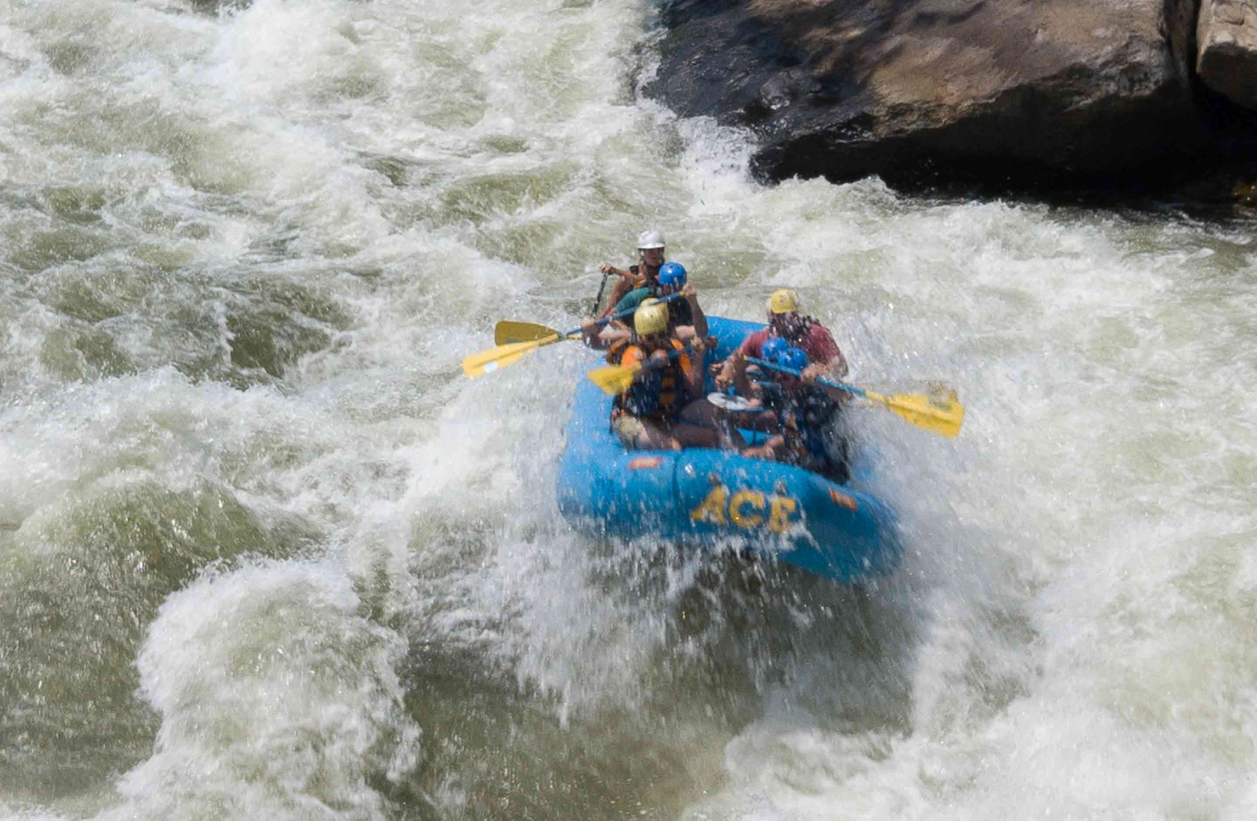
How do we guide, lead, create intersections and hubs
in today’s environment?

Slide 19
I wonder
if current disruptions are
creating openings for
new pathways, candidates, and
ways of thinking about our charge.

Slide 20
What if
candidacy committees
seized this moment for the sake of the future witness of the Christian faith?

Slide 21
I wonder
if we (candidacy committees) have become too passive?

Slide 22
What if
something new is emerging
out of our current
contextual realities?

Slide 23
What if
our focus shifted from adapting past practices to discerning how the Spirit is leading us into the future?

Slide 24
I wonder
if we need scouts scanning the horizon and actively pursuing leaders?

Slide 25
What if
we cultivated playgrounds
for developing leaders and enlisted ALL of GOD’s church to participate?

Slide 26
How do we design
processes for our
dynamic environment?

Slide 27
What?
do we do

Slide 28
relational
spiritual
strategic
managerial

Slide 29
13 responsibilities fall into three categories
(Page 12 of Candidacy Manual, 2021)
attending the candidate
work a process
connect the pieces and the whole

Slide 30
one call with
shared practices
contextualization

Slide 31
shared call
What are your challenges?
contextual variance

Slide 32


Slide 33
Universal Challenges
- Do our current practices fit our contextual needs?
- What are the obstacles?
- How do we access the needs/demands/capacities needed for tomorrow’s leaders?

Slide 34

GPS
Dynamic Stability

Slide 35
What Spirit-led practices create the conditions for stewarding the future a Christian witness?

Slide 36
Write down your questions.

Slide 37
Why?
How?
What?
How can our why
anchor and free us?
How do we design
processes for
our dynamic environment?
What Spirit-led practices create the conditions for stewarding the future a Christian witness?
Discuss
Put your questions into conversation with these areas. What insights did you discover?
What questions are central for our future?

Slide 39
Beyond Entrance, Endorsement, and Approval
Reimagining our Call to Steward Leaders
terrielton.com - go to presentations 2021

