Slide 1
Strategies for Navigating Warp Speed Change - 2
Terri Martinson Elton

Slide 2

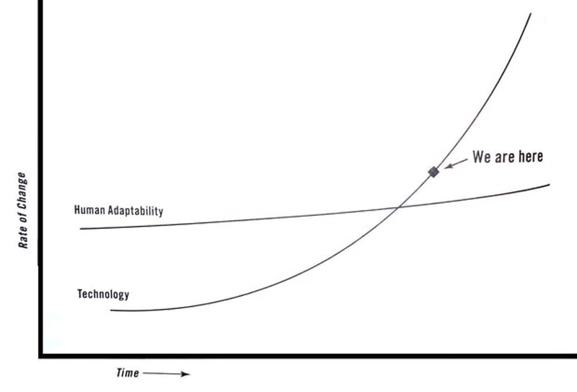

Thomas Friedman, Thanks for Being Late
It is time to
Pivot
the past is no longer a good predictor of the future
Warp Speed
Notes:
The speed of change is such that we can no longer keep up,
We must change the way we approach change.
The past is no longer good predictor of the future.
Therefore, it his time to pivot, to reorient our eyes from seeing the past as the “norm” to looking toward the future God is inviting us into.

Slide 3
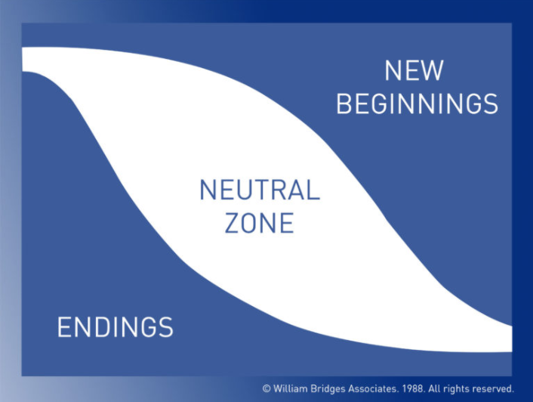
Transition requires Tending to the emotional process
There are no shortcuts
William Bridges, The Way of Transition

Slide 4
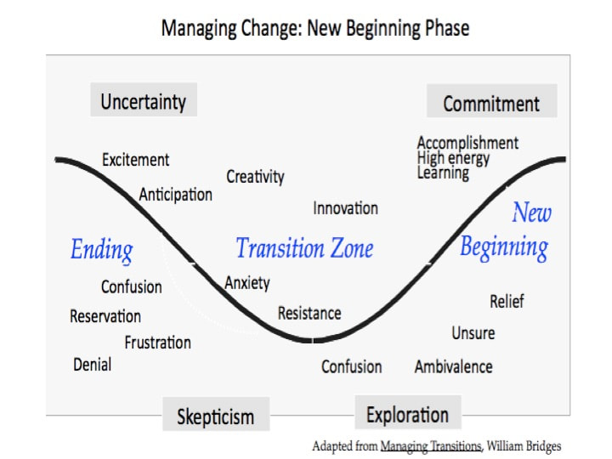
Learn the difference between change
And transition
Notes:
Transitions begin with Endings!
This first phase begins NOT when an event, but when people identify what they are losing and begin managing and or deal with these losses. They see and name what is over and being left behind. These may include relationships, processes, team members, status, location, or even their own comfort or doing what “they like.”
This is not about adding new activities to our ministries, but weaving these aspects INTO the ministry as it is.

Slide 5
Learn the difference between change
And transition
Notes:
The second phase is the transition or neutral zone. This is a “wilderness” time or period “in-between.” This phase is mostly psychological. This is the phase when things get real and feel confused. Navigating this period takes lots of energy - doing ordinary things. Why? Because NOTHING works or goes as it did before.

Slide 6


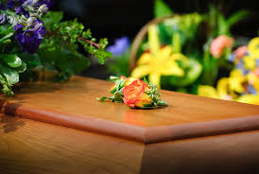

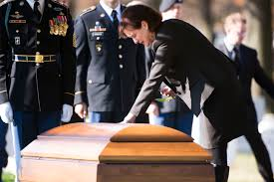

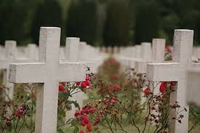
The ending
The neutral zone
Notes:
Think about when we experience death. The first phase has “activities” - calling the funeral home and deciding what to do with the body - choosing a casket or having the body cremated, etc; telling friends and family about the death and planning a funeral or gathering to celebrate their life and mark their death; burying the body or receiving the cremated body; cleaning out their house or distributing their belongings and selling their house; working out insurance or financial affairs.
At some point these activities are over - and while the emotional processing already started - the void, the loss dreams, the empty space, and the deep pain now is revealed. This is the point where the deep work of grief takes place - Maybe you miss the daily phone calls - and the silence fills the house. Perhaps this is the death of your only parent and now it is time to come to terms with being an orphan. Perhaps you catch yourself referring to the person in the present tense - my husband loves golf, my wife hates seafood, my son is going to college.
People go through an in-between time when the old is gone but the new isn’t fully operational. It is when the critical psychological realignments and repatternings take place. It is the very core of the transition process. This is the time between the old reality and sense of identity and the new one. People are creating new processes and learning what their new roles will be. They are in flux and may feel confusion and distress. The neutral zone is the seedbed for new beginnings.

Slide 7
Learn the difference between change
And transition
Notes:
People go through an in-between time when the old is gone but the new isn’t fully operational. This is the season were our identity is challenged and the old reality slips away. While it is the seedbed of new beginnings, it is more like winter than spring - the time when the soil lies fallow and dormant, before the warmth of the spring sun awakens it from slumber.
It is a season of being more than doing, of slowing down rather than spending up.

Slide 8

being
This is a season of

Slide 9

rest
This is a season for

Slide 10

Grace
This is a season for

Slide 11

Recreation
This is a season for

Slide 12


Sabbath
This is a season for

Slide 13
practice
how is your being?
What do you need to rest?
Where do you need grace?
How might you re-create this summer?
What might sabbath entail?
Notes:
In small groups or alone, reflect on these questions.
Have the person who has been in ministry the longest begin by picking a question and answer it. The have others share about their experience with that practice. Then go to the person who has been in ministry the second longest and repeat the pattern. Groups conclude at 10:55 and we will begin again at 11:00.

Slide 14
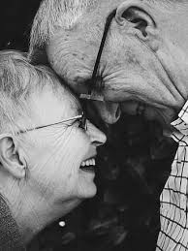
Being
with those you love
Allow extra time for
Notes:
During COVID we have had some health issues in our family. This has been really hard AND really good for us - because we have allowed much more time for being with each other - without an agenda (no homeschooling or chores), just time together.
Being with those we love reminds us of our identity.

Slide 15
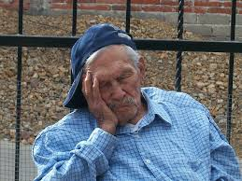
naps
Take
Notes:
Notice what is going on with your body, and give your body a break. Daily, or as your body tells you it needs a break, find a semi-quiet space and set a timer for even 15 minutes where you can close your eyes and let your mind relax.

Slide 16

Grace
Soak in
Notes:
Create a practice that reminds you of God’s grace. Perhaps you can make yourself a card with Eph 2:8 on it: For it is by grace you have been saved, through faith, this is not from yourself, it is a gift from God, and pull it out whenever you are getting overly stressed.

Slide 17

Recreation
This is a season for
Notes:
Discover what YOU need to restore or re-create you. In COVID, many of our normal ways of doing that are no longer available to us, but what might be? Take a cooking class. Start biking. Try Yoga or learn to play guitar. Record worship or have someone else lead worship and take a weekend off and find somewhere you can get away. Do one-on-one dates with your kids. Write poetry or read a light-hearted novel.

Slide 18
sabbath
Experiment with
Notes:
As our daily and weekly patterns change, experiment with new ways of creating sabbath - perhaps a full day is not realistic, then create an hour each day or two mornings where you read, journal, pray, or dream. But work sabbath time into your life. This is a long haul, not a sprint.

Slide 19

more?

