Slide 1

Leading in a Connected World:
Platform, People, and Purpose
Terri Martinson Elton

Slide 2

The world is flattening
Thomas Friedman concludes The World is Flat because globalization in leveling the playing field, giving individuals the power to collaborate and compete globally.
Thomas L. Friedman, The World is Flat: A Brief History of the Twenty-First Century, 3rd ed, (New York: Picador, 2007)
Here Comes Everybody, by Clay Shirky, identifies how the Internet’s decentralizing communication has provided new ways for groups to organize without formal structures.
Clay Shirky, Here Comes Everybody: The Power of Organizing Without Organizations, (New York: Penguin Books, 2008).

Slide 3
The world is flattening
And Nicholas Christakis and James Fowler acknowledge how Connected we are and the profound ways social networks form and shape us.
Nicholas A. Christakis and James H. Fowler, Connected: The Surprising Power of Our Social Networks and How They Shape Our Lives - How Your Friends’ Friends’ Friend Affect Everything You Feel, Think, and Do, (New York: Back Bay Books, 2009).

Slide 4
The world is flattening
And because this flattening process is happening “at warp speed and directly or indirectly touching a lot more people on the planet at once,” organizations that “lack the leadership, flexibility, and imagination to adapt” are at risk.
The breadth and depth of these changes is qualitatively changing our experience.

Slide 5
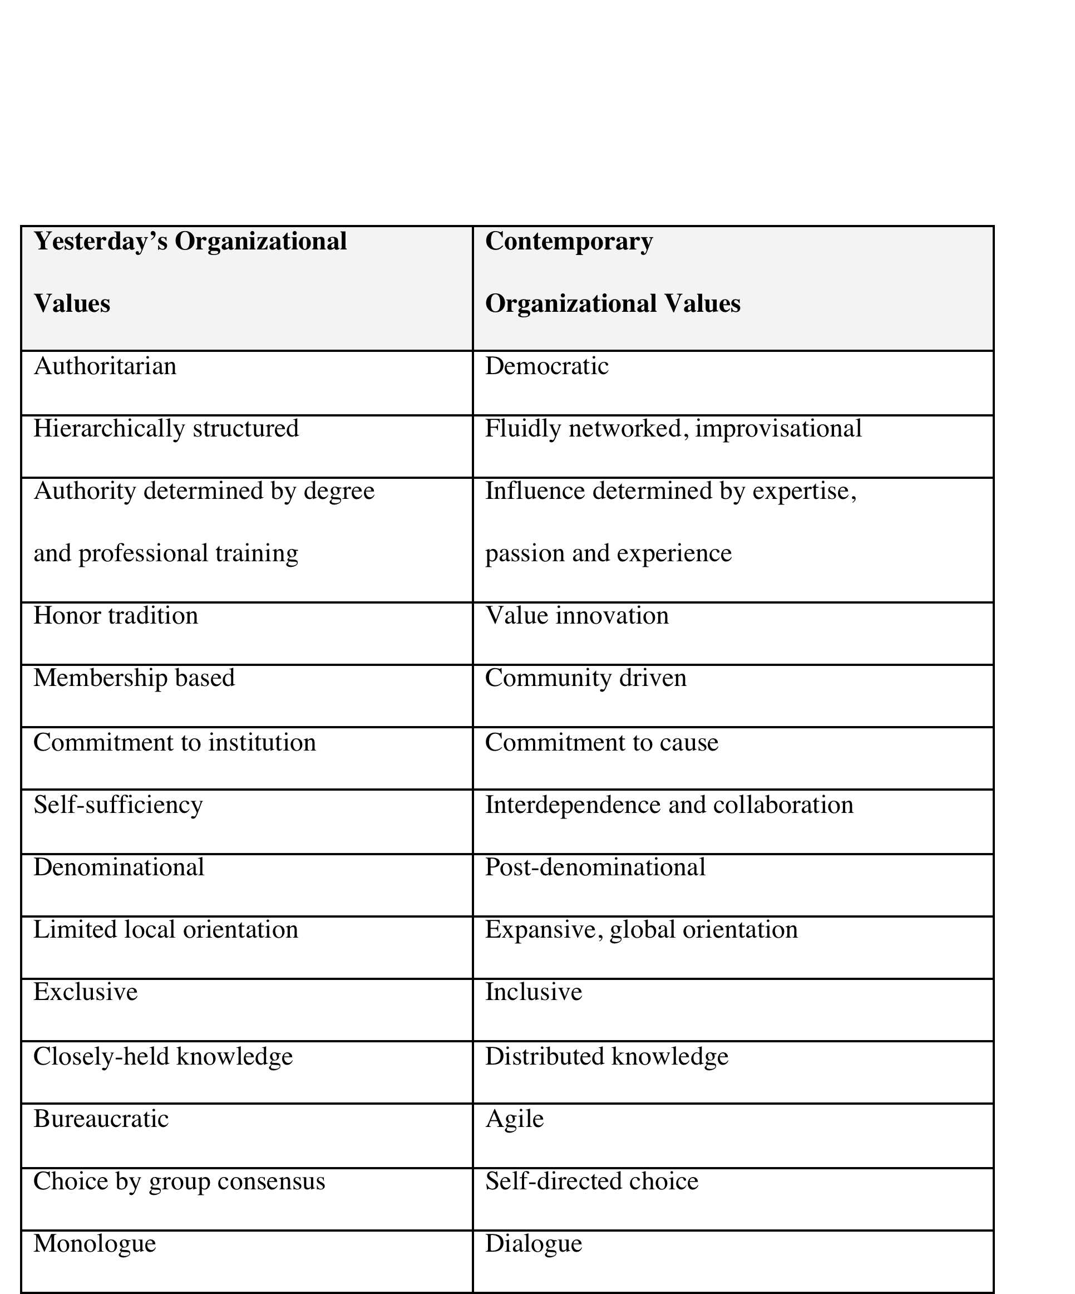
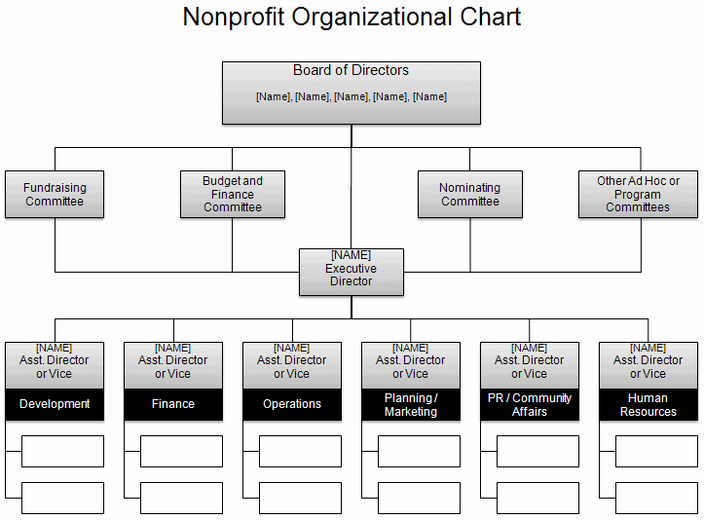
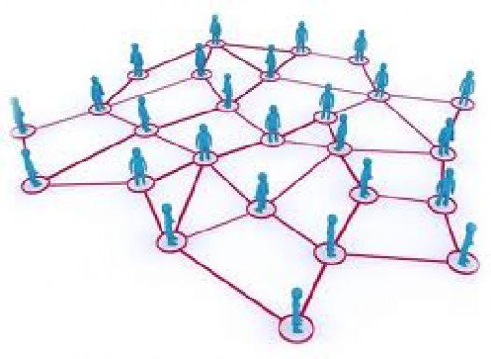
Organizations
1.0 to 3.0
Notes:
Org. 1.0- until about mid-1990’s; Central physical address; Command and control; symbol: hierarchical org. chart
Org. 20-from mid-1990’s to June 29, 2007 : Still command control; Central physical address w/Parallel web presence
Org. 3.0 – iPhone – social networking available to masses
Physical and web locations blur; fluidity of behavior on web flows back into bricks and mortar
24/7/365 availability; need to think I.P address and P.O. (post office) physical address

Slide 6

4 Foci for Leading

Slide 7
Do you know your mission?
Are you engaging people in meaningful ways around that mission?
Creating a Compass
Mission and identity
is central
Structure is simply the holding space.
Purpose and Identity
N

Slide 8
Cultivating Community
Relationships need tending -
internally and externally
bridging
capital
bonding capital
External
Internal

Slide 9

Do you have a vision?
Are decisions made strategically?
How does information flow?
Generate Momentum
Set direction.
Lead people.
Manage flow.

Slide 10


Are you risking today for the sake of a vital future?
Experiment
Become an
agile learning community.
Eye to the Future
Open system
Collective Intelligence

Slide 11
4 Foci for Leading
Creating a Compass –Mission and Identity
Cultivating Community – Attending to Relationships
Generating Momentum – Setting Direction and Making Decisions
Experimenting –Becoming an Agile Learning Community
N

Slide 12
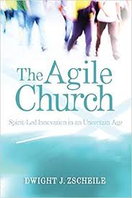
9 Disciplines for
a Learning Church

Slide 13
9 Disciplines for
a Learning Church
  Cultivating Spaces for Conversation and Practice
  “creating safe spaces for people to practice and play in the Christian story and life.” Agile Church, 89
  Address Fear and Shame
  “Brene Brown defines shame as the feeling that we are flawed and therefore unworthy of love and belonging. Shame is the fear of disconnection, the breaking of relationships…” it is an issue of vulnerability. Agile Church, 92
  Engage Ambivalence and Conflict
  difference between espoused theory and theory-in-use. Awakened the disconnect and create “double-loop learning” or why are we doing what we are doing and is this what we want to be doing? - Agile Church, 94-95
Notes:
TE and HH provide some examples

Slide 14
9 Disciplines for
a Learning Church
  Interpret the Present in Light of the Past
  “create holding environments for innovation..by helping the community interpret its legacy, present situation, and the future” in dialogue. “Church leaders are curators and stewards of the stories and practices of the community, which means they must help the church identify a useable past.” Agile Church, 96-97
  Discover Open Spaces
  Where are spaces to learn with neighbors? Find where people already gather and join! More like public library than church. Agile Church, 98-99
  Be Present
  learning, listening, and presence = trust. Agile Church, 101
Notes:
TE and HH provide some examples

Slide 15
9 Disciplines for
a Learning Church
  Practice Your Way Forward
  Simple practices of listening to Scripture, learning to pray and attend to God, and interpreting God’s movement in our daily life” becomes the grammar or framework for imagining our way into the future. Agile Church, 104
  Translate
  “The incarnation represents the translation of the divine Word into human life I the neighborhood so that God’s life-giving gospel may be expressed in every culture through the body of Christ,” Agile Church, 105 How do we translate this life-giving gospel into various contexts today?
  Improvise
  improv is “not seen ahead of time” (Latin). Like jazz, you learn while doing, embracing imperfection, trying things out, and pushing boundaries, within shared structures and patterns. Agile Church, 107
Notes:
TE and HH provide some examples

Slide 16
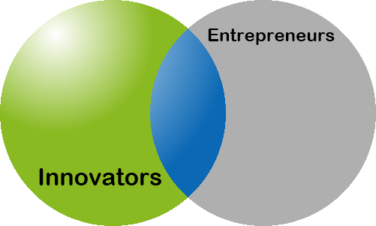
What’s the Difference?

Slide 17

Innovation
  An act or series of action
  Short or long cycles
  Can/does exist within hierarchies
  May lead to entrepreneurial culture
Notes:
Challenge: congs. may feel need to innovate
But, goal is to innovate something meaningful, not yesterday’s “best practices”

Slide 18
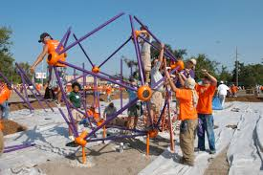

Entrepreneurship:
Playground and Laboratory
-Agility and Precision
-Design thinking and planning
-“Noble failure”
Notes:
My latest insight-meaning behind picture

Slide 19
Innovation is a key capacity, not a luxury
Congregations/organizations that innovate are more likely to thrive
Every congregation can and should innovate
Should every congregation become entrepreneurial? (no!)

