Slide 1

Building Capacity, Courage, and Community
Terri Martinson Elton

Slide 2
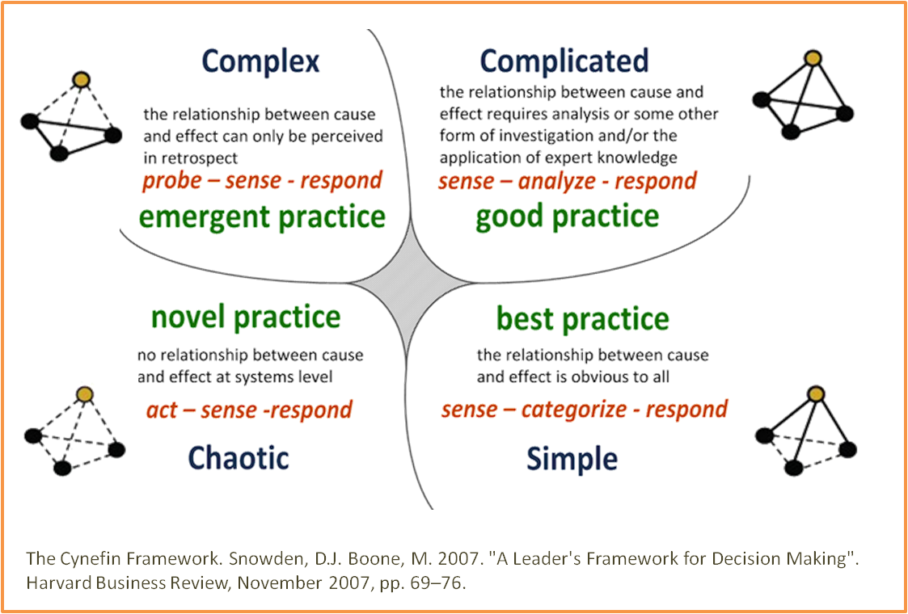
Unordered
Ordered

Slide 3
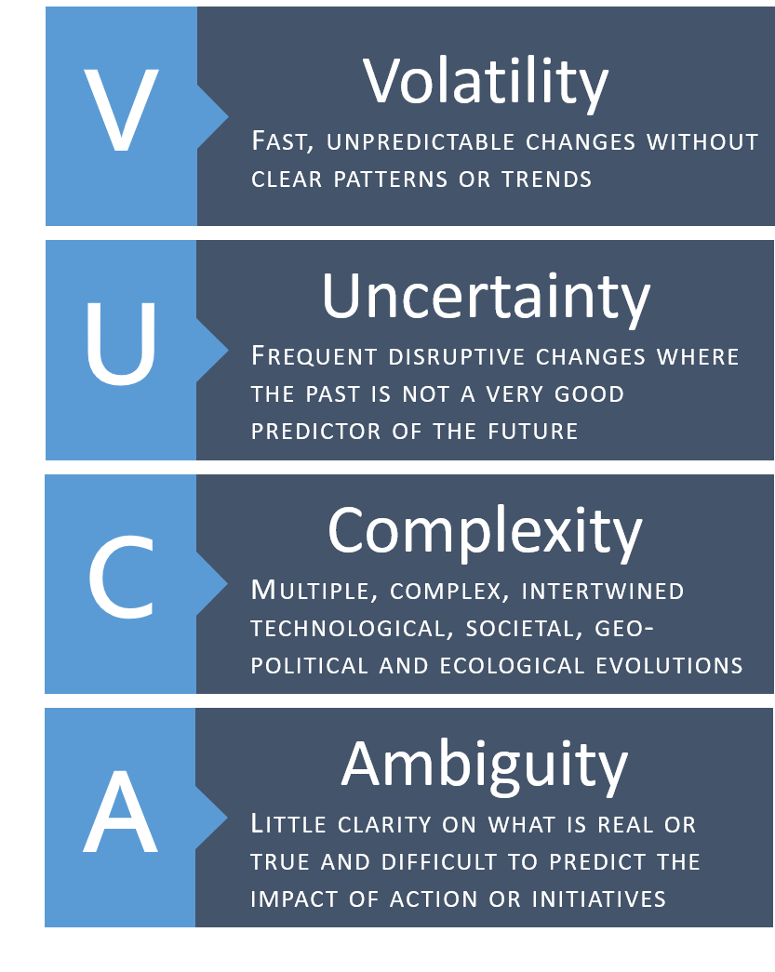
VUCA environment

Slide 4
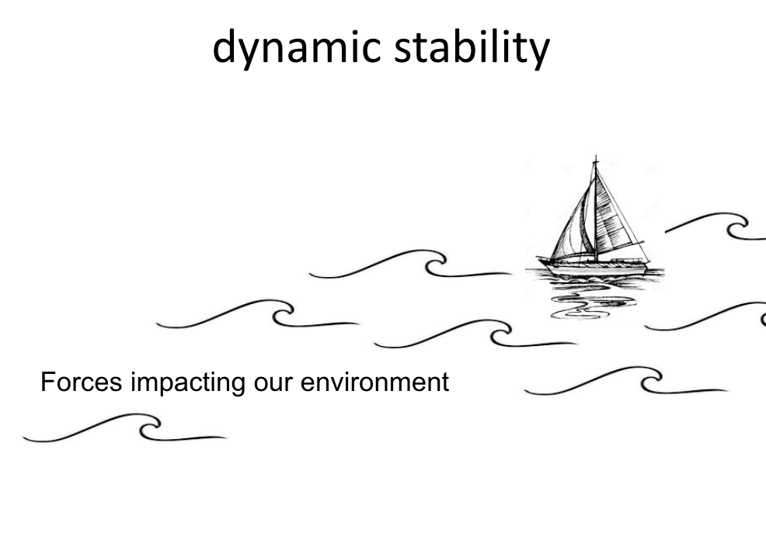
Notes:
Stability for forming faith in dynamic environment comes from the interlay of theology, relationships,, and context.
Working with this interplay provides the church what it needs for balancing and adapting to environmental changes AND accompany people in making faith meaningful and integrated into their everyday lives.

Slide 5
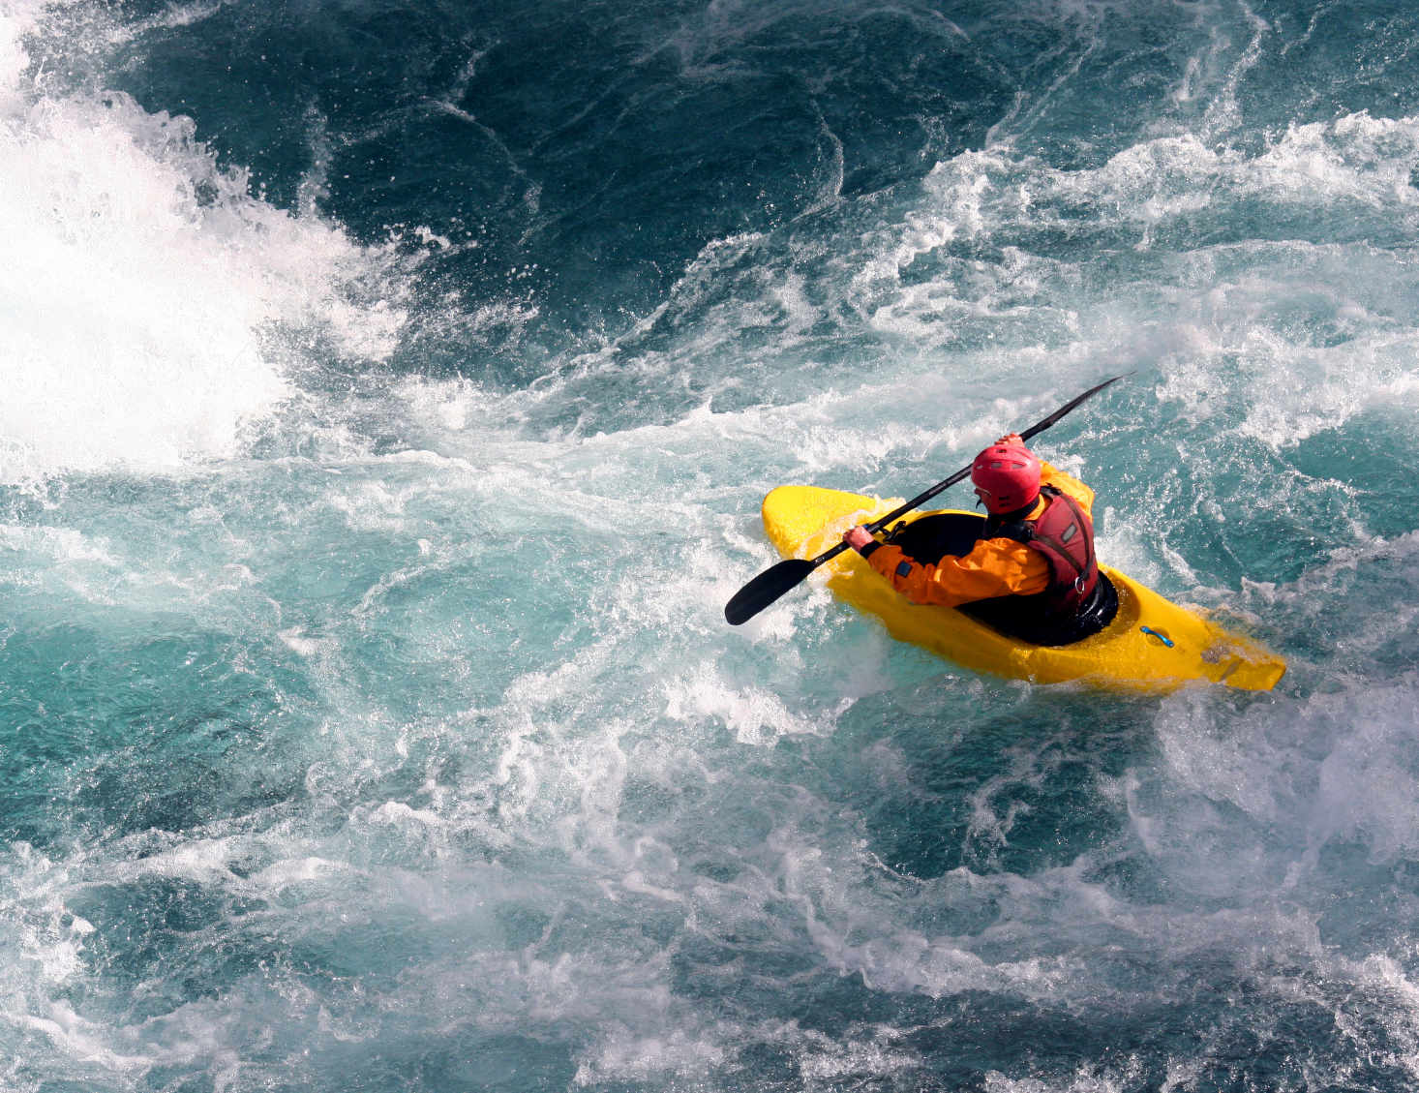

Slide 6
Dynamic Stability
Identity/purpose
              (Why do you exist? What is your unique purpose?)
2. Getting oriented, reading environment
(Where are we? Honest look at reality)
3. Direction/vision
(Where are we going? How are you contributing to the common good?)

Slide 7
Leadership
listening - reality check and relationship building - community
learning - from failure, other fields, and solving real problems - capacity building
experimenting - not on the edges, but related to the core work - courage

Slide 8

Questions
How have you and/or your organization experienced complexity?
How have you and/or your organization found dynamic stability in complex times?
What leadership qualities/capacities have you relied on to thrive in complexity?

Slide 9
Panel

Slide 10
Community
“It is so much easier to venture far—not just in distance but also in terms of your willingness to experiment, take risks, and reach out to others—when you know that you're still tethered to a place called home, and to a real community.”
Friedman, Thanks for Being Late, 452–53.

Slide 11
Capacity Building
“The social fabric is tearing across this country, but everywhere it seems healers are rising up to repair their small piece of it. They are going into hollow places and creating community, building intimate relationships that change lives one by one”
David Brooks in his June 21, 2016 New York Times column.

Slide 12
Courage
“Courage is a heart word…In one of its earliest forms, the word courage meant ‘To speak one's mind by telling all one's heart.’ Over time, this definition has changed, and today, we typically associate courage with heroic and brave deeds. But in my opinion, this definition fails to recognize the inner strength and level of commitment required for us to actually speak honestly and openly about who we are and about our experiences -- good and bad. Speaking from our hearts is what I think of as "ordinary courage.” Brene Brown, I Thought It Was Just Me: Women Reclaiming Power and Courage in a Culture of Shame

