Slide 1
Now What?
Learning from the Future
Terri Martinson Elton

Slide 2
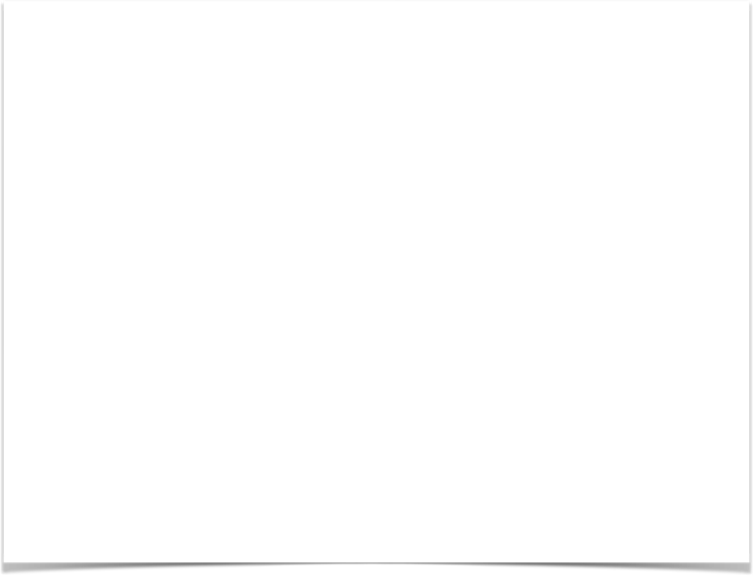

Notes:
What if you received a letter from the future?
The letter described a vibrant community where people were engaged in each other’s lives, people not only knew their neighbors, but worked together to make their neighborhood a just community, and God’s presence was acknowledged and dynamic force.
As you read through the letter, stories illuminated particular ways they had rallied to support friends and family members connected to the community and advocated for justice after a neighborhood incident. There were testimonies of ways people’s connection with this community had given them hope in the midst of desperate times and cared for their physical, relational, and spiritual needs when they could not care for themselves.
Reading on you learn this community has the same name of the ministry you now serve. This surprises you because while there are vague similarities, this is in now way the future you would have envisioned for this ministry from where you sit today.
The letter nots this community was not always like this, and then begins to tell their story of transformation. Eager to hear more, you get to the bottom of the page and turn the paper over…only to discover it blank…Not only that, but there are no other papers in the envelope.
Perplexed, you look for a return address or clue to who sent the letter, only to find no name on the envelope or city on the postmark. What could this mean? Was this real or was it a joke?

Slide 3
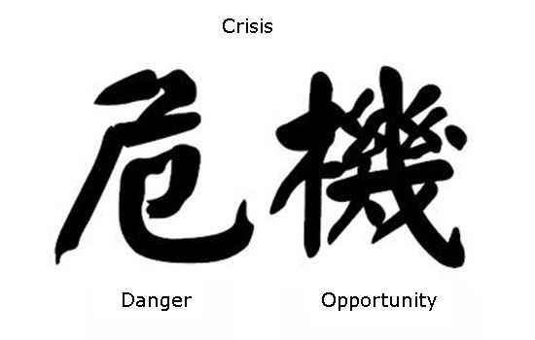
disruptive times
Notes:
These are disruptive times. Times when it is hard to believe what it fact and what is fiction.
When we finally get a chance to pause and reflect, we wonder what is real and what difference we make in the grand scheme of things.
This event is a moment to pause, to reflect on these disruptive times, and wonder. What’s real and what difference can each of make?
I want to say - you can make a difference - and the story we heard about the challenges facing the church today are real. But they are the only thing that is real. Today’s disruptions cause alarm, even signal danger in some cases. Salaries may not be paid, mortgages are stressing church budgets, and there are not enough rostered clergy to serve in every established congregation. And there is another true. God’s love is being shared in visits to the hospital, in befriending those of us who are lonely, as food is graciously given to hungry mothers and fathers, and reconciliation is happening between family members, communities, and estranged friends. Both realities live alongside each other.
The word crisis in Japanese (危機=kiki) has the kanjis of 危=”danger” and 機=”opportunity” (This kanji has also other meanings) This is a reminder that disruptive times both ignite fear and provide opportunities.
http://www.ageekinjapan.com/crisis-danger-opportunity/

Slide 4

Notes:
This gathering is about helping us, leaders of God’s church, recalibrate so we are better positioned to see the opportunity, rather than the crisis. Recalibrating is the work in front of the church today, and it is the work each of us is called to in this time and place. Frankly, I’m tired. I’m tired of running to keep up. I’m tired of learning new things. I’m tired of having my assumptions challenged. And I’m tired of not knowing.
Being tired is one reality. And it is the reality that can permeate my leadership in this time…or it can live alongside another reality. The reality that In my weakness, God is strong. As my limitations become evident, I lean more into God’s creative and redemptive power. When I get to the end of what I know, I have the opportunity to see beyond what is in front of me to a future God’s promised.
On this journey of recalibrating, I’m disciplining myself to acknowledge both realities, trusting in God’s guidance one day at a time.

Slide 5
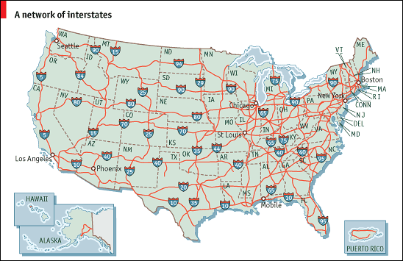
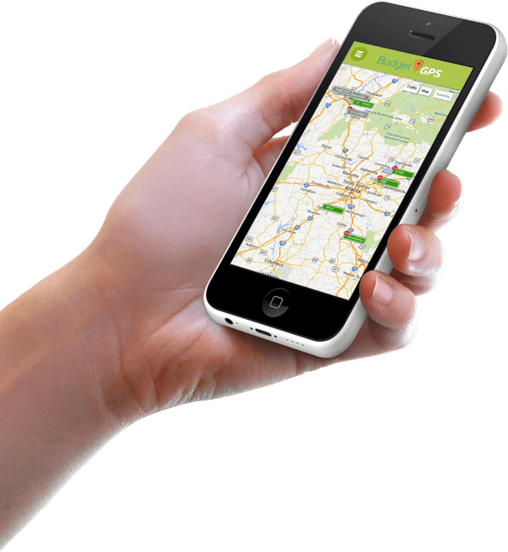
Navigated Established Routes
Discovering Dynamic Stability
Predictable and Efficient
Up-to-date and Portable
Notes:
In the past, we have navigated ministry via established routes. Like plotting a road trip from Minneapolis to Los Angeles, the routes were steady and trustworthy. Knowing the speed limit in each state, the miles per gallon of my car, and the amount of time I can go between bathroom stops, I could predict my journey and be as efficient as I want. As ministry leadership “matured” we too got to the point where predictability and efficiency become core values, best practices helped our learning curve, and ministry excellence pushed us to refine our models and approaches over time. That worked for awhile. But life changed, as our environment changed. And now plotting a road time involves tools we can use “on the road” and as we face new information. While we still rely on established routes, we recalibrate continually when faced with a sudden thunderstorm, car crash, or last minute invitation to have dinner with a friend.
Navigating dynamic environments require discovering dynamic stability.

Slide 6
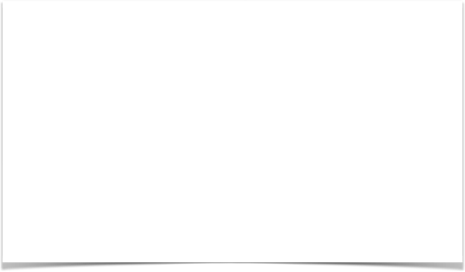
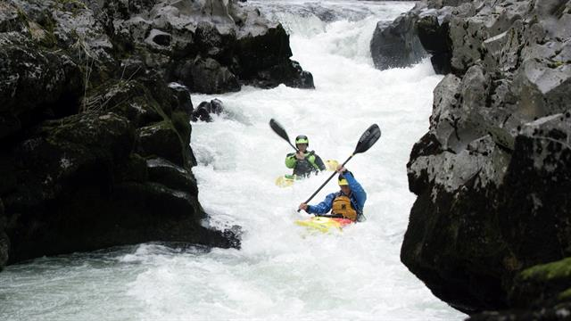
Discovering Dynamic Stability
Notes:
Thomas Friedman observes that people today feel “a loss of control and are desperate for navigational help and sense-making” because their capacities to adapt are not adequate for today’s rate of change. Comparing navigating today’s context with kayaking rapids, he says stability comes from paddling with the current or disruptive forces. In other words, to find our way in a highly dynamic world we need “dynamic stability.” (Friedman, Thanks for Being Late, 198-199) Dynamic stability is like finding your balance on a boat, you need a center of gravity that allows you to work with your surroundings that are fluid and constantly shifting.
Each of us need to discover dynamic stability in our own lives, but so do our congregations.
What if recalibrating meant being able to “paddle with the current”?

Slide 7
Discovering Dynamic Stability
Requires:
Clear direction
New mindset
New capacities
Notes:
This session suggests that leading in the 21st century leaders relies on dynamic stability.
And dynamic stability requires having a clear direction, adopting a new mindset, and cultivating new capacities. Let’s look at each of these three separately.

Slide 8

Direction
Where are we going?
Notes:
Where are we going?

Slide 9
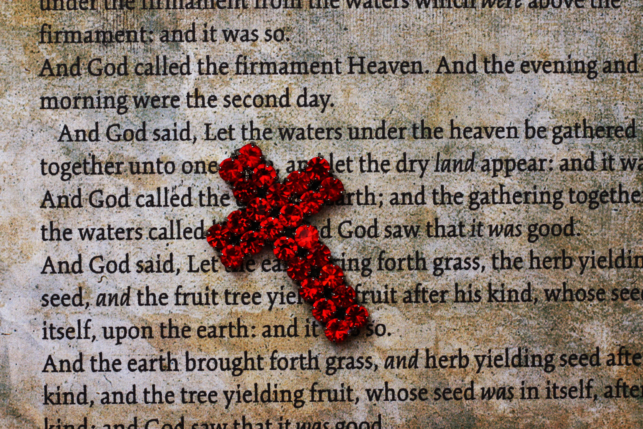
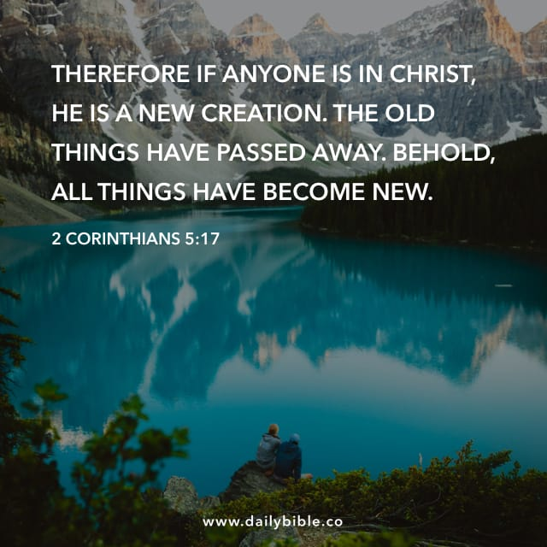

God’s Promised Future
Reorients our lives.
Makes us co-creators with God.
Notes:
We are going toward a future - a future God has promised. From Genesis to Revelation, God promises life. Life is God’s first and last move. Life, not death, has the final word. And God desires that all of creation with live abundantly.
Yet, the world is not yet as God intends. God, in Jesus, came to reconcile the world to Godself. Christ’s death and resurrection create a new future, but we live in-between that moment and the end of time.
Yet God continues to be about life and God is active making the world new. God’s promised future lives alongside death and evil, even as it pulls us forward and gives us hope. As people of faith we can see beyond current circumstances, because faith has reoriented time.
Not only are our lives reoriented, but God commissions us co-creators in making God’s promised future a reality. This is the direction to which we are headed.

Slide 10
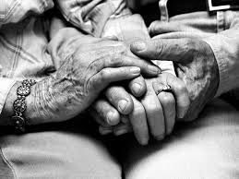


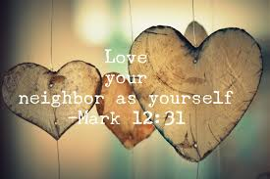
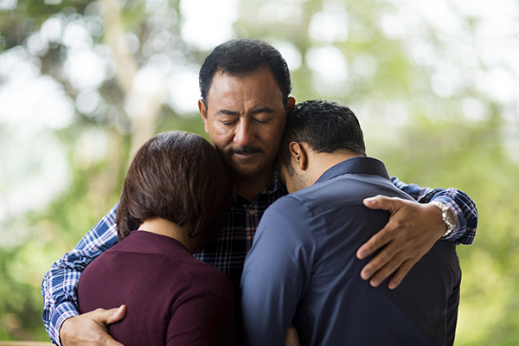
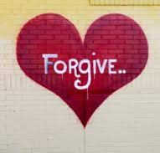
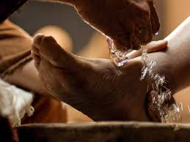
God’s Mission of Love
Transforms, forms, and informs us
Participate by loving God and our Neighbor
Notes:
Life is rooted in God’s love - for us and the world.
God’s love transforms us, forms us, and informs our lives.
In response to God’s gracious love, we love others.
Love turns us away from ourselves to toward others - our friends, our neighbors, and even our enemies. In each and every encounter of our lives, we have the opportunity to extend God’s love into the world.
Loving God and our neighbor, both familiar and foreign, we participate in God’s promised future becoming a reality. Love, like life, is a powerful force in the world.

Slide 11

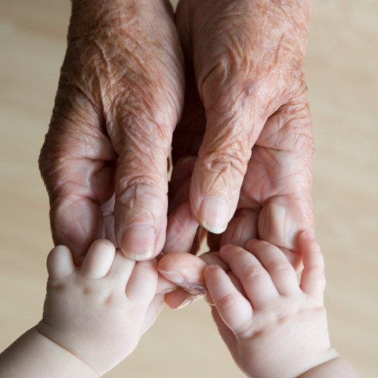
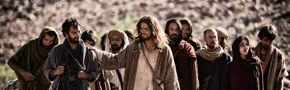

Our calling
steward the future witness to the Christian faith
Notes:
Loving God and our neighbor, we have a call to steward the future witness to the Christian faith.
Not only does our neighbor need our love, but God’s church needs witnesses to point people toward the future God promised. A future with no crying, pain, or suffering, where God dwells with us. God’s love for us is steady and trustworthy, but God’s witness in the world includes us! We are part of God’s plan for creating God’s promised future.
Our God is a God who makes all things new, who brings order out of chaos, and life out of death. God’s deepest desire is for all to live abundantly. Our way forward is relying on God, embracing God’s call for us and letting God’s love orient our lives.

Slide 12
What if God’s love and our call oriented us toward the future?
Notes:
Imagine the letter you received. What if God is pulling you into such a future?
What would leaning into such a future require of you?

Slide 13
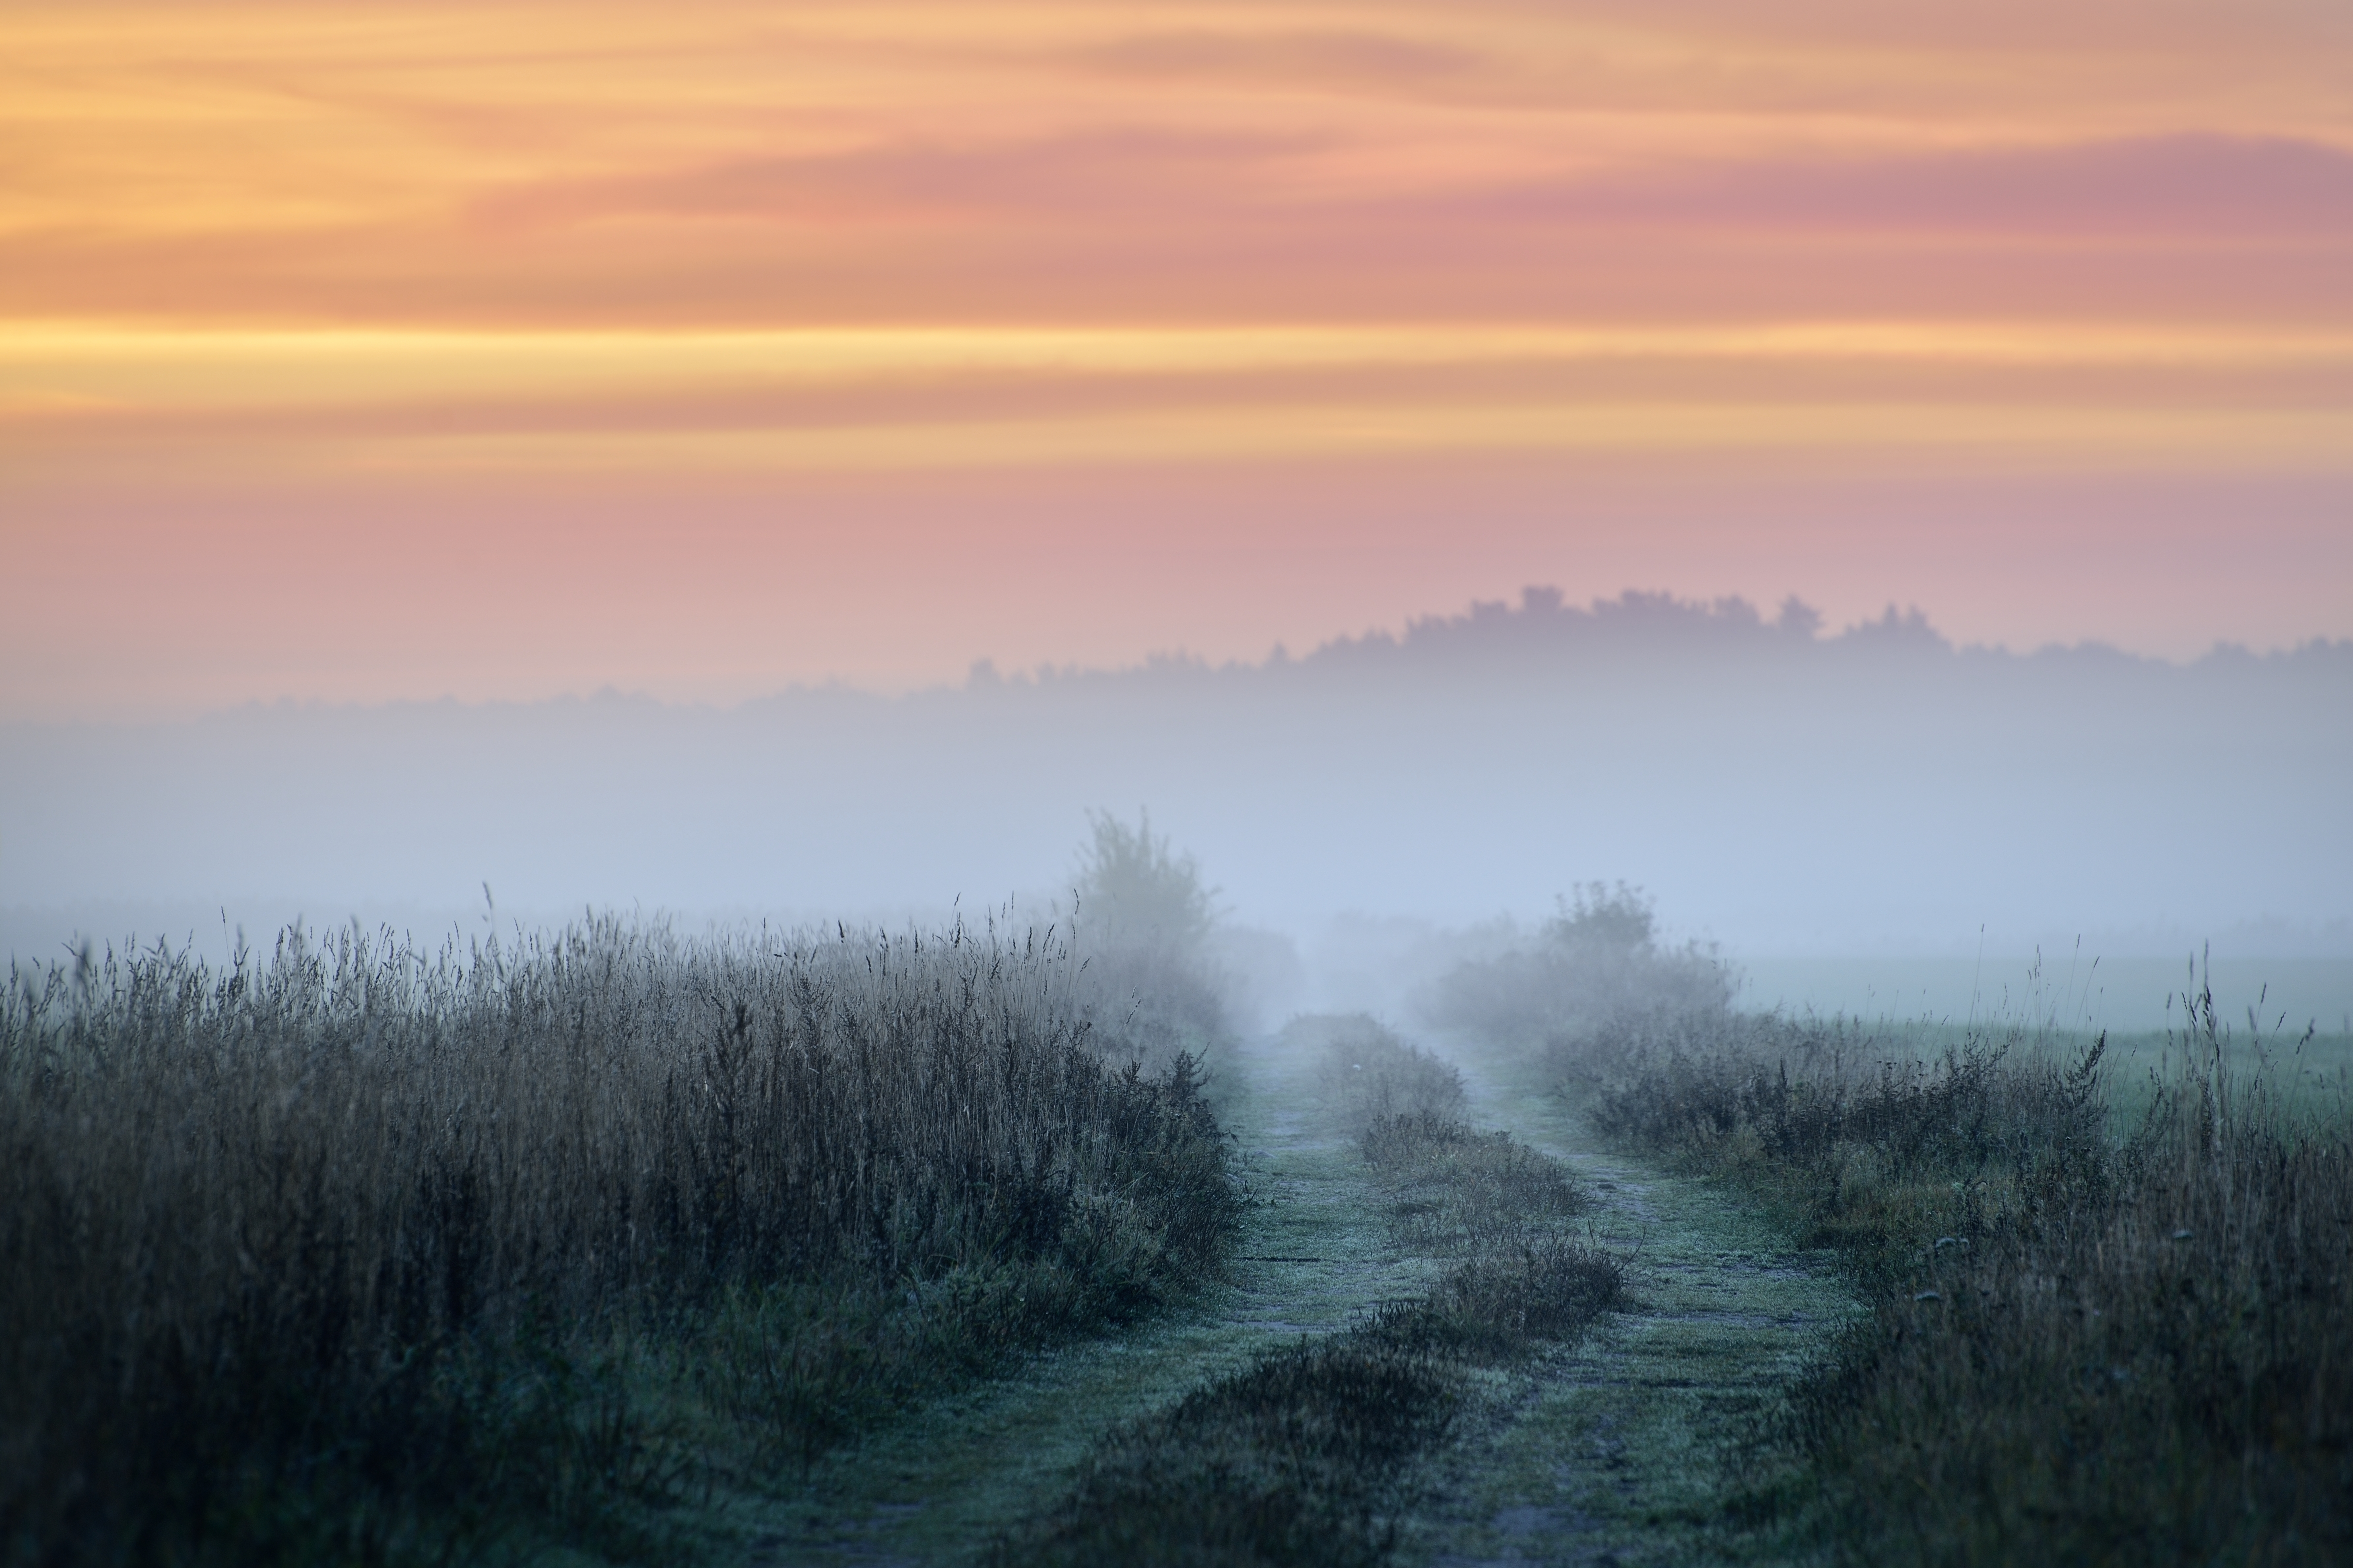
New Mindset
Notes:
Directed toward the future, in highly dynamic environments, requires learning to get “off the main roads.” It is not efficient or predictable, because the path is discerned on the way as well go.

Slide 14

Learning
Knowledge and wisdom are developed as new discoveries are integrated into understandings built on lessons we have already learned.
Notes:
Learning naturally builds on lessons from the past.
Knowledge and wisdom are developed as new discoveries are integrated into understandings built on lessons we have already learned.
For example, learning the alphabet and grammar is foundational for developing vocabulary and the capacity for writing.

Slide 15

Learning
Learning from the future requires suspending judgements, redirection attention, letting go of past knowledge, and leaning into the future.
Notes:
Learning from the future requires “suspending judgements, redirection attention, letting go of past learnings, leaning into the future and letting the future come. (Otto Scharmer, Learning from the Emerging Future, 3) Building on the example of learning language, learning a second language with a different alphabet and/or grammar, requires letting go of past learnings, rules, and assumptions.
Learning in the twenty-first century demands learning not only from the past, but also from the future.? Because today’s environment is less predictable and the problems more complex.

Slide 16
Learning
Examples:
best practices, changing styles of worship, and/or revamping curriculum
Notes:
Learning from the past entails best practices, changing styles of workshop and/ore revamping curriculum.

Slide 17
Learning
Recalibrating learning from the future requires seeing blindspotsband adopting a new operating system.
Notes:
Recalibrating learning from the future requires seeing blindspots and adopting a new operating system, according to Otto Scharmer.
To see our blindspots and adopt a new operating system, we must first look inward and recalibrate our mindset.

Slide 18
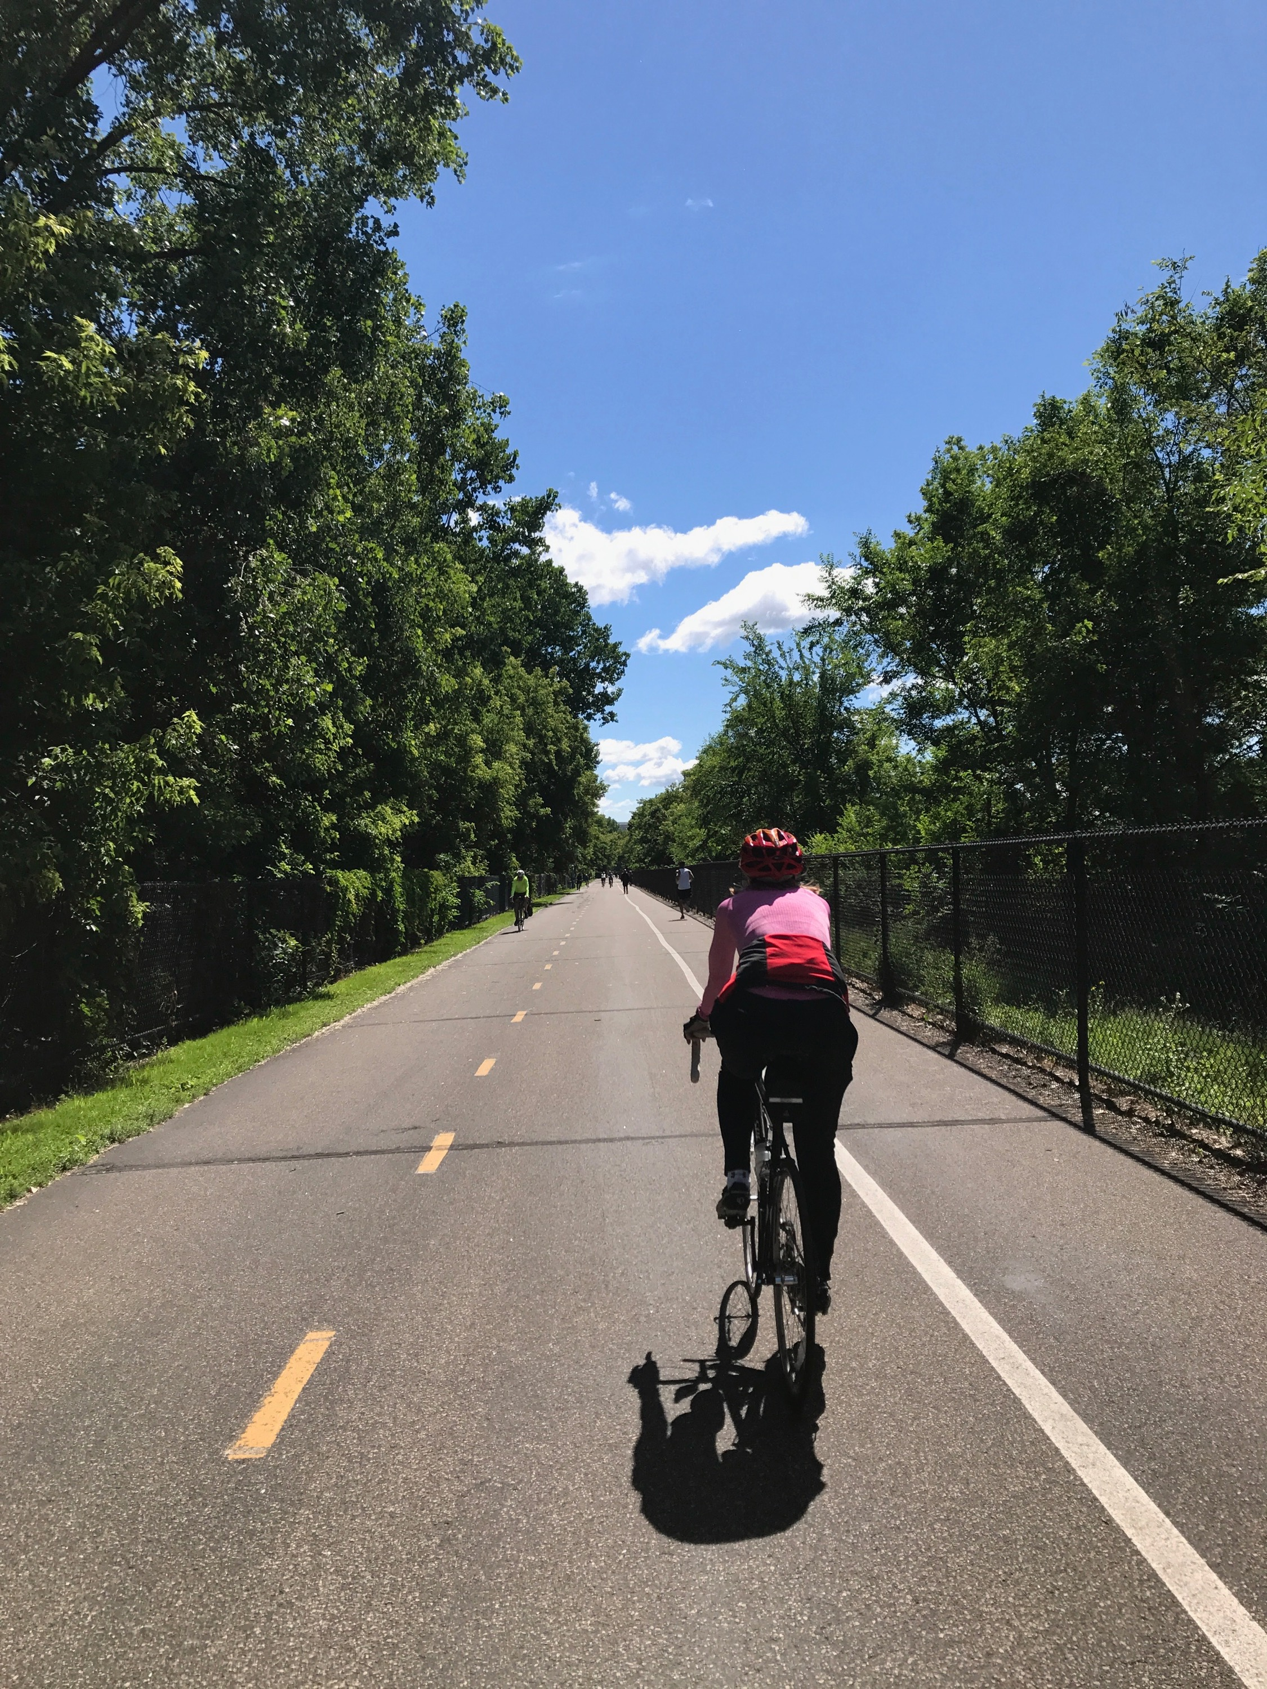
Explorer Mindset
Notes:
The summer I turned 52…

Slide 19

we are people
Faith is a living relationship with God.
Faith is formed as we encounter God, others, and the world.
Ongoing journey - we are always discovering a Christian way of life.
As we discern and join God’s activity in our lives and in the world.
way of life
Notes:
Faith is a living relationship with God. This relationship is formed as we encounter God, others, and the world. It begins at birth and moves us into eternity. Faith is way of life, our pattern of being, doing, and thinking that help us navigate and make meaning of all aspects of life.
Douglas John Hall in Cross in our Context (28) says, The”purpose of faith is to free us for life … and to illumine the meaning that occurs to us.” Faith, like love, give life meaning and purpose.
How do we discover a Christian way of life? As we discern God’s activity and join God in loving the world.
We are becoming people, people who never arrive, but are always embracing God’s love and looking over the horizon to God’s promised future.

Slide 20
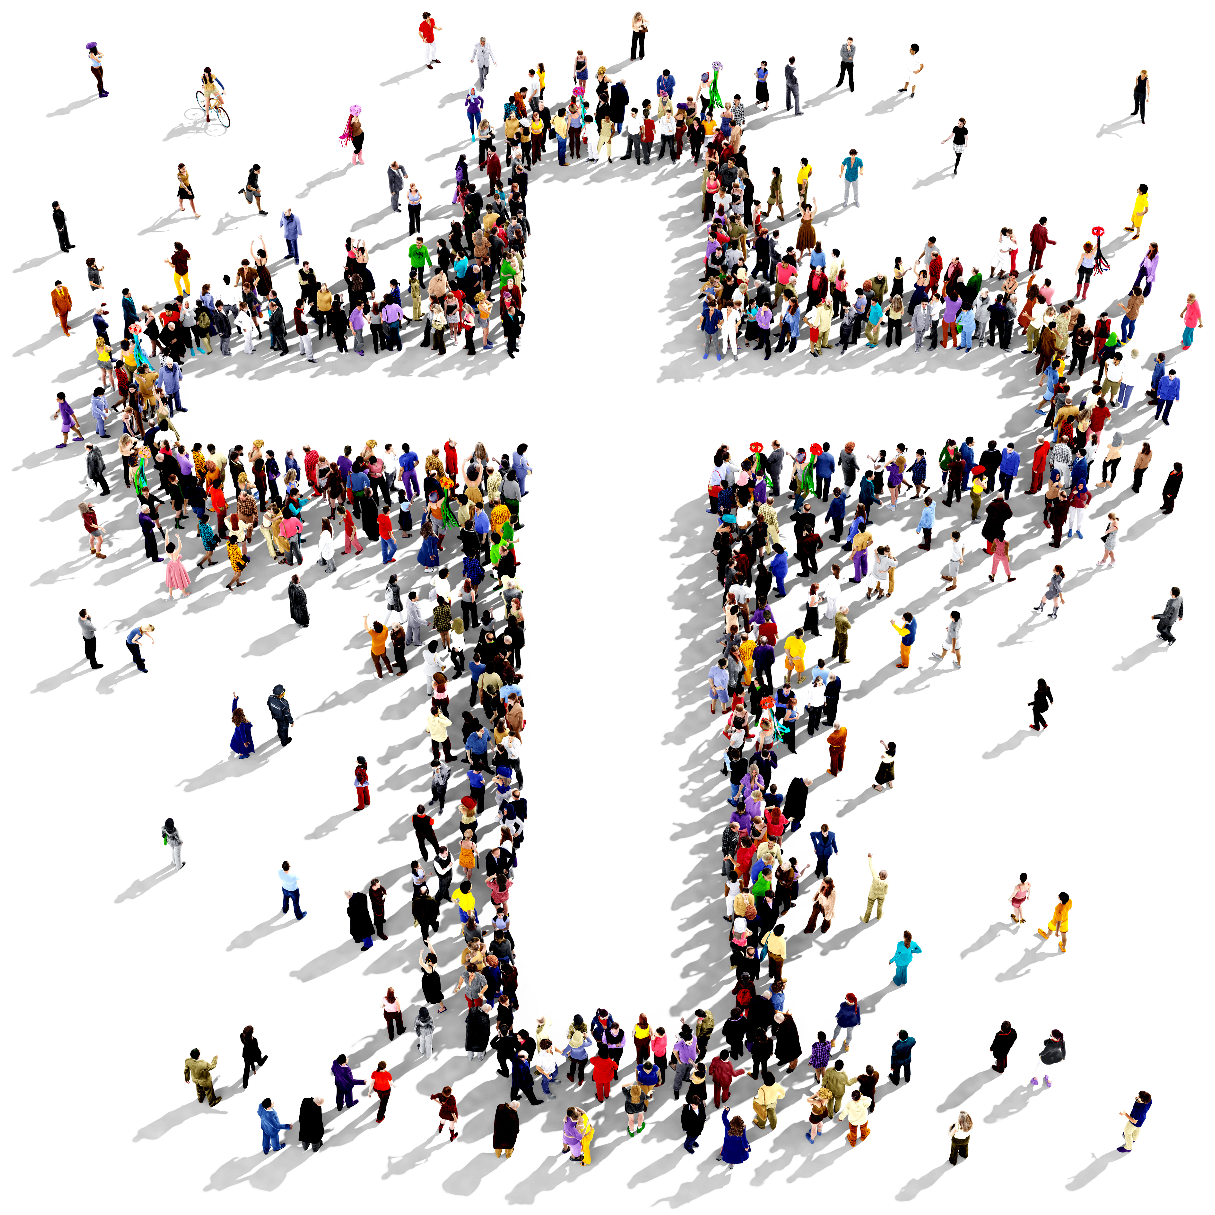
God’s People are in the World and On the Move
Notes:
And we are in the world and on the move.
Gathering people on Sundays or Wednesdays is not point. Loving God and our neighbor is.
And people of faith are scattered in the world - near and far.
Learning from the future requires suspending judgments and letting go of assumptions. Perhaps one of the biggest judgments and assumptions is our fixation with our time gathered.
What would happen if we could lay down our judgments and assumptions about church programs, church vitality, church growth, church budgets, and all the other ways we measure church?
What if we could adopt an explorer mindset and turn our attention toward God’s becoming people commissioned to be co-creators of the future with God who are dispersed in the world?

Slide 21
What if God’s people are dispersed in the world co-creating the future with God?
Notes:
Imagine the stories in the letter you received from the future. Where you surprised at who was leading reconciling efforts with neighbored? Did the lack of attention on worship and preaching startle you? What staff did you imagine leading this community? As you open yourself to the future, are you able to set aside your current models of ministry? Can you lay aside what was meaningful in forming your faith, for the sake of witnessing to future generations?

Slide 22

New Capacities
Notes:
Learning from the future begins with turning inward, recognizing our own blindspots and examining our own assumptions, but it does’t end there. Placing ourselves in liminal space, we are ready to adopt a new operating system that relies on new capacities.

Slide 23
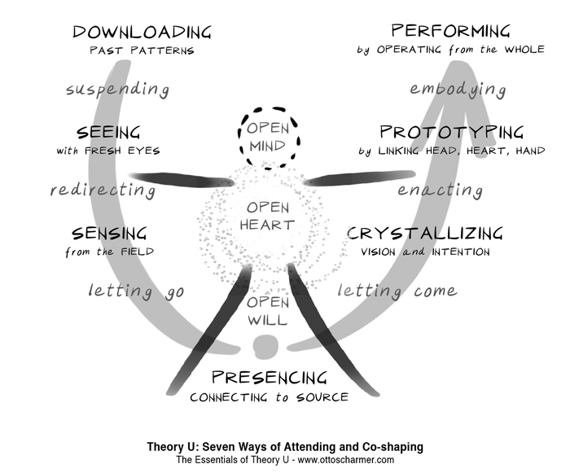
Otto Scharmer, Theory U
Notes:
This is Otto Scharmer’s framework for learning from the future. We have already “downloaded” past patterns - as we pointed our blindspots and let go of assumptions. Now we find ourselves at the bottom of the U - with an open minds, heart, and will. Before we move up the U - taking in new perspectives and information - there is one more recalibration.

Slide 24
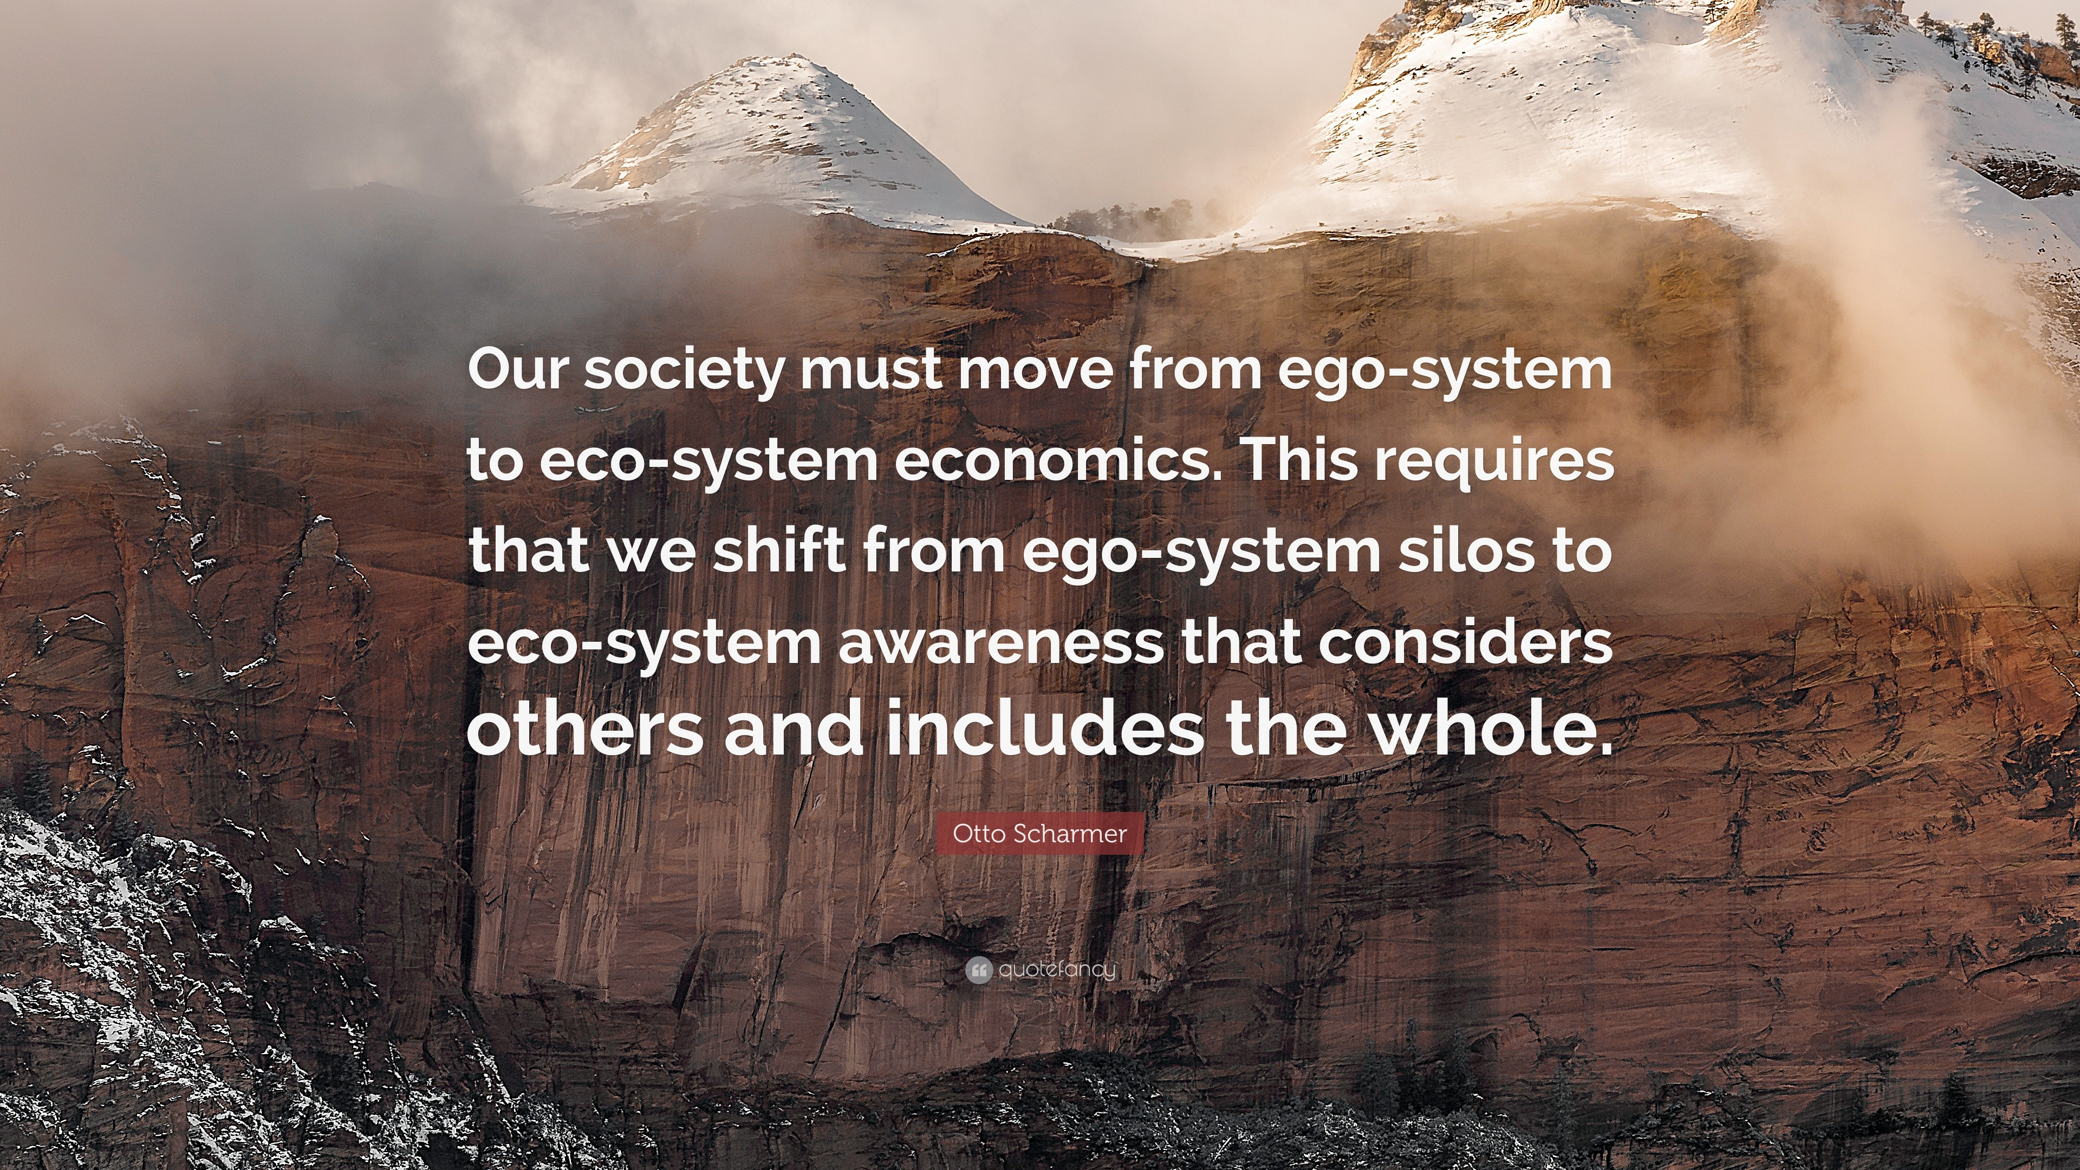
Notes:
Learning from the future requires a new operating system. Scharmer’s scan of our global world even leads him to belief all of us need to “update the mental and structural operating code” by which we live. (Essentials of Theory U. 133) For centuries, the world operating systems, with few exceptions, have been ego-centric, or placing themselves and their interests at the center. For the world to flourish as an interconnected, global community, we need to operate with a eco-centric operating system, one that places the good of all at the center. And he goes even further saying, we are called to co-shape a future where everyone lives abundantly. As a researcher, economist, futurist, and scholar, Scharmer’s conclusion for the future is the same as God’s - abundantly living = co-shaping a future together. The difference is joining our agency with God’s.
Said differently, not only does a life of faith put us into explorer mode, it calls for an eco-centric view of life.

Slide 25
Otto Scharmer, Theory U
Collaborative
efforts
Experimenting
Storytelling
Listening
Notes:
With an eco-centric operating system, new capacities raise to the top.
Listening to others - this practice reengages our heart.
Storytelling - this practice names the complexities of our time within the particulars of lived experiences.
Identifying openings - needs or disharmonies - and experimenting with solutions - this practice is learning with our hands, not our heads.
Collaborating with diverse partners - this practice unites across difference - and makes possible abundant living in new and unique expressions for the thriving of all.

Slide 26
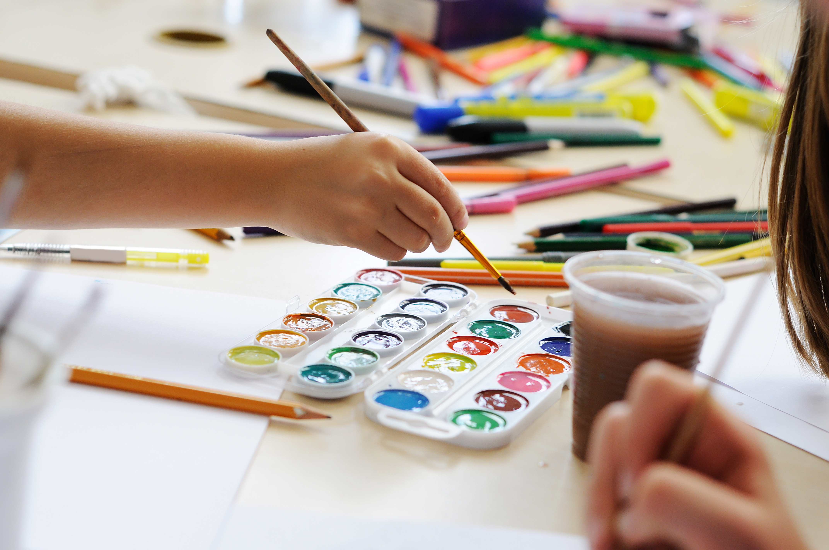
Playgrounds of Possibility
Notes:
Learning from the future requires setting aside our assumptions, seeing beyond current circumstance, opening ourselves to others, and being willing to “learn with our hands”
What are playgrounds of possibility in your ministry setting? Who are people you could listen to? Neighbors you could learn from? Initiatives you could learn from? Leaders who could teach you?

Slide 27
What if the future is already around us?
Notes:
What if the future is already peaking its head out? What if God’s people in your midst are recalibrating their lives around loving God and their neighbor? What if your neighbors have ideas about how God’s church could cultivate abundant life in your neighborhood? What if, in our tiredness, we are overlooking the Spirit’s movement?

Slide 28
Notes:
God has a vision for our life - and our world - it is abundant living for all of creation. To live into this vision the church has to continually recalibrate so it can live its unique call to witness to God’s presence in the world. Recalibrating is tiresome work, but we do not do it alone. God is with us, and God’s people are already on the move. Discovering dynamic stability by setting aside our assumptions, adopting an explorer mindset and learning from the future allow us to work with God in co-creating the future.

