Slide 1
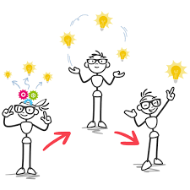

Learning by Doing
6 practices for innovation
Terri Martinson Elton

Slide 2
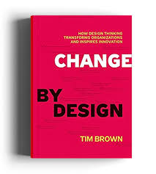
Change by Design
“What we need is an approach to innovation that is powerful, and broadly accessible, that can be integrated into all aspects of business and society, and that individuals and teams can use to generate breakthrough ideas that are implemented and that therefore have an impact.” Change by Design, 3.

Slide 3
Change by Design
Design thinking utilizes the skills designers have used to match human needs with available technology and practical constraints to create a process that all people can learn to address a wide array of complex problems. Change by Design, 4.

Slide 4
Change by Design
“Design thinking taps into capacities we all have but are often overlooked by more conventional problem-solving practices. It is not only human-centered, but deeply human in and of itself. Design thinking relies on our ability to be intuitive, recognize patterns, to construct ideas that have emotional meaning as well as functionality, to express ourselves in media other than words or symbols.” Change by Design, 4.

Slide 5
Innovation is …
Invention that leads to the
Adoption of a new practice by a community that over time creates a
New mindset or way of seeing the world.

Slide 6
6 dimensions of innovation
Learning about the people impacted by the challenge
Defining the Challenging
Imagining Possible Solutions
Testing Solutions with Users
Refining Solutions
Adopting Solution

Slide 7

Learning about the people impacted by the challenge
“Growing good ideas into possibilities is a practice. It is a practice of listening and observing for disharmonies and asking what is possible if the disharmony could be resolved. We call this practice sensing.” (The Innovator’s Way, 111)

Slide 8
Learning about the people impacted by the challenge
“Most successful innovators do not focus on the mind at all. The heart of their skill is their ability to hear what people deeply care about and bring forward ways to take care of those concerns.” (The Innovator’s Way, 112)

Slide 9
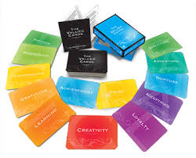
Practice #1
Card Sort
Challenge you are addressing:
  Creating Meaningful Faith Formation
Think about this challenge from your perspective.
Pick your top 3 values regarding the challenge.
  Write down values.
Get into pairs and share why these values are important to you.

Slide 10

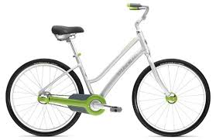
Defining the Challenge
Coasting Bike Story
Change By Design, Chapter 1

Slide 11

Practice #2
5 Whys
Challenge: Creating Meaningful Faith Formation (in your context)
Describe your challenge to a partner in 2 sentences.
  The partner asks, Why?
You share your answer.
  The partner asks, Why? 4 more times.
Now write down your core challenge and why it matters.

Slide 12
Imagining Possible Solutions
“…creative confidence is about believing in your ability to create change in the world around you. It is the conviction that you can achieve what you set out to do. We think this self-assurance, this belief in your creative capacity, its at the heart of innovation. Creative confidence is like a muscle - it can be strengthened and nurture through effort and experience.” (Creative Confidence, 2-3)

Slide 13


Practice #3
Yes…
and
Challenge: Meaningful Faith Formation
Constraints: congregation with solo pastor and 1/2 program staff, $1,000 budget, and worships 200 people.
Get four people into a circle. As a group you are going to come up an idea for creating meaningful faith formation in this congregation. Using the improv technique of yes and, the first person will a sentence or phrase response…(say, offer a class), the next person adds (and it meets online), then the next person adds (and the instructor is from another congregation), then the next person adds (and people join from all across the country)…until you have taken that idea as far as you can. Then have another person start a thread and repeat the exercise.

Slide 14
Prototypes
Three objectives:
building to think
earning faster by failing early
giving permission to explore new behaviors.
Prototypes are learning tools.
Because human behavior is tied to contexts,
and setting ideas in contexts which they may be played out
early in development advances the design process.

Slide 15
Prototypes
start rough
speed up learning
reduce the cost of failure
avoid emotional attachment
Seek to answer 1 or 2 questions at a time.

Slide 16

Practice #4
Challenge: Meaningful Faith Formation
From the Yes…and exercise pick one of your ideas and have the group act of the scenario. Decide your roles and then “act out” the scenario fo 5 minutes.
http://www.designkit.org/methods/36
Role Playing

Slide 17
Testing Solutions with Users
Prototypes needs to be tangible and provide the opportunity for feedback.
“a successful prototype is not one that works flawlessly; it is one that teaches us something.” (Change by Design, 105)

Slide 18
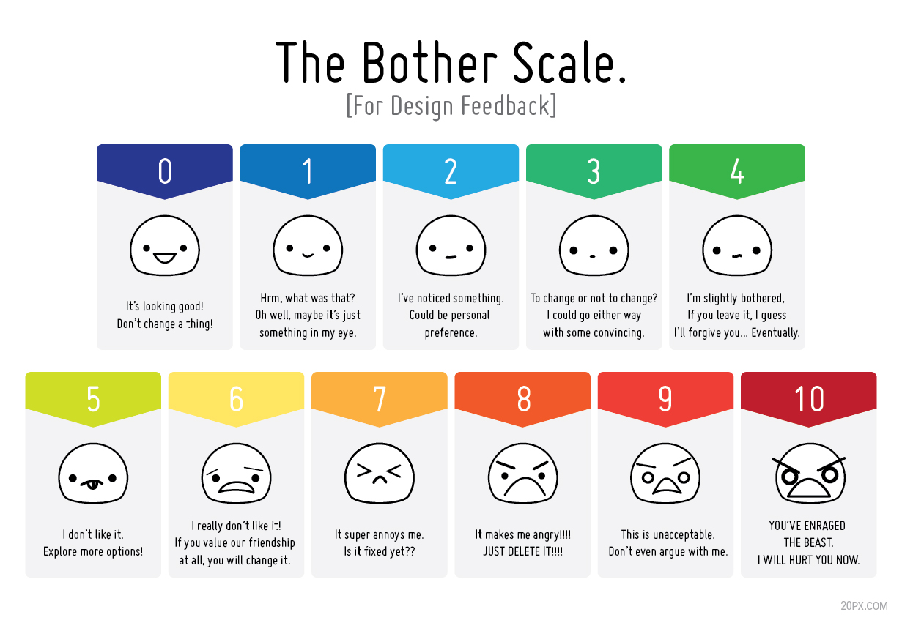
Practice #5
Feedback

Slide 19
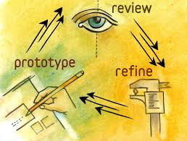
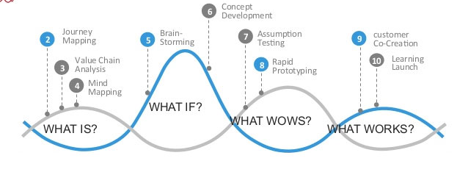
Refining Solutions

Slide 20
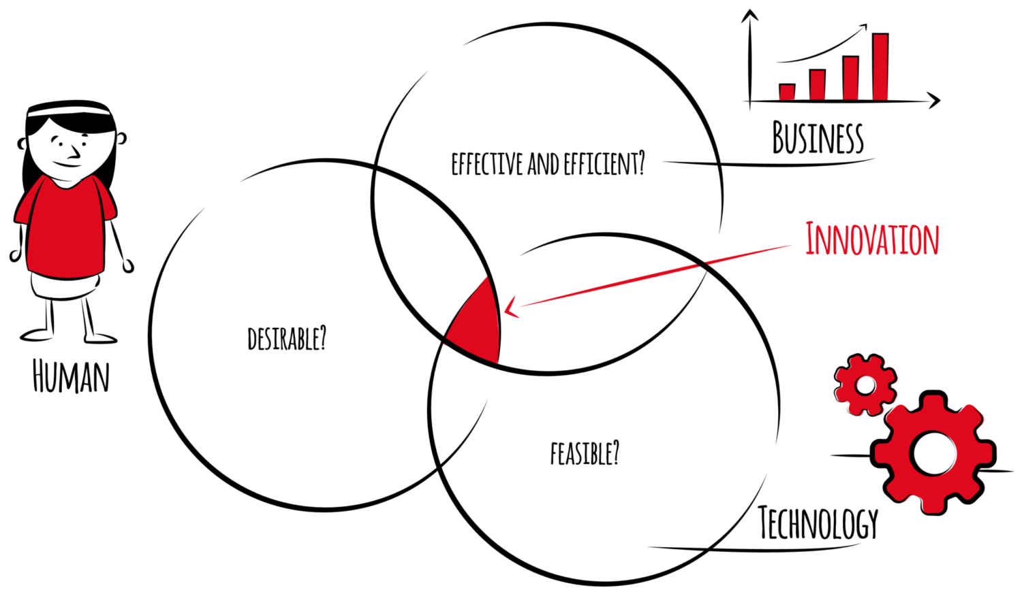
Practice #6
Refine
framework for evaluating

Slide 21
Adopting Solution
“If a man is offered a fact that goes against his instincts he will scrutinize it closely, and unless the evidence is overwhelming, he will refuse to believe it.
If, on the other hand, he is offered something that affords a reason for acting in accordance with his instincts, he will accept it even on the slightest evidence.”
Quote by Bertrand Russell
(Dunning and Dunham, The Innovator’s Way, 174)

Slide 22
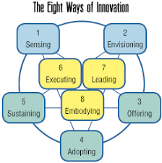
Adopt
“Our proposed innovation begins its journey from an idea to an adopted practice when we make an offer to being it into the world.”
Dunning and Dunham, The Innovator’s Way, 174

Slide 23
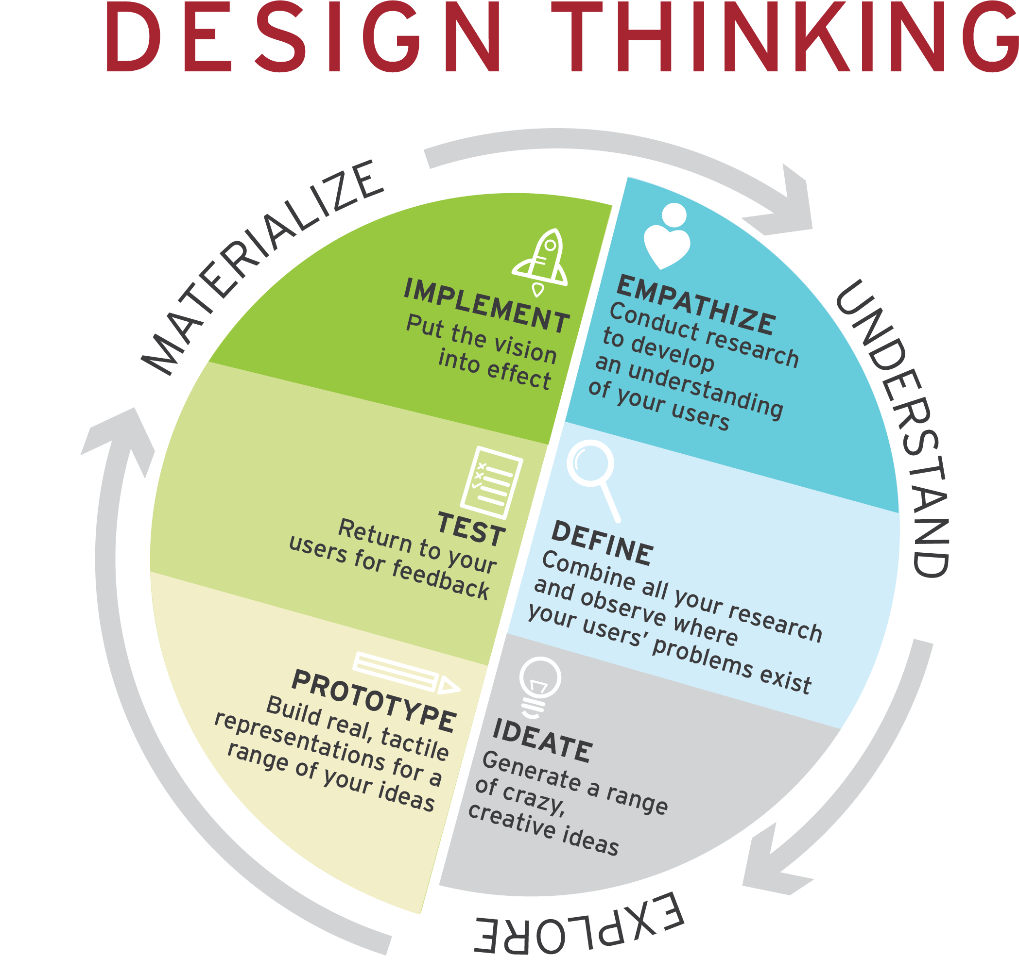

Slide 24

Why learning by doing works?
Communal leadership and process
Users are central and involved through the process
Idea creation is accountable to user and the challenge trying to be solved
Multiple perspectives/skills required - language, motor skills, imagination, feedback, collective problem-solving
Process clarifies the why or importance of addressing the issue.

Slide 25
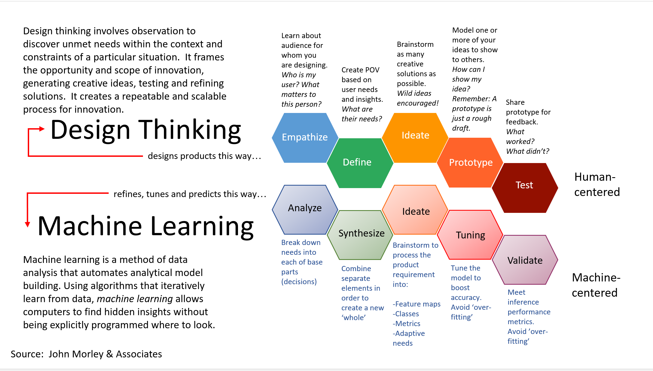

Slide 26
Resources
Change by Design, Tim Brown
The Innovator’s Way, Dunning and Dunham
The Field Guide to Human-Centered Design by IDEO (book of ideas)
Method Cards - https://www.ideo.com/post/method-cards
Activities - https://www.ideo.org/approach

