Slide 1

Confirmation’s
Renewed Place
in Forming Faith
Terri Martinson Elton, PhD
terrielton.com/presentations

Slide 2

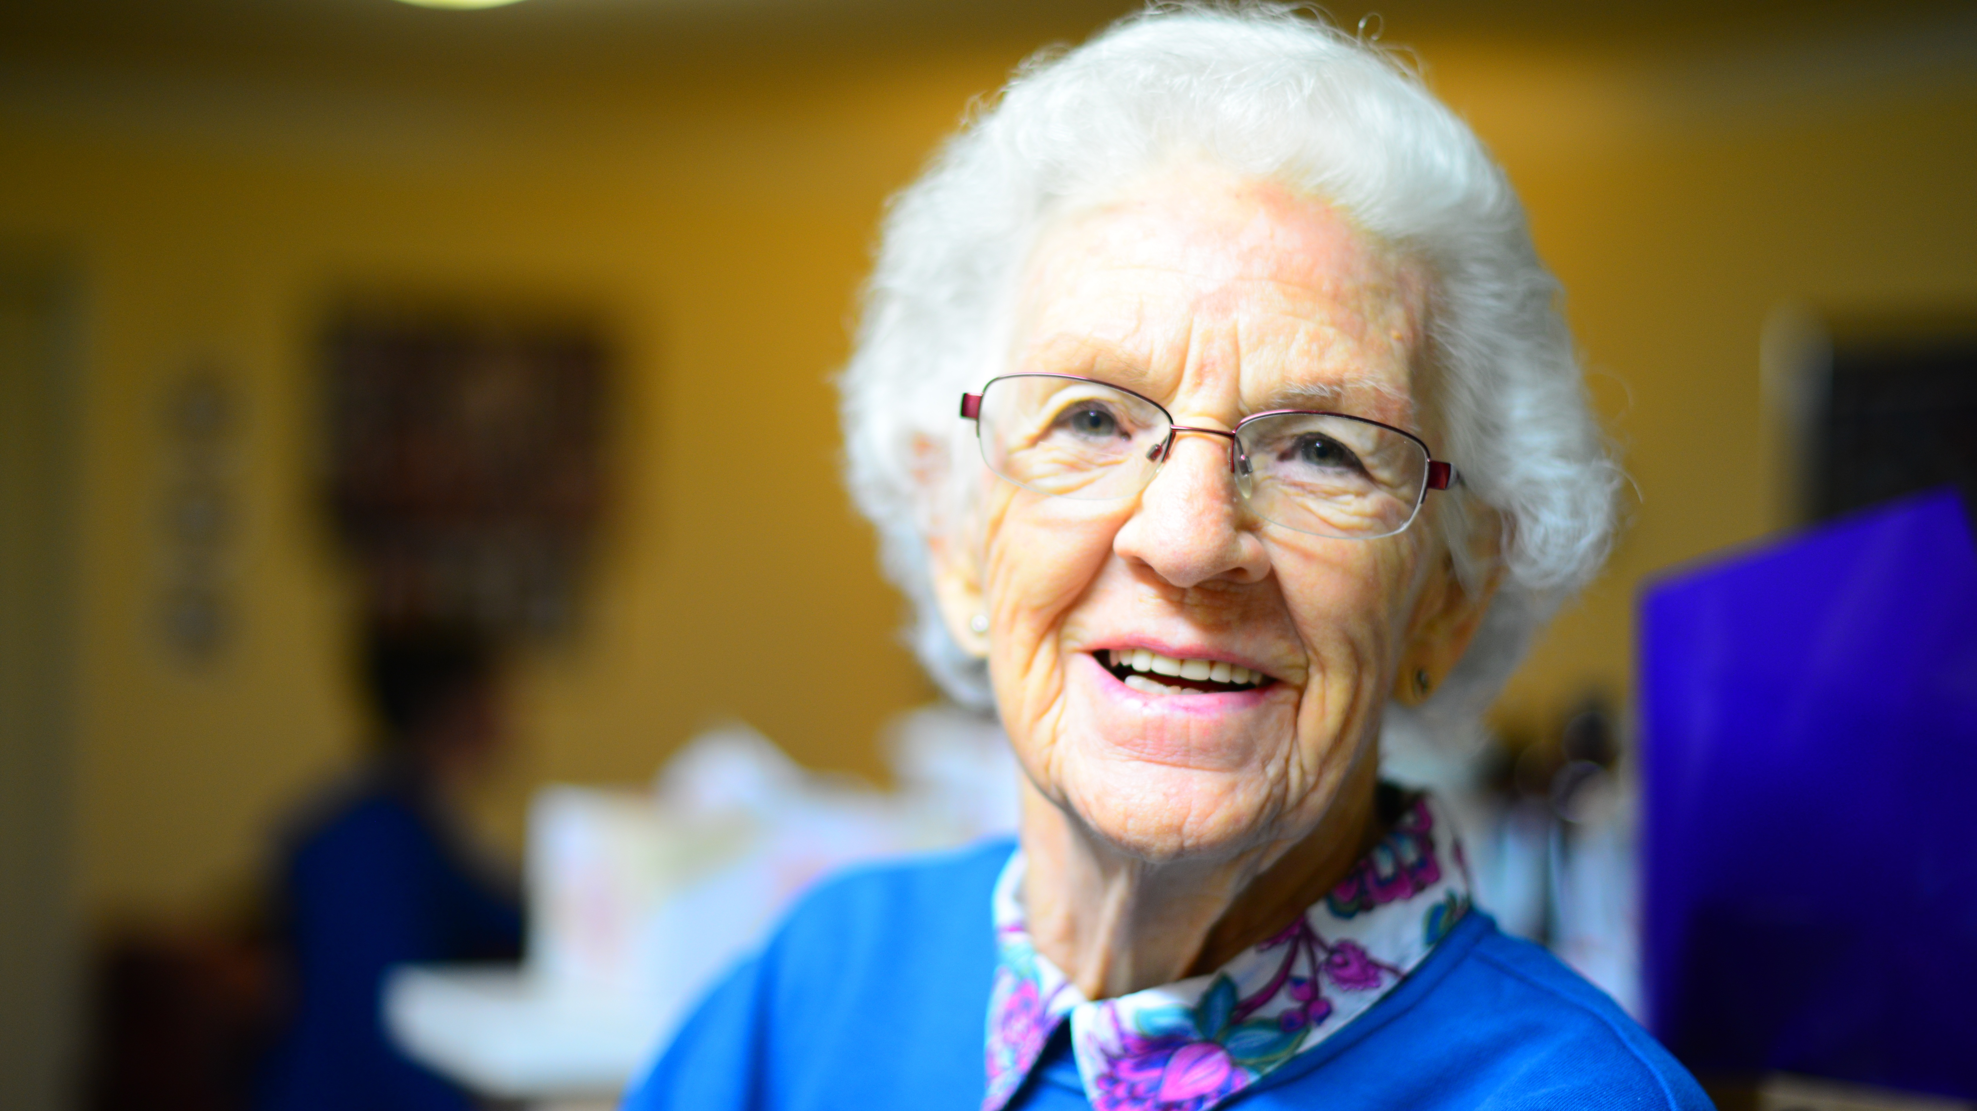
A Story
Pat and Naomi

Slide 3


Vibrant confirmation ministry flows from
encountering the gospel anew,
personally and communally.
This simple claim is also profound.

Slide 4

Why?
People, raised and not raised in the Christian faith,
are hunger to discover the good news the gospel.
(People are not longing for learning doctrine
or membership in the institutional church.)

Slide 5
Why?
Shift from confirmation
focusing primarily on teaching the beliefs of the church to
confirmation as a life changing encounter with God.

Slide 6
Why?
Confirmation as a two-fold ministry:
about maturing the faith of young people and about congregations living out their call to share the gospel.

Slide 7
Why?
As congregations participate in confirmation,
they bear witness to the reconciling and redemptive
love of God and the covenant of grace
into which all Christians are baptized.
When they do lives are changed.

Slide 8

Five Denominations:
African Methodist Episcopal, United Methodist Church, Evangelical Lutheran Church in America, Presbyterian Church (USA), and Episcopal Church.

Slide 9


Research Question
What is the state of confirmation and equivalent practices within five denominations that practice infant baptism?
How does confirmation and equivalent practices contribute to youth discipleship?

Slide 10

7 Patterns

Slide 11

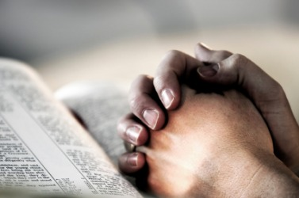

purpose
1. There is a high degree of agreement among leaders, youth, and parents that the purpose of confirmation and equivalent ministries is to strengthen young people’s faith.

Slide 12
Understanding of Confirmation
Goal:
Maturing in faith is the most commonly expressed goal of confirmation.
Maturing in faith = a faith that connects knowledge, belief, and action into a confirmand’s identity

Slide 13
Understanding of Confirmation
Process:
Starting with at least some familiarity with the Christian story, Christian practices, and the church’s theology,
this maturation happened as young people engaged in learning activities within a community of faith and
concluded with young people making a personal commitment while participating in a public rite.

Slide 14
Understanding of Confirmation
Tasks:
        Appropriate time to ask questions about faith.
        Strengthen personal faith.
        Learn more about God and faith.
        Develop a personal view of faith.

Slide 15

“Confirmation ministry encourages and cultivates growth and is a source of life for youth and adults. It not only teaches the content of faith, but ‘incarnates and integrates’ faith in ‘lived experience.’ It takes risks and creates a community where hard questions and dealing with day-to-day and messy aspects of faith and life are possible…It is a ministry where young people are not separated, but integrated into the life and mission of the whole congregations and serve the surrounding … community and beyond. It integrates the confirmand into a God story, a practicing faith community and lifestyle of vocation that can unfold across a lifetime.”
Quote from person in an ELCA congregation in the study

Slide 16
Understanding of Confirmation
Definition:
Confirmation is an important opportunity for young people to encounter the gospel anew in ways that
strengthen their understanding of the faith,
deepen their experience of the Christian community, and
equip them to discern their calling to join in God’s mission to the world.
As congregations participate in confirmation ministry they bear witness to the redemptive love of God and the covenant of grace into which all Christians are baptized.
Notes:
Some described the process and culminating rite as the moment where confirmands commit to be a lifelong follower of Jesus, for other it was the time when they became an adult member of a congregation, and for others it related to their ability to articulate the beliefs of the church.

Slide 17

Understanding of Confirmation
ELCA:
“Confirmation ministry is a pastoral and educational ministry of the church that helps the baptized through Word and Sacrament to identify more deeply with the Christian community and participate more fully in its mission.”
The Confirmation Ministry Task Force Report – adopted by the third biennial Churchwide Assembly of the ELCA on September 1, 1993.
Notes:
Some described the process and culminating rite as the moment where confirmands commit to be a lifelong follower of Jesus, for other it was the time when they became an adult member of a congregation, and for others it related to their ability to articulate the beliefs of the church.

Slide 18

Reflections
How can this understanding guide us (congregations and ELCA) into the future?
What opportunities does it provide?
Notes:
Some described the process and culminating rite as the moment where confirmands commit to be a lifelong follower of Jesus, for other it was the time when they became an adult member of a congregation, and for others it related to their ability to articulate the beliefs of the church.

Slide 19
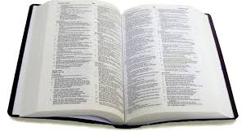
content
2. Parents, youth, and leaders expect confirmation to focus on the traditional contents of the Christian tradition but to do so in ways that are engaging and participatory.
3. Confirmation and equivalent discipleship ministries are typically located at the end of childhood and the beginning of adolescence.
  82% of all confirmation programs begin between the age of 11 and 13.
age

Slide 20
content
Rating the importance of twenty-five different topics,
Six surfaced in the top ten in all three groups:
  death and resurrection, the Bible, God (Father, Son, and Holy Spirit), Lord’s Prayer, Apostle’s Creed, and Experiences with God.
Four topics surfaced in two of the three groups:
  Lord’s Support, Baptism, 10 Commandments, and worship services.
A few surfaced only for one of the groups:
  for leaders - justice for others
  for youth - meaning of life, history of tradition, and miracles.
Four surfaced at the bottom in all three groups:
  abortion, gay marriage, church governance, and drug abuse.

Slide 21

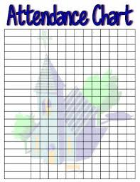


pedagogy
4. While confirmation still operates within a classroom paradigm, many programs include other activities that are significant to faith formation.
      95% require class attendance
      96% small group discussion

Slide 22
requirements and pedagogy
3 practices in 60% or more of congregations:
  Sunday worship attendance (77% required, 22% optional),
  homework (65% required, 24% optional), and
  writing a faith statement (59% required, 18% optional).
3 practices in about 33% of congregations:
  Mission trip/service project (40% required, 38% optional),
  retreat (34% required, 23% optional), and
  presenting faith statement (32% required, 16% optional)
2 significant yet less required practices are
  classes for parents of confirmands (17% required, 27% optional) and
  camp (8% required, 18% optional).

Slide 23
Typical ELCA Program
Age - Begins at age 12 (50%) and confirmed at 14-15 (77%)
Culminates in a public rite of confirmation
Lasts 2 years (25% last 3+ years)
Median class is 10 students (25% have less than 4)
Average ratio of adult to students = 3.86

Slide 24
# Students in ELCA Programs

Slide 25
Typical ELCA Program
Includes multiple methods of instruction
        Group Discussion = 96%
        Games = 70%
        Catechism = 76%
        Camp/retreat/service = 57%
          camp and/or retreat = 43%
          service project/trip = 33%
Center of program is regular class attendance
Worship attendance required (84%)

Slide 26

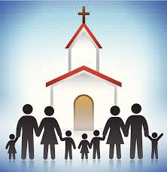
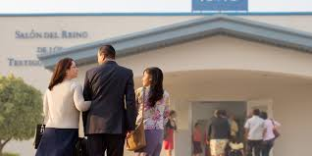
leadership
5. The creativity and passion of congregations and leaders is critical.

Slide 27
Clergy involved in nearly all. (97%)
Clergy only = 27%, Clergy + 2-3 adults = 25%, Parents leading = 54%.
Training = 75%
        Clergy are leading, but most are not doing it alone!

Slide 28
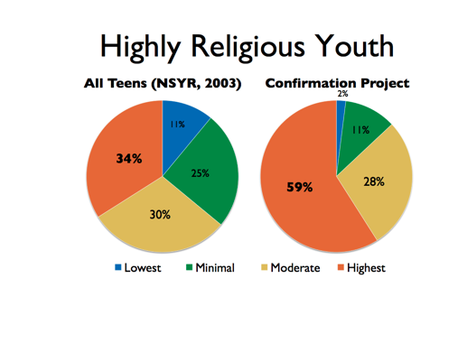
not evangelistic
6. Most young people in confirmation and related discipleship ministries are already involved in their congregations.

Slide 29

7. Family members’ attitudes toward the Christian faith are a major factor in young people’s experience of confirmation.
no other factor came close to faith in the home in terms of impact on belief, religious practices, and congregational connection.
family

Slide 30
5 Characteristics
of Vibrant Confirmation

Slide 31
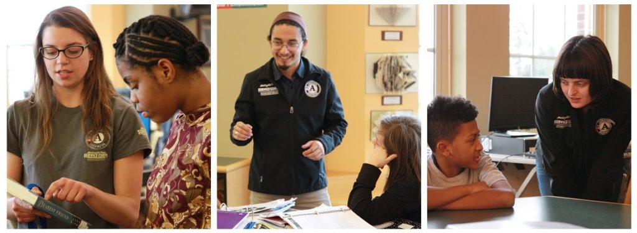
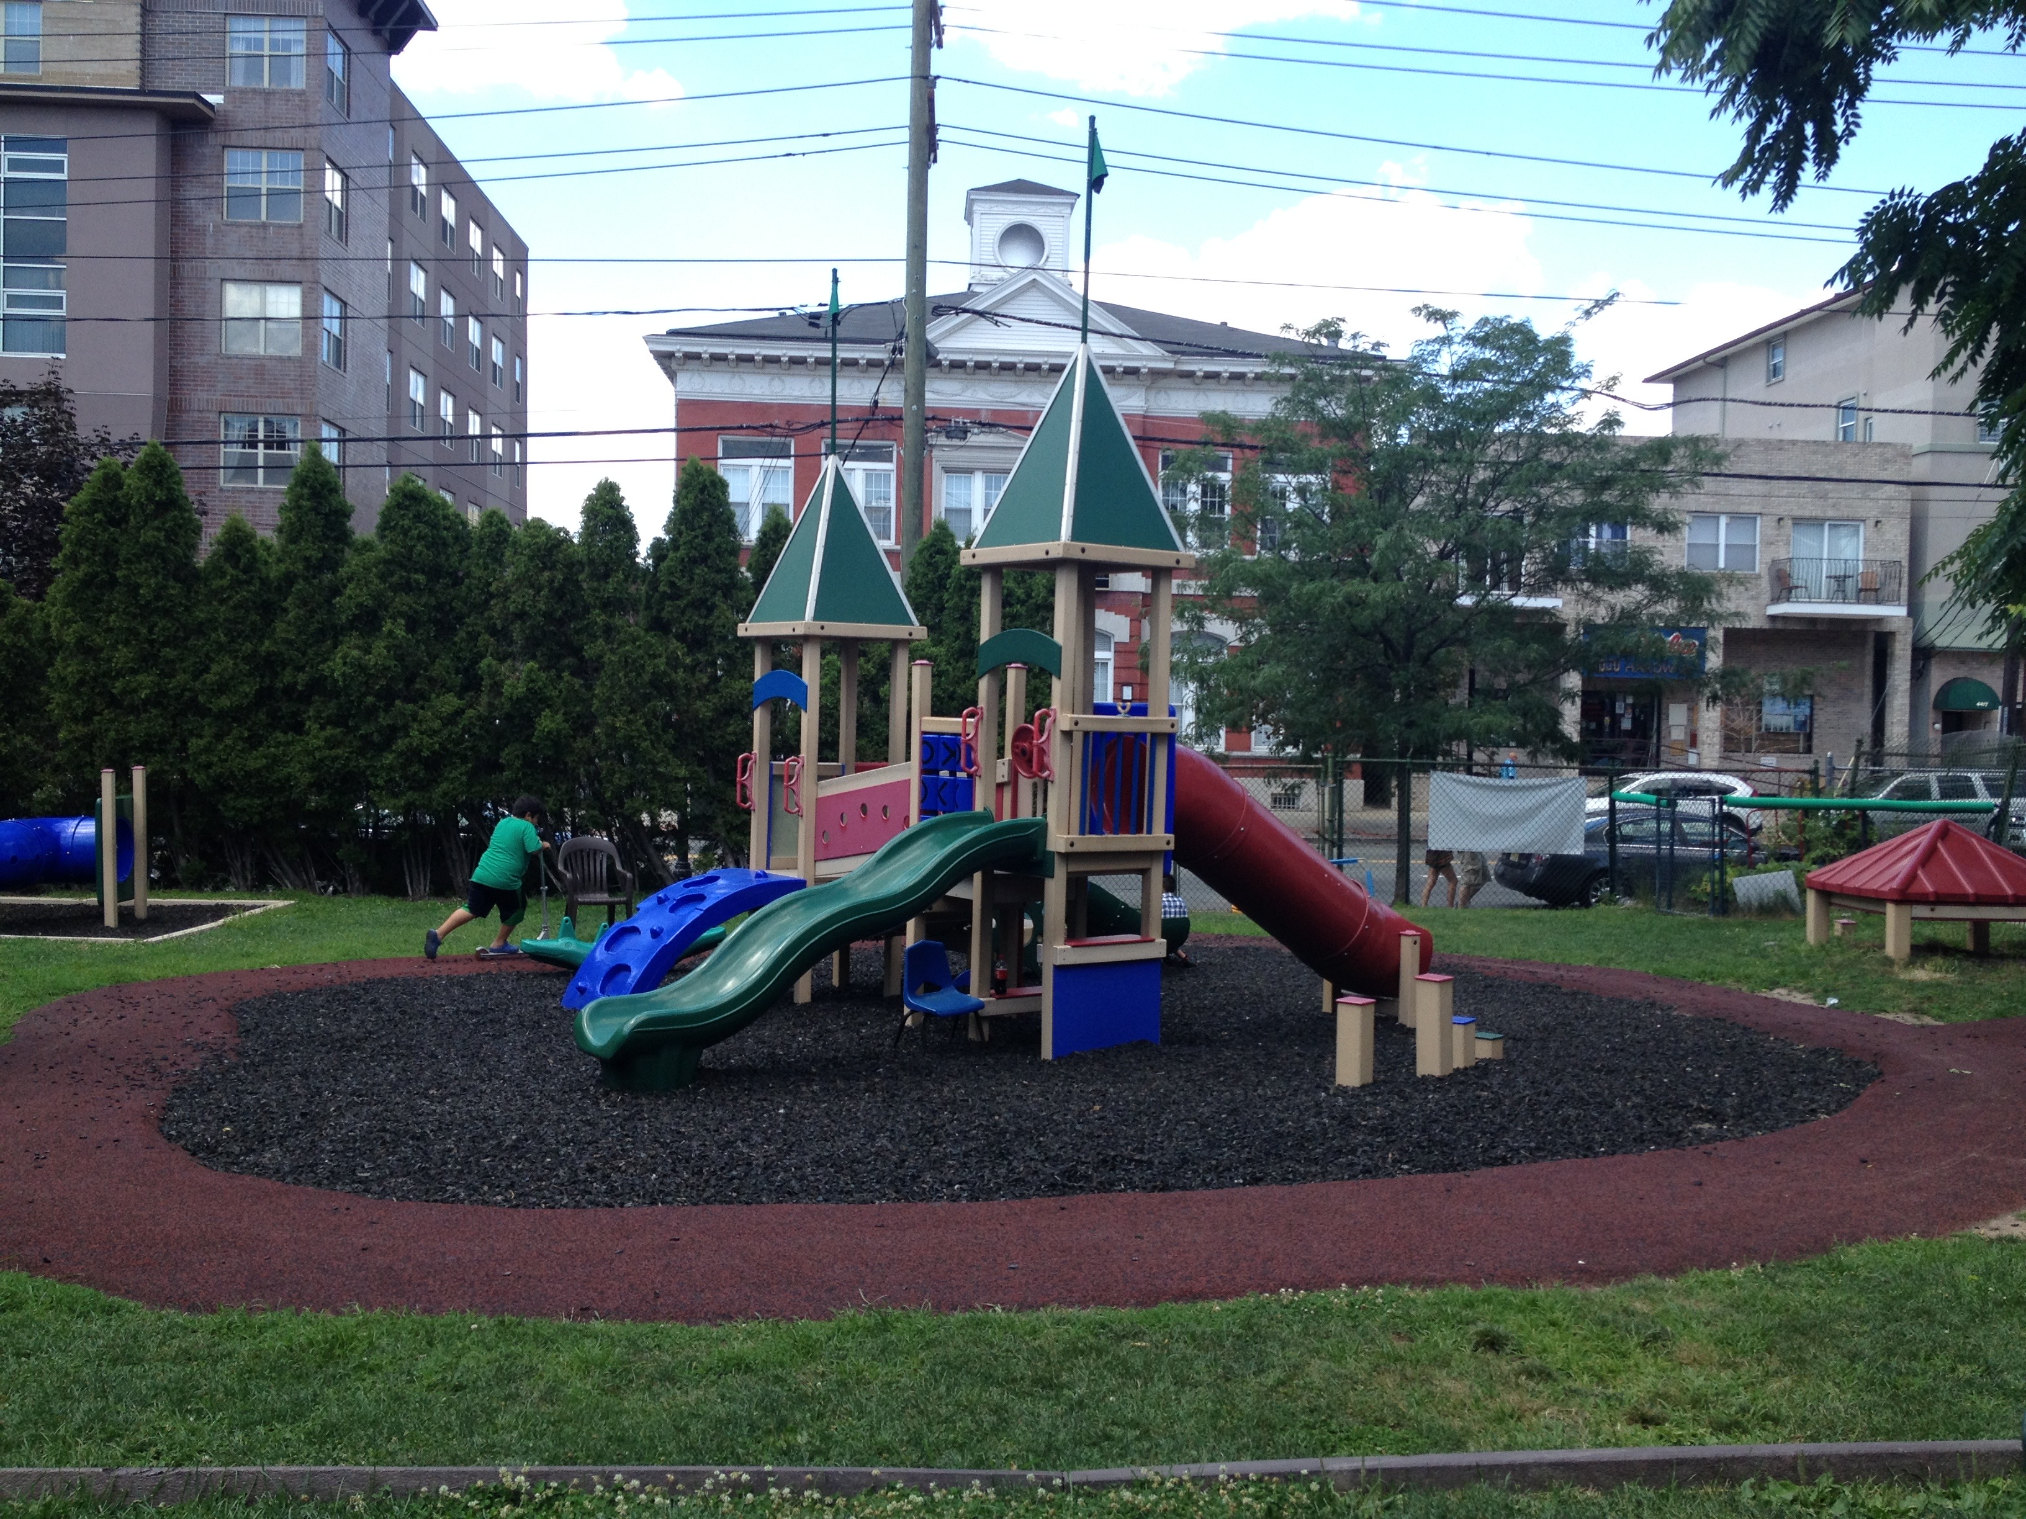
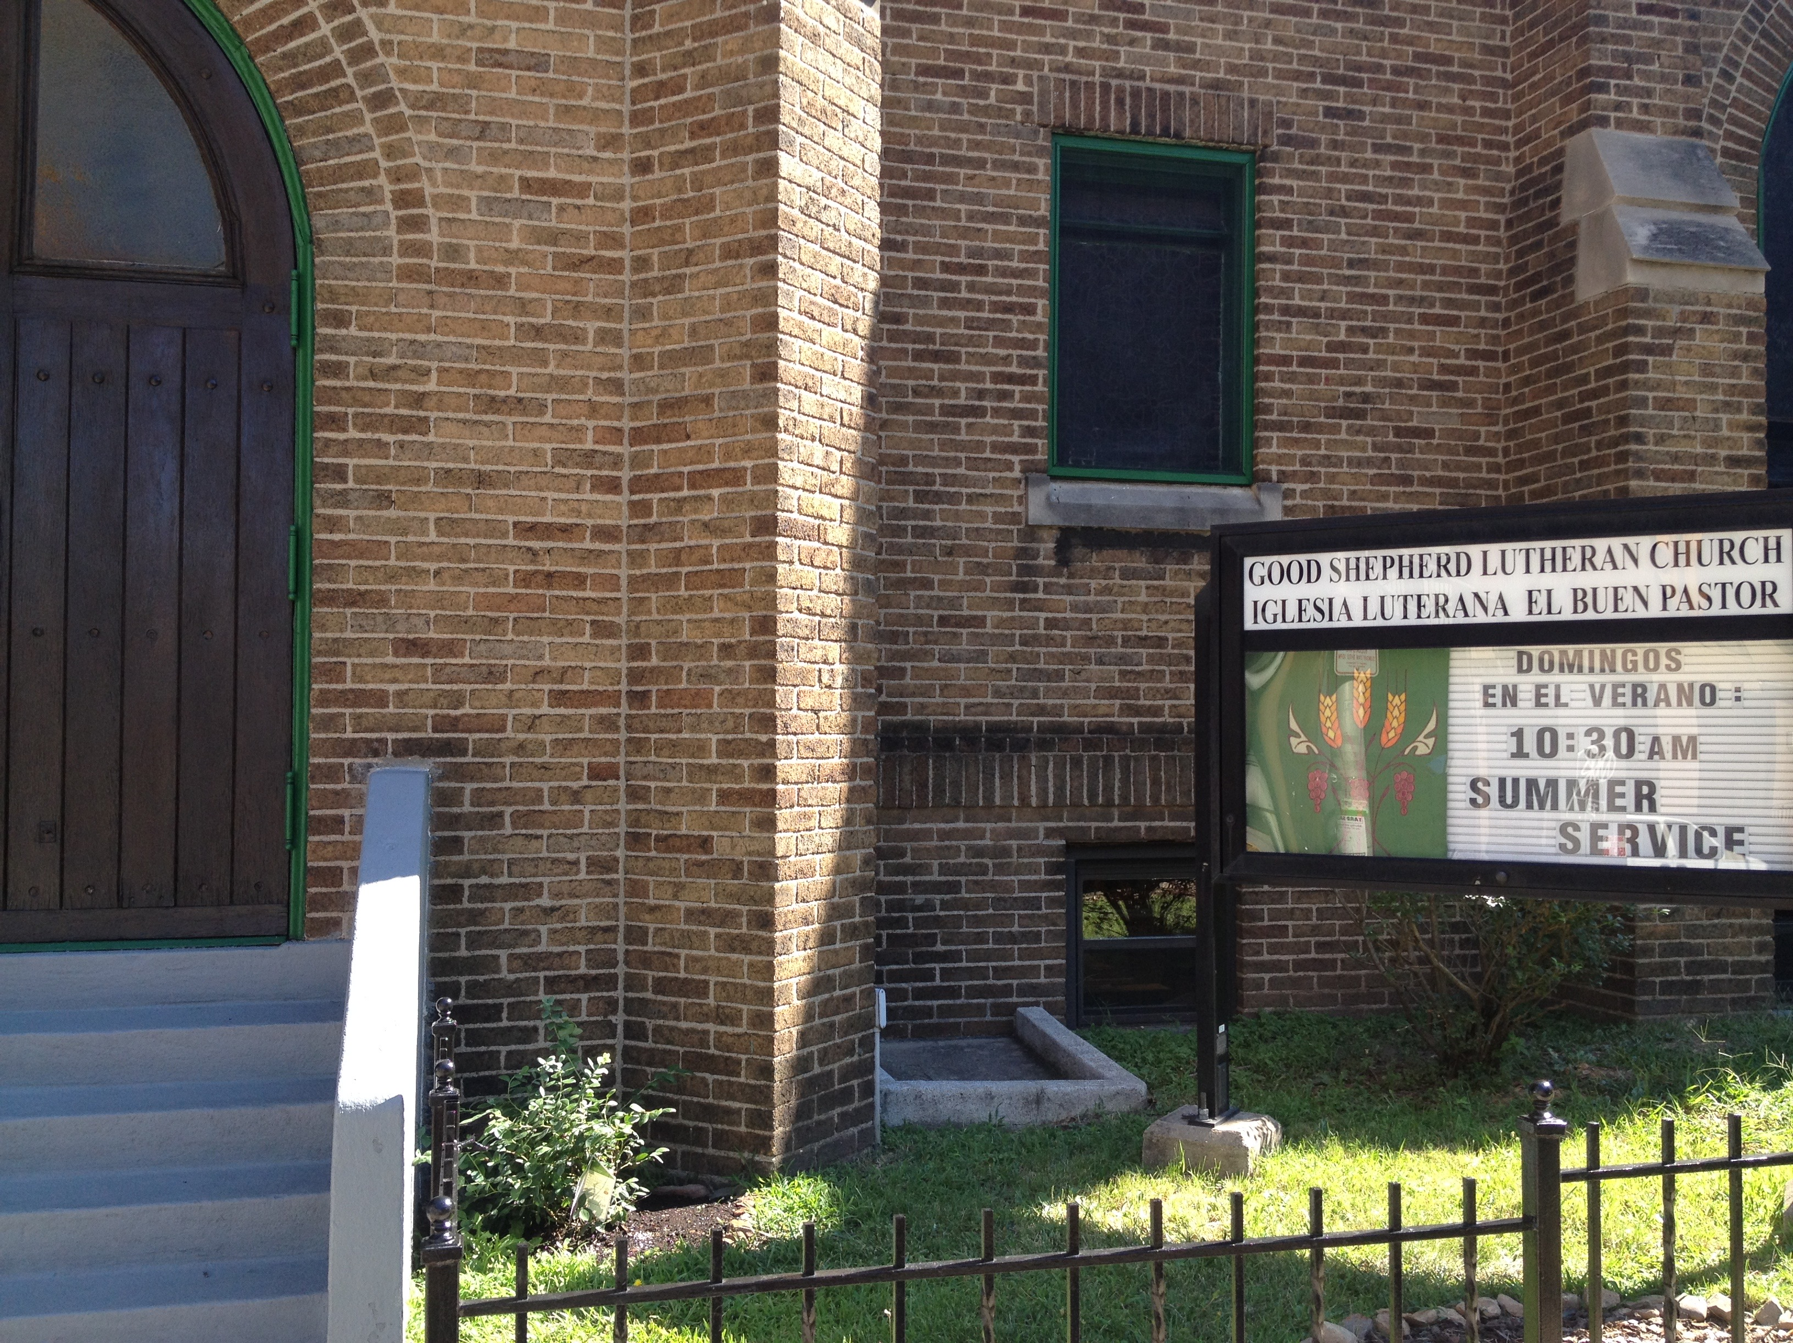
design
  1. Custom-designed and contextually adapted communities of learning
  By listening, willing to adapt, and constantly evaluating.

Slide 32
design
“The confirmation program … only lasts four to six weeks. But it manages to engage thirteen year olds in serious reflection on their faith in dialogue with a Presbyterian catechism, explore questions about God’s judgment, the atonement, and the salvation of Jewish, Muslim, and Hindu friends. This is serious stuff for early adolescents. It reminds us that young people can think seriously about their faith when they are taken seriously themselves and challenged by good teaching in a loving, supportive environment.” (Presbyterian congregation)
“The confirmation relationships, materials and activities have as a core focus: Scripture, the Creed, the Wesleyan Tradition and developing one’s own faith expressions, practices, and vocation … all this is consistently brought into dialog with life together as God’s people and daily life with neighbors in the world.” (UMC congregation)

Slide 33

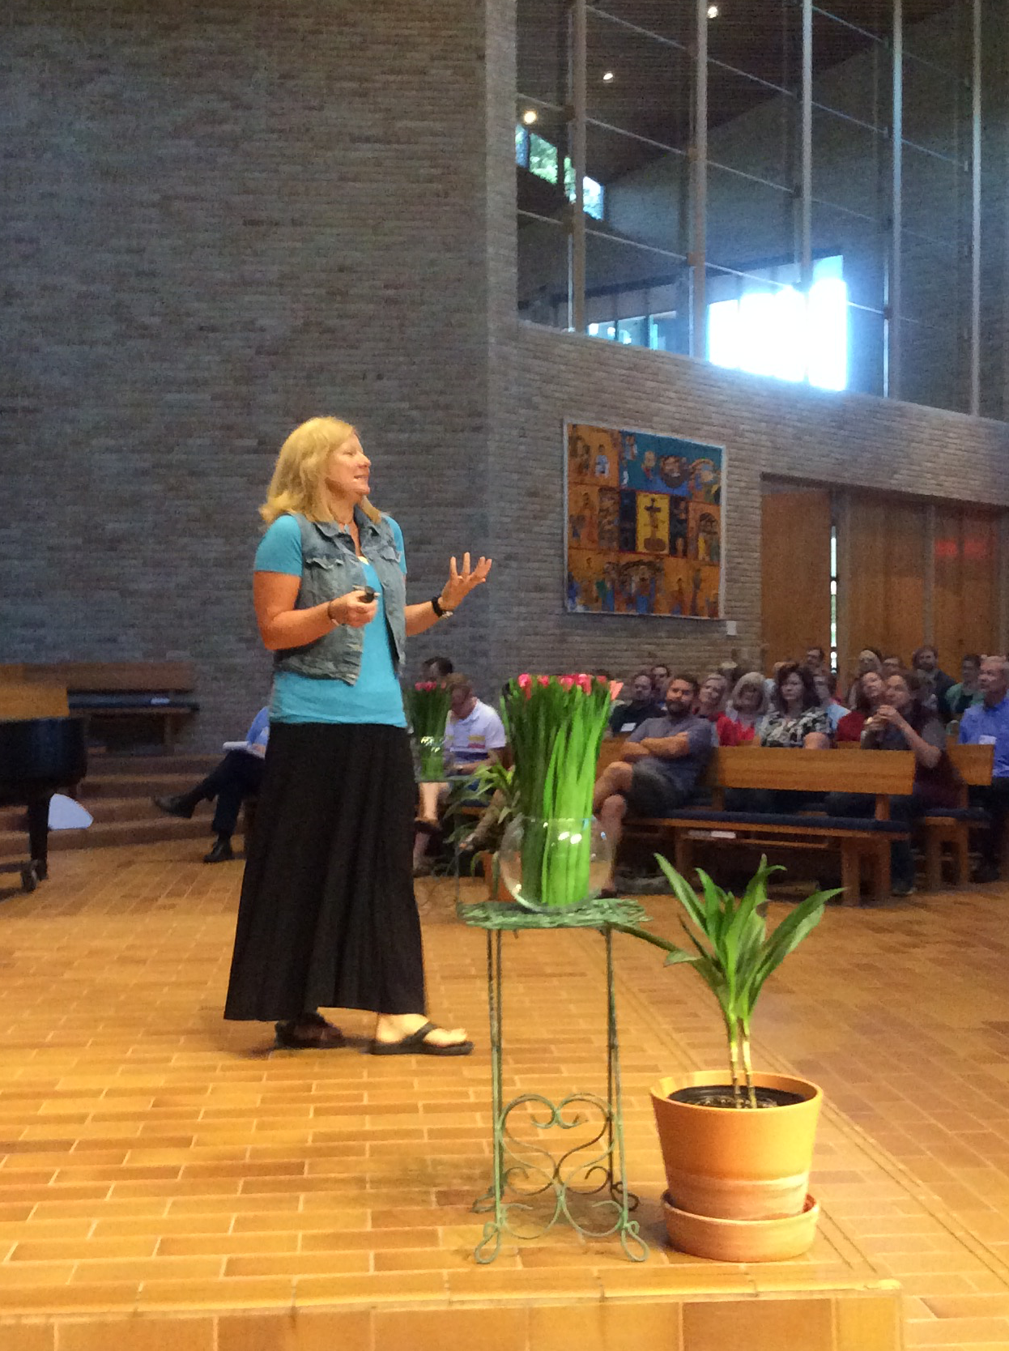
leadership
2. Faithful, committed, and shared
  Champion…and a team!
  12 characteristics:
  Self-awareness and self-self-definition
  Curiosity and openness
  Objectivity and self-critical reflection
  Interest in the particular while also seeing the big picture
  Active listening
  Evocative questioning
  Keen sense of observation
  Active engagement and willingness to risk
  Recognition of the power of shared interpretation
  Expectation of discovering God present and active in the world
  Ability to integrate belief and experience into strategic panning and action
  Humility and a sense of humor

Slide 34
leadership
One bishop told his staff, “it was time to re-imagine the practice of diocesan confirmation services (for all ages) and challenged his team to develop confirmation liturgies (and other rites of re-affirmation) to provide a rich context for candidates to make a mature public affirmation of faith while also experiencing authentic spiritual transformation in the midst of the celebration itself.” (Episcopal Church)
“here is an expectation that, while it is the youth’s demonstrated commitment to the process that ultimately ensures their successful completion, parents/guardians, the pastor and church membership …. assist [youth] in attaining spiritual principles that influence making the right moral decisions as a result of attending to the confirmation process.” (AME congregation)

Slide 35
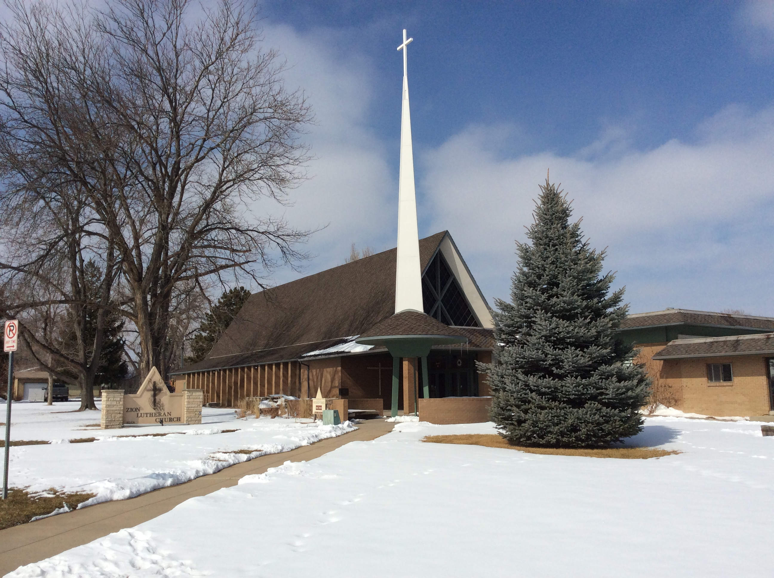


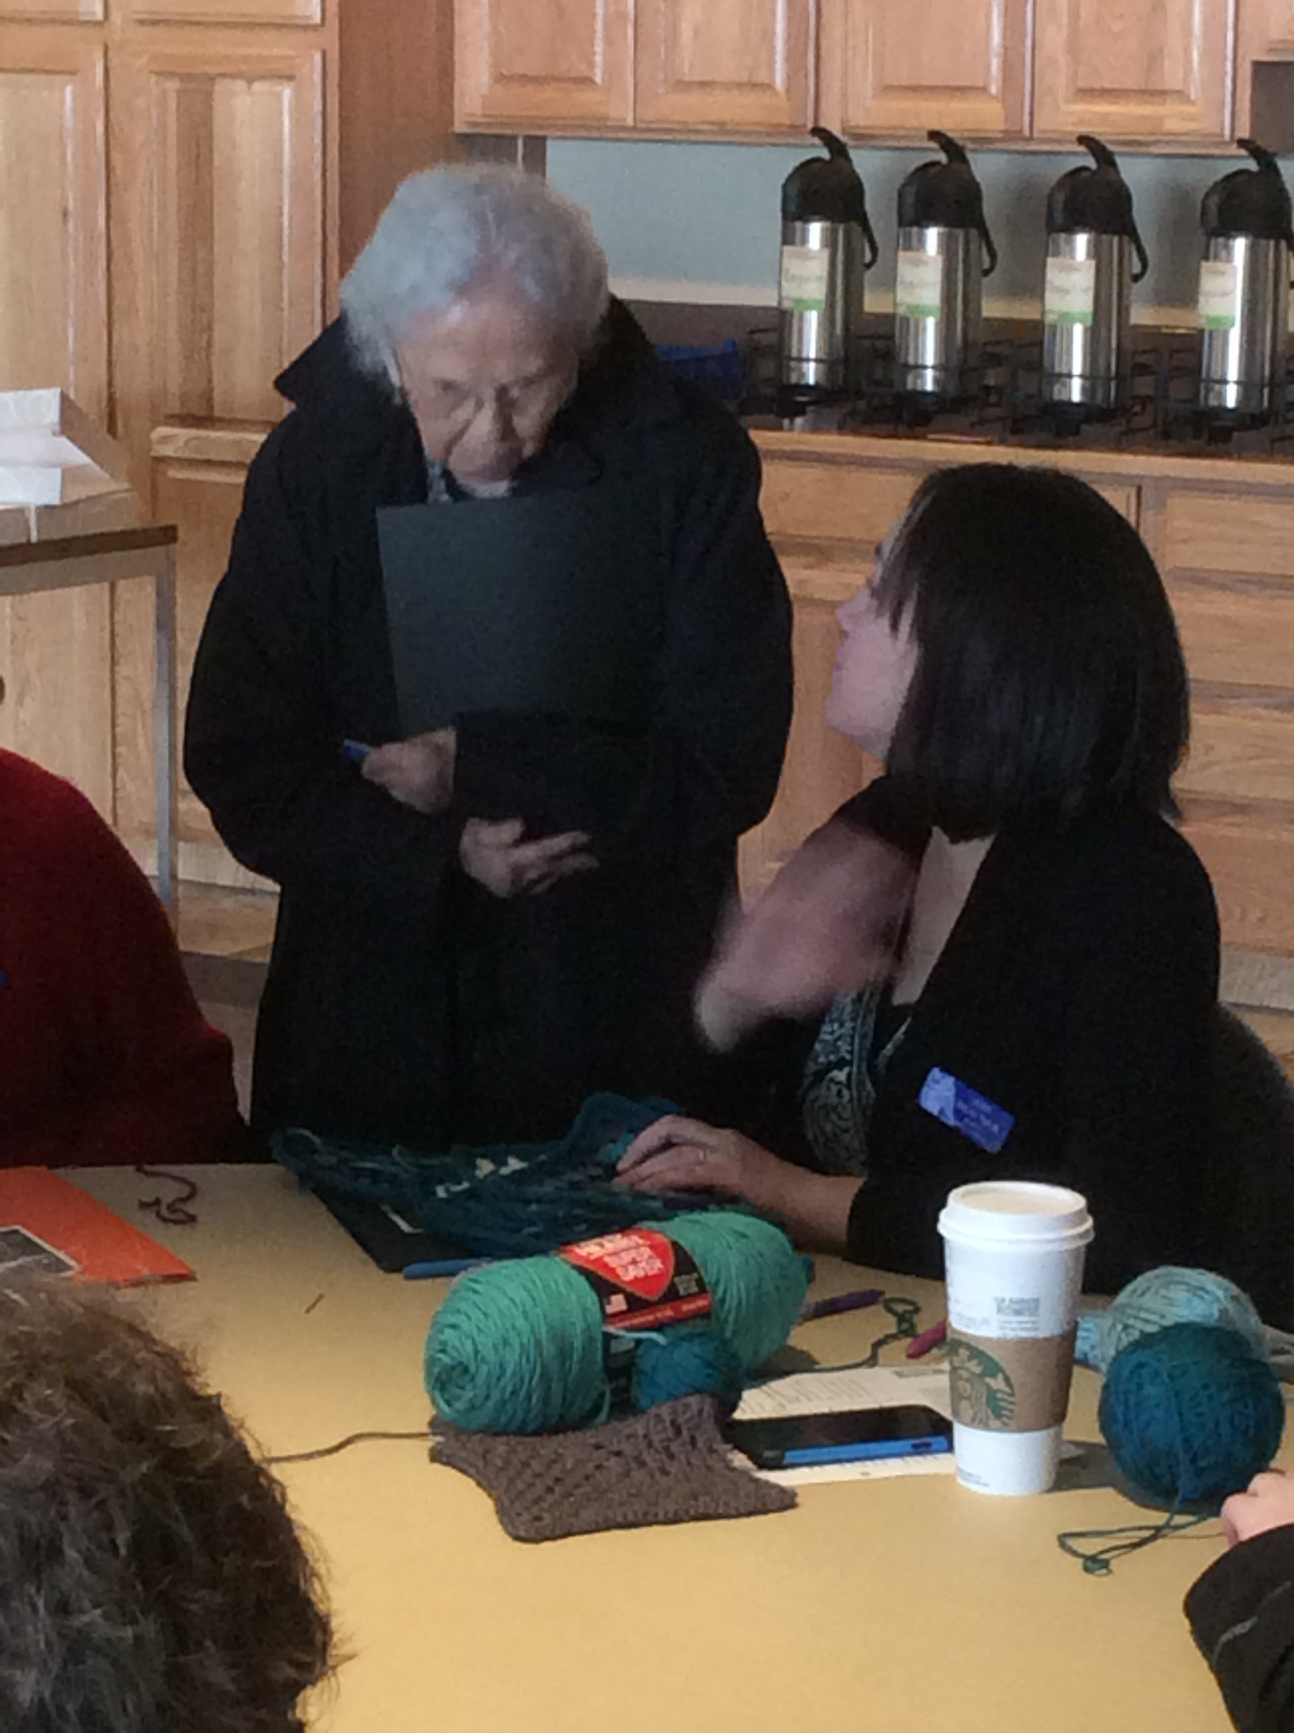
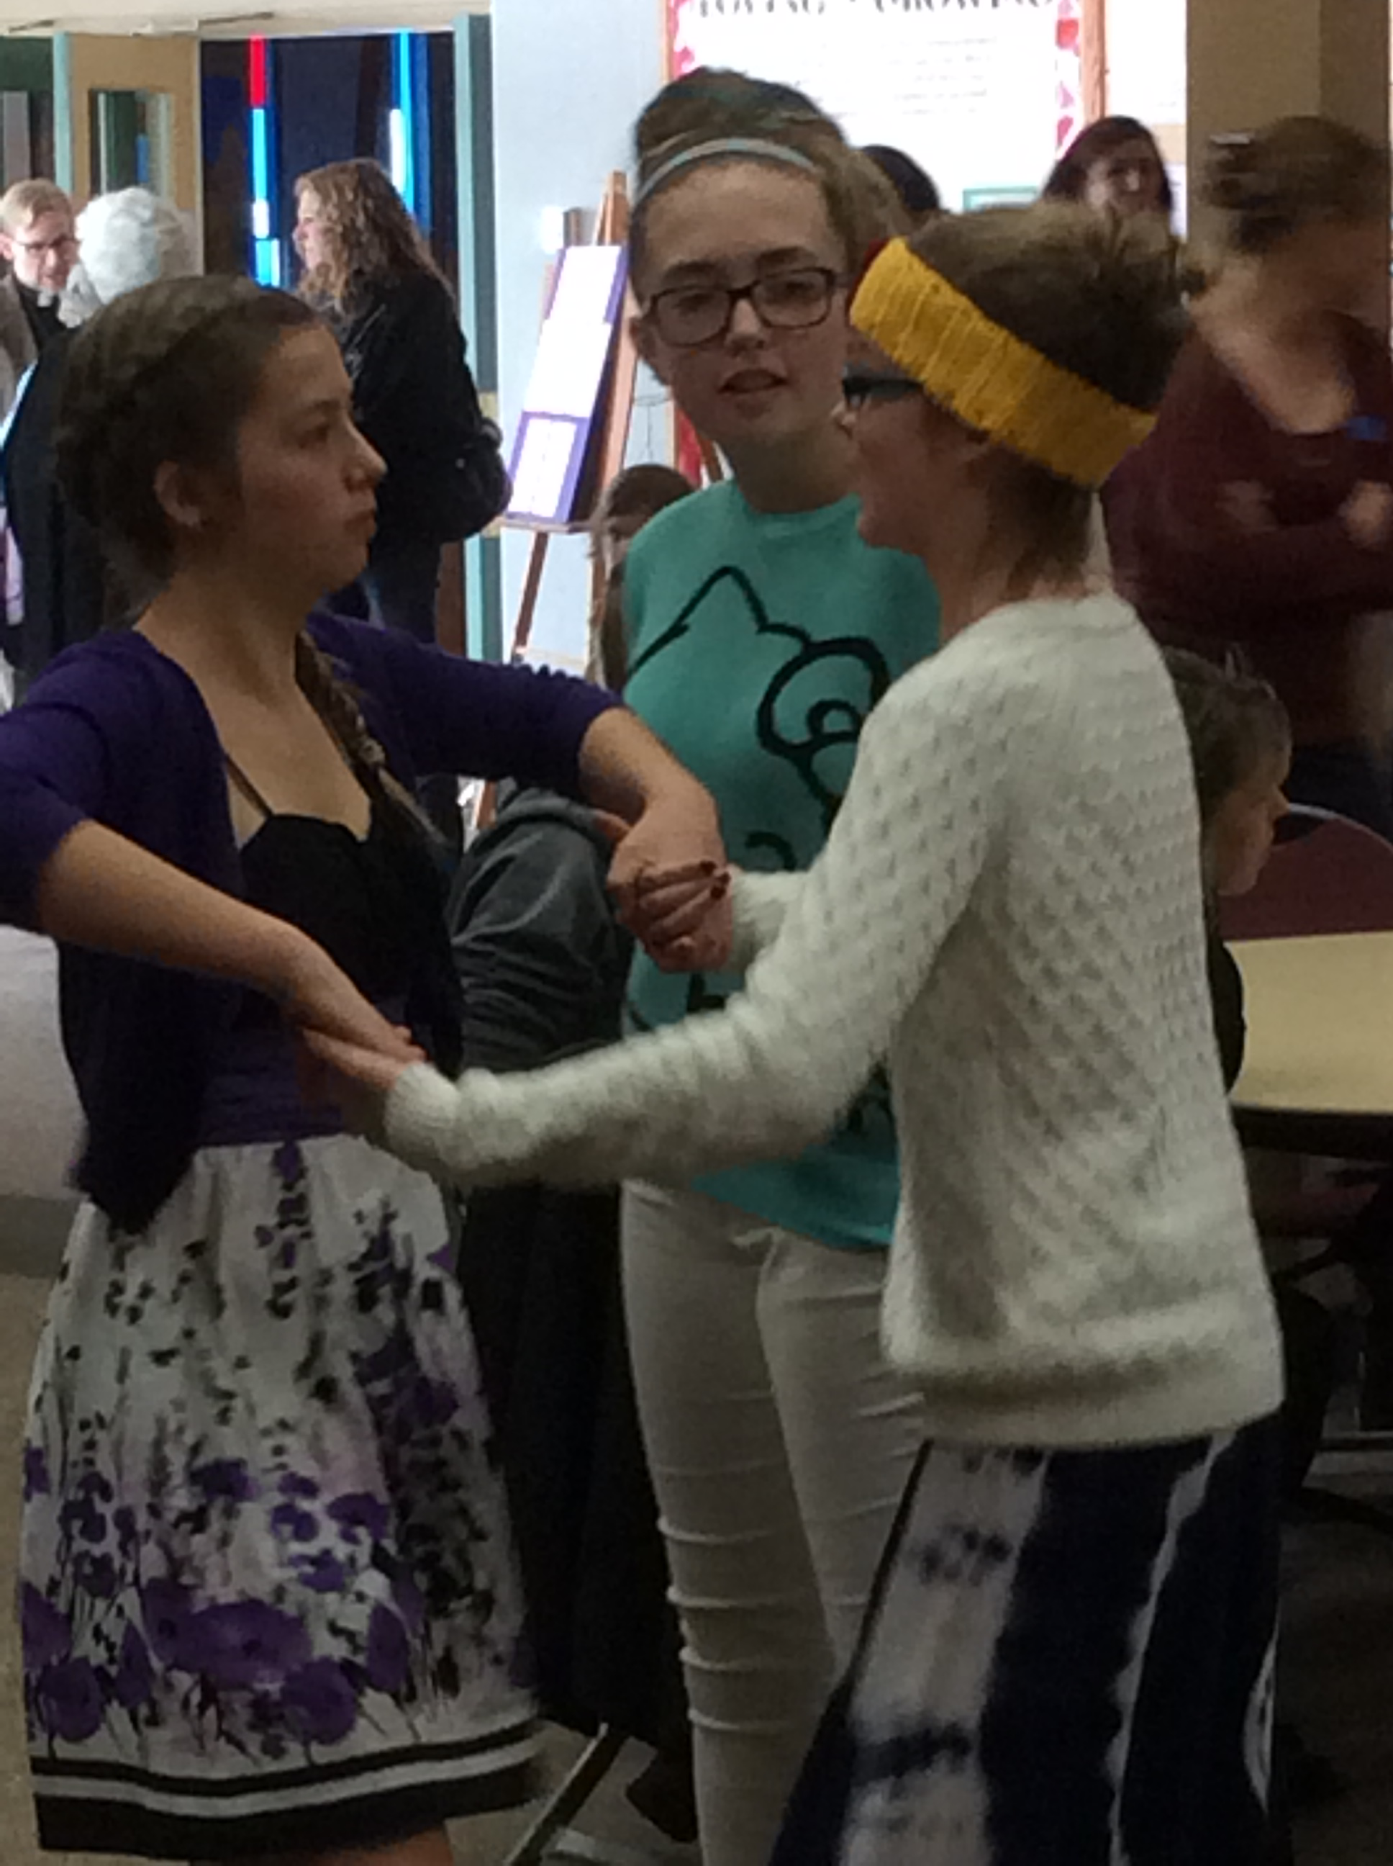

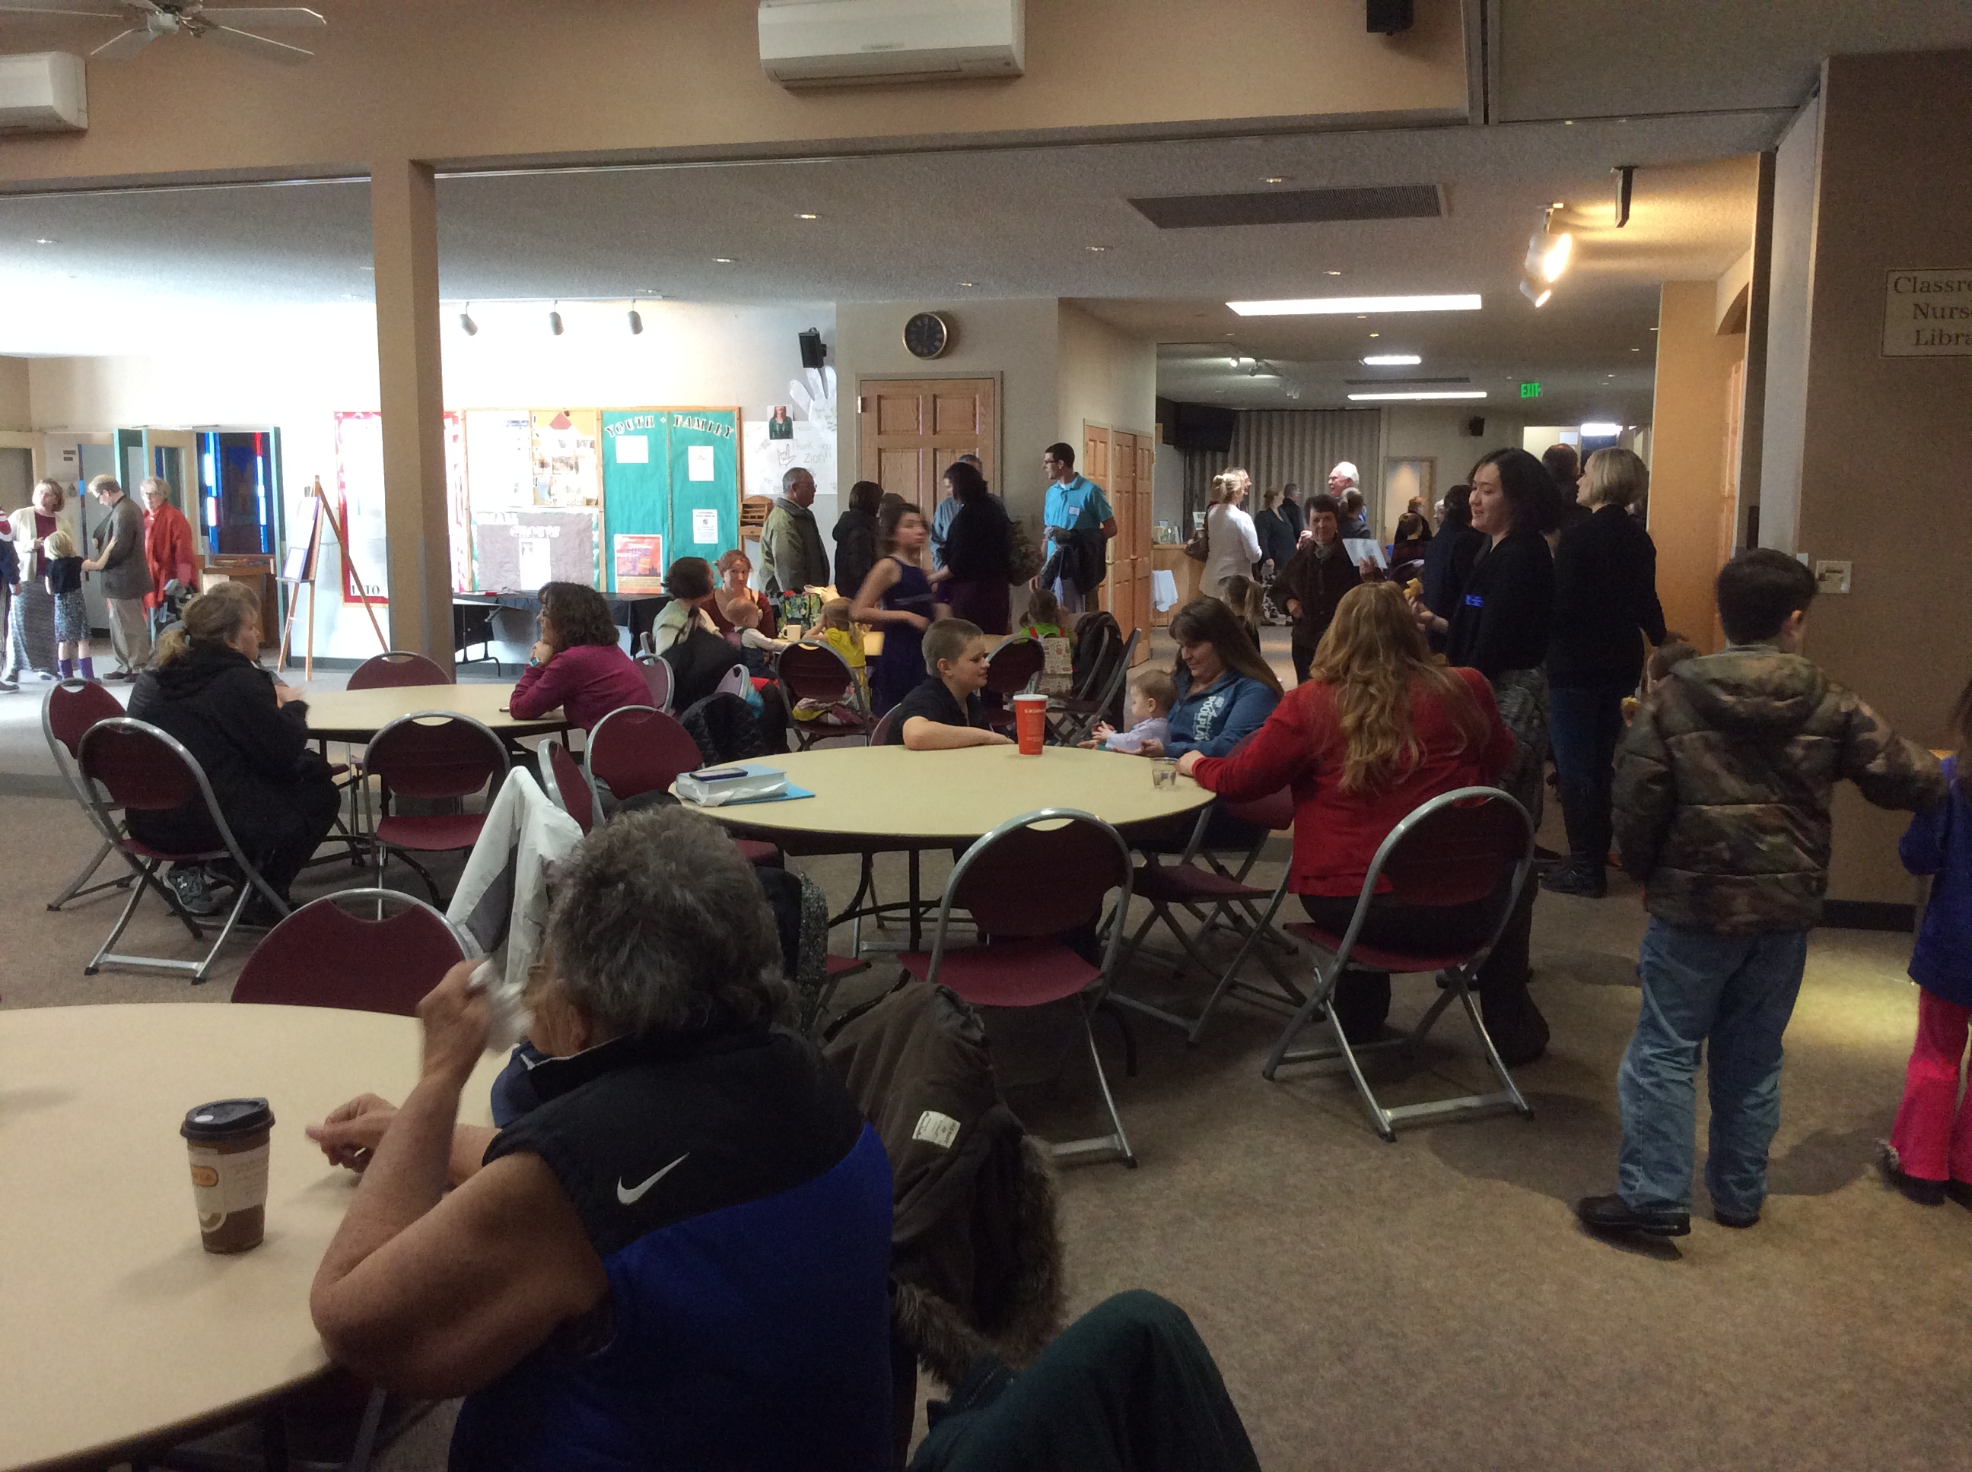
ecology
  3. Confirmation is part of a larger whole.
learning
discipleship
relationships

Slide 36
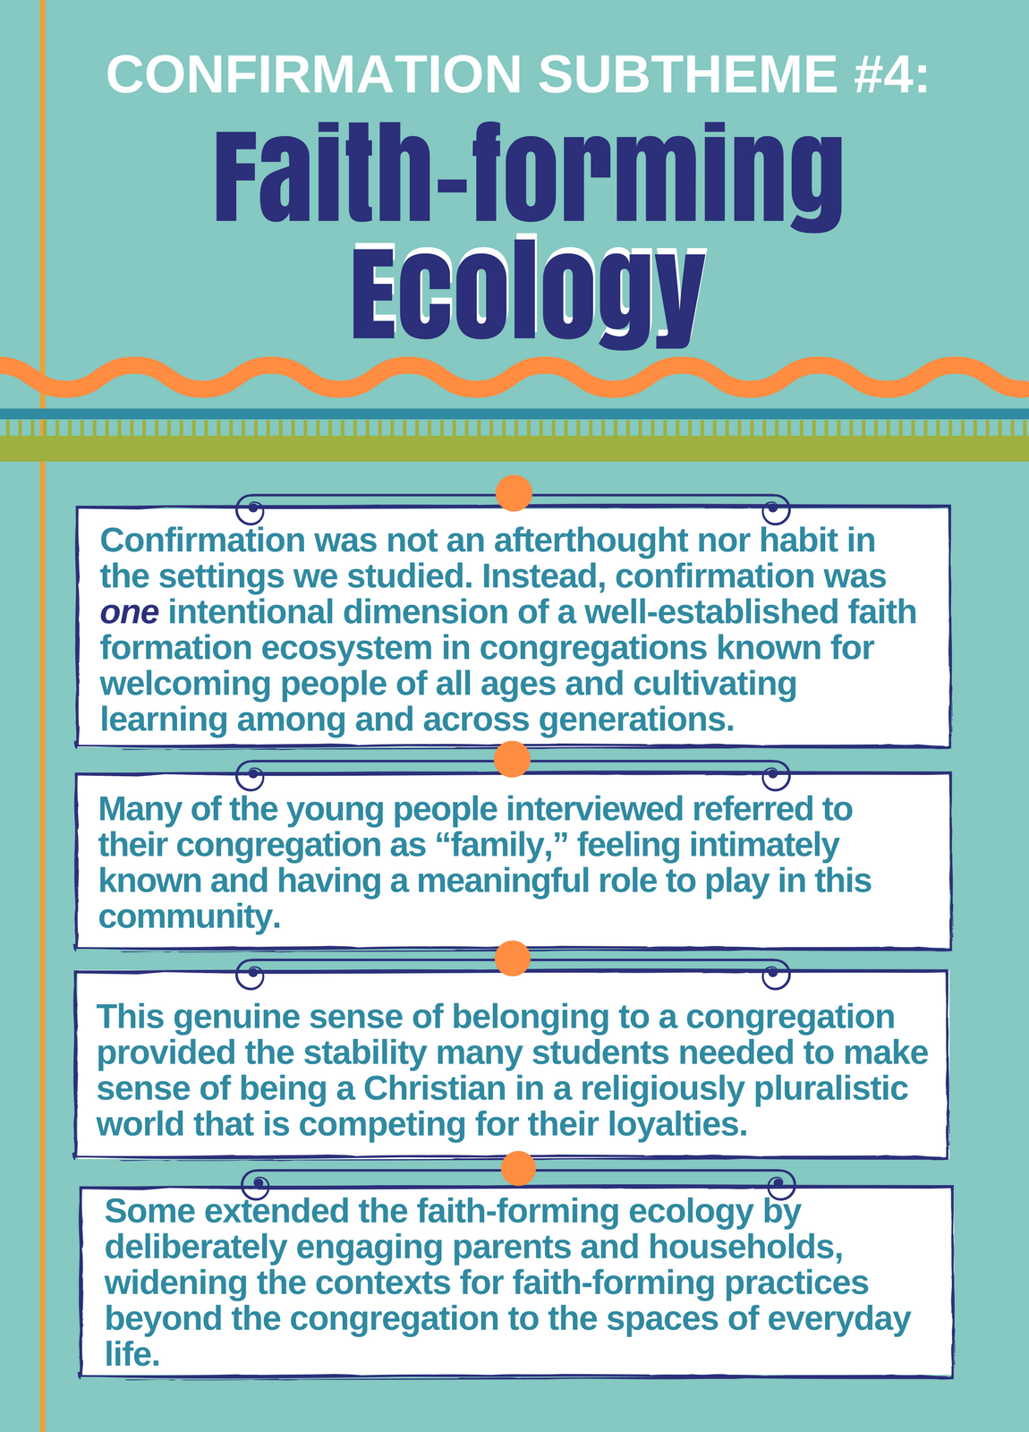
ecology
“Confirmation is a ministry where young people are not separated, but
integrated into the life and mission of the whole congregation.” (ELCA
congregation)
The purpose of confirmation very much reflects that of the whole congregation and encapsulates the vision of faith formation as well: “to build a Christian community where nonreligious and nominally religious students and their families are becoming deeply committed Christians.” Confirmation within this congregation is “best described as robust. Students’ minds and bodies are engaged through worship, service, and prayer. Confirmands are encouraged to struggle through real issues and to grasp their faith more deeply.” (UMC congregation)

Slide 37

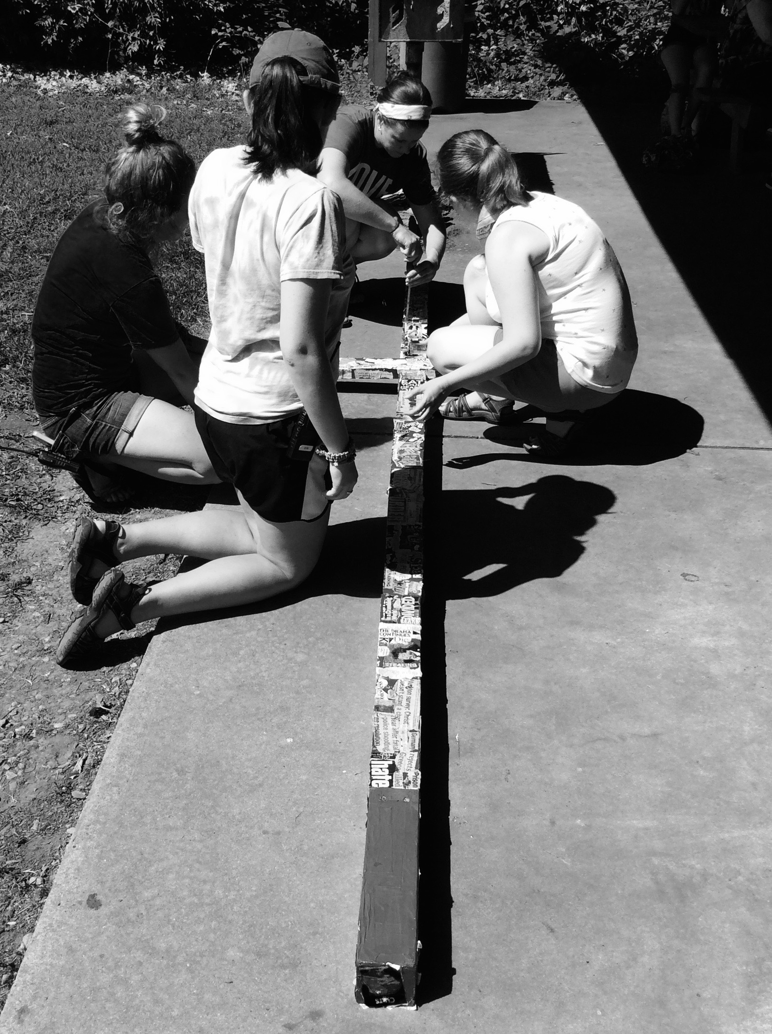

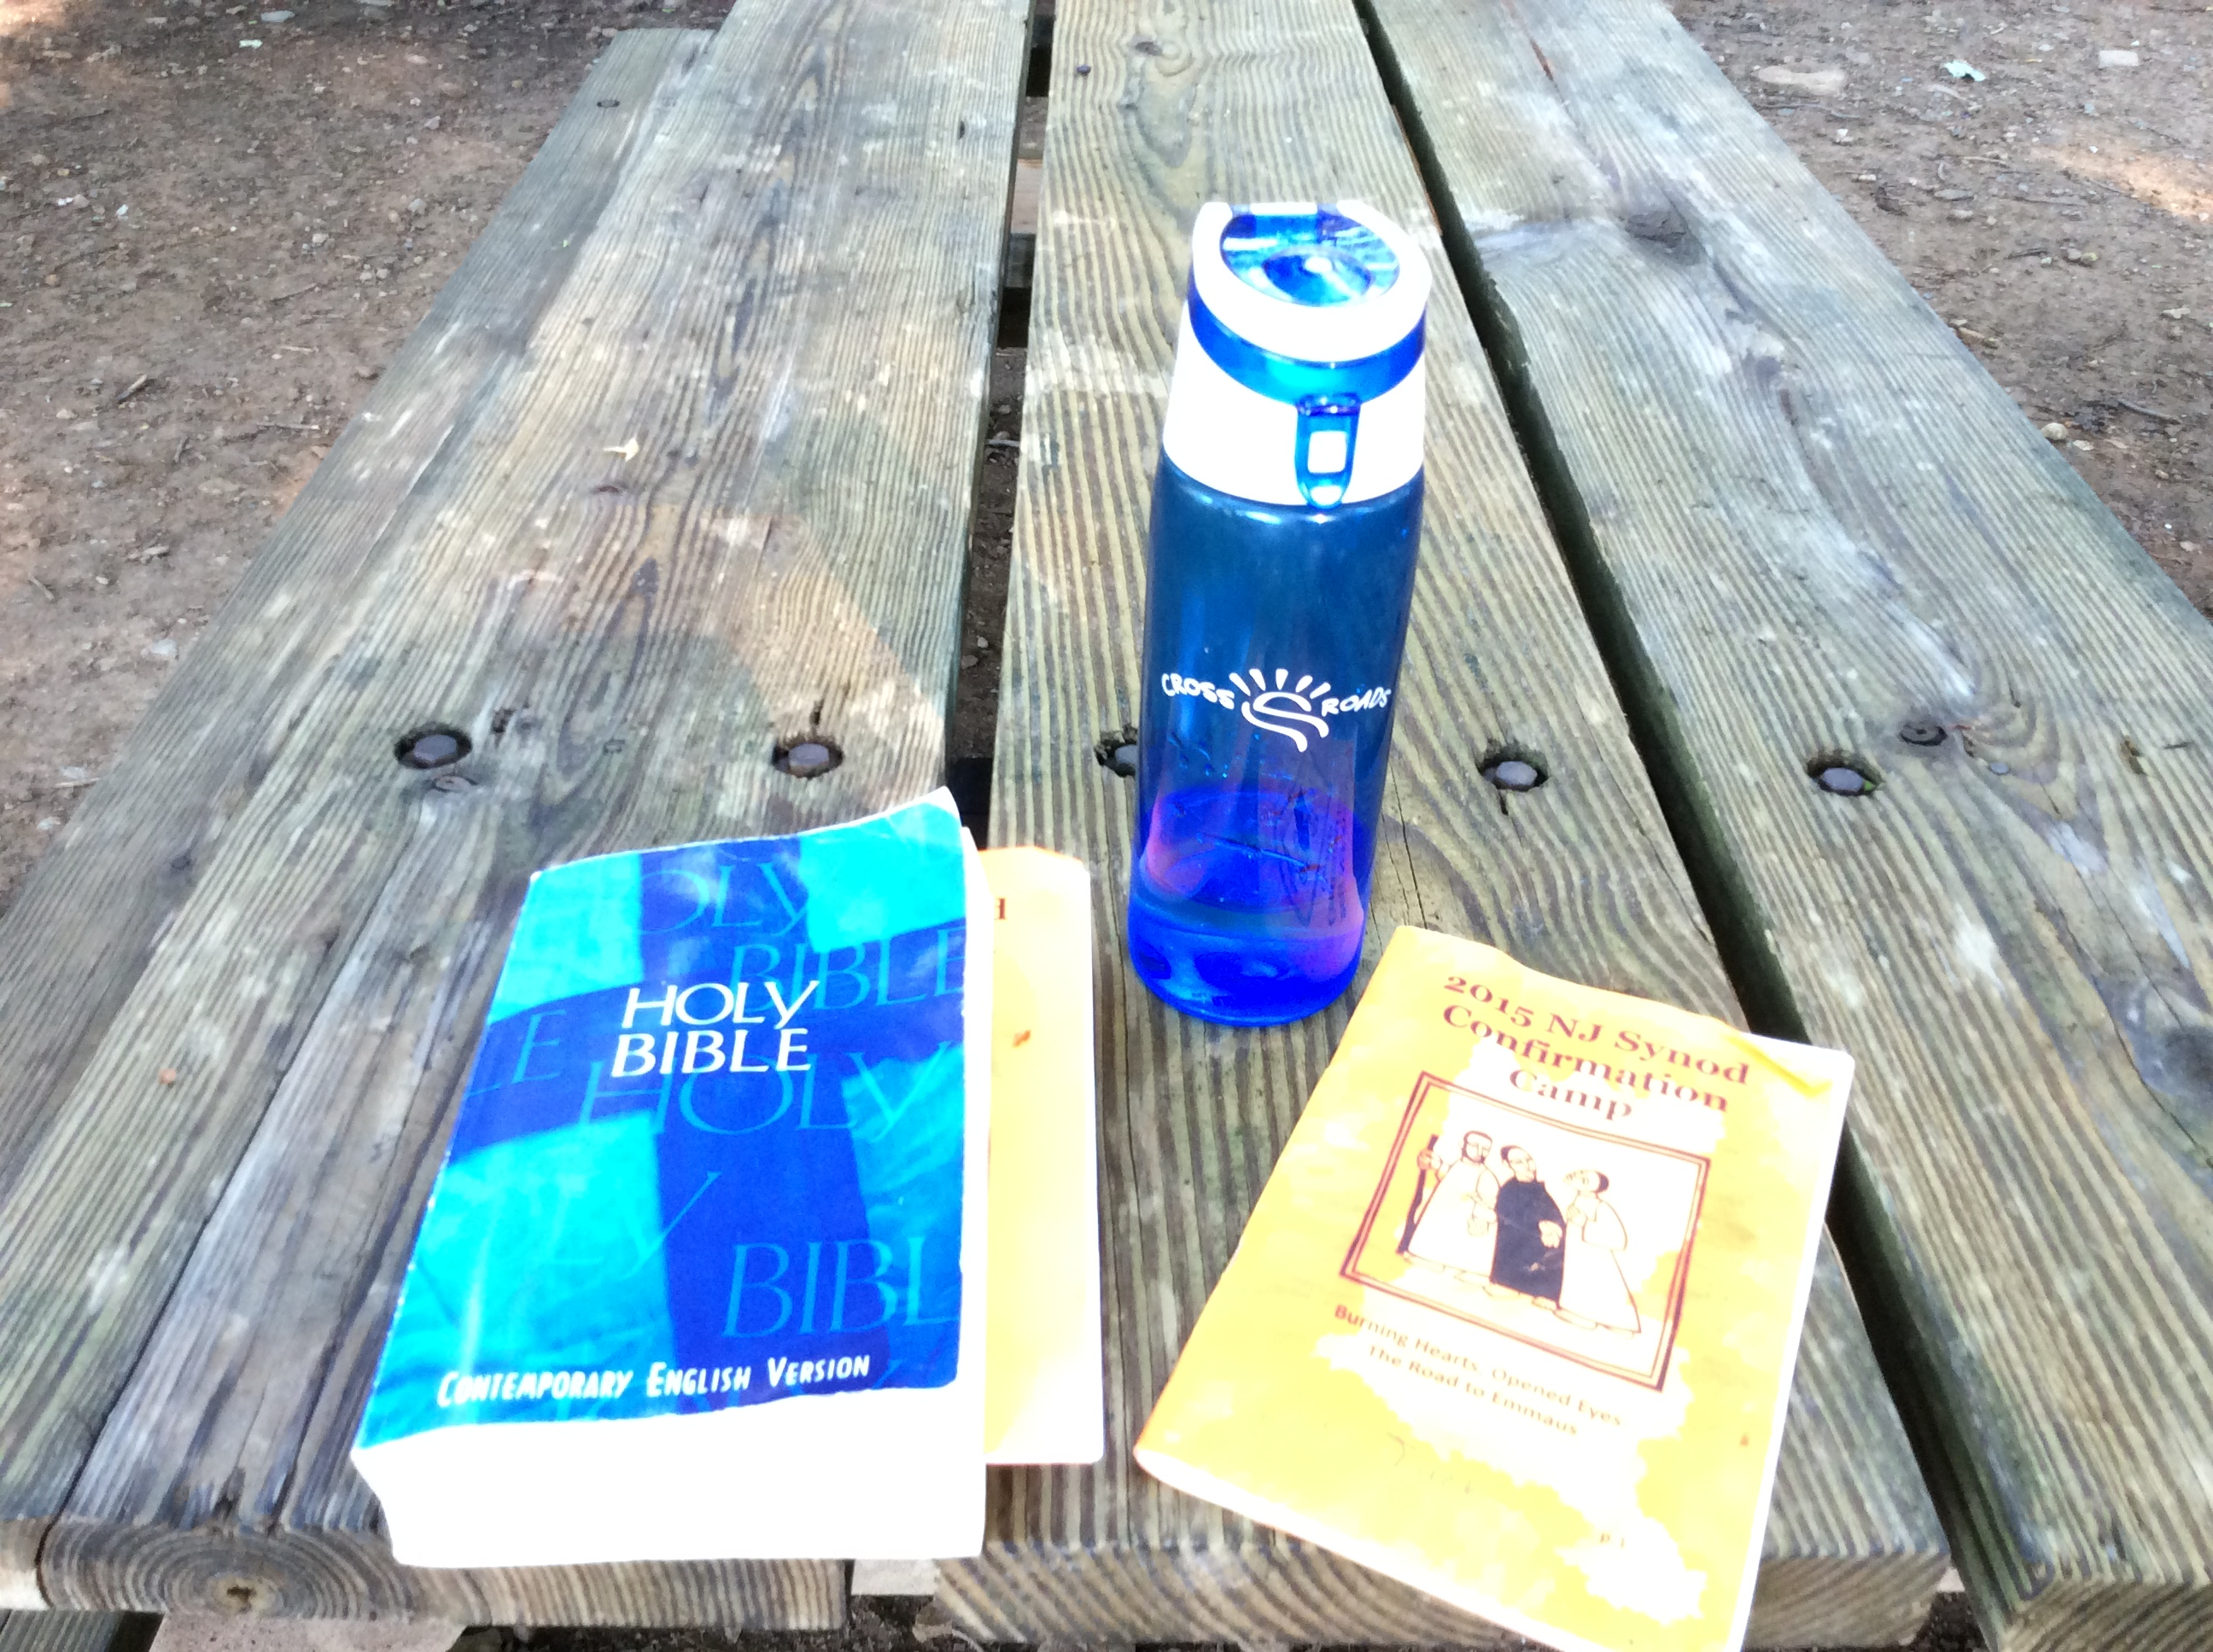


curriculum
  4. Creative teaching in the classroom and beyond.
Curriculum is the skeleton - content and/or lessons
Be flexible and adaptive
High quality teaching and learning
Both/and - 59% denomination/53% write their own

Slide 38
curriculum
Weaves together three things -
Scripture, Christian tradition, and everyday life issues -
and assumes familiarity with the faith.
“Students are not only learning the content of the faith, the stories and language of their faith, they are experiencing the substance of that content in the community of faith and wrestling with their own sense of ethics and morals not only as a worldview but also as it applies to their identities, decisions, and actions.” (ELCA congregation)
One student said she “appreciated that there was space for questioning and doubt…a place to learn what it means to be Christian … in the midst of a culture that wants them to be something else.” (Presbyterian congregation)

Slide 39

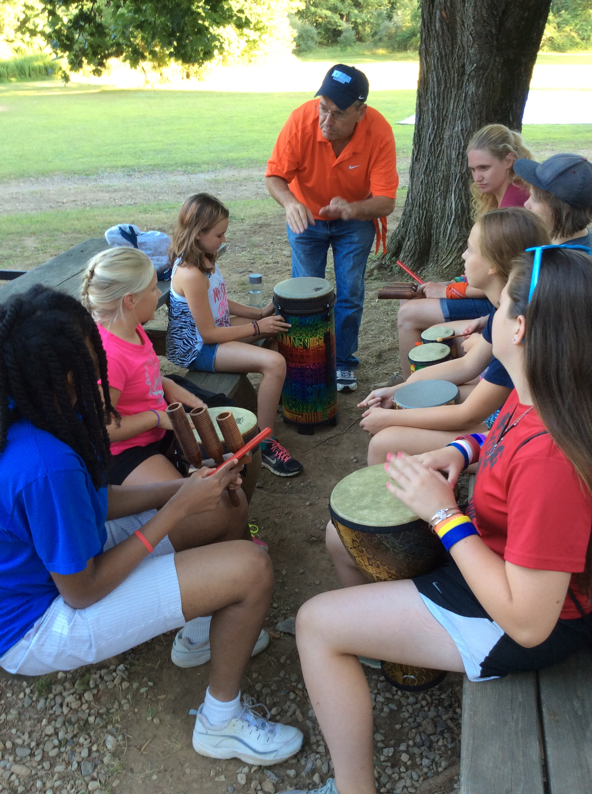
relationships
  5. Depends on strong relationships at every level
Relationships (between and among youth and adults) is as important as the curriculum.
The web of relationship provides the necessary energy for making confirmation meaningful and having a long-term, lasting impact.
Tending relationships builds a sense of community.

Slide 40
relationships
An urban congregation talked about confirmation as “grounded in relationships and focused on getting to know each other’s stories in the midst of digging deeper into the Christian narrative.” For them, bi-monthly learning experiences at church were combined with confirmation camp, because add “faith to the disruption camp brings to our lives and camp makes it possible to authentically engage in questions of meaning, purpose, community, and personhood in ways that staying at home often never gets to.” (ELCA congregation)
“The process of transforming ‘stale’ church language to talk about God and faith, passed down from one generation to another, to discovering a personal vernacular for talking about God in a living community opens students to seeing Christian practices through new eyes and with a renewed sense of purpose and meaning about God and faith in their everyday life.” (Episcopal congregation)

Slide 41
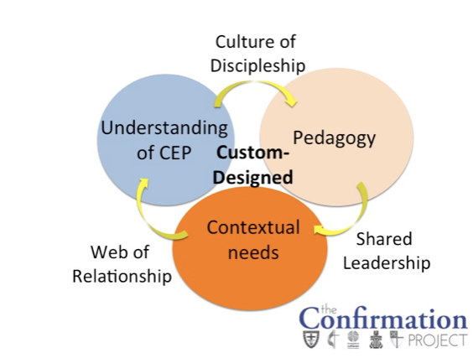

Slide 42
Reflections
How are you contextualizing?
Who is your champion and who is your team?
How does confirmation fit into your ecology?
Name the ways your teaching approaches are creative?
How could you enhance the web of relationships?
Notes:
Some described the process and culminating rite as the moment where confirmands commit to be a lifelong follower of Jesus, for other it was the time when they became an adult member of a congregation, and for others it related to their ability to articulate the beliefs of the church.

Slide 43
ELCA leadership session -
Wonder about Confirmation
Cultivating Teen Faith, Eerdmans, 2018
Word & World Confirmation Edition - Spring 2018
www.theconfirmationproject.com
Facebook Group - The Confirmation Project

Slide 44
What if…
Confirmation was a three-fold practice:
ecclesial, personal, and missional.

Slide 45
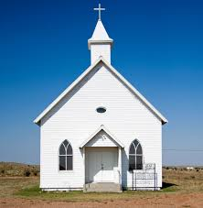
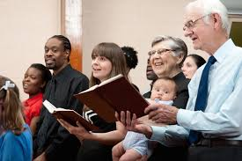

What if…
Ecclesial practice
a practice that passes on the Christian faith and embeds confirmands in the body of Christ.
This is a calling of the body of Christ.
Here the practices of the church (over the years and within one’s denomination) shape the content, leadership, and methods of confirmation, as well as connect young people to the church both local and universal.

Slide 46

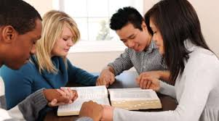

What if?
Child of God
Personal practice
a practice that helps confirmands internalize the faith the corporate community confesses.
Seeing each person as a unique child of God, confirmation invites confirmands to claim their identity in Christ and discover their own vocabulary for talking about their relationship with God, the Christian community, and the world.
This practice centers on God’s love, with relationships being the primary way God’s love is understood.

Slide 47


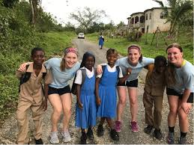
What if?
Missional practice
a practice where confirmands discover ways to join God’s ongoing mission in the world.
Intentional about placing faith and society into dialog, this practice explicitly addresses life scattered in the world.
This practice has young people sharing questions from their lived experience, as it also explores what it means to love the neighbor. It recognizes God’s people live apart more than gathered, so learning how to see God’s activity in the world and hear Jesus’ words in various settings helps confirmands encounter the gospel in unexpected places.

Slide 48
Reflections
Reflecting on your congregation,
what practices do you have in each of these areas?
what one or two things might you do to adapt?
Notes:
Some described the process and culminating rite as the moment where confirmands commit to be a lifelong follower of Jesus, for other it was the time when they became an adult member of a congregation, and for others it related to their ability to articulate the beliefs of the church.

