Slide 1


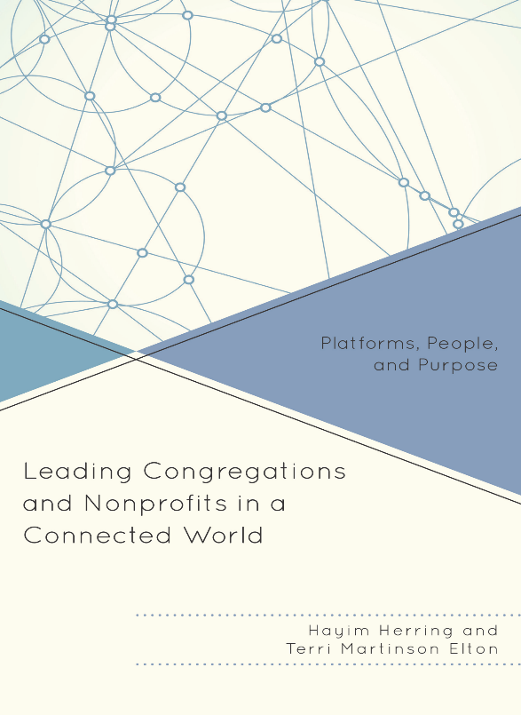
Rethinking Church in a Connected World
Terri Martinson Elton
terrielton.com

Slide 2
The Evolution of Organizations

Slide 3
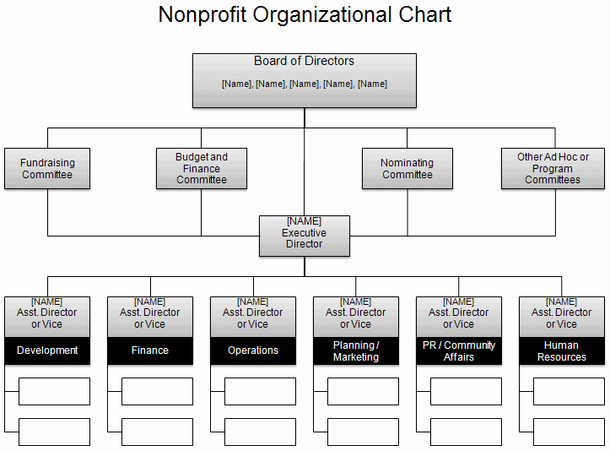
Organizations
1.0
1.0 - Hierarchies
Organizational chart
Clear centralized communication
Production is key
Good for routine/quality control/solving known problems
People specialize and are to be managed
Direction/vision decided from the top - flows down
Work flows up
Universal practices - apply across contexts
Change via strategy
Born in the Modern Era
Notes:
Org. 1.0- until about mid-1990’s; Central physical address; Command and control; symbol: hierarchical org. chart
Org. 20-from mid-1990’s to June 29, 2007 : Still command control; Central physical address w/Parallel web presence
Org. 3.0 – iPhone – social networking available to masses
Physical and web locations blur; fluidity of behavior on web flows back into bricks and mortar
24/7/365 availability; need to think I.P address and P.O. (post office) physical address

Slide 4
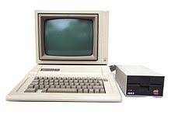
Organizations
2.0
Digital world pre-iPhone
Digital tools to enhance 1.0 world/values.
Brick and mortar mirrors bytes and clicks world.
Communication is the same on all platforms (newsletter, announcements in worship, on website).
Centralized communication strategy.
Tested/pushed 1.0 values, with little modification.
Emerged in early Postmodern Era
Notes:
Org. 1.0- until about mid-1990’s; Central physical address; Command and control; symbol: hierarchical org. chart
Org. 20-from mid-1990’s to June 29, 2007 : Still command control; Central physical address w/Parallel web presence
Org. 3.0 – iPhone – social networking available to masses
Physical and web locations blur; fluidity of behavior on web flows back into bricks and mortar
24/7/365 availability; need to think I.P address and P.O. (post office) physical address

Slide 5
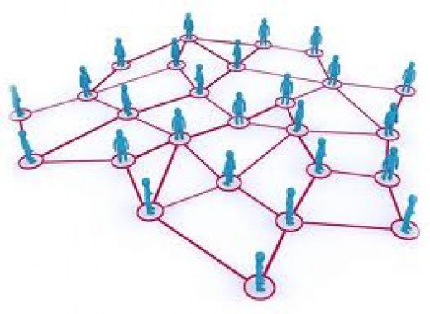
Organizations
3.0
Digital world - Facebook/iPhone
Integrated and global - 2007 marked a shift - iPhone, big data, Facebook, internet has global reach, AI
Decentralized and diversified
Environment is not predictable (VUCA) - focus on conditions, not outcomes.
Adaptive challenge and complexity
Empower “all” - ease of creating and collaborating
Generous - gift economy
Open and transparent
Self-directed, not led but internal motivation
Crowdsourcing - curation.
DIY - amateur valued less than professional.
Change via mass participation.
The “Post” Era:
Post-modern
Post-denomination
Post-industrial
Notes:
Org. 1.0- until about mid-1990’s; Central physical address; Command and control; symbol: hierarchical org. chart
Org. 20-from mid-1990’s to June 29, 2007 : Still command control; Central physical address w/Parallel web presence
Org. 3.0 – iPhone – social networking available to masses
Physical and web locations blur; fluidity of behavior on web flows back into bricks and mortar
24/7/365 availability; need to think I.P address and P.O. (post office) physical address

Slide 6

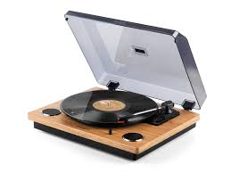
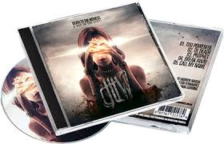
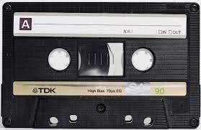
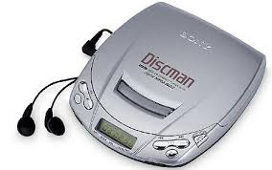


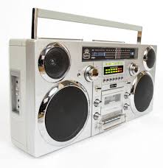


1.0 to 3.0

Slide 7
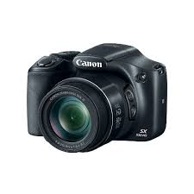







1.0 to 3.0

Slide 8
Organization1.0
Organization 3.0
Hierarchies
Organizational chart
Clear centralized communication
Production is key
Good for routine/quality control/solving known problems
People specialize and are to be managed
Direction/vision decided from the top - flows down
Work flows up
Universal practices - apply across contexts
Change via strategy
Digital world - Facebook/iPhone
Integrated and global - 2007 marked a shift - iPhone, big data, Facebook, internet has global reach, AI
Decentralized and diversified
Environment is not predictable (VUCA) - focus on conditions, not outcomes.
Adaptive challenge and complexity
Empower “all” - ease of creating and collaborating
Generous - gift economy
Open and transparent
Self-directed, not led
Crowdsourcing - curation.
DIY - amateur valued less than professional.
Change via mass participation
Notes:
Org. 1.0- until about mid-1990’s; Central physical address; Command and control; symbol: hierarchical org. chart
Org. 20-from mid-1990’s to June 29, 2007 : Still command control; Central physical address w/Parallel web presence
Org. 3.0 – iPhone – social networking available to masses
Physical and web locations blur; fluidity of behavior on web flows back into bricks and mortar
24/7/365 availability; need to think I.P address and P.O. (post office) physical address

Slide 9

Congregations are not the ends, but a means for nurturing faith and participating in God’s mission.
“What if congregations operated more like platforms than self-sustaining organizations?”

Slide 10
Characteristics of a platform.
- porous boundaries
- centered-set/self-organizing hub
- rely on bonding and bridging
  relational ties
- empower participants to solve problems
- attention to flow

Slide 11
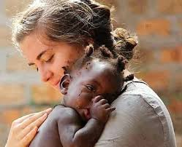


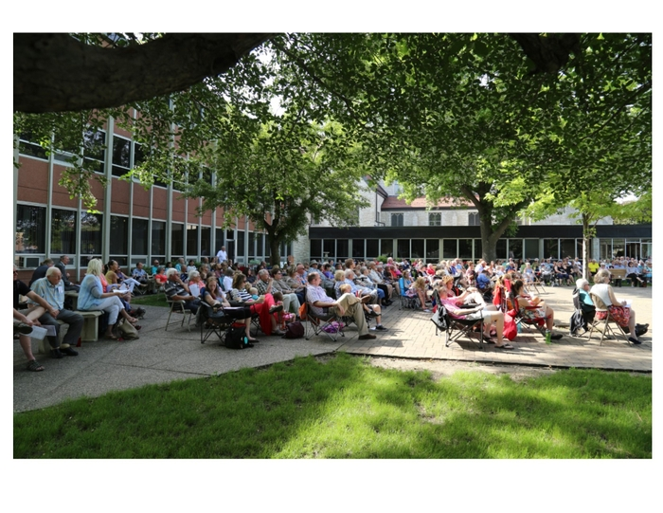
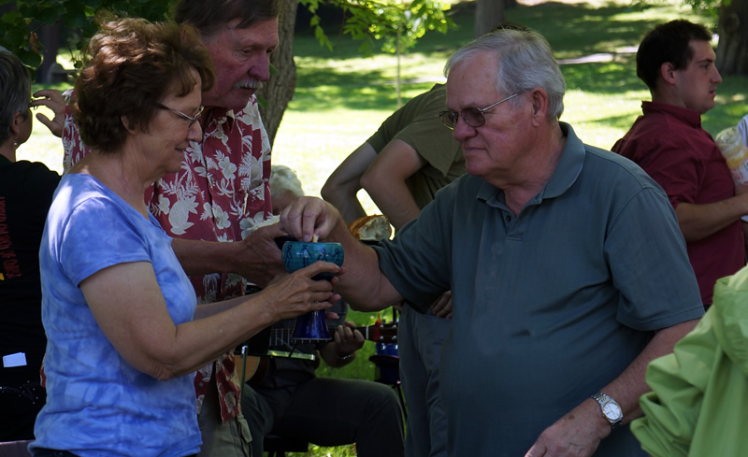
Congregations as Platform
for loving God and our Neighbor
Notes:
Congregations are called to steward the future witness to the Christian faith. God’s love for us is steady and trustworthy, but the future does not look like the past.
This is a pivotal moment. Our highly dynamic context is being disrupted at accelerating speeds and we, the church have the opportunity to join God’s movement in the world or hold tightly to the past.
Our God is a God who makes all things new, who brings order out of chaos and life out of death. God’s deepest desire is for all to live abundantly. Our way forward is relying on God, of embracing God’s call for us and letting God’s love orient our lives.

Slide 12


Innovation
  An act or series of actions
  Short or long cycles
  Can/does exist within hierarchies
  May lead to entrepreneurial culture
Notes:
Challenge: congs. may feel need to innovate
But, goal is to innovate something meaningful, not yesterday’s “best practices”

Slide 13
4 Pathways to Innovation
  Reiterating the role
  Significantly upgrading and changing an existing program or service and continuing to experiment and refine it.
  Provides continuity between
  the old and the new.
Notes:
TE and HH provide some examples

Slide 14
4 Pathways to Innovation
  Reiterating the role
  Cracking the code
  Fusing the model
  Breaking the mold
Notes:
TE and HH provide some examples

Slide 15
4 Pathways to Innovation
  Cracking the code
  Very focused mission and pursue it faithfully and relentlessly.
  Innovation by doing less (not more) exceptionally well.
Notes:
TE and HH provide some examples

Slide 16
4 Pathways to Innovation
  Fusing the model
  Merging two distinct forms of entities
  into one that releases new energy.
  Retains something familiar
  as it also offers a new experience.
Notes:
TE and HH provide some examples

Slide 17
4 Pathways to Innovation
  Breaking the mold
  Builds on DNA that is different in content and structure.
  Entrepreneurial or
  embedded in culture.
Notes:
TE and HH provide some examples

Slide 18
Innovation is a key capacity, not a luxury
Congregations/organizations that innovate are more likely to thrive
Every congregation can and should innovate
Should every congregation become entrepreneurial? (Spoiler alert: no!)

Slide 19

HOW?

Slide 20
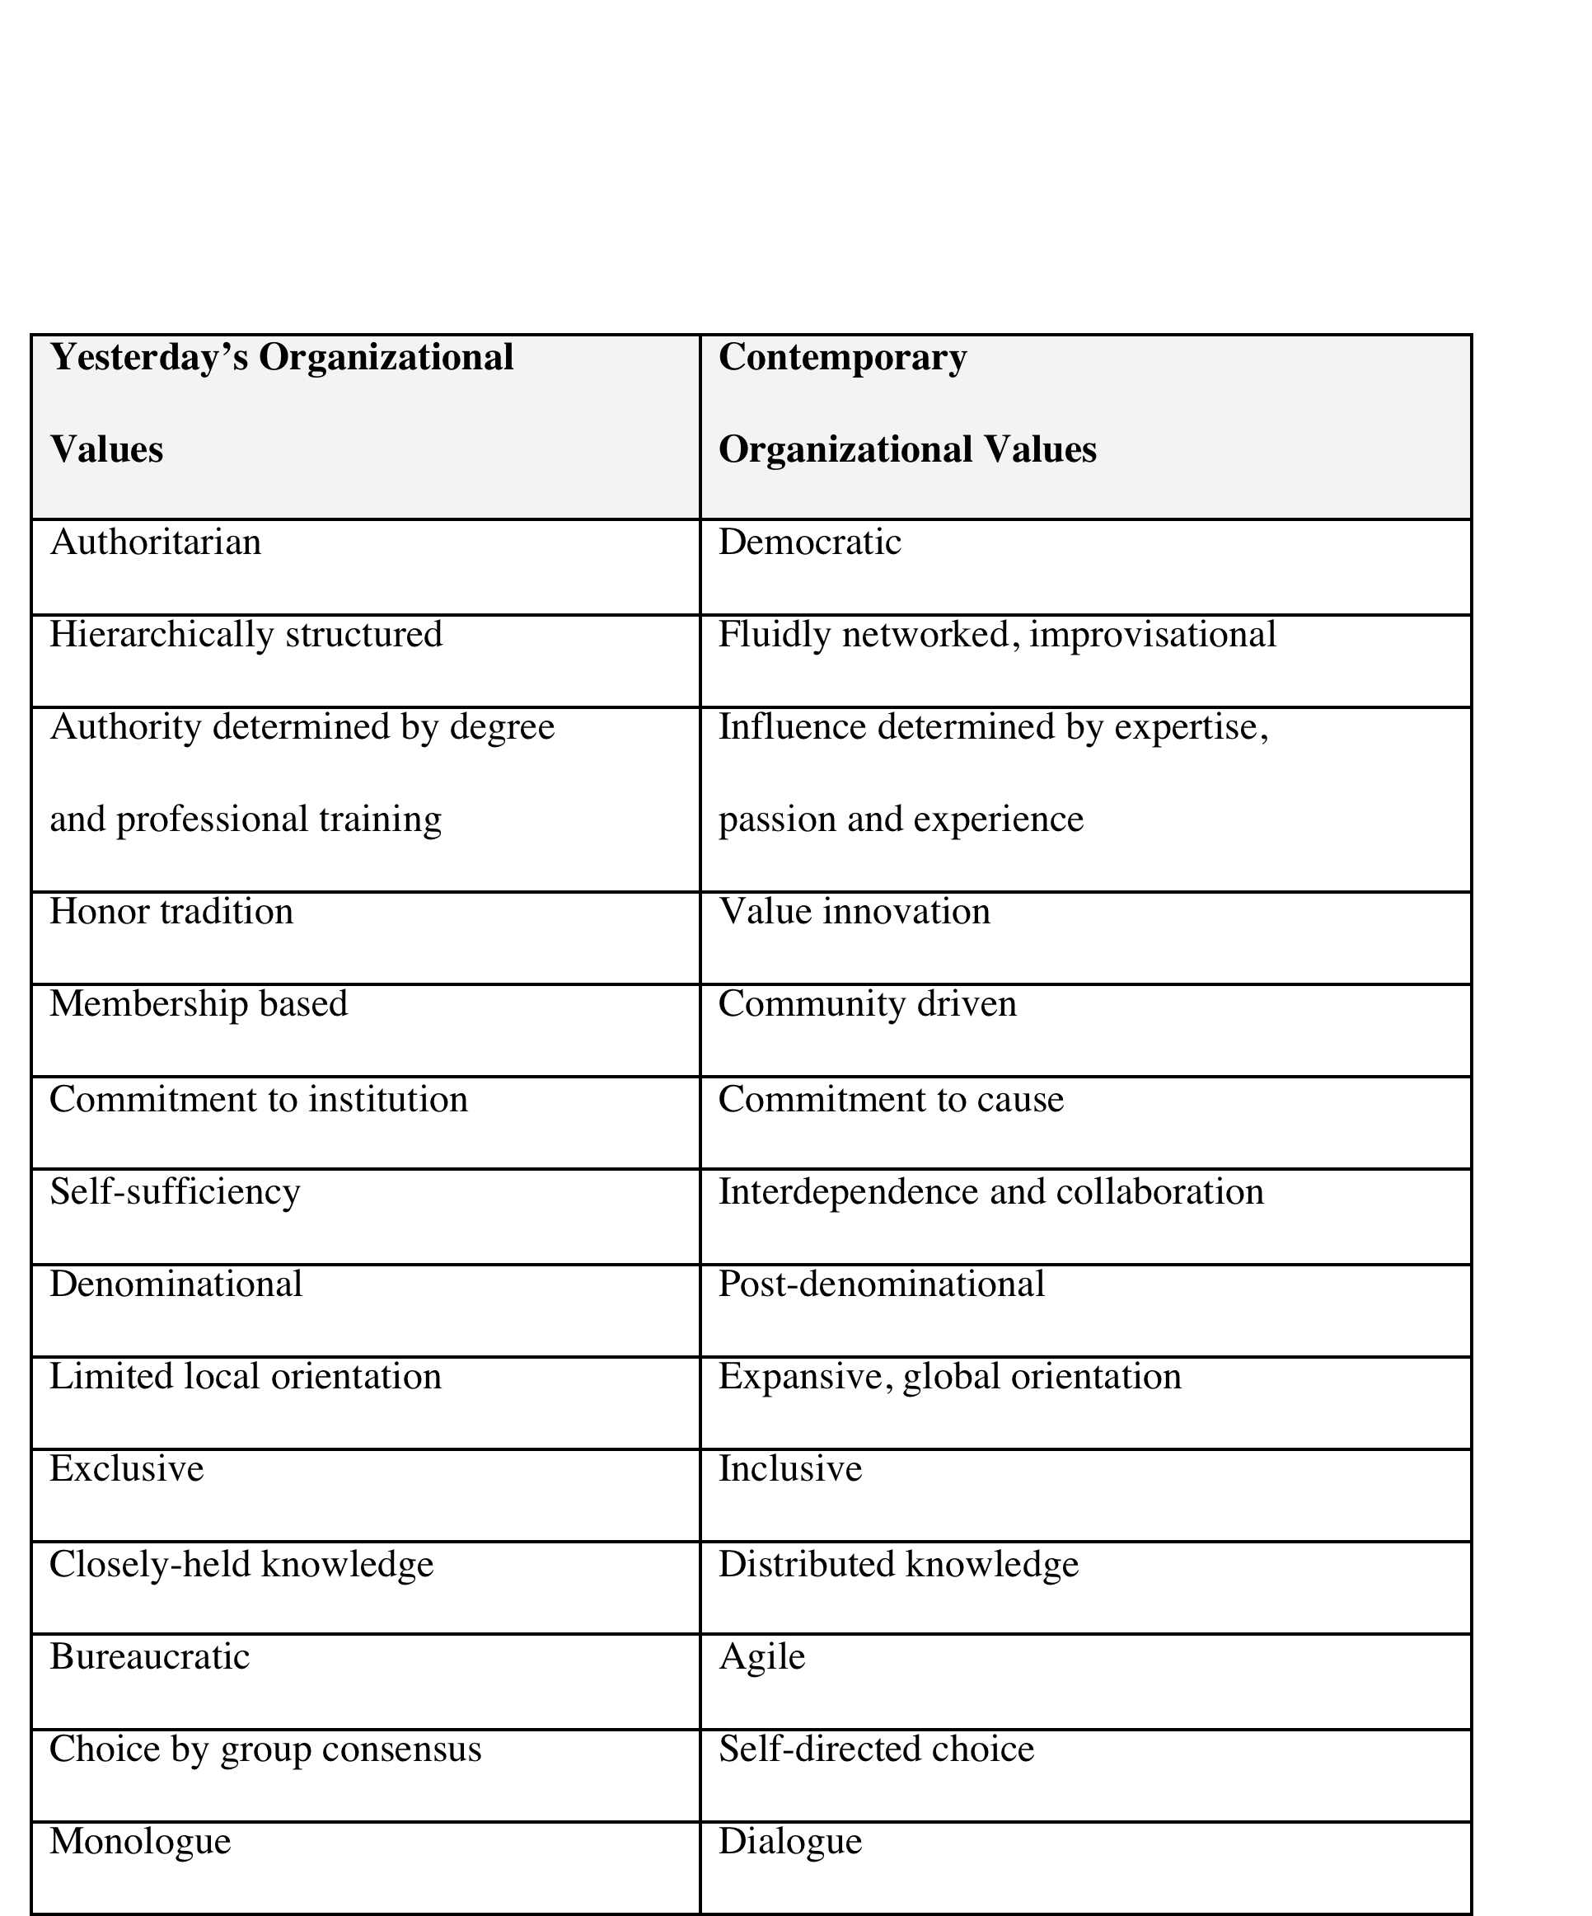
  Organizational Assessment exercise
  1.0 - 3.0
Rate each 1 (old) to 5 (new)

Slide 21
Innovative Ingredients | We have it: Where does it surface? | We need more of it: what are our barriers?
Passion: We only do work that contributes to making a real difference in people’s lives and in the community.
Optimism: Our faith will help us through the uncertainties of taking risks.
Focus: We maintain and update a “focus list” and an “ignore list.”
Ambition: We aim for better ideas and avoid incremental change.
Pivot: We are prepared for executing on our ideas and are just as prepared to readjust if needed.
Curiosity: We set up formal ways to learn from people outside of our immediate circles.
Transparency: We communicate our process during our experimentation - the good, the bad, and the ugly.
Beta-Testing: Implementing an idea sooner that is 80 percent developed is better than waiting until it is 100 percent planned.
Collaboration: We solve problems collectively and do not blame individuals for errors.

Slide 22

  Fusing the Model Exercise
What if …
IKEA (the Swedish furniture company) decided to create spiritual communities?
What would faith formation be like using IKEA’s simple, modern design, ready-to-assemble, eco-friendly DNA?
Pick one scenario from the bag.
Worship meets Trader Joes’
Evangelism meets Nike
Social Ministry meets the Farmer’s Market
Leadership Development meets YouTube
Bible Study meets Amazon
Pastoral Care meets the Public Library

Slide 23
Scenario Planning
Possible Futures
Gathered
Take two dimensions of an issue,
Place one on the horizontal axis and the other on the vertical axis.
Then complete the four quadrants.
Try Worship
Real Time
Any Time
Scattered

Slide 24
Implications Wheel
Consequences of Various Actions
Offer age-specific faith formation on another day
Equip people of all ages with resources for forming with “on their own”
New leaders would emerge
Offer all
types of intergenerational faith formation
People across age groups form relationships
People care for each other
No longer offering Sunday age-specific faith formation
No one would participate

Slide 25


Platforms with purpose
that lead people to a new future
with a posture open to the world
Notes:
Platforms, People, Purpose…and Posture together can help us all experiment our way into a new way of being in this time in history.

