Slide 1

Rethinking Church in a Connected World 2
Terri Martinson Elton
terrielton.com

Slide 2

Are we ready for the future?

Slide 3
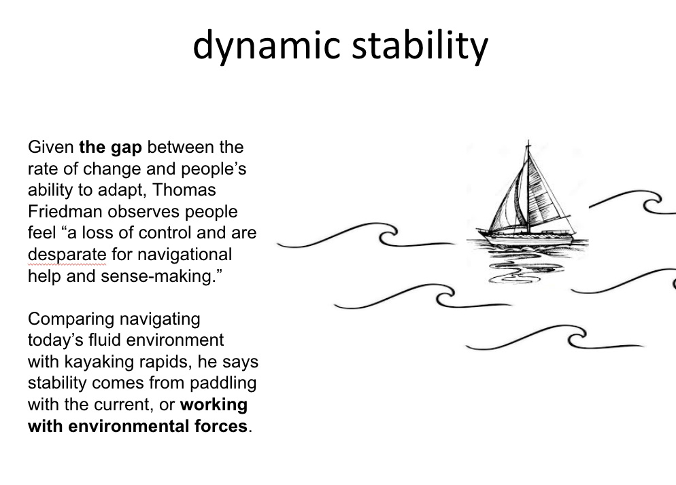
Notes:
We need GPS for forming faith - a way to navigating our VUCA world that allows us to find balance and meaning in the midst of unending changes.

Slide 4
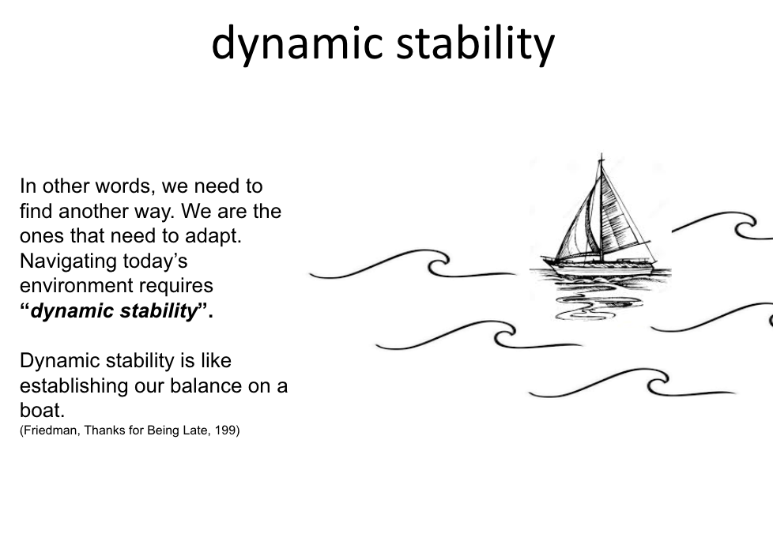
Notes:
We need GPS for forming faith - a way to navigating our VUCA world that allows us to find balance and meaning in the midst of unending changes.

Slide 5

HOW are we working with our environment?

Slide 6

reframing life
“‘Consumerism’ refers to a way of life structured by and around various practices of consumption and accumulation. In a consumerist society, consumption dominates social practices, such that relationships, activities, space, work, and leisure come to be structured around various practices related to consumption. Consumption becomes a way to achieve social solidarity – relational connections with others, even as it also marks identity and status.”
Mercer, Welcoming Children, 73

Slide 7
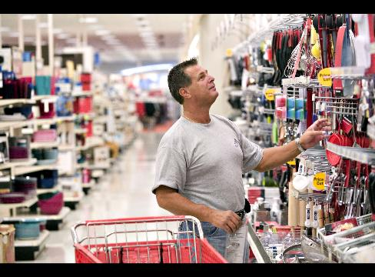
Consumption as central, orienting principle
Shaping identity and defining abundant life.

Slide 8

Digital revolution
“When we change the way we communicate, we change society.”
Clay Shirky, Here Comes Everybody, 17.

Slide 9
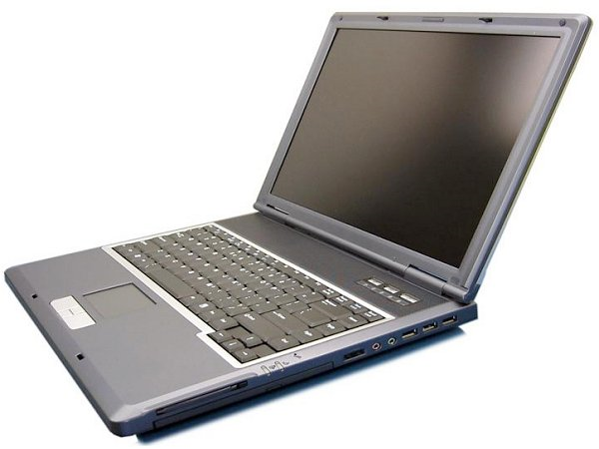
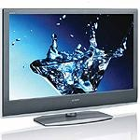
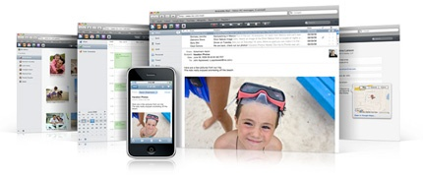
Digital revolution
2007…Pivotal year
iPhone
Open-source platform
Storage exploded
Big data made possible
FaceBook open to everyone
Twitter becomes its own platform
change.org emerged
Google bought YouTube and launched Android
Airbnb conceived
Amazon released Kindle
Internet crossed over 1 billion users
IBM began creating Watson - cognitive computer
Notes:
There is no going back. We are in a new world.

Slide 10
reframing relationships
So what?
Decentralized, diversified communication
Requires active participation.
Web is now its own ecosystem.
Communication is a social activity.
Our social networks now have virtual pathways.
The way we create, collaborate, think, and live is being reshaped.
Virtual world lives alongside physical world.
Identity and relationship formation takes place disembodied.
Way of life is disrupted once again.
Notes:
We are now our own communication directors.

Slide 11
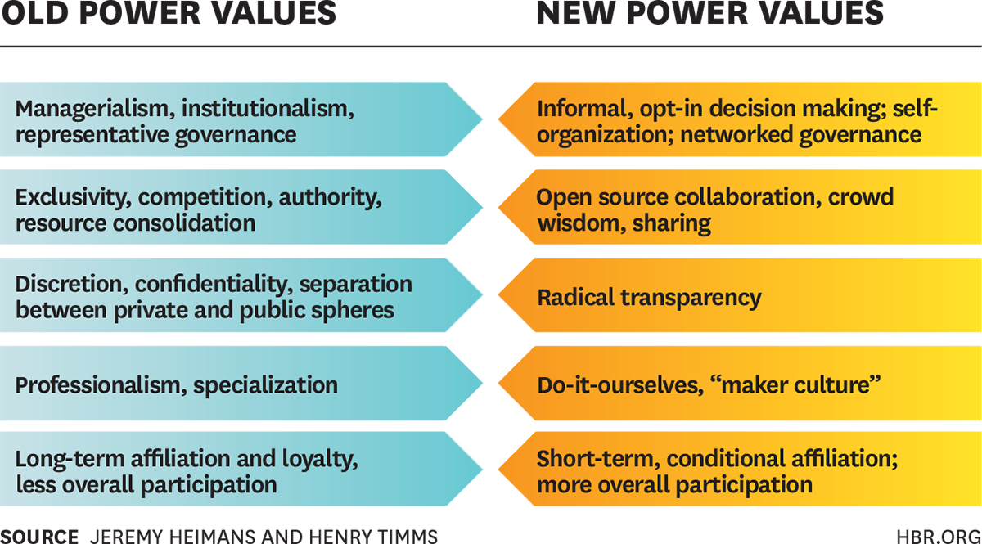
Currency to Current
Notes:
Old power = currency
New power = current

Slide 12
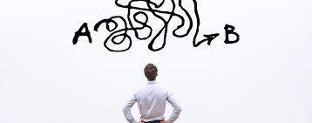
reframing how we solve problems
Learning in an information age =
Addressing real-world challenges +
making meaning + in community
Learner-centric = Ground learning in lived experiences and current circumstances!

Slide 13
GPS for church

Slide 14
WHAT does this mean?

Slide 15
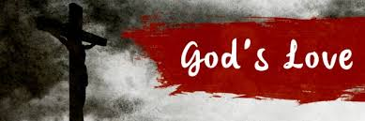
What is Faith?
God is our reference point for faith.
A living relationship with God
We are transformed from objects to subjects of God’s love.
God’s love reorients our lives - love God and love neighbor.
Notes:
God is the reference point of faith. On our own we fixate on ourselves…we cannot help is. But God intervenes.With the life, death, and resurrection of Jesus Christ God disrupts our inclination and restores our relationship.
This gift of grace is person and expansive.
God’s love transforms our lives, change us from objects of God’s creation to subjects of God’s love.
Reorients our lives - turning us outward - to love God and our neighbor.
As Christians we make a radical claim- God is alive among us - in the world and in our lives. Yes how often do we think about God’s activity outside of the church walls? God’s presence can be pushed to the back of our minds. Yet God is still there - we just get to stop and notice.
When I was a young adult thought I had to cultivate this relationship with God. So I engaged in various Christian practices - not only going to worship and serving, but also time along with God in prayer and reading Scripture. Yet as life got busy (kids and work) and my time with God as less, I felt guilty.
Recently I discovered a different mindset - Rather then focus on what I did in our relationship, what if I was just more attentive to God’s activity around me? In other words, I flipped from my actions to God’s. If God is all around, can I be a scout on the look for God? And it didn’t take long before I could see God in small and big ways everyday.
Faith focuses on God’s actions first, and our second.

Slide 16

What is a life of Faith?
In its simplest form how the Christian faith shapes our encounters
with God, others, and the world.
Lifelong pursuit of discovering a Christian way of life.
Embracing our identity as children of God and participating in God’s mission in the world.
Discerning and joining God’s activity in our lives and in the world.
Notes:
Faith formation is a messy term that can be used as an umbrella term for: Christian education, discipleship, ministry with children and youth, and intergenerational ministry.
In its simplest form faith formation has to do with how the Christian faith shapes people as they encounter God, others, and the world.
Aim - Discovering a Christian way of life -
Faith as a way of life - pattern of our being, doing, and thinking that are shared and to which we assign meaning.

Slide 17

God’s Promised Future
God is about life, full and abundant life for all of creation, and for us.
God’s kingdom unfolding around us about about God’s promised future breaking into our current time,
While God’s vision is real, we live in a “now and not yet” world.
Revelation 21:1,3-7
Notes:
God’s vision is a view of life that is abundant - there is enough for all to thrive. It is not scarcity, but love that when shared multiples.
God’s overflowing love flows through us into the world as we love and serve our neighbor.

Slide 18
Innovation - Practices
Discovering the real challenge - 5 Whys
Doing deeper - Guided Tour
Prototypes - Get Visual
Preparing for possible situations - Scenario Planning
Consequences for choices - Implications Wheel
Looking into the future - T.I.P.S

Slide 19
Whys
Defining the Challenge
5

Slide 20

Guided Tour
Arrange for a tour of a home or work place of someone you are designing. With another person have them give you a tour of the space.
What questions would you ask? Why?
What would you want to discover?
What would be important to remember?

Slide 21
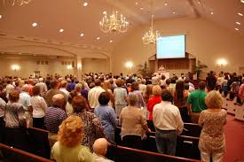
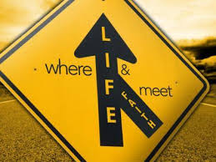

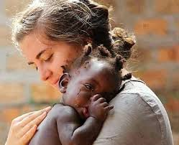
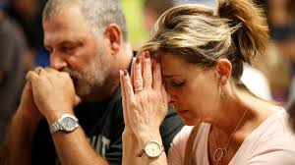
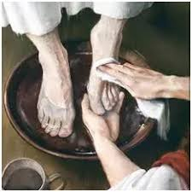

Get Visual
C
B
Brainstorm as many ideas as possible (divergent thinking). Then before narrowing the list (convergent thinking) connect visuals to your ideas.
Share then with the group.
After sharing have each member of the group vote on their top 5 visuals.
D
A
F
E
G

Slide 22
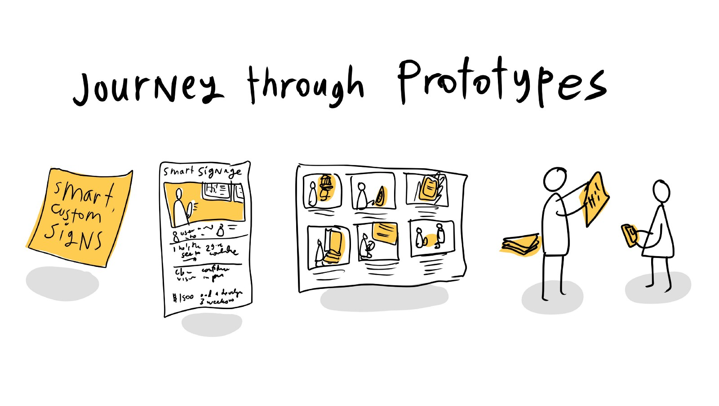
Prototypes
Prototypes shift abstract to physical and back again.
Prototypes are “thinking with your hands.” (Change by Design, 89)
They open our minds to new possibilities.
“The faster we make our ideas tangible, the sooner we will have to be able to evaluate then, refine then, and zero in on the best solution.” (Change by Design, 89)

Slide 23
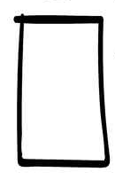
Learning from the future begins with our hands.
Name 5-10 possibly actions that could address your challenge.

Slide 24
Scenario Planning
Gathered
Take two dimensions of an issue,
Place one on the horizontal axis and the other on the vertical axis.
Then complete the four quadrants.
Real Time
Any Time
Scattered

Slide 25
Implications Wheel
Offered age-specific faith formation on another day
Equipped people of all ages with resources for forming with “on their own”
New leaders would emerge
Offered all
types of intergenerational faith formation
People across age groups form relationships
People care for each other
No longer offered Sunday age-specific faith formation
No one would participate

Slide 26
Trends, Innovation, Paradigm Shifts - T.I.P.S.
Cultural Shifts
Spirituality
Technology
Education
Demographics
Economics

Slide 27
Trends, Innovation, Paradigm Shifts - T.I.P.S.
Less commitment to organized religion
Immigrant Patterns
Cultural Shifts
Spirituality
Diversified, Centralized Communication
Problem-based learning
Technology
Education
Artificial Intelligence
Online learning
Demographics
Economics
Aging population
eCommerce
Increasing ethnic diversity

Slide 28
WHAT does this mean?

Slide 29
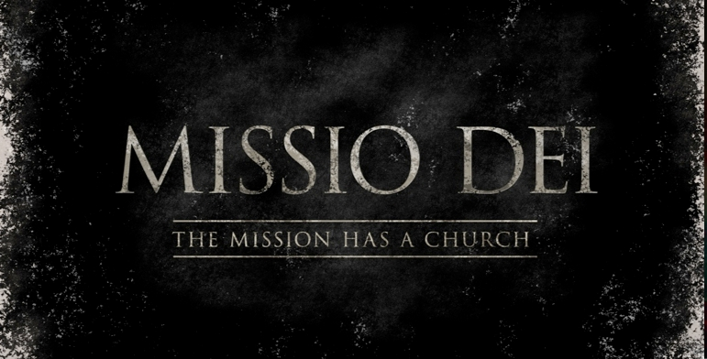
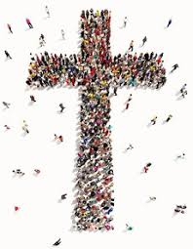
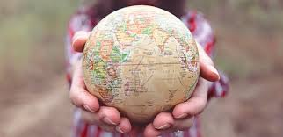
God’s Mission
God so loved the world…
Love God, love your neighbor.
Co-creators of God’s Future.

Slide 30

2 movements
Notes:
Gathering God’s beloved people as the body of Christ - faith forming and informing our lives.
Scattered in the world, God’s people are co-creators of God’s mission transforming the world.

Slide 31





4 commitments
Gift of love
Compass for living
Witness to God’s Story
Agent of God’s love
Notes:
To these two movements we add four commitments that highlight the multi-multi-faceted nature of faith.

Slide 32
What is a life of Faith?
In its simplest form how the Christian faith shapes our encounters with God, others, and the world.
Lifelong pursuit of discovering a Christian way of life.
Discerning and joining God’s activity in our lives and in the world.
Notes:
Faith formation is a messy term that can be used as an umbrella term for: Christian education, discipleship, ministry with children and youth, and intergenerational ministry.
In its simplest form faith formation has to do with how the Christian faith shapes people as they encounter God, others, and the world.
Aim - Discovering a Christian way of life -
Faith as a way of life - pattern of our being, doing, and thinking that are shared and to which we assign meaning.

Slide 33
God’s Promised Future
God is about abundant life, for all of creation and for us.
God’s kingdom unfolding around us about about God’s promised future breaking into our current time,
While God’s vision is real, we live in a “now and not yet” world.
Revelation 21:1,3-7
Notes:
God’s vision is a view of life that is abundant - there is enough for all to thrive. It is not scarcity, but love that when shared multiples.
God’s overflowing love flows through us into the world as we love and serve our neighbor.

Slide 34
What are you taking away?
Notes:
Organizations arise to “change lives, change communities” (Peter Drucker)
Does An Organization’s Structure HINDER or FOSTER connections, meaning, impact?
Structure becomes invisible-hence, need to raise question

