Slide 1

Rethinking Church in a Connected World 2
Terri Martinson Elton
terrielton.com

Slide 2

Are we ready for the future?

Slide 3
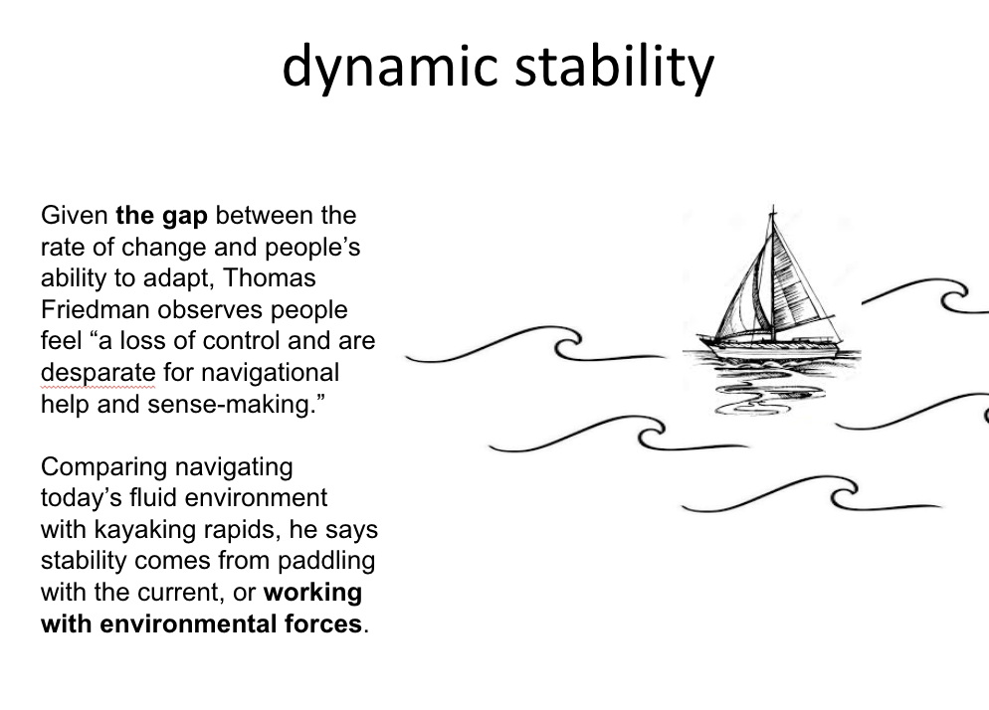
Notes:
We need GPS for forming faith - a way to navigating our VUCA world that allows us to find balance and meaning in the midst of unending changes.

Slide 4
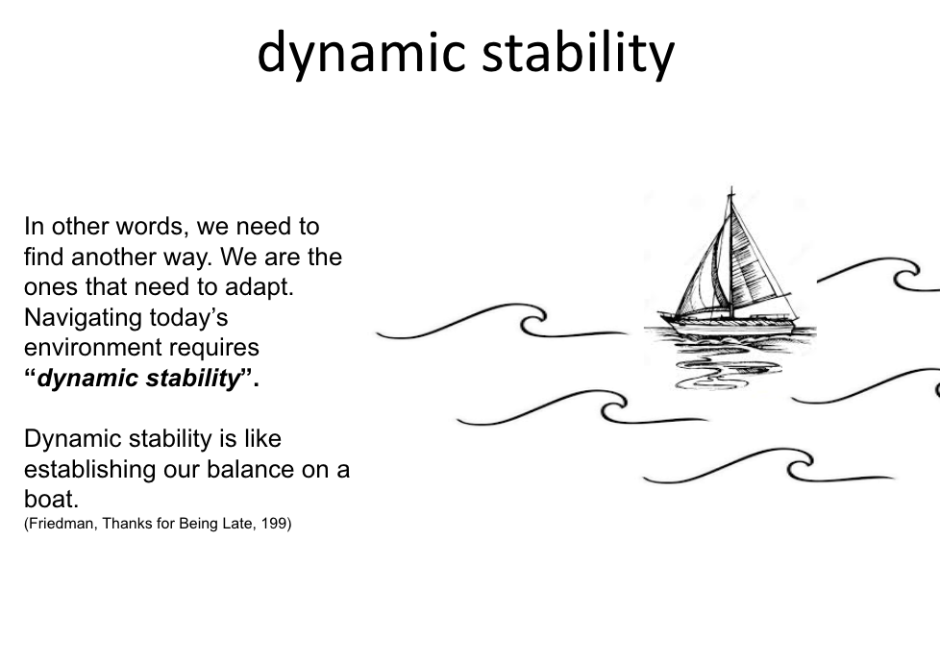
Notes:
We need GPS for forming faith - a way to navigating our VUCA world that allows us to find balance and meaning in the midst of unending changes.

Slide 5

HOW are we working with our environment?

Slide 6
GPS for church
what tools allow us to recalibrate along the way?

Slide 7
Practices
Discovering the real challenge - 5 Whys
Who is the user? Doing deeper - Guided Tour
Imagining - Get Visual
Preparing for possible situations - Scenario Planning
Consequences for choices - Implications Wheel
Looking into the future - T.I.P.S

Slide 8
Whys
Defining the Challenge
5

Slide 9

Guided Tour
Getting to Know the User
Arrange for a tour of a home or work place of someone you are designing. With another person have them give you a tour of the space.
What questions would you ask? Why?
What would you want to discover?
What would be important to remember?

Slide 10
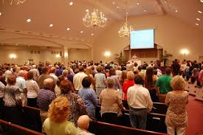


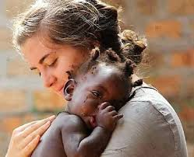
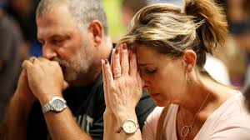
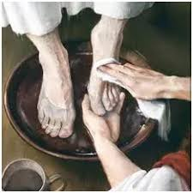

Get Visual
C
B
Brainstorm as many ideas as possible (divergent thinking). Then before narrowing the list (convergent thinking) connect visuals to your ideas.
Share then with the group.
After sharing have each member of the group vote on their top 5 visuals.
D
A
F
E
A Life of Faith
G

Slide 11
Scenario Planning
Possible Futures
Gathered
Take two dimensions of an issue,
Place one on the horizontal axis and the other on the vertical axis.
Then complete the four quadrants.
Real Time
Any Time
Scattered

Slide 12
Implications Wheel
Consequences of Various Actions
Offer age-specific faith formation on another day
Equip people of all ages with resources for forming with “on their own”
New leaders would emerge
Offer all
types of intergenerational faith formation
People across age groups form relationships
People care for each other
No longer offering Sunday age-specific faith formation
No one would participate

Slide 13
Trends, Innovation, Paradigm Shifts - T.I.P.S.
Environmental Forces
Cultural Shifts
Spirituality
Technology
Education
Demographics
Economics

Slide 14
Trends, Innovation, Paradigm Shifts - T.I.P.S.
Less commitment to organized religion
Immigrant Patterns
Cultural Shifts
Spirituality
Diversified, Centralized Communication
Problem-based learning
Technology
Education
Artificial Intelligence
Online learning
Demographics
Economics
Aging population
eCommerce
Increasing ethnic diversity

Slide 15
WHAT does this mean?

Slide 16

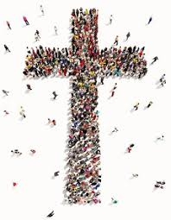

God’s Mission
God so loved the world…
Love God, love your neighbor.
Co-creators of God’s Future.

Slide 17

2 movements
Notes:
Gathering God’s beloved people as the body of Christ - faith forming and informing our lives.
Scattered in the world, God’s people are co-creators of God’s mission transforming the world.

Slide 18





4 commitments
Gift of love
Compass for living
Witness to God’s Story
Agent of God’s love
Notes:
To these two movements we add four commitments that highlight the multi-multi-faceted nature of faith.

Slide 19

What is a life of Faith?
In its simplest form how the Christian faith shapes our encounters with God, others, and the world.
Lifelong pursuit of discovering a Christian way of life.
Discerning and joining God’s activity in our lives and in the world.
Notes:
Faith formation is a messy term that can be used as an umbrella term for: Christian education, discipleship, ministry with children and youth, and intergenerational ministry.
In its simplest form faith formation has to do with how the Christian faith shapes people as they encounter God, others, and the world.
Aim - Discovering a Christian way of life -
Faith as a way of life - pattern of our being, doing, and thinking that are shared and to which we assign meaning.

Slide 20

God’s Promised Future
God is about abundant life, for all of creation and for us.
God’s kingdom unfolding around us about about God’s promised future breaking into our current time,
While God’s vision is real, we live in a “now and not yet” world.
Revelation 21:1,3-7
Notes:
God’s vision is a view of life that is abundant - there is enough for all to thrive. It is not scarcity, but love that when shared multiples.
God’s overflowing love flows through us into the world as we love and serve our neighbor.

Slide 21
What are you taking away?
Notes:
Organizations arise to “change lives, change communities” (Peter Drucker)
Does An Organization’s Structure HINDER or FOSTER connections, meaning, impact?
Structure becomes invisible-hence, need to raise question

