Slide 1

Rethinking Church in a Connected World
Terri Martinson Elton
terrielton.com

Slide 2
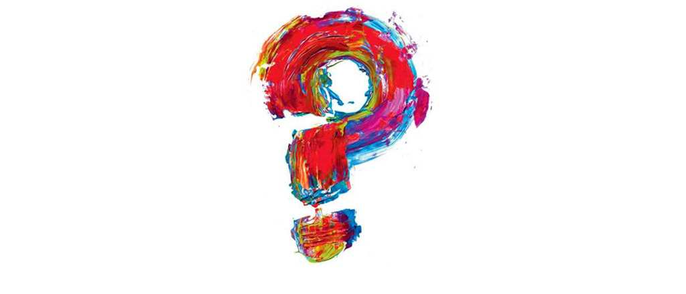
WHY?

Slide 3
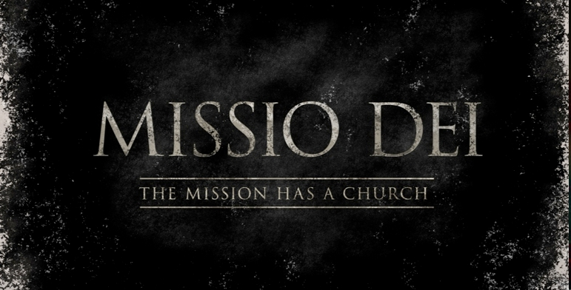
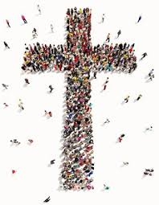

God’s Mission
God so loved the world…
Love God, love your neighbor.
Co-creators of God’s Future.

Slide 4

2 movements
Notes:
Gathering God’s beloved people as the body of Christ - faith forming and informing our lives.
Scattered in the world, God’s people are co-creators of God’s mission transforming the world.

Slide 5
2 movements
Gathered in community we discover our identity and participate in Christian practices, encounter God’s story, and live in relationship with other people of faith.
Scattered in the world we participate in God’s mission of loving the world as we encounter difference, name pain and injustice, and love and serve others.
Notes:
Gathered in community we discover our identity and participate in Christian practices, encounter God’s story, and live with other people of faith.
Scattered in the world we participate in God’s mission of loving the world as we encounter difference, name pain and injustice, and love and serve others.
Most of our time, in the past, has been on our time gathered. Yet most of our lives are lived scattered in the world. AND faith, as a way of life, is about all of life, not just our time in Christian community.
What if we took rethought our time gathered as accompanying people of faith to discover a Christian way of life scattered? What difference would that make?

Slide 6


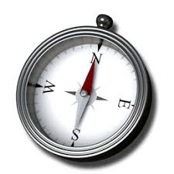

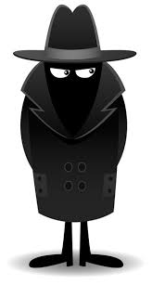
4 commitments
Gift of love
Compass for living
Witness to God’s Story
Agent of God’s love
Notes:
To these two movements we add four commitments that highlight the multi-multi-faceted nature of faith.

Slide 7
WHY do we exist?

Slide 8
What if it’s time to
ask new questions?

Slide 9
HOW?

Slide 10
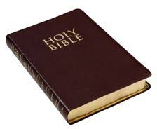
We are leading in disruptive times.
The past is not the best indicator for the future.
But people of faith have been disrupted in the past.
“What does it mean to stewards of a faith tradition with an eye toward a vital future?”
Notes:
Organizations arise to “change lives, change communities” (Peter Drucker)
Does An Organization’s Structure HINDER or FOSTER connections, meaning, impact?
Structure becomes invisible-hence, need to raise question

Slide 11
Characteristics of a steward.
- tend someone else’s resources
- work toward thriving
- must be aware of environmental changes
- time limited (will hand it off)

Slide 12
If leaders are stewards of a faith tradition they…
- know the mission
- hold ownership loosely
- look backwards and forwards
- nurture vitality
- work with contextual realities

Slide 13

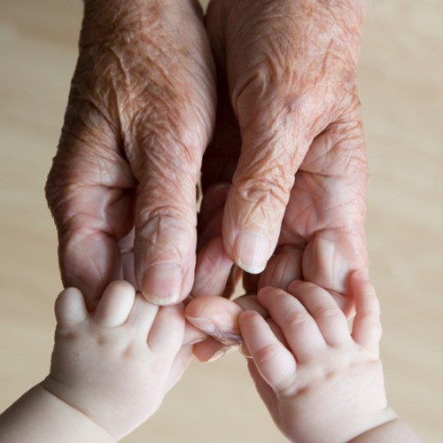
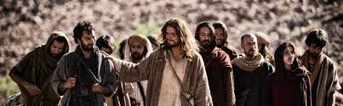

Church’s calling
to steward the future witness to the Christian faith.
Notes:
Congregations are called to steward the future witness to the Christian faith. God’s love for us is steady and trustworthy, but the future does not look like the past.
This is a pivotal moment. Our highly dynamic context is being disrupted at accelerating speeds and we, the church have the opportunity to join God’s movement in the world or hold tightly to the past.
Our God is a God who makes all things new, who brings order out of chaos and life out of death. God’s deepest desire is for all to live abundantly. Our way forward is relying on God, of embracing God’s call for us and letting God’s love orient our lives.

Slide 14
HOW?

Slide 15
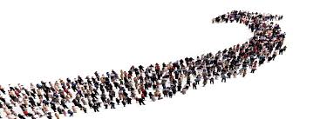
The church is a living entity called to be the body of Christ on earth.
"What if the church operated more like a movement?”

Slide 16
Characteristics of a movement.
- from bottom-up
- does not rely on dominant culture
- relies on relational ties
- practices integrate new behavior into everyday life

Slide 17
If the church was a movement it would…
- tend to connectivity
- ignite energy around a shared mission
- decentralize leadership (empower others)
- cultivate diverse relationships and embrace difference
- assume an unstable environment
- celebrate forward movement

Slide 18

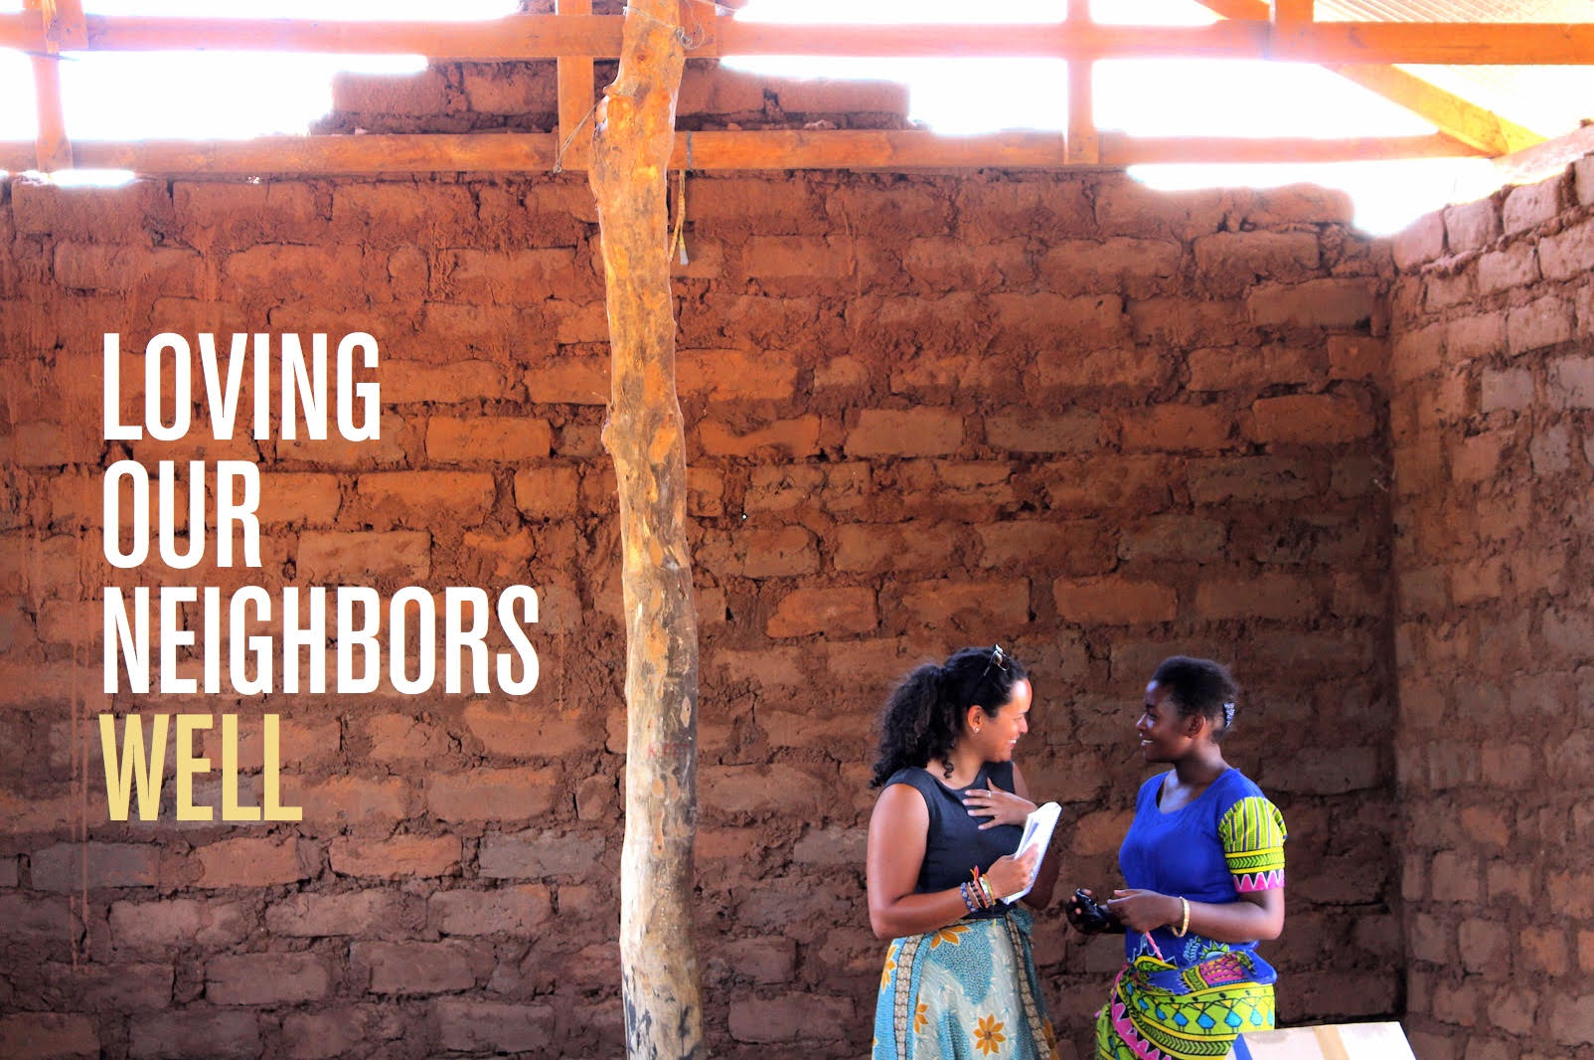
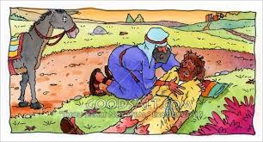

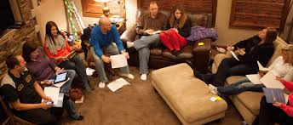
Church as Movement
so all of may live abundantly
Notes:
Congregations are called to steward the future witness to the Christian faith. God’s love for us is steady and trustworthy, but the future does not look like the past.
This is a pivotal moment. Our highly dynamic context is being disrupted at accelerating speeds and we, the church have the opportunity to join God’s movement in the world or hold tightly to the past.
Our God is a God who makes all things new, who brings order out of chaos and life out of death. God’s deepest desire is for all to live abundantly. Our way forward is relying on God, of embracing God’s call for us and letting God’s love orient our lives.

Slide 19
HOW?

Slide 20

Congregations are not the ends, but a means for nurturing faith and participating in God’s mission.
“What if congregations operated more like platforms than self-sustaining organizations?”

Slide 21
Characteristics of a platform.
- porous boundaries
- centered-set or self-organizing hub
- rely on bonding and bridging
  relational ties
- empower participants to solve problems
- facilitate flow

Slide 22
If congregations are more like platforms…
- they have an eye to the future
- they collaborate and integrate
- they focus on engagement
- they reduce barriers
- they connect what happens in the platform with life outside (context and people’s lives)

Slide 23
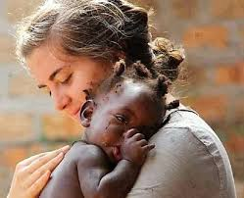
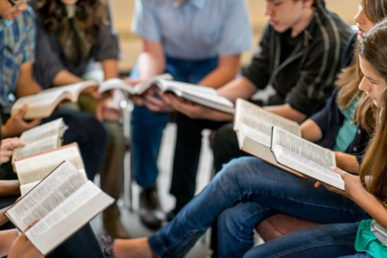

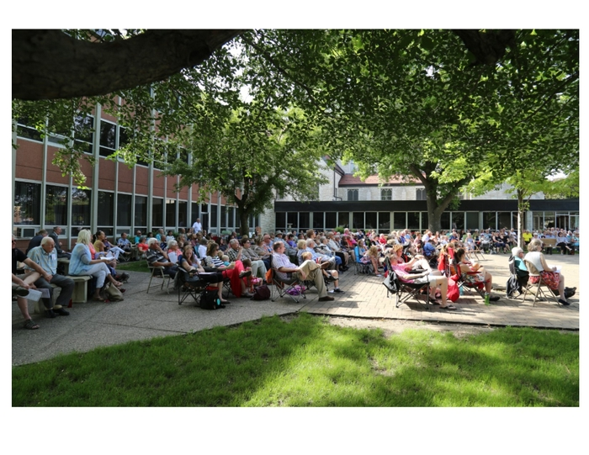
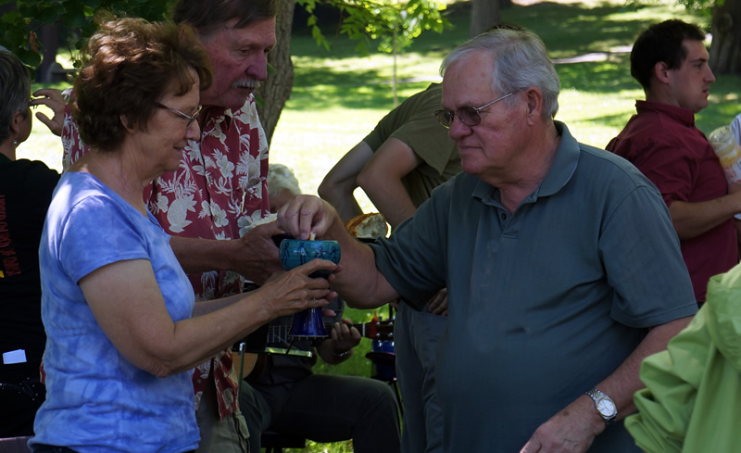
Congregations as Platform
for loving God and our Neighbor
Notes:
Congregations are called to steward the future witness to the Christian faith. God’s love for us is steady and trustworthy, but the future does not look like the past.
This is a pivotal moment. Our highly dynamic context is being disrupted at accelerating speeds and we, the church have the opportunity to join God’s movement in the world or hold tightly to the past.
Our God is a God who makes all things new, who brings order out of chaos and life out of death. God’s deepest desire is for all to live abundantly. Our way forward is relying on God, of embracing God’s call for us and letting God’s love orient our lives.

Slide 24
Structure matters!

Slide 25
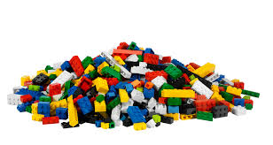
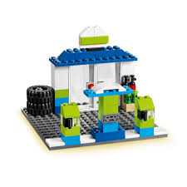
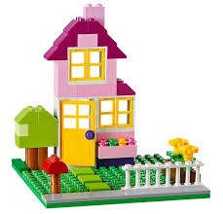
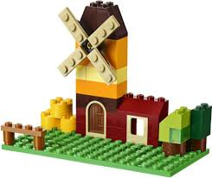
Structures put together
similar components
in different ways.

Slide 26
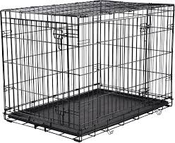
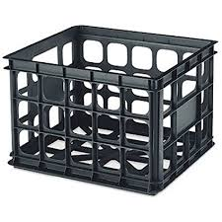
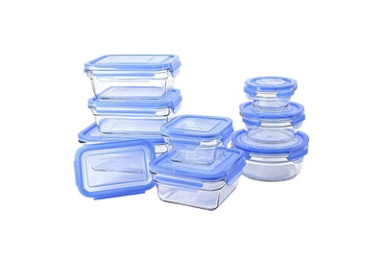
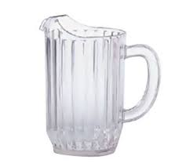
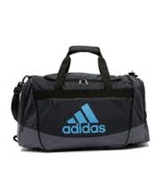
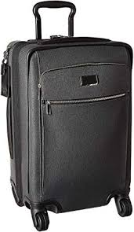
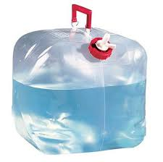
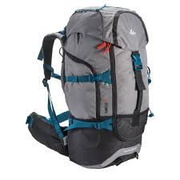
All structures were designed for
different purposes.

Slide 27

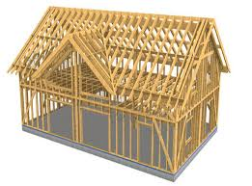
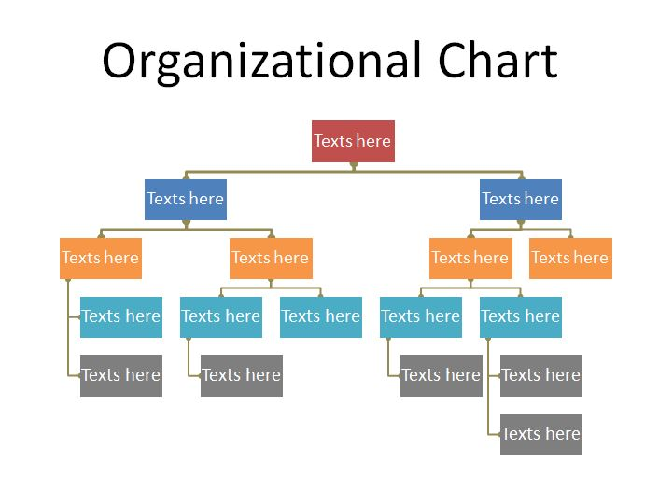
Each structure is created
to accomplish and/or
accelerate a mission.

Slide 28

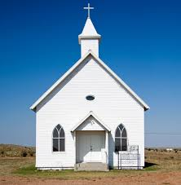
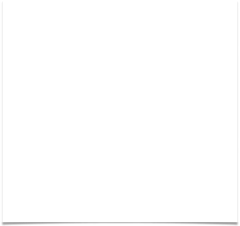
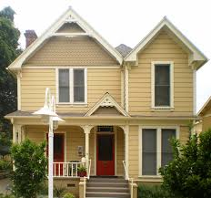
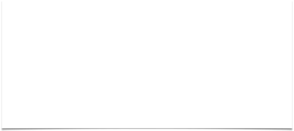
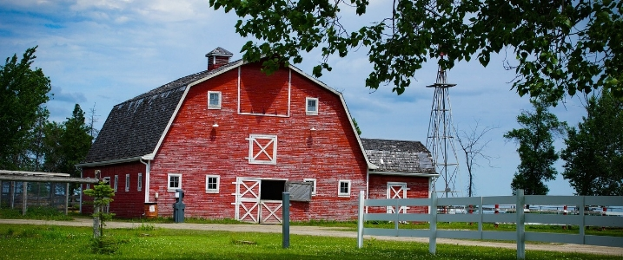
Embedded within all structures are core values.
Structures are designed to privilege and prioritize certain values.

Slide 29

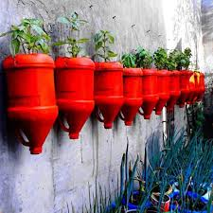


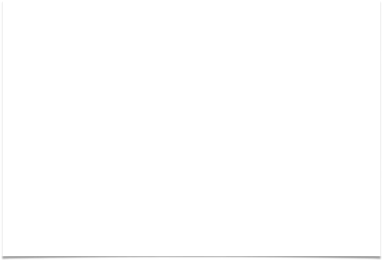
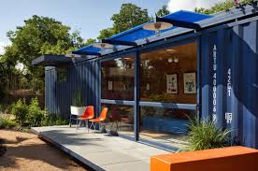

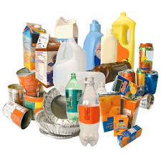
Structures have lifespans.
Keeping organizations vital requires tending, recycling, repurposing, and/or reconfiguring.

Slide 30
The Evolution of Organizations

Slide 31
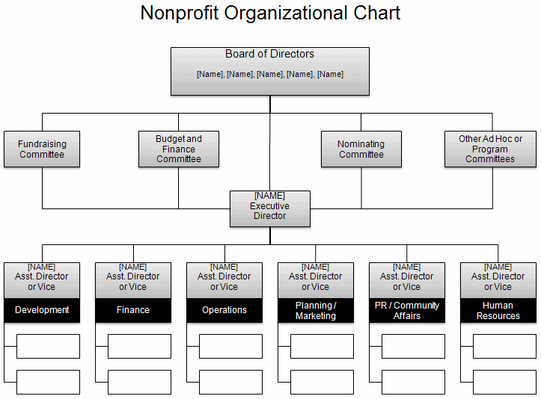
Organizations
1.0
1.0 - Hierarchies
Organizational chart
Clear centralized communication
Production is key
Good for routine/quality control/solving known problems
People specialize and are to be managed
Direction/vision decided from the top - flows down
Work flows up
Universal practices - apply across contexts
Change via strategy
Born in the Modern Era
Notes:
Org. 1.0- until about mid-1990’s; Central physical address; Command and control; symbol: hierarchical org. chart
Org. 20-from mid-1990’s to June 29, 2007 : Still command control; Central physical address w/Parallel web presence
Org. 3.0 – iPhone – social networking available to masses
Physical and web locations blur; fluidity of behavior on web flows back into bricks and mortar
24/7/365 availability; need to think I.P address and P.O. (post office) physical address

Slide 32
Organizations
1.0
Information Flow
Centralized and Controlled
Clear guidelines policies, boundaries
designed for efficiency
look to past for best practices or standards
Role People Play
Specialized roles
Authority determined by training/degree/credentials and position
Recruit members
Efficient use of resources
Supervision - up and down
honor tradition
commitment to institution
Communication
flow is predictable - create pattern, use it.
Regulatory or franchise model
Value excellence or quality control
centralize/one public voice
Born in the Modern Era
Notes:
Org. 1.0- until about mid-1990’s; Central physical address; Command and control; symbol: hierarchical org. chart
Org. 20-from mid-1990’s to June 29, 2007 : Still command control; Central physical address w/Parallel web presence
Org. 3.0 – iPhone – social networking available to masses
Physical and web locations blur; fluidity of behavior on web flows back into bricks and mortar
24/7/365 availability; need to think I.P address and P.O. (post office) physical address

Slide 33
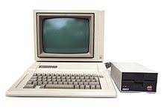
Organizations
2.0
Digital world pre-iPhone
Digital tools to enhance 1.0 world/values.
Brick and mortar mirrors bytes and clicks world.
Communication is the same on all platforms (newsletter, announcements in worship, on website).
Centralized communication strategy.
Tested/pushed 1.0 values, with little modification.
Emerged in early Postmodern Era
Notes:
Org. 1.0- until about mid-1990’s; Central physical address; Command and control; symbol: hierarchical org. chart
Org. 20-from mid-1990’s to June 29, 2007 : Still command control; Central physical address w/Parallel web presence
Org. 3.0 – iPhone – social networking available to masses
Physical and web locations blur; fluidity of behavior on web flows back into bricks and mortar
24/7/365 availability; need to think I.P address and P.O. (post office) physical address

Slide 34
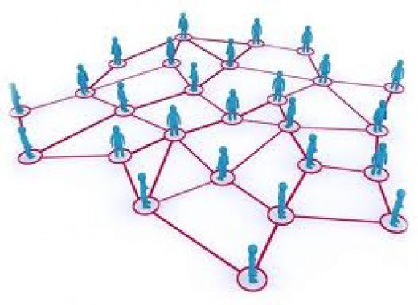
Organizations
3.0
Digital world - Facebook/iPhone
Integrated and global - 2007 marked a shift - iPhone, big data, Facebook, internet has global reach, AI
Decentralized and diversified
Environment is not predictable (VUCA) - focus on conditions, not outcomes.
Adaptive challenge and complexity
Empower “all” - ease of creating and collaborating
Generous - gift economy
Open and transparent
Self-directed, not led but internal motivation
Crowdsourcing - curation.
DIY - amateur valued less than professional.
Change via mass participation.
The “Post” Era:
Post-modern
Post-denomination
Post-industrial
Notes:
Org. 1.0- until about mid-1990’s; Central physical address; Command and control; symbol: hierarchical org. chart
Org. 20-from mid-1990’s to June 29, 2007 : Still command control; Central physical address w/Parallel web presence
Org. 3.0 – iPhone – social networking available to masses
Physical and web locations blur; fluidity of behavior on web flows back into bricks and mortar
24/7/365 availability; need to think I.P address and P.O. (post office) physical address

Slide 35
Organizations
3.0
Information Flow
flow takes place through people (not position or structure)
Used to solve problems
freely shared and accessible.
must be pushed and curated
Role People Play
nurture relational ties
collaborate across diverse areas to address complex problem
authority by expertise, passion or experience
value related to commitment to mission
eye to the future
value innovation
Communication
decentralized and diversified means and methods
online and in-person
inclusive or open to anyone willing to contribute.
internal and external
fluid and improvisational - adapts to circumstances
Notes:
Org. 1.0- until about mid-1990’s; Central physical address; Command and control; symbol: hierarchical org. chart
Org. 20-from mid-1990’s to June 29, 2007 : Still command control; Central physical address w/Parallel web presence
Org. 3.0 – iPhone – social networking available to masses
Physical and web locations blur; fluidity of behavior on web flows back into bricks and mortar
24/7/365 availability; need to think I.P address and P.O. (post office) physical address

Slide 36

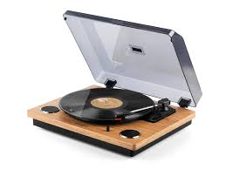
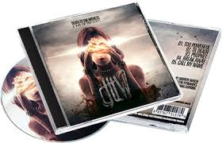
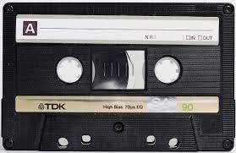
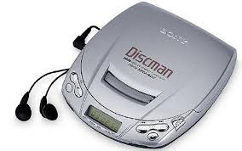
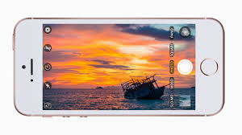

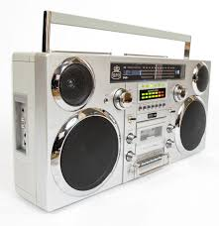


1.0 to 3.0

Slide 37
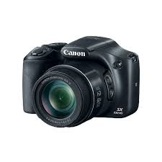




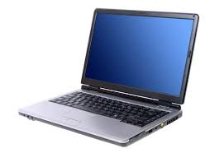


1.0 to 3.0

Slide 38
HOW?

Slide 39
Organization1.0
Organization 3.0
Hierarchies
Organizational chart
Clear centralized communication
Production is key
Good for routine/quality control/solving known problems
People specialize and are to be managed
Direction/vision decided from the top - flows down
Work flows up
Universal practices - apply across contexts
Change via strategy
Digital world - Facebook/iPhone
Integrated and global - 2007 marked a shift - iPhone, big data, Facebook, internet has global reach, AI
Decentralized and diversified
Environment is not predictable (VUCA) - focus on conditions, not outcomes.
Adaptive challenge and complexity
Empower “all” - ease of creating and collaborating
Generous - gift economy
Open and transparent
Self-directed, not led
Crowdsourcing - curation.
DIY - amateur valued less than professional.
Change via mass participation
Notes:
Org. 1.0- until about mid-1990’s; Central physical address; Command and control; symbol: hierarchical org. chart
Org. 20-from mid-1990’s to June 29, 2007 : Still command control; Central physical address w/Parallel web presence
Org. 3.0 – iPhone – social networking available to masses
Physical and web locations blur; fluidity of behavior on web flows back into bricks and mortar
24/7/365 availability; need to think I.P address and P.O. (post office) physical address

Slide 40
HOW are we living out our why?

