Slide 1



Leading in a 3.0 World
Terri Martinson Elton
terrielton.com

Slide 2
Structure matters!

Slide 3
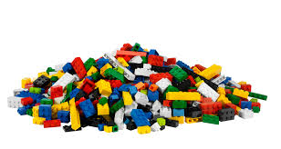
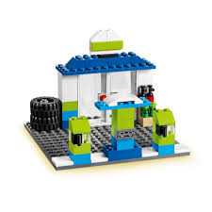
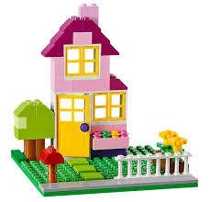
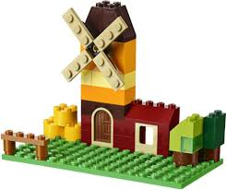
Structures put together
similar components
in different ways.

Slide 4
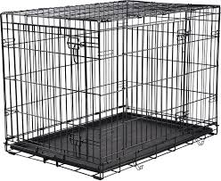
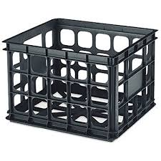
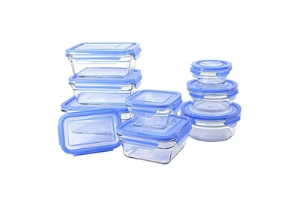
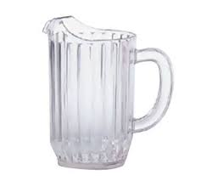
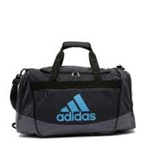
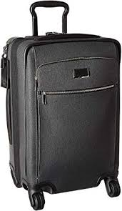
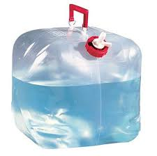
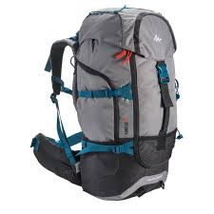
All structures were designed for
different purposes.

Slide 5

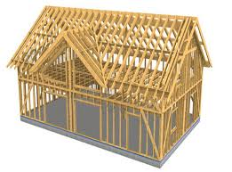
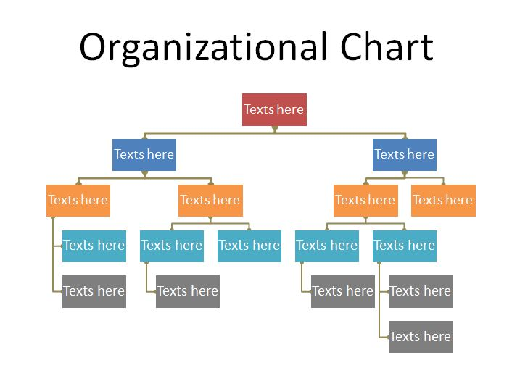
Each structure is created
to accomplish and/or
accelerate a mission.

Slide 6

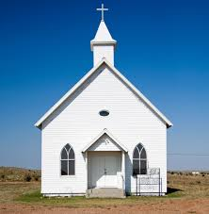

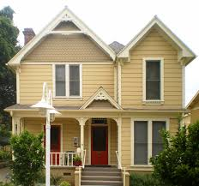

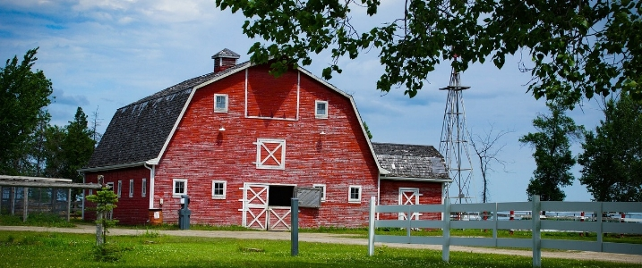
Embedded within all structures are core values.
Structures are designed to privilege and prioritize certain values.

Slide 7





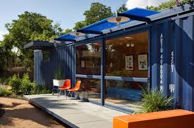


Structures have lifespans.
Keeping organizations vital requires tending, recycling, repurposing, and/or reconfiguring.

Slide 8
The Evolution of Organizations

Slide 9
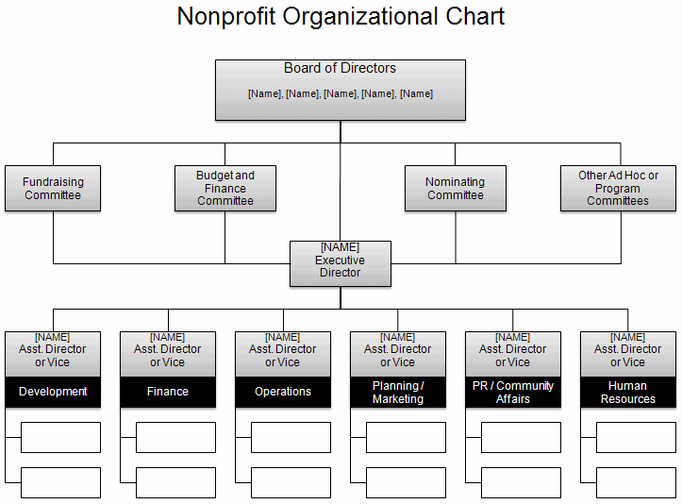
Organizations
1.0
1.0 - Hierarchies
Organizational chart
Clear centralized communication
Production is key
Good for routine/quality control/solving known problems
People specialize and are to be managed
Direction/vision decided from the top - flows down
Work flows up
Universal practices - apply across contexts
Born in the Modern Era
Notes:
Org. 1.0- until about mid-1990’s; Central physical address; Command and control; symbol: hierarchical org. chart
Org. 20-from mid-1990’s to June 29, 2007 : Still command control; Central physical address w/Parallel web presence
Org. 3.0 – iPhone – social networking available to masses
Physical and web locations blur; fluidity of behavior on web flows back into bricks and mortar
24/7/365 availability; need to think I.P address and P.O. (post office) physical address

Slide 10
Organizations
1.0
Information Flow
Centralized and Controlled
Clear guidelines policies, boundaries
designed for efficiency
look to past for best practices or standards
Role People Play
Specialized roles
Authority determined by training/degree/credentials and position
Recruit members
Efficient use of resources
Supervision - up and down
honor tradition
commitment to institution
Communication
flow is predictable - create pattern, use it.
Regulatory or franchise model
Value excellence or quality control
centralize/one public voice
Born in the Modern Era
Notes:
Org. 1.0- until about mid-1990’s; Central physical address; Command and control; symbol: hierarchical org. chart
Org. 20-from mid-1990’s to June 29, 2007 : Still command control; Central physical address w/Parallel web presence
Org. 3.0 – iPhone – social networking available to masses
Physical and web locations blur; fluidity of behavior on web flows back into bricks and mortar
24/7/365 availability; need to think I.P address and P.O. (post office) physical address

Slide 11

Organizations
2.0
Digital world pre-iPhone
Digital tools to enhance 1.0 world/values.
Brick and mortar mirrors bytes and clicks world.
Communication is the same on all platforms (newsletter, announcements in worship, on website).
Centralized communication strategy.
Tested/pushed 1.0 values, with little modification.
Emerged in early Postmodern Era
Notes:
Org. 1.0- until about mid-1990’s; Central physical address; Command and control; symbol: hierarchical org. chart
Org. 20-from mid-1990’s to June 29, 2007 : Still command control; Central physical address w/Parallel web presence
Org. 3.0 – iPhone – social networking available to masses
Physical and web locations blur; fluidity of behavior on web flows back into bricks and mortar
24/7/365 availability; need to think I.P address and P.O. (post office) physical address

Slide 12
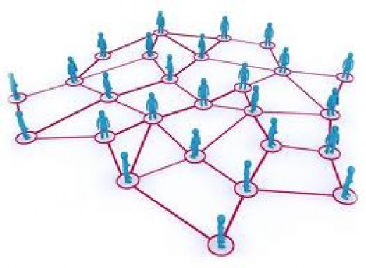
Organizations
3.0
Digital world - Facebook/iPhone
Integrated and global - 2007 marked a shift - iPhone, big data, Facebook, internet has global reach, AI
Environment is not predictable (VUCA) - focus on conditions, not outcomes.
Adaptive challenge and complexity
Convergence and interconnected.
Empower “all” - ease of creating and collaborating
Generous - gift economy
Open and transparent
Self-directed, not led but internal motivation
Crowdsourcing - curation.
DIY - amateur valued less than professional.
The “Post” Era:
Post-modern
Post-denomination
Post-industrial
Notes:
Org. 1.0- until about mid-1990’s; Central physical address; Command and control; symbol: hierarchical org. chart
Org. 20-from mid-1990’s to June 29, 2007 : Still command control; Central physical address w/Parallel web presence
Org. 3.0 – iPhone – social networking available to masses
Physical and web locations blur; fluidity of behavior on web flows back into bricks and mortar
24/7/365 availability; need to think I.P address and P.O. (post office) physical address

Slide 13
Organizations
3.0
Information Flow
flow takes place through people (not position or structure)
Used to solve problems
freely shared and accessible.
must be pushed and curated
Role People Play
nurture relational ties
collaborate across diverse areas to address complex problem
authority by expertise, passion or experience
value related to commitment to mission
eye to the future
value innovation
Communication
decentralized and diversified means and methods
online and in-person
inclusive or open to anyone willing to contribute.
internal and external
fluid and improvisational - adapts to circumstances
Notes:
Org. 1.0- until about mid-1990’s; Central physical address; Command and control; symbol: hierarchical org. chart
Org. 20-from mid-1990’s to June 29, 2007 : Still command control; Central physical address w/Parallel web presence
Org. 3.0 – iPhone – social networking available to masses
Physical and web locations blur; fluidity of behavior on web flows back into bricks and mortar
24/7/365 availability; need to think I.P address and P.O. (post office) physical address

Slide 14

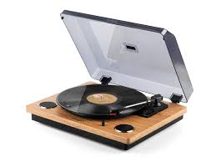


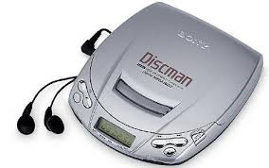


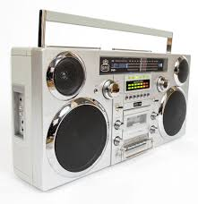


1.0 to 3.0

Slide 15
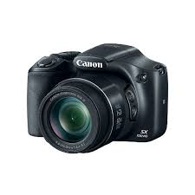







1.0 to 3.0

Slide 16
Group Exercise:
A good friend’s baby was born early. Mom, baby (and Dad) are doing fine. The hospital is several hours from their home and they anticipate the baby will be in the hospital for at least 3-6 weeks. You want to care for this family and rally others to support them in various ways.
Real World Scenario
Notes:
Organizations arise to “change lives, change communities” (Peter Drucker)
Does An Organization’s Structure HINDER or FOSTER connections, meaning, impact?
Structure becomes invisible-hence, need to raise question

Slide 17

What can people do to support this family?
Who would you enlist to help?
How will you communicate with the people involved?
How will these actions support the family?
What do you hope they will experience?
Notes:
Organizations arise to “change lives, change communities” (Peter Drucker)
Does An Organization’s Structure HINDER or FOSTER connections, meaning, impact?
Structure becomes invisible-hence, need to raise question

Slide 18
What values guided your decisions?
What type of information was important to share?
What means of communication did you use?
What informed your thinking about who should participate?

Slide 19
Group Exercise:
LSS gets a call from a pastor. She is worried about a teenager in her confirmation class. The student is 14, has recently been placed in foster care, and has already been referred to juvenile court at least once for an altercation In school. The girl alternates between being withdrawn and angry. The pastor has known this girl and her family for a long time. The family has had a number of challenges over the years particularly with addiction and all of the challenges that go with substance use disorders. The pastor also knows the foster family and is worried that this arrangement won't offer her much stability for long (the family is already struggling with how to handle her behaviors). The pastor is unsure of where to go for help. This young woman lives in Rugby. What can LSSND do to help? Use 3.0 attributes.
LSS Scenario
Notes:
Organizations arise to “change lives, change communities” (Peter Drucker)
Does An Organization’s Structure HINDER or FOSTER connections, meaning, impact?
Structure becomes invisible-hence, need to raise question

Slide 20
information - How did it flow?What information would you need from across LSS and/or could share?What outside (LSS) information did you need?
communication - What means of communication was helpful? What means did you use to access needed information? How might you share with others what you discovered?
who - What expertise was needed in this scenario? How did you know who had that expertise? What would help you access expertise needed if you didn’t already know?

Slide 21
Personal Exercise:
What is an adaptive or complex scenario you are currently facing in your work?
  Information
  Communication
  People
LSS Scenario
Notes:
Organizations arise to “change lives, change communities” (Peter Drucker)
Does An Organization’s Structure HINDER or FOSTER connections, meaning, impact?
Structure becomes invisible-hence, need to raise question

Slide 22
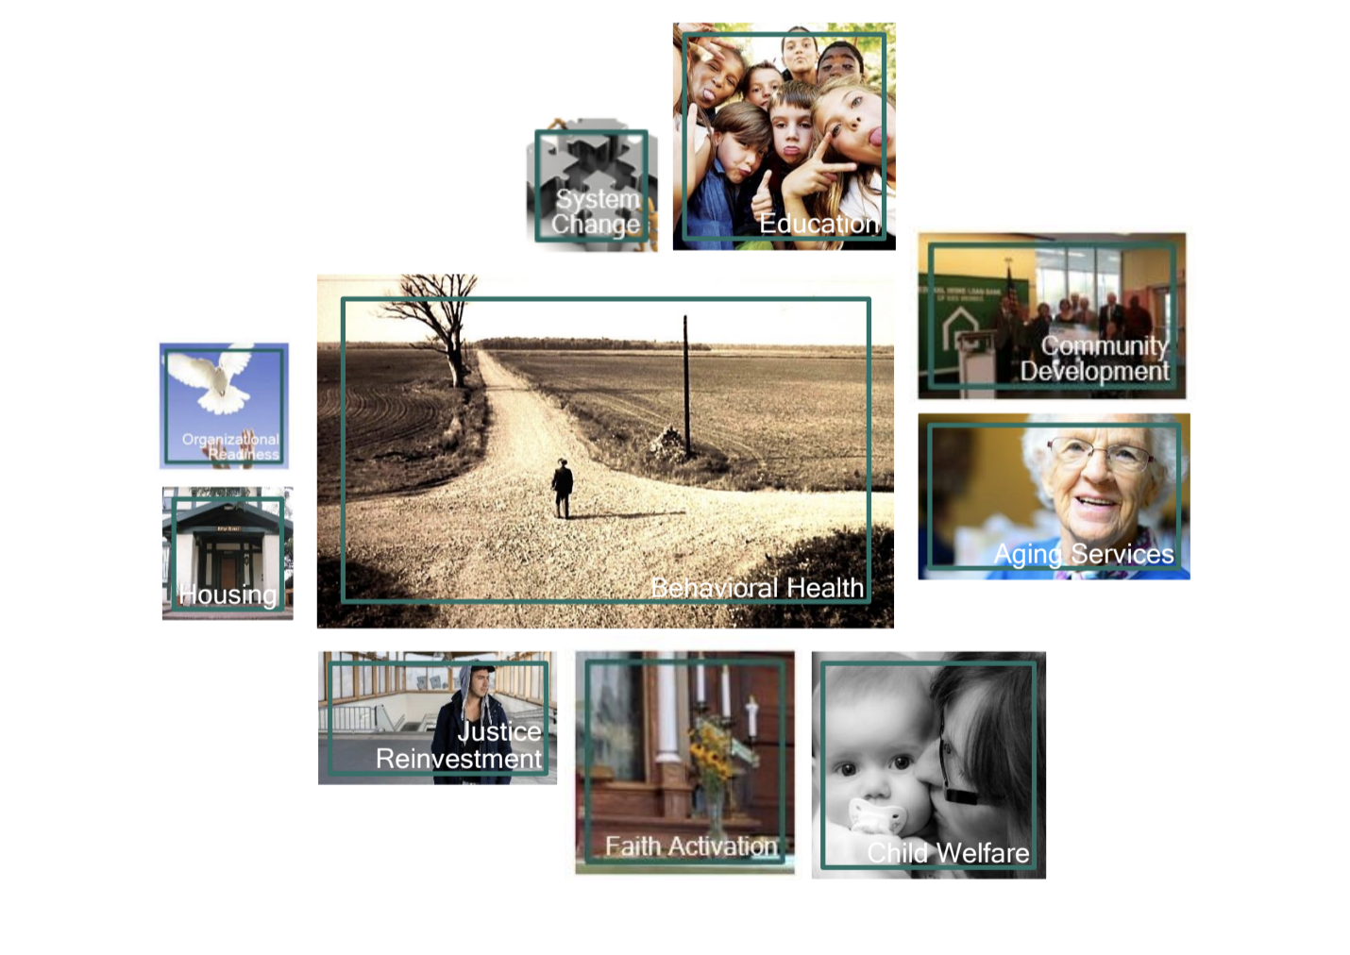
How:
deliver services - in home or in community
Be a connecting point to serve
Restore natural support systems
A team of teams
Competencies:
Care coordination and case management
Facilitating and connecting
Coaching and counseling
Companionship and home visiting
Problem solving with people
Business Strategy:
Deliver, coordinate, or connect people to quality care that meets their unique needs.
Core Values:
trust God who heals and calls
Respond to needs of all people
Provide excellence and integrity
Single Enterprise:
Solving problems. Finding a way forward.
10 strategic frames
Purpose:
Help people live and be well in their family, home and community
Mission:
Guided by God’s love and grace we bring healing, help, and hope

Slide 23

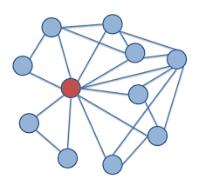
Organizational success relies on information flow.
How do I help move information to those who need it?
Notes:
Organizations arise to “change lives, change communities” (Peter Drucker)
Does An Organization’s Structure HINDER or FOSTER connections, meaning, impact?
Structure becomes invisible-hence, need to raise question

Slide 24

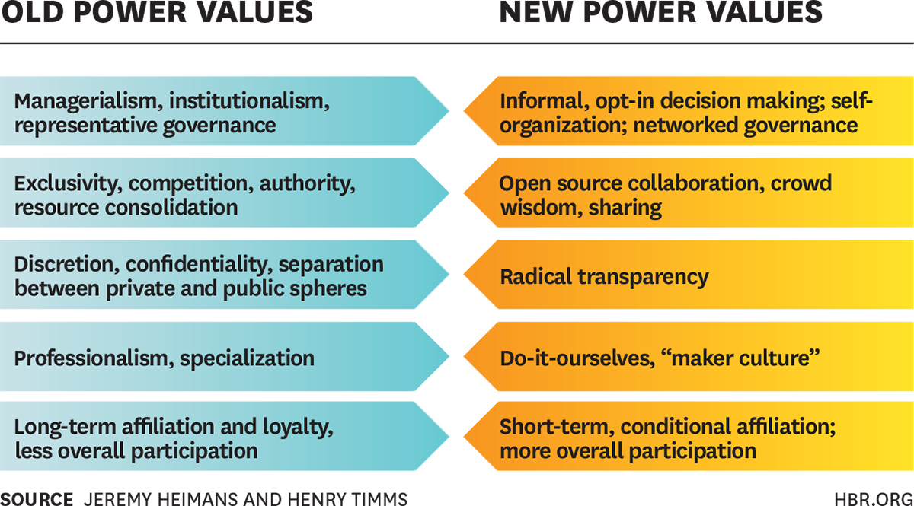
How can I work with new power?

Slide 25


Organizations move into 3.0 organizations through acting their way into a new way.
What practices are you already doing that embrace 3.0 attributes?
What new practices will you try?
Notes:
Organizations arise to “change lives, change communities” (Peter Drucker)
Does An Organization’s Structure HINDER or FOSTER connections, meaning, impact?
Structure becomes invisible-hence, need to raise question

Slide 26



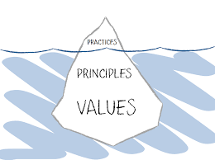




Collective Learning
Cloud
Informal conversations
Partnering - inside and outside
Notes:
Organizations arise to “change lives, change communities” (Peter Drucker)
Does An Organization’s Structure HINDER or FOSTER connections, meaning, impact?
Structure becomes invisible-hence, need to raise question

Slide 27


Personal Action
Name 1 expertise you will share
Name 1 new practice for sharing information
Name 1 way you will contribute to strategic framework
Notes:
Organizations arise to “change lives, change communities” (Peter Drucker)
Does An Organization’s Structure HINDER or FOSTER connections, meaning, impact?
Structure becomes invisible-hence, need to raise question

