Slide 1

Forming Faith in the
21st Century
Wilderness
Adventure
Terri Martinson Elton

Slide 2
An Operating System for
Forming Faith
in the Wilderness
Wilderness
Adventure

Slide 3
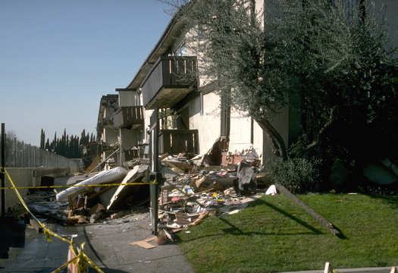

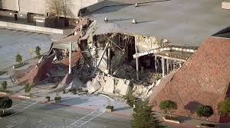
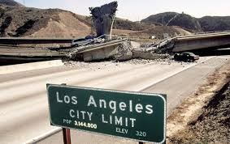
Notes:
What Ground are we standing on?

Slide 4


Notes:
A life of faith is like journeying in the wilderness. No longer defined by this world, we live in this world while not being defined by it. Always becoming who God created us to be, we are continually discerning our path in the midst of unknowns.
Forming faith is always contextual because the Christian faith is an embodied faith lived in the world. So what do we know about today’s environment?

Slide 5
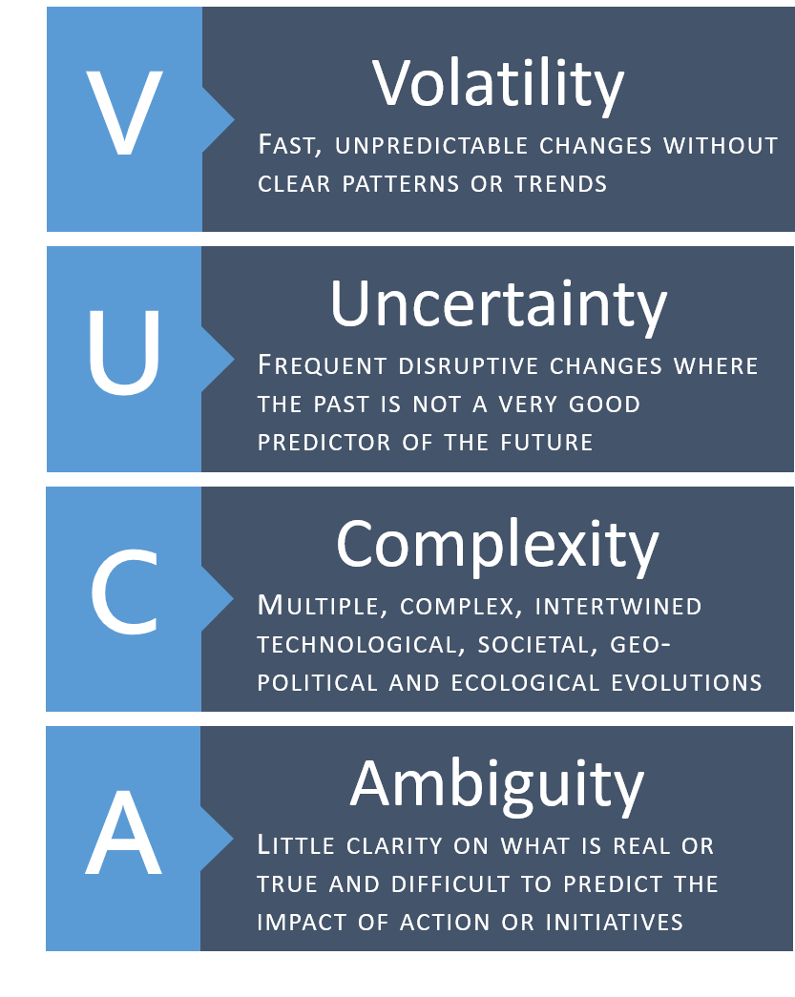
VUCA environment
6 Forces coming together:
Globalization
Technology
Digitalization
Individualization
Demographic Change
Environmental Crisis

Slide 6

Notes:
Most of our approaches to faith formation were created for a different environment, one that was steady (slower rate of change where the past was a strong indicator of what was ahead) and where Christianity held a dominant place in society (or at least worked in partnership with society).
Both of those things have changed. So what do we do?

Slide 7
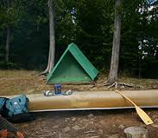
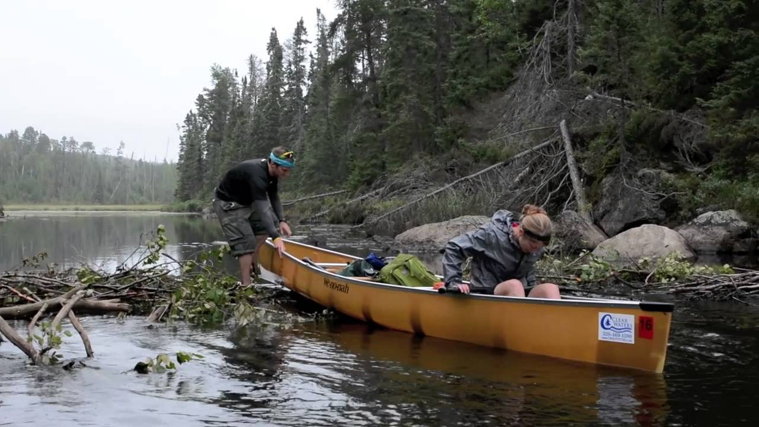
Notes:
Remember our trips to the BWCA. How formative the where for me and my family. That way of life was different than our way of life at home.
What if forming faith in the 21st century was like navigating in the wilderness?

Slide 8
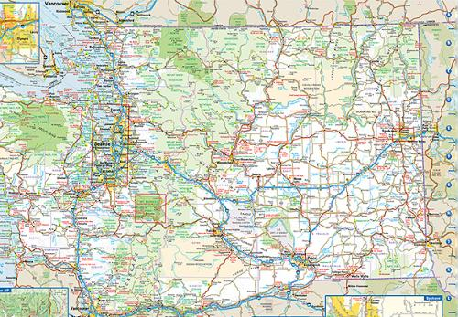
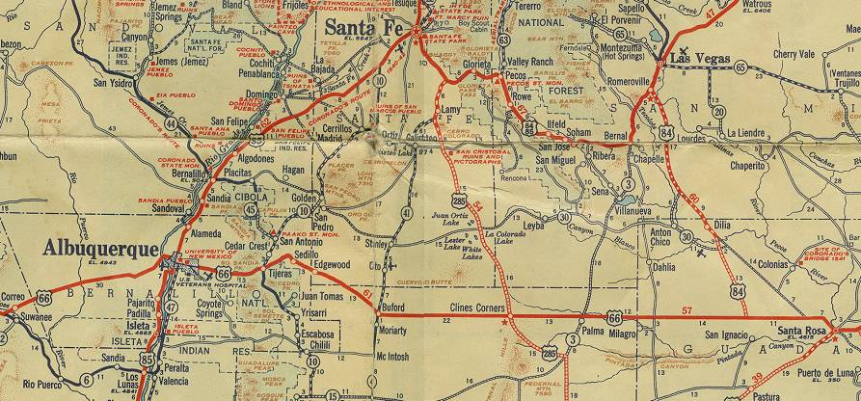

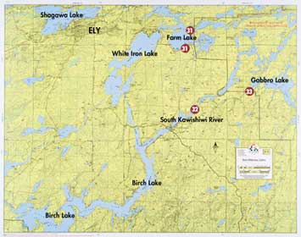
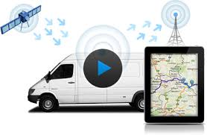
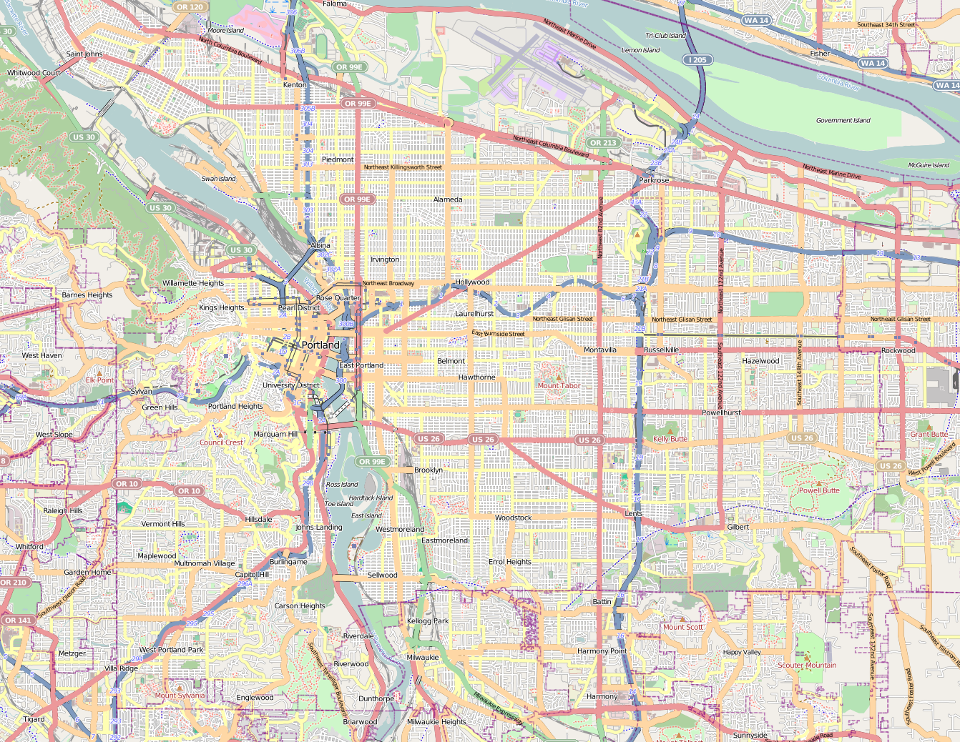
Notes:
I Love maps. Paper maps filled out car.
But paper maps have their limitations.
Today I use a GPS - as it helps me locate myself with the dynamic, every changing conditions.

Slide 9
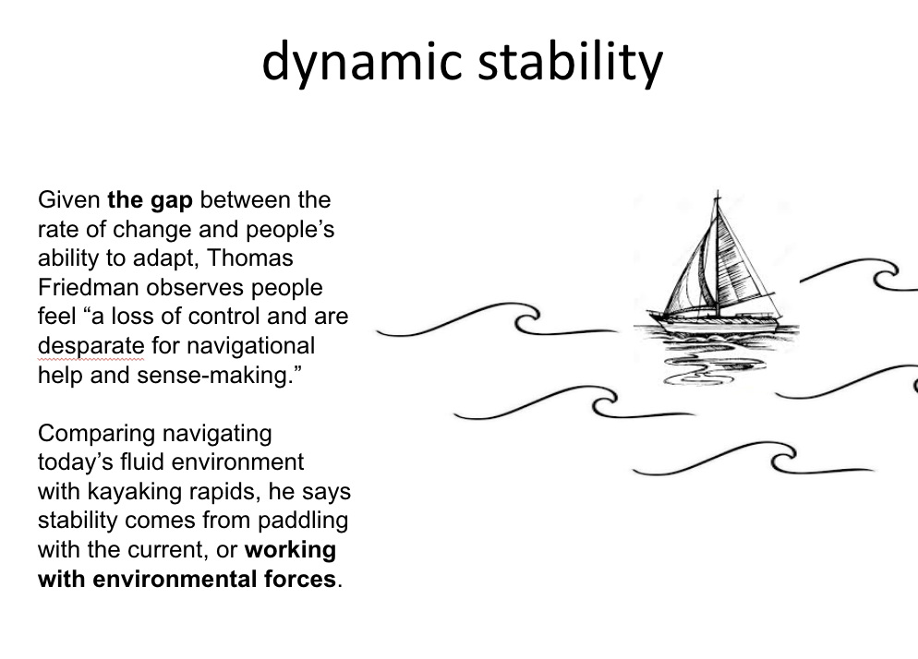
Notes:
We need GPS for forming faith - a way to navigating our VUCA world that allows us to find balance and meaning in the midst of unending changes.

Slide 10
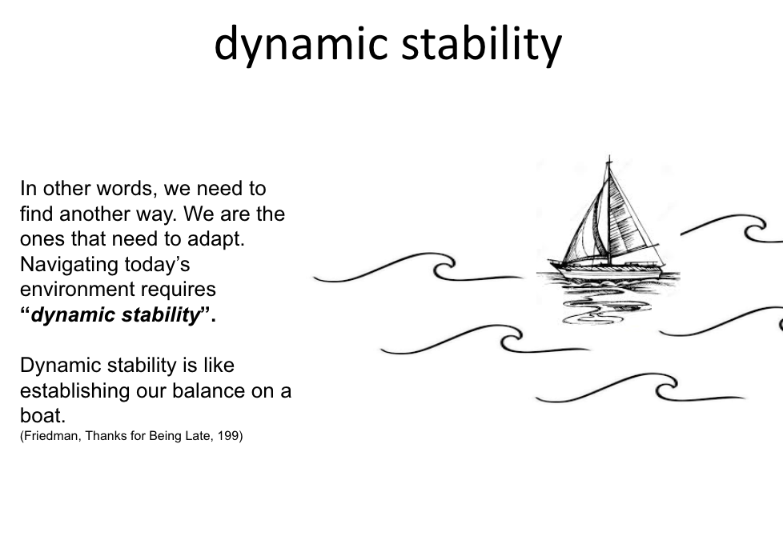
Notes:
We need GPS for forming faith - a way to navigating our VUCA world that allows us to find balance and meaning in the midst of unending changes.

Slide 11

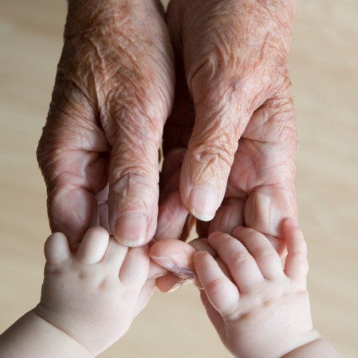
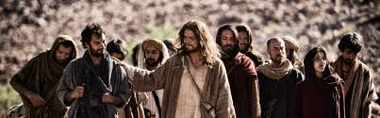

Our calling
is to steward the future witness to the Christian faith.
Notes:
Congregations are called to steward the future witness to the Christian faith. God’s love for us is steady and trustworthy, but the future does not look like the past.
This is a pivotal moment. Our highly dynamic context is being disrupted at accelerating speeds and we, the church have the opportunity to join God’s movement in the world or hold tightly to the past.
Our God is a God who makes all things new, who brings order out of chaos and life out of death. God’s deepest desire is for all to live abundantly. Our way forward is relying on God, of embracing God’s call for us and letting God’s love orient our lives.

Slide 12
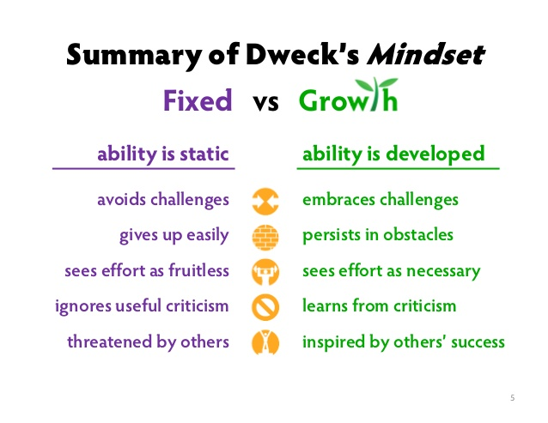
Adventurer’s Mindset
Notes:
But before we begin this journey,
we need a new mindset - a Growth Mindset.
All born with growth mindsets, but over time our mindsets can become fixed.
Triggers - people and tests condition us to let go of our growth mindset.
“not yet” mentality.
A life of faith is a journey of becoming. Made new in Christ, we are new creations - not only once, but everyday. Our becoming does not end at a particular age or developmental stage. Rather it believes tomorrow can be different than yesterday.
God’s future is ahead of us, and God’s mission to love the world gives our life purpose. Embracing our becoming nature is part of being a follower of Jesus.

Slide 13
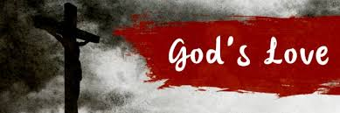
What is Faith?
A living relationship with God
Objects to subjects of God’s love.
God is our reference point for faith.
God’s love reorients our lives - love God and love neighbor.
Notes:
God is the reference point of faith. On our own we fixate on ourselves…we cannot help is. But God intervenes.With the life, death, and resurrection of Jesus Christ God disrupts our inclination and restores our relationship.
This gift of grace is person and expansive.
God’s love transforms our lives, change us from objects of God’s creation to subjects of God’s love.
Reorients our lives - turning us outward - to love God and our neighbor.
As Christians we make a radical claim- God is alive among us - in the world and in our lives. Yes how often do we think about God’s activity outside of the church walls? God’s presence can be pushed to the back of our minds. Yet God is still there - we just get to stop and notice.
When I was a young adult thought I had to cultivate this relationship with God. So I engaged in various Christian practices - not only going to worship and serving, but also time along with God in prayer and reading Scripture. Yet as life got busy (kids and work) and my time with God as less, I felt guilty.
Recently I discovered a different mindset - Rather then focus on what I did in our relationship, what if I was just more attentive to God’s activity around me? In other words, I flipped from my actions to God’s. If God is all around, can I be a scout on the look for God? And it didn’t take long before I could see God in small and big ways everyday.
Faith focuses on God’s actions first, and our second.

Slide 14


What is Faith Formation?
In its simplest form faith formation has to do with how the Christian faith shapes people as they encounter God, others, and the world.
Its aim? Discovering a Christian way of life.
Embracing our identity as children of God and participating in God’s mission in the world.
Discerning and joining God’s activity in our lives and in the world.
Notes:
Faith formation is a messy term that can be used as an umbrella term for: Christian education, discipleship, ministry with children and youth, and intergenerational ministry.
In its simplest form faith formation has to do with how the Christian faith shapes people as they encounter God, others, and the world.
Aim - Discovering a Christian way of life -
Faith as a way of life - pattern of our being, doing, and thinking that are shared and to which we assign meaning.

Slide 15

God’s Promised Future
God is about life, full and abundant life for all of creation, and for us.
God’s kingdom unfolding around us about about God’s promised future breaking into our current time,
While God’s vision is real, we live in a “now and not yet” world.
Revelation 21:1,3-7
Notes:
God’s vision is a view of life that is abundant - there is enough for all to thrive. It is not scarcity, but love that when shared multiples.
God’s overflowing love flows through us into the world as we love and serve our neighbor.

Slide 16
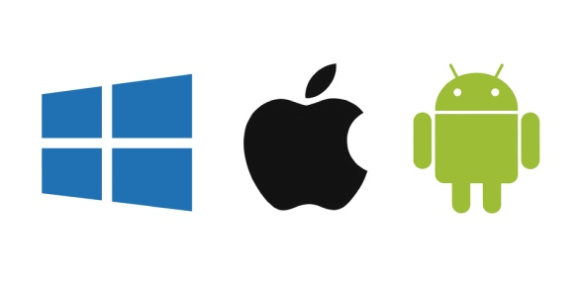
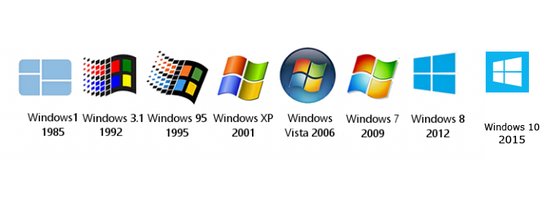
Does Faith Formation Need a New Operation System?
Notes:
We need new operating systems for forming faith!
What operating system are you using? Does it work with today’s context?
Operating systems are invisible, but important for our lives. When they work, they take the complexity out of our lives, freeing us to do what we need to do. When they don’t work, they distract us from what we need to do, taking energy and attention aware from loving those around us.
What if we could update our operating systems - to work together - and …
The main reason for having an operating system in place is to manage the device’s hardware and software resources. In addition to this, the operating system provides the necessary common services for installed programs to run. It works as an intermediary between the hardware and any programs that are being run on the mobile device or computer.

Slide 17
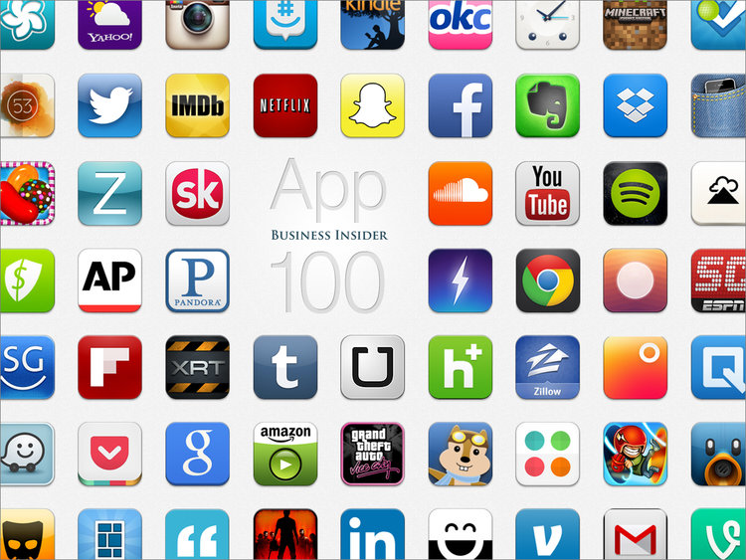

…that allows us to contextualize our approaches.
Notes:
Then add the programs or applications needed to fit with our particular context.
In the past most adaptations to faith formation have taken the form of programs - new curriculum or different pedagogies. Changing “applications” is not enough to get at the root issue - working with the environment.

Slide 18
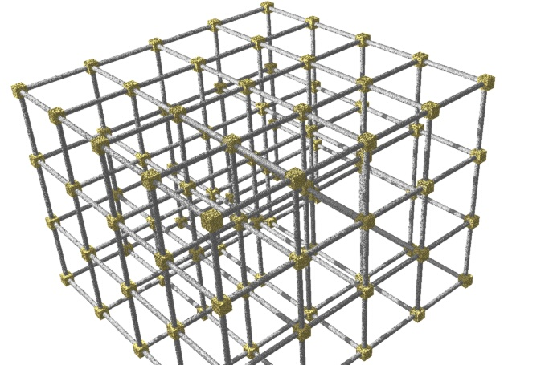
a New Operation System
2 movements
+
4 commitments
Notes:
This weekend, I am going to present to you an operating system for faith formation. Your role is to contextualize it for your ministry setting - or add the apps.
This operating system has an eye to the future, is aware of the past, and is intended to be lived in the present working with the environment.
We will begin by looking at 2 movements and 4 commitments of this operating system.

Slide 19

2 movements
Notes:
Gathering God’s beloved people as the body of Christ - faith forming and informing our lives.
Scattered in the world, God’s people are co-creators of God’s mission transforming the world.

Slide 20
2 movements
Gathered in community we discover our identity and participate in Christian practices, encounter God’s story, and live in relationship with other people of faith.
Scattered in the world we participate in God’s mission of loving the world as we encounter difference, name pain and injustice, and love and serve others.
Notes:
Gathered in community we discover our identity and participate in Christian practices, encounter God’s story, and live with other people of faith.
Scattered in the world we participate in God’s mission of loving the world as we encounter difference, name pain and injustice, and love and serve others.
Most of our time, in the past, has been on our time gathered. Yet most of our lives are lived scattered in the world. AND faith, as a way of life, is about all of life, not just our time in Christian community.
What if we took rethought our time gathered as accompanying people of faith to discover a Christian way of life scattered? What difference would that make?

Slide 21




4 commitments
Gift of love
Compass for living
Witness to God’s Story
Agent of God’s love
Notes:
To these two movements we add four commitments that highlight the multi-multi-faceted nature of faith.

Slide 22
Faith as a Gift
Faith is not something we earn. It anchors and transforms us into subjects of God’s love.
Faith tells us who and whose we are and ignites a lifelong journey of becoming.
Eph 2:8
Discovering (and rediscovering) faith as a gift is vital for forming faith.

Slide 23
Compass for Living
Faith directs our lives toward God’s mission in the world.
As an embodied faith, God’s love and God’s promised future guide our actions and relationships.
Eph 4:1
Discerning our actions in light of God’s activity and present circumstances is part of faith. formation.

Slide 24
Witness to God’s Story
Faith witnesses to a peculiar story — the life, death, and resurrection of Jesus Christ.
As this story is written on our hearts, we share stories of God’s ongoing activity in our lives and the world.
Acts 2:36
Learning God’s Story and sharing our story of faith is critical for forming faith.

Slide 25
Agent of God’s Love
Faith moves our attention from ourselves to or neighbor and God’s world.
Faith commissions us as agent of God’s love.
2 Cor. 5:20
Discovering how we join God in loving the world in an ongoing aspect of faith formation.

Slide 26
4 commitments
Gift of love
Compass for living
Witness to God’s Story
Agent of God’s love

Slide 27

- How would you describe faith?
- How would you describe faith formation?
- What do you think the vision of the Christian life is?
- What are you initial thoughts on the operating system for forming faith?
What did you hear?

Slide 28
Living Scattered
in the World
Wilderness
Adventure

Slide 29

5 disruptive forces

Slide 30

reframing life
“’Consumerism’ refers to a way of life structured by and around various practices of consumption and accumulation. In a consumerist society, consumption dominates social practices, such that relationships, activities, space, work, and leisure come to be structured around various practices related to consumption. Consumption becomes a way to achieve social solidarity – relational connections with others, even as it also marks identity and status.”
Mercer, Welcoming Children, 73

Slide 31
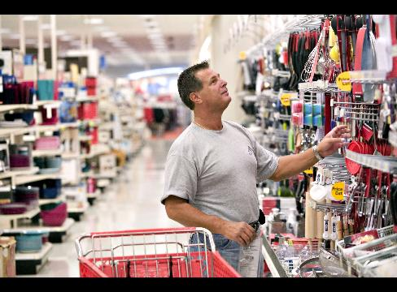
Consumption as central, orienting principle
Shaping identity and defining abundant life.

Slide 32

Protean Power
is the power to turn anything into a product to be packaged, sold and consumed.
Commodification logic has resulted in a shift within humans from a focus on being to having.
accumulation
Notes:
As a consequence of a capitalistic society, commodities were now readily available and affordable. Products became standardized and consumption was accompanied with promises of “the good life.”

Slide 33
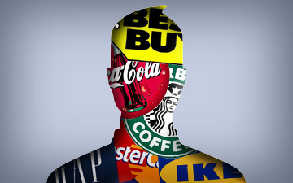
a second shift for humans from a focus
on being to having to now appearing
Lifestyle, within consumerism,
is based on one’s ability to choose, modify and enjoy life in a capitalistic society.
Notes:
Life is a commodity.
Identity is something we choose by what we buy or the image we portray.
Way of life is tied to purchasing.

Slide 34

Digital revolution
“When we change the way we communicate, we change society.”
Clay Shirky, Here Comes Everybody, 17.

Slide 35
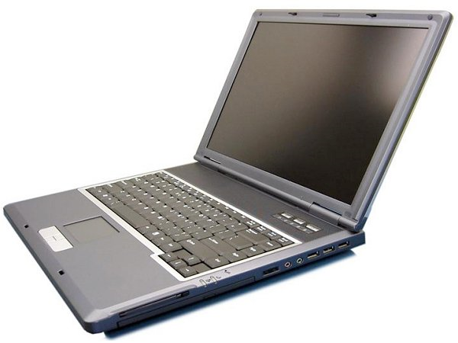
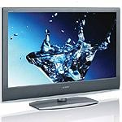
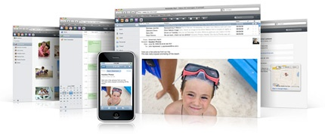
2007…Pivotal year
Open-source platform
Storage exploded
Big data made possible
FaceBook open to everyone
Twitter becomes its own platform
change.org emerged
Google bought YouTube and launched Android
Airbnb conceived
Amazon released Kindle
Internet crossed over 1 billion users
IBM began creating Watson - cognitive computer
Notes:
There is no going back. We are in a new world.

Slide 36
So what?
Decentralized, diversified communication
Requires active participation.
Web is now its own ecosystem.
Communication is a social activity.
Our social networks now have virtual pathways.
The way we create, collaborate, think, and live is being reshaped.
Virtual world lives alongside physical world.
Identity and relationship formation takes place disembodied.
Way of life is disrupted once again.
Notes:
We are now our own communication directors.

Slide 37

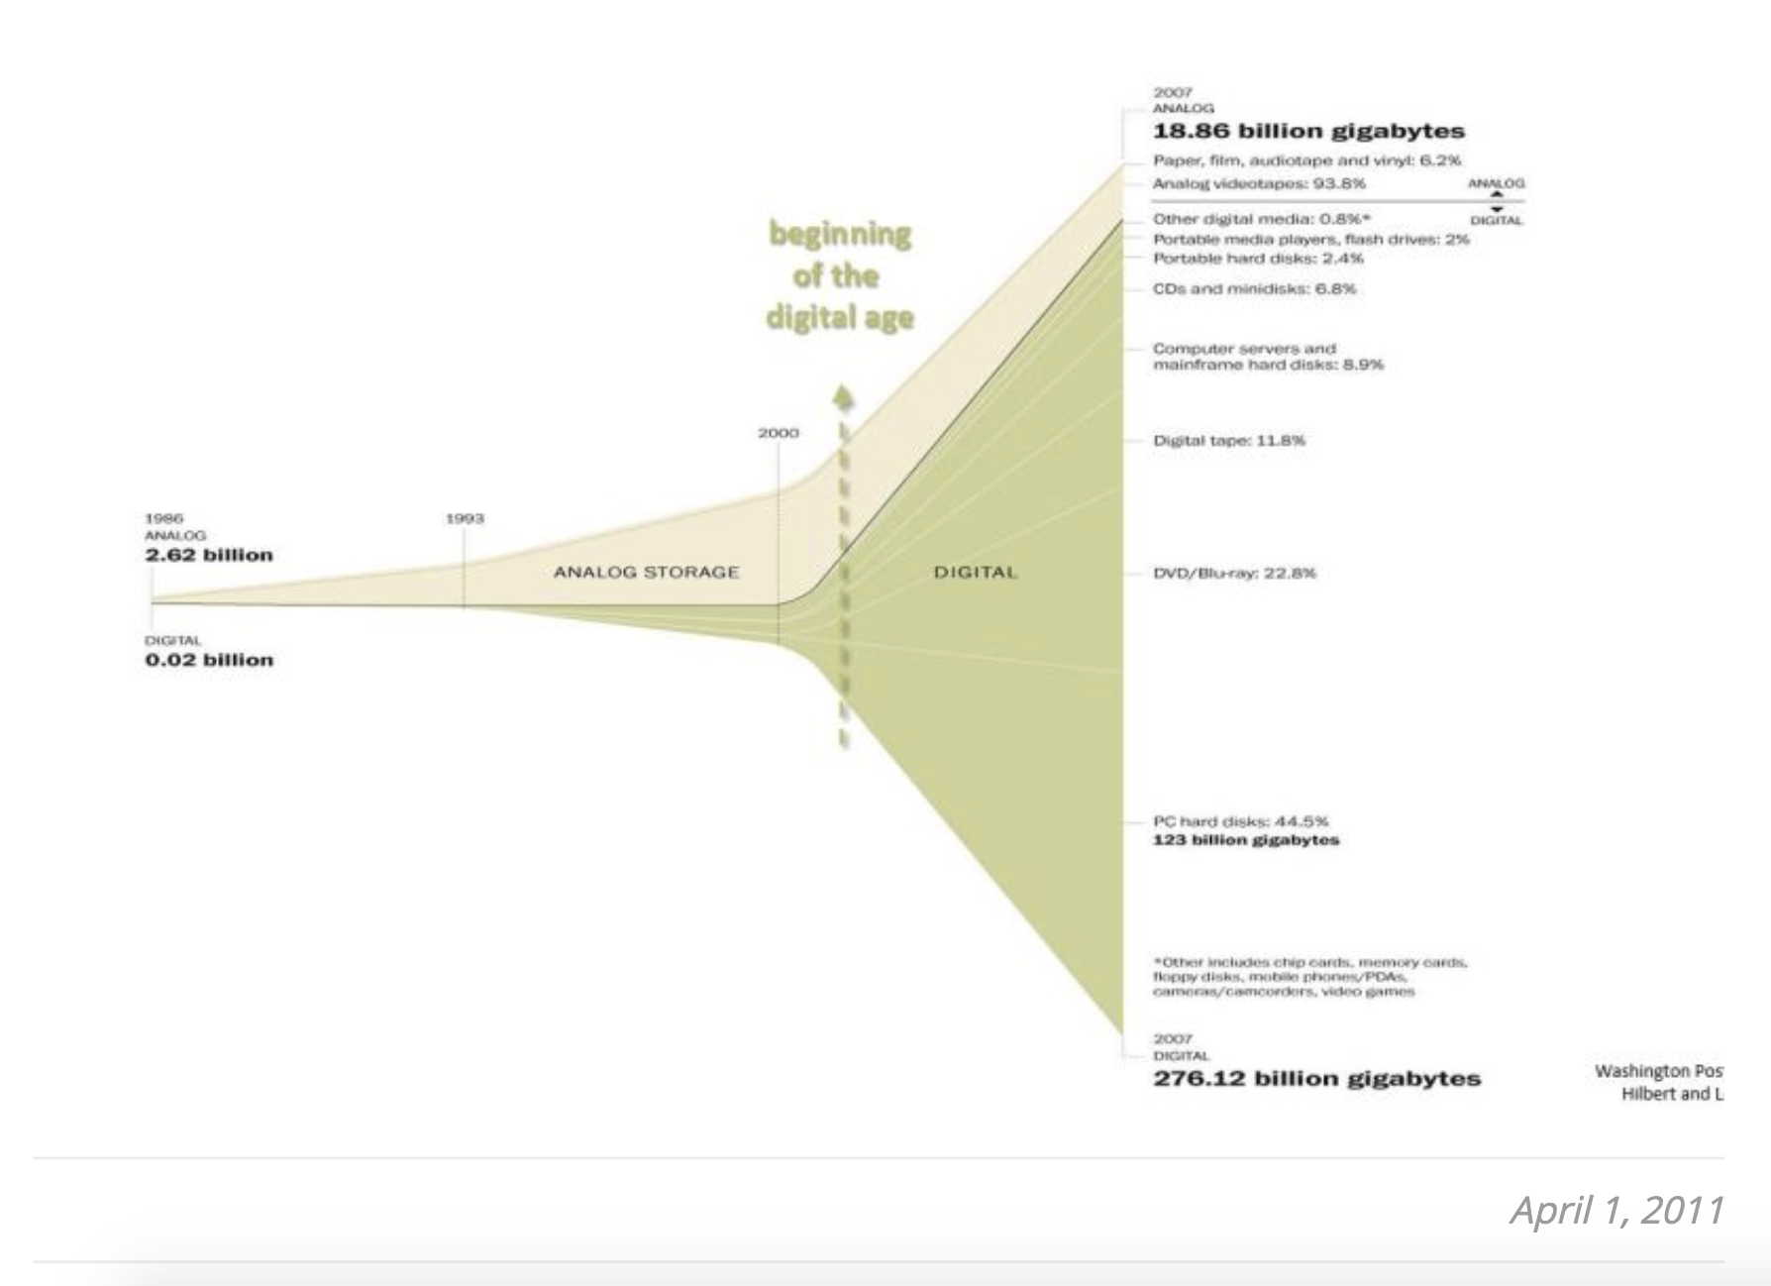
Information Age
The digital revolution created the opportunity for information to explode!
Information is the economy of the digital age.

Slide 38
Information Age
Information is hard to control.
Information Age works with a gift economy - information is intended to be shared!

Slide 39
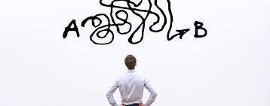
As challenges become more complex and information is abundant - collaborate learning is expected (and needed) to solve today’s challenges.

Slide 40
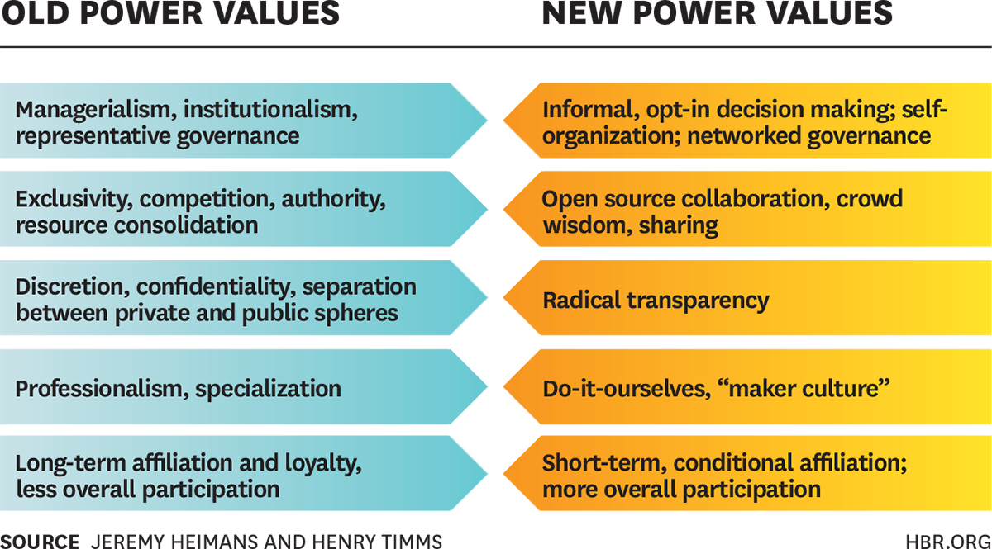
Notes:
Old power = currency
New power = current

Slide 41
Learning in an information age =
Addressing real-world challenges +
making meaning + in community
Learner-centric = Ground learning in lived experiences and current circumstances!

Slide 42
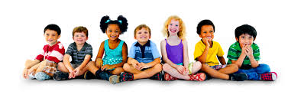
Globalization
We are global citizens.
Today anyone, from anywhere, has the potential to contribute, connect, collaborate, and compete on a global stage. That reality has possibilities, problems, responsibilities, responsibilities, and consequences.
Our economic, political, religious, and ecological systems are now all connected.

Slide 43
Globalization
We rely on the world. (Coca-Cola is available almost anywhere in the world, even in places without steady electricity or drinking water. Starbucks draws on resources from. 19 countries to provide 1 cup of coffee,)
The world has arrived at our doorsteps. (All parts of the US are diversifying.)
We are becoming increasingly diverse as a nation. (Projections - by 2021-2038 we will become a minority-majority country.)
Notes:
In 1870 1910— 14.4%-14.8% of the US Population were immigrants.
In 1970 - down to 4.7% (lowest)
In 2016 - back up to 13.5% and projected that by 2021-2038 we will become a minority-majority country.

Slide 44
Globalization
Culture is an invisible system that captures the multi-faceted nature of our socialization. Our beliefs, values, patterns of life, and identity all play into our cultural formation.
We are all formed by our locations. Woven within our locations are multiple cultural influences.
We now life in a multi-cultural, interconnected, interdependent world.

Slide 45

Religious Pluralism
The United Stated has operated with a de facto church and state.
American Civil Religion (1967) - out of Judeo-Christian tradition
Yet today hate crimes are on the rise, and they are the highest they have been in four decades. And anti-religious crimes make-up 21% of them (19% are anti-Jewish).

Slide 46
Religious Pluralism
American religion is extremely fluid and interconnected. Roughly 35-40% of Americans are switching religions, half of all marriages are across religious lines, and almost 90% of people believe people outside their religion go to heaven.
Our religious tapestry in the United States is becoming increasingly intricate, with different colors and textures.
Increase in the nones, dones, millennials, and
immigrants are all changing the landscape.

Slide 47
Religious Pluralism
American Civil Religion
(public symbols and discourse, national civic solidarity)
Organized Religion
(formal religious institutions and organizations, with particular beliefs)
A new level is being added - Moralistic Therapeutic Deism
(God wants people to be good and nice, central goal of life is to be happy, Good people go to heaven, God exists and created the world, God doesn’t to want to be particularly
involves, except to resolve a problem)
Individual Religion
(idiosyncratic, eclectic, popular, lived
beliefs and practices)
Notes:
MTD is about making meaning of this fluid, religiously pluralistic landscape.

Slide 48
Religious Pluralism
We need a pathway between hate crimes and passive tolerance.

Slide 49
5 disruptive forces
- consumerism - identity
-information age - learning
- digital revolution - relationships
- globalization - difference
- religious pluralism - one of many

Slide 50
What about your setting?
- How are these disruptive forces playing out in your context?
- What impact are they having in forming faith?
- What would working with the environment look like in your setting?

Slide 51
Gathering in Christian Community
Wilderness
Adventure

Slide 52
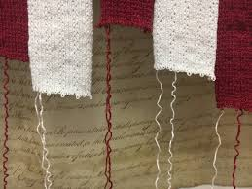
The Church is Unraveling
It is time to rediscover our call and rethink our relationship with our context.
Notes:
From the societal norms and values and practices.
It is time to disestablish ourselves and rediscover our calling.

Slide 53
5 Openings
consumerism - identity
digital revolution - community
information age - learning
globalization - difference
religious pluralism - minority posture

Slide 54

Identity
Gift from God, given and received.
Identity is not something we create.
Our identity is relational - it is cultivated in community.

Slide 55

Community
As relational beings, God’s people gather in community.
As the world loses social capital, we need to reimagine how to foster it again. Congregations have both bridging and bonding ties.
Cultivate spaces for making meaning - intergenerational, affinity, support, serving.
Learning communities, or communities of practice, where different ideas are welcome and people are accepted.
Notes:
Social capital - relational capacity in society that incorporates social networks, norms of reciprocity, mutual assistance, and trustworthiness.
Bridging and bonding ties.
Intimate relationship are cultivated through repeated encounters around the mundane.

Slide 56

Learning
Learning has been part of congregations for centuries. How do we integrate it into all areas of congregational life, not just “education hour”?
We have current practices that can be reimagined around collaborative learning.
Learning needs home (community), edge (aspiration), and groove (pattern) because learning involves risk, vulnerability, and a preferred future. Can congregations cultivate cultures of learning across the lifespan?

Slide 57

Encountering Difference
We have a theology for unity with diversity - triune God and body of Christ.
Christianity is embodied and translatable into all cultures.
God calls us to love God and our neighbor.
Can rethink practices and equip people to encounter difference in the world around them.

Slide 58
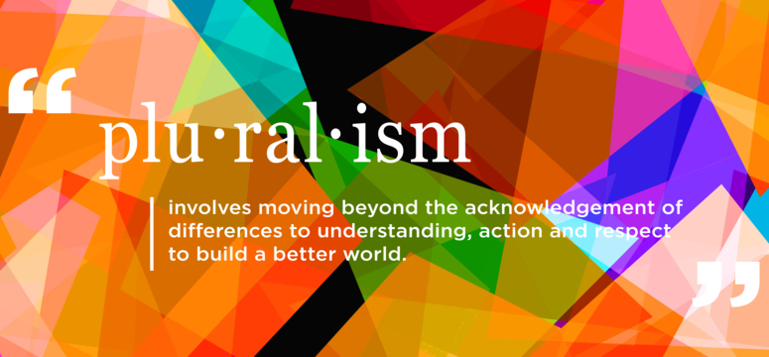
Minority Posture
Abundant life is a vision for all of creation.
Christianity is rooted in relationships.
(re)Discover our own distinctiveness.

Slide 59


Learning from the Future

Slide 60

Identify one complex challenge

Slide 61

As you reflect on your complex challenge,
make a list of 8-10 assumptions you have about your challenge.
1.
2.
3.
4.
5.
6.
7.
8.
9.
10.

Slide 62
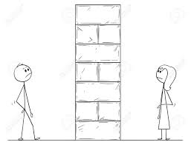
Name 6-9 obstacles that get in the way of you addressing your challenge.
1.
2.
3.
4.
5.
6.
7.
8.
9.
How do those obstacles make you feel?

Slide 63


Imagine possibilities.
List 10 of the
worst outcomes.
1.
2.
3.
4.
5.
6.
7.
8.
9.
10.
1.
2.
3.
4.
5.
6.
7.
8.
9.
10.

Slide 64
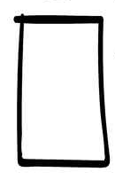
Learning from the future begins with our hands.
Name 5-10 possibly actions that could address your challenge.

Slide 65
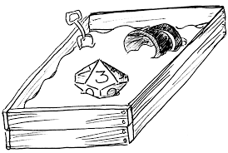
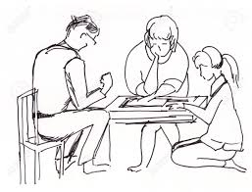
Reviewing your challenge and your 5-10 possible actions,
what area would you like to “play in”?
Who might join you?

Slide 66
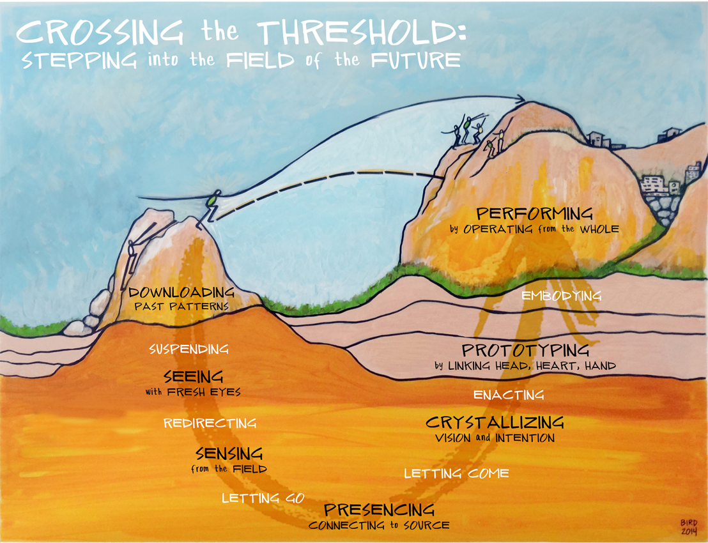

Theory U
Otto Scharmer
http://www.ottoscharmer.com/theoryu

Slide 67
Cruciform Communities of Hope
Wilderness
Adventure

Slide 68
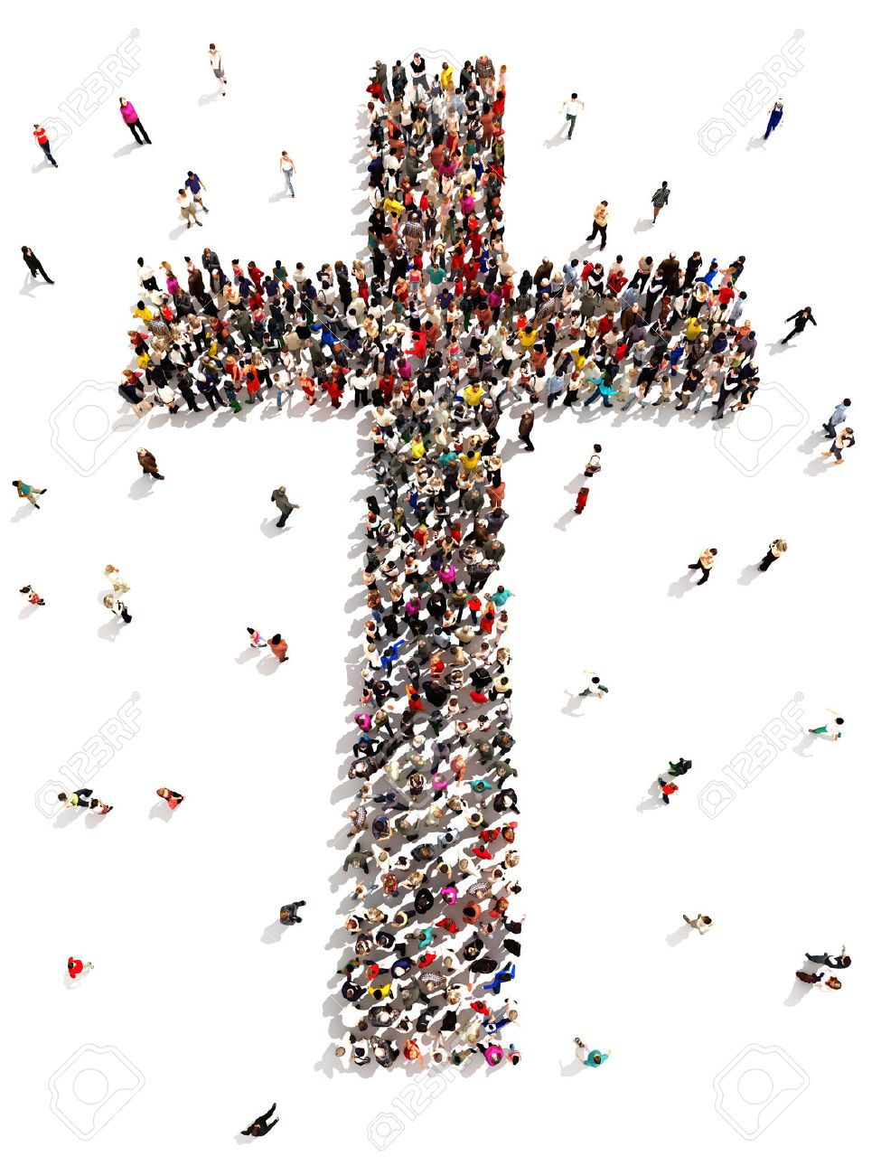
Cruciform Communities of Hope

Slide 69
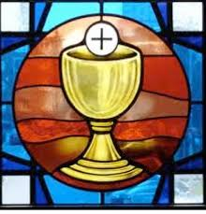
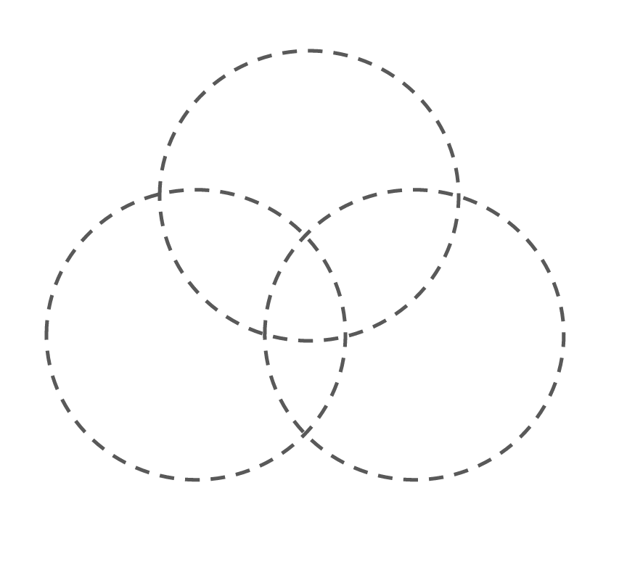

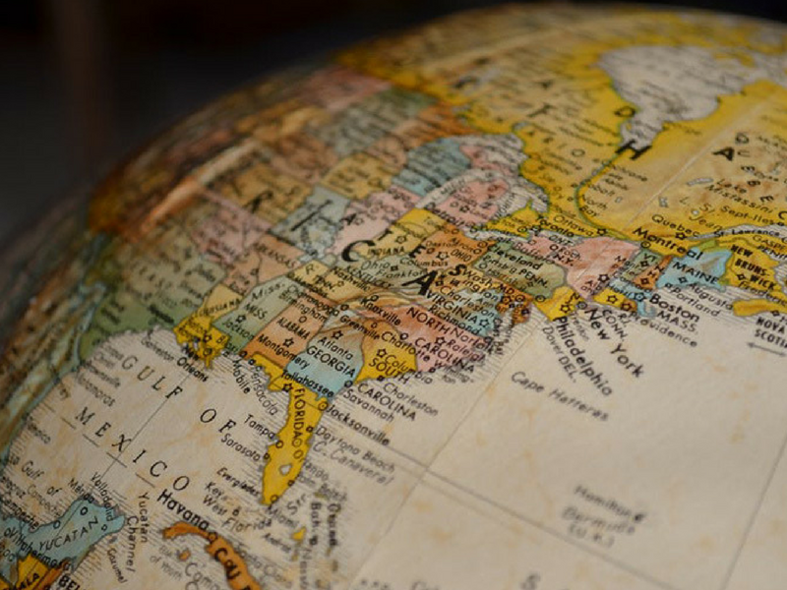
3 sets of practices
sacramental
incarnational
missional

Slide 70
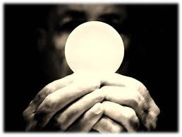
Sacramental

Slide 71
3 sets of practices
sacramental
incarnational
missional

Slide 72
Sanctuary
Dwelling in the Word
Sacraments
Reflecting on Experience
Sabbath
sacramental

Slide 73
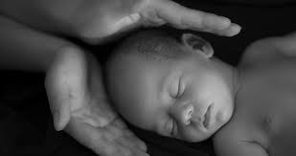
Incarnation

Slide 74
Campfire
Open Friendships
Listening
Telling Faith Stories
incarnational

Slide 75
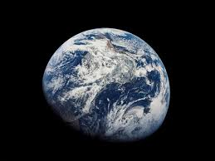
Missional

Slide 76
Outpost
Being Hosted
Vocation
Dwelling in the World
Experimenting
missional

Slide 77
- Are congregations to be cruciform communities of hope? Why or why not?
- Do these three sets of practices make sense to you? What practices would you add in each category?
- Imagine your ministry setting - which area are you strongest in? which area is in need of development?
What did you hear?

Slide 78
Wrap-up
Wilderness
Adventure

Slide 79
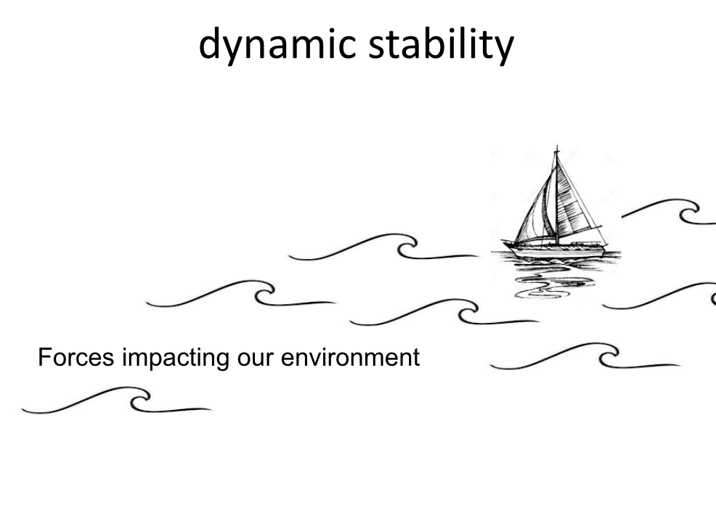
Notes:
Stability for forming faith in dynamic environment comes from the interlay of theology, relationships,, and context.
Working with this interplay provides the church what it needs for balancing and adapting to environmental changes AND accompany people in making faith meaningful and integrated into their everyday lives.

Slide 80
Cruciform Communities of Hope
Notes:
Congregations are
Grounded in God’s love, people of faith embrace God’s vision of abundant living.

Slide 81
4 commitments
Gift of love
Compass for living
Witness to God’s Story
Agent of God’s love
Notes:
Faith is a living relationship with God, lived in the world.
Faith forms, informs, and transforms our lives as we love God and our neighbor.
As peculiar people our identity is a gift, life is a calling, story is a witness, and agency is empowered by the Spirit…we live in a now and not-yet world and join God in co-creating the future.

Slide 82
2 movements
Notes:
Faith is a way of life - as it reorients our hearts, minds, and actions. It is the patterns of being, doing, and thinking that we share as people of faith and that bring meaning to our lives.
Scattered and gathered in the world, we discover this Christian way of life as we love God and our neighbor.

Slide 83
3 sets of practices
Sanctuary
Campfire
Outpost
Notes:
Accompanying people in faith as a way of life of faith is the role the local church plays in forming faith. This work of discerning and joining God’s activity centers around 3 sets of practices -

Slide 84
- Are congregations to be cruciform communities of hope? Why or why not?
- Do these three sets of practices make sense to you? What practices would you add in each category?
- Imagine your ministry setting - which area are you strongest in? which area is in need of development?
Group Sharing

Slide 85
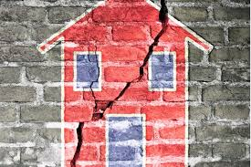
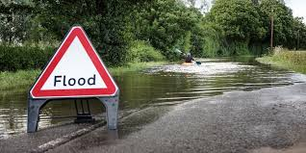

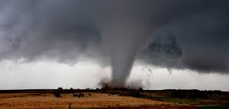
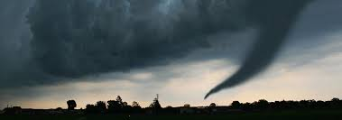
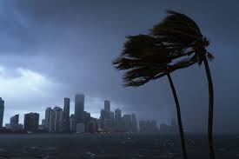


Slide 86


Slide 87


