Slide 1


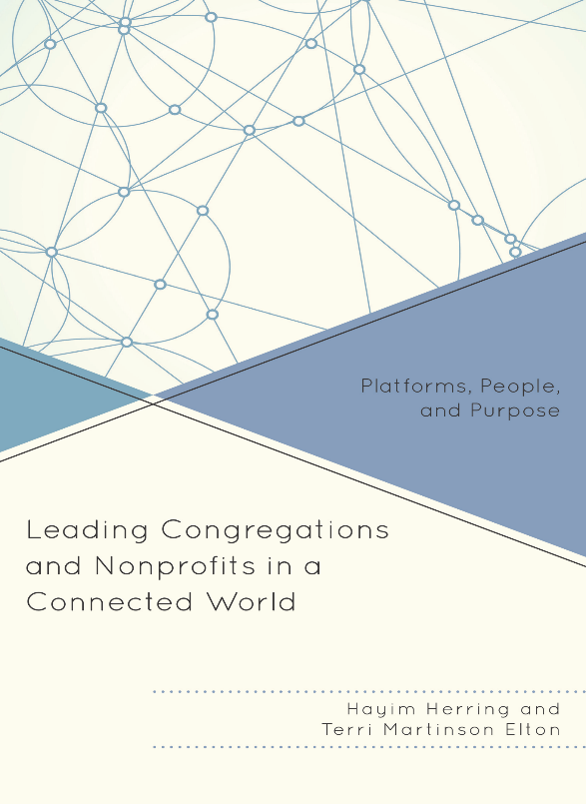
Framing our Discussion
Shifting from a 1.0 to 3.0 World
Terri Martinson Elton

Slide 2
Definition
Platforms - web-based technology that enable diverse individuals to build community as the “do” something. (Think chassis of a vehicle)
Platforms are also physical and “positions” or places from which to bring people together to accomplish a mission.
Platforms operate with particular values embedded within them and foster particular kind of relationships.
What are some platforms you engage on a regular basis?

Slide 3
Definition
Social Networks - human relational networks are the ways groups organize themselves.
Social networks evolve over time and draw on available tools.
Social networks recognize the power (and benefit) of collective organizing (vs individual action).
The internet did not create social networks, but it did change their power and expand their accessibility. Once geographically bound, now people have the ability to connect instantaneously with people near and far.

Slide 4
Definition
Social Networks cont.-
Catherine Alter and Jerald Hage predict network organizations are the future institution. And “this new institutional form will increasingly replace both markets and hierarchies as governance mechanisms.” (6)
Networks are a set of interconnected nodes, with humans being the nodes and hubs the gatherings and intersections that connect and accelerate flow.

Slide 5
Definition
Social Networks cont.-
The vibrance of social networks is based on the number of hubs, the level of engagement, the flow of information, and the connectors or individuals who are active in multiple hubs.
Mapping and analyzing social networks provides insights into the relational strength of an organization, based on information flow and connectivity.

Slide 6
Definition
Social Networks cont.-
Raine and Wellman say the turn toward network operating systems has been built on connectivity between individuals and the ability to trust one another across distance and groups without requiring cohesive force! (8)
This sounds like the work of synods (and regions).

Slide 7
Definition
Social Networks cont.-
In what ways does you synod see the benefit
(power) of collective organizing (vs individual action)?
Identify the hubs in your synod. (Physical, people, and digital).
How would you rate the relational strength of your synod, based on information flow and connectivity? What are you strengths? What are obstacles?

Slide 8
Definition
Social Media - Tools used to create, share, and collaborate that is user-generated and/or culled from existing content. (9)
Social media is a tool (for social networks) that mediated information (relies on flow/sharing) and uses platforms (for various purposes).

Slide 9
How we organize matters!
Organizations or structures are containers to accomplish and accelerate the work of accomplishing a mission.
Embedded within them are values that state what’s important or what work should be prioritized.

Slide 10
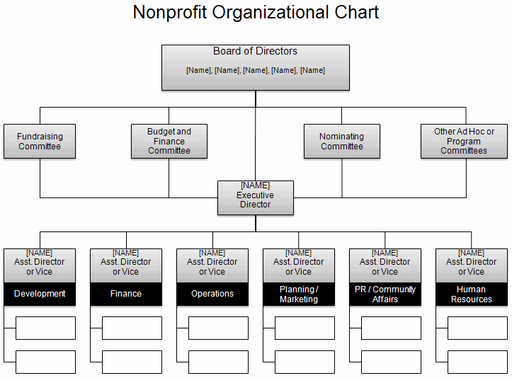
Organizations
1.0 to 3.0
1.0 - Hierarchies
Organizational chart
Clear communication
Efficiency
Good for routine/quality control/solving known problems
People with specialities/managed
Direction/vision decided from the top - flows down
Work flows up
Universal practices - apply across contexts
Values -
membership based,
honor tradition, authority determined by training/degree/credentials, commitment to institution, self-sufficient, exclusive or clear boundaries
Notes:
Org. 1.0- until about mid-1990’s; Central physical address; Command and control; symbol: hierarchical org. chart
Org. 20-from mid-1990’s to June 29, 2007 : Still command control; Central physical address w/Parallel web presence
Org. 3.0 – iPhone – social networking available to masses
Physical and web locations blur; fluidity of behavior on web flows back into bricks and mortar
24/7/365 availability; need to think I.P address and P.O. (post office) physical address

Slide 11
Organizations
1.0 to 3.0
2.0 - Digital world pre-iPhone
Digital tools enhanced 1.0 world.
Brick and mortar mirrors bytes and clicks world.
Communication is the same on all platforms (newsletter, announcements in worship, on website).
Centralized communication strategy.
Slight modification of 1.0 values.
Notes:
Org. 1.0- until about mid-1990’s; Central physical address; Command and control; symbol: hierarchical org. chart
Org. 20-from mid-1990’s to June 29, 2007 : Still command control; Central physical address w/Parallel web presence
Org. 3.0 – iPhone – social networking available to masses
Physical and web locations blur; fluidity of behavior on web flows back into bricks and mortar
24/7/365 availability; need to think I.P address and P.O. (post office) physical address

Slide 12
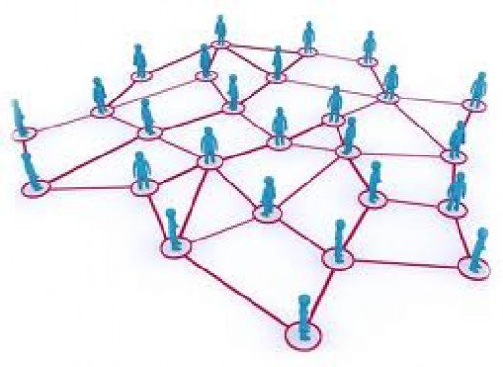
Organizations
1.0 to 3.0
3.0 - Digital world - Facebook/iPhone
2007 marks the shift - iPhone, big data, Facebook, internet has global reach
Interconnected - convergence
Ease of creating and collaborating empowered “all”
Generous - gift economy (Wikipedia)
Open and transparent
Self-directed, not led.
Crowdsourcing.
DIY
Values -
democratic, fluid and improvisational, authority by expertise of passion or experience, value innovation, commitment to institution, inclusive, agile, expansive.
Notes:
Org. 1.0- until about mid-1990’s; Central physical address; Command and control; symbol: hierarchical org. chart
Org. 20-from mid-1990’s to June 29, 2007 : Still command control; Central physical address w/Parallel web presence
Org. 3.0 – iPhone – social networking available to masses
Physical and web locations blur; fluidity of behavior on web flows back into bricks and mortar
24/7/365 availability; need to think I.P address and P.O. (post office) physical address

Slide 13
How do you see 1.0, 2.0, and 3.0 operating in your world (primarily but not limited to your work)?
What are the tensions of living in a 3.0 world with 2.0 organizations?
Notes:
Organizations arise to “change lives, change communities” (Peter Drucker)
Does An Organization’s Structure HINDER or FOSTER connections, meaning, impact?
Structure becomes invisible-hence, need to raise question

Slide 14
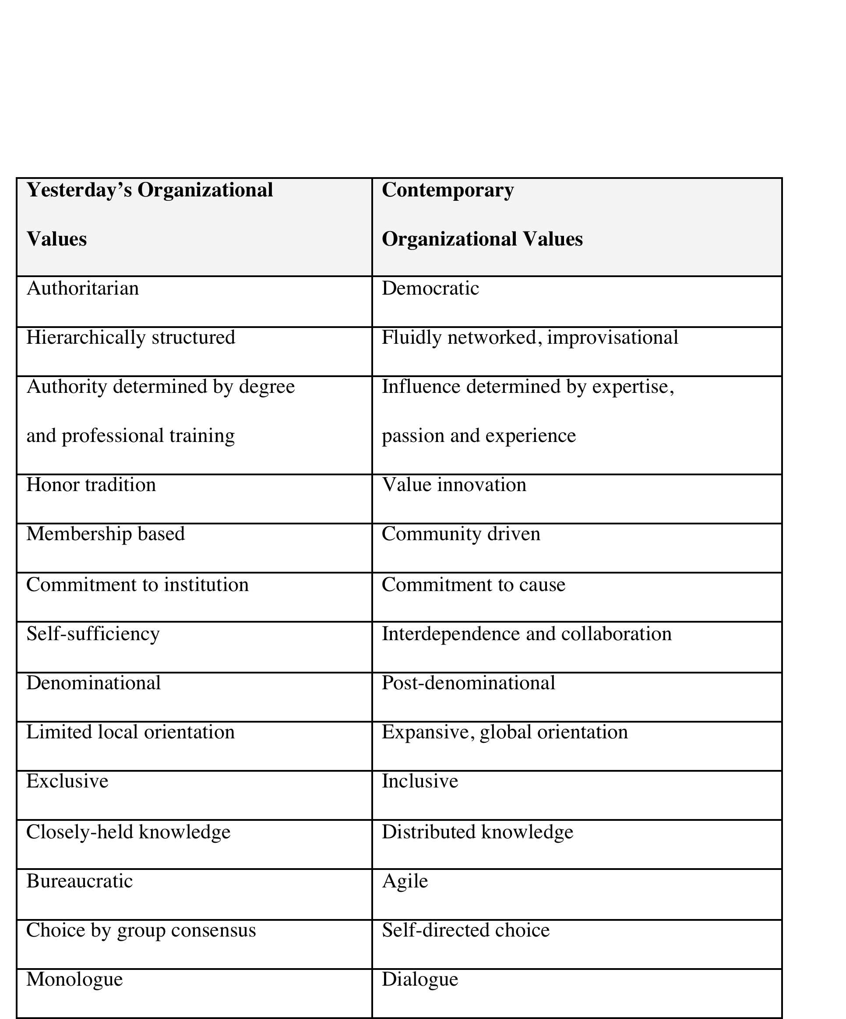
  Organizational Assessment exercise
Rate each 1 (old) to 5 (new)

Slide 15
The Shift:
Church as Institution or Movement?

Slide 16
Paradigm Shifts are disruptive!
“disrupt” - to cause something to be unable to continue in the normal way; to interrupt the normal progress of activity of something.
Notes:
Organizations arise to “change lives, change communities” (Peter Drucker)
Does An Organization’s Structure HINDER or FOSTER connections, meaning, impact?
Structure becomes invisible-hence, need to raise question

Slide 17
“innovator’s dilemma” - the very principles that companies used to become successful in sustaining (non-disruptive) times are the ones that can cause them to fail in disruptive times. (Clay Christensen)
The main reason is the value set of the organization and the value set of the public become out of sync. (48)
Notes:
Organizations arise to “change lives, change communities” (Peter Drucker)
Does An Organization’s Structure HINDER or FOSTER connections, meaning, impact?
Structure becomes invisible-hence, need to raise question

Slide 18
What does leadership look like in an environment where disruptive change is becoming the norm?
Notes:
Organizations arise to “change lives, change communities” (Peter Drucker)
Does An Organization’s Structure HINDER or FOSTER connections, meaning, impact?
Structure becomes invisible-hence, need to raise question

Slide 19
Leading in disruptive times is not new to Christian (or Jewish) communities.
“What does it mean to be stewards of a long faith tradition committed to a vital future?” (50)
Notes:
Organizations arise to “change lives, change communities” (Peter Drucker)
Does An Organization’s Structure HINDER or FOSTER connections, meaning, impact?
Structure becomes invisible-hence, need to raise question

Slide 20

Compass = organization and work follow call/mission
What is the call of the church?
What do we know about
who the church is called to be and
what the church is called to do?
Each table write their answer on a
big post-it.

Slide 21

Challenges of the Shift
Name the challenges the church is facing as we seek to live out our call.
Small post-its - name as many as you can.
Share the small post-its with the table and cluster into themes.
Write themes on big post-its and put on the wall

Slide 22
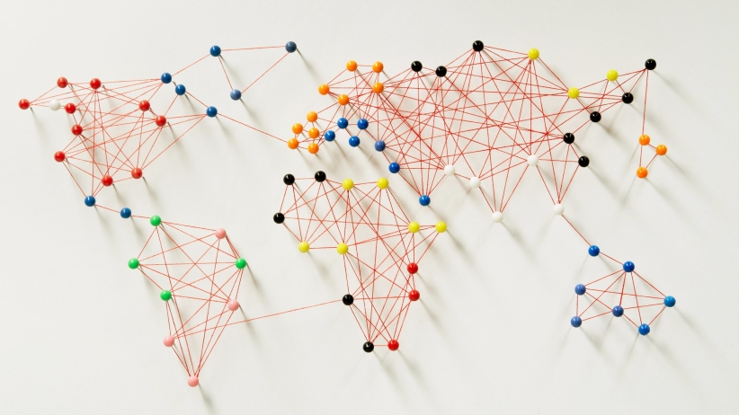
Challenges of the Shift
Emerging Congregations:
living in societal and economic uncertainty
Identifying, recruiting, and retaining leadership who “get it”
After initial start-up - how to push deeper
Questions around space and location
Moving from shared intimacy to shared ownership

Slide 23
Challenges of the Shift
Adapting Congregations:
Lack of visual representation of organization (no replacement of org chart)
Questions about digital presence
Assessment, feedback, and data utilization are challenging
Do not have robust external conversation partnership (homogeneous networks)
Would like to use network-thinking to improve decision-making
Need new language to replace membership

Slide 24
Challenges of the Shift
Missional Challenges:
Religiously pluralistic world - talking about our faith with others
Secular age - belief in God and understanding of human agency
Digital influence - changing relationships and learning
Consumerism - identity and way of life
Accelerated life - space for reflection, integration, and sense making

Slide 25
The primary role of leadership is be culture creators by developing an organizational compass.
Notes:
Organizations arise to “change lives, change communities” (Peter Drucker)
Does An Organization’s Structure HINDER or FOSTER connections, meaning, impact?
Structure becomes invisible-hence, need to raise question

Slide 26
Is your mission/call central to all you do?
Are you engaging people in meaningful ways around that mission/call?
Creating a Compass
Mission and identity
is central
Structure is simply the holding space.
Purpose and Identity
N

Slide 27
How would having an organizational compass help you navigate these disruptive times?
What would that look like in your setting?

Slide 28
Characteristics of Church as Movement or Living body
Small post-its - name as many as you can.
Share the small post-its with the table and cluster into themes.
Write themes on big post-its and put on the wall

Slide 29
Cultivating a Culture of Call

Slide 30
What if “cultivating a culture of call” was part of the mission and identity of all the synods in Region 3?

Slide 31
With our shared understandings of what the church is called to be and do as our backdrop -
What would a culture of call entail?

Slide 32
4 Foci for Leading
Creating a Compass –Mission and Identity
Cultivating Community – Attending to Relationships
Generating Momentum – Setting Direction and Making Decisions
Learning Community –Becoming Agile and Experimenting
N

Slide 33
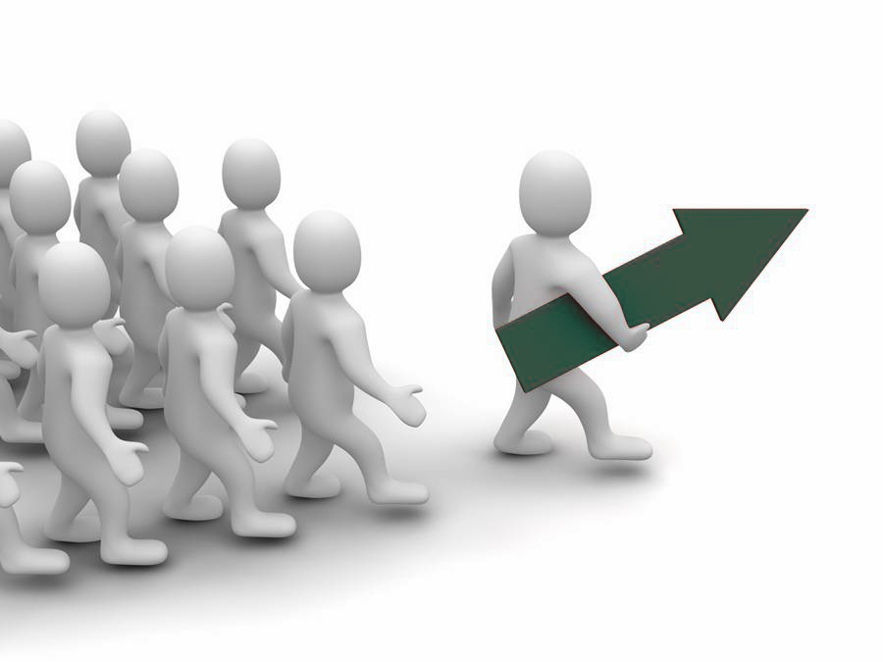
Do you have a vision/picture of the future?
Are decisions made strategically?
How does information flow?
Generate Momentum
Set direction.
Lead people.
Manage flow.

Slide 34
Generate Momentum
What difference would a culture of call make for God’s church and the world?
5 whys exercise
Shift in decision-making practices
Name one shift in the flow of information you could make that could become a practice for cultivating a culture of call.

Slide 35
Cultivating Community
Relationships need tending -
internally and externally
bridging
capital
bonding capital
External
Internal

Slide 36
Creating Community
Internal - 1 minute write down all the relationships to tend that would creating bonding capital. Share your list with a partner and consolidate your answers. As a table name the top 10.
External - repeat with creating bridging capital.

Slide 37


Are you risking today for the sake of a vital future?
Learning Community
Becoming
agile and experimenting.
Eye to the Future
Open posture
Collective Intelligence

Slide 38
Learning Community
What do you need to learn and why?
Pick one area and develop it further.
How could you learn about it?
Who could help you learn it?
How would you feed the learning into the system?
Who should be apart of this learning?
How would you assess it that learning was helping you cultivate a culture of call?
Think of one experiment you could do to test it.

Slide 39
Learning Community
Name practices that you could embrace that would help you become curious and continual learners about cultivating a culture of call.

Slide 40
Imagining a Shared Future

Slide 41
Looking into the Future in Disruptive Times
  Strategic Planning - as we know it - has its limitations in a non-stable environment.
  Organizational foresight is as important as ever.
  Defining and understanding the challenges we face is critical, takes time, and needs more of our attention.
  Discovering “more than one” way forward prepares us to be more nimble in the moment.
Notes:
Challenge: congs. may feel need to innovate
But, goal is to innovate something meaningful, not yesterday’s “best practices”

Slide 42
3 Practices for Exploring the Future
  Scenario Planning
  Trends, Innovations, and Paradigm Shifts - T.I.P.S
  Implications Wheel
Notes:
TE and HH provide some examples

Slide 43
Scenario Planning
Traditional
methods
Take two dimensions of an issue,
Place one on the horizontal axis and the other on the vertical axis.
Then complete the four quadrants.
Credential
Vetting
Competency
Vetting
Innovative
Methods

Slide 44
Trends, Innovation, Paradigm Shifts - T.I.P.S.
Cultural Shifts
Spirituality
Technology
Education
Demographics
Economics

Slide 45
Implications Wheel
Candidates would be less self-aware
Candidates could get into misconduct
Synod could be sued
No longer requiring CPE for ordination

