Slide 1
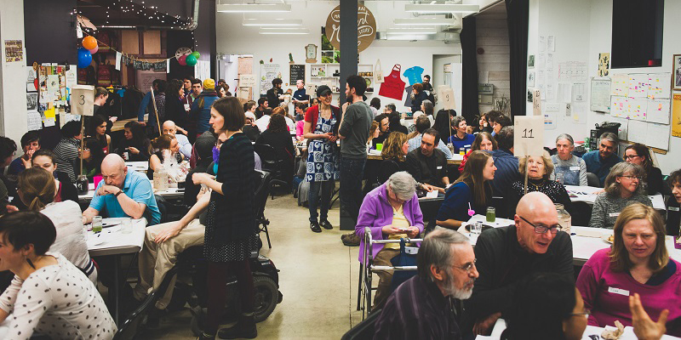
Leading All Generation
Terri Martinson Elton, Phd

Slide 2


Leading on purpose and
engaged and connected includes
being attentive to all generations.

Slide 3
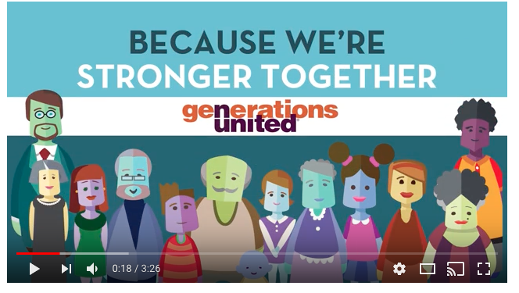
Generations United
http://www.gu.org/
https://youtu.be/9WEe3cIXQbQ

Slide 4

Deuteronomy 6:4-9
Hear O Israel, The LORD is our God, the LORD alone. You shall love the LORD your God with all your heart, and with all your soul, and with all your might. Keep these words that I am commanding you today in your heart. Recite them to your children and talk about them when you are at home and when you are away, when you lie down and when you rise. Bind them as a sign on your hand, fix them as an emblem on your forehead, and write them on the doorposts of your house and on your gates.

Slide 5
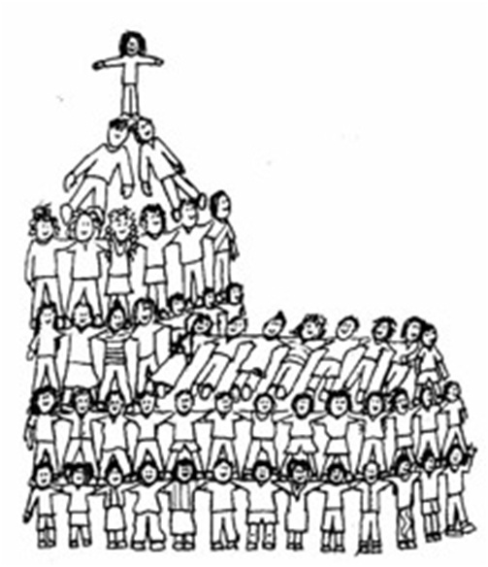
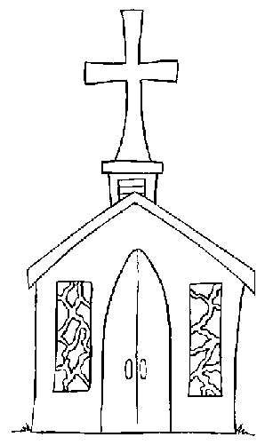
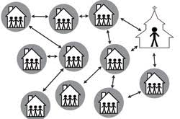
Church as…
What view do you want to live into?
dispenser of religious services, led by ordained pastor.
Center is worship with various programs to carry out ministry.
community of people, gathered for worship and sharing ministry.
place
community
way of life
people of faith gathered and scattered seeking to discover a Christian way of life.

Slide 6
As communities called to pass on faith across the generations, how might we embrace this call faithfully and with imagination?
Where are opportunities?
What obstacles exist?
What experiments might you engage?

Slide 7
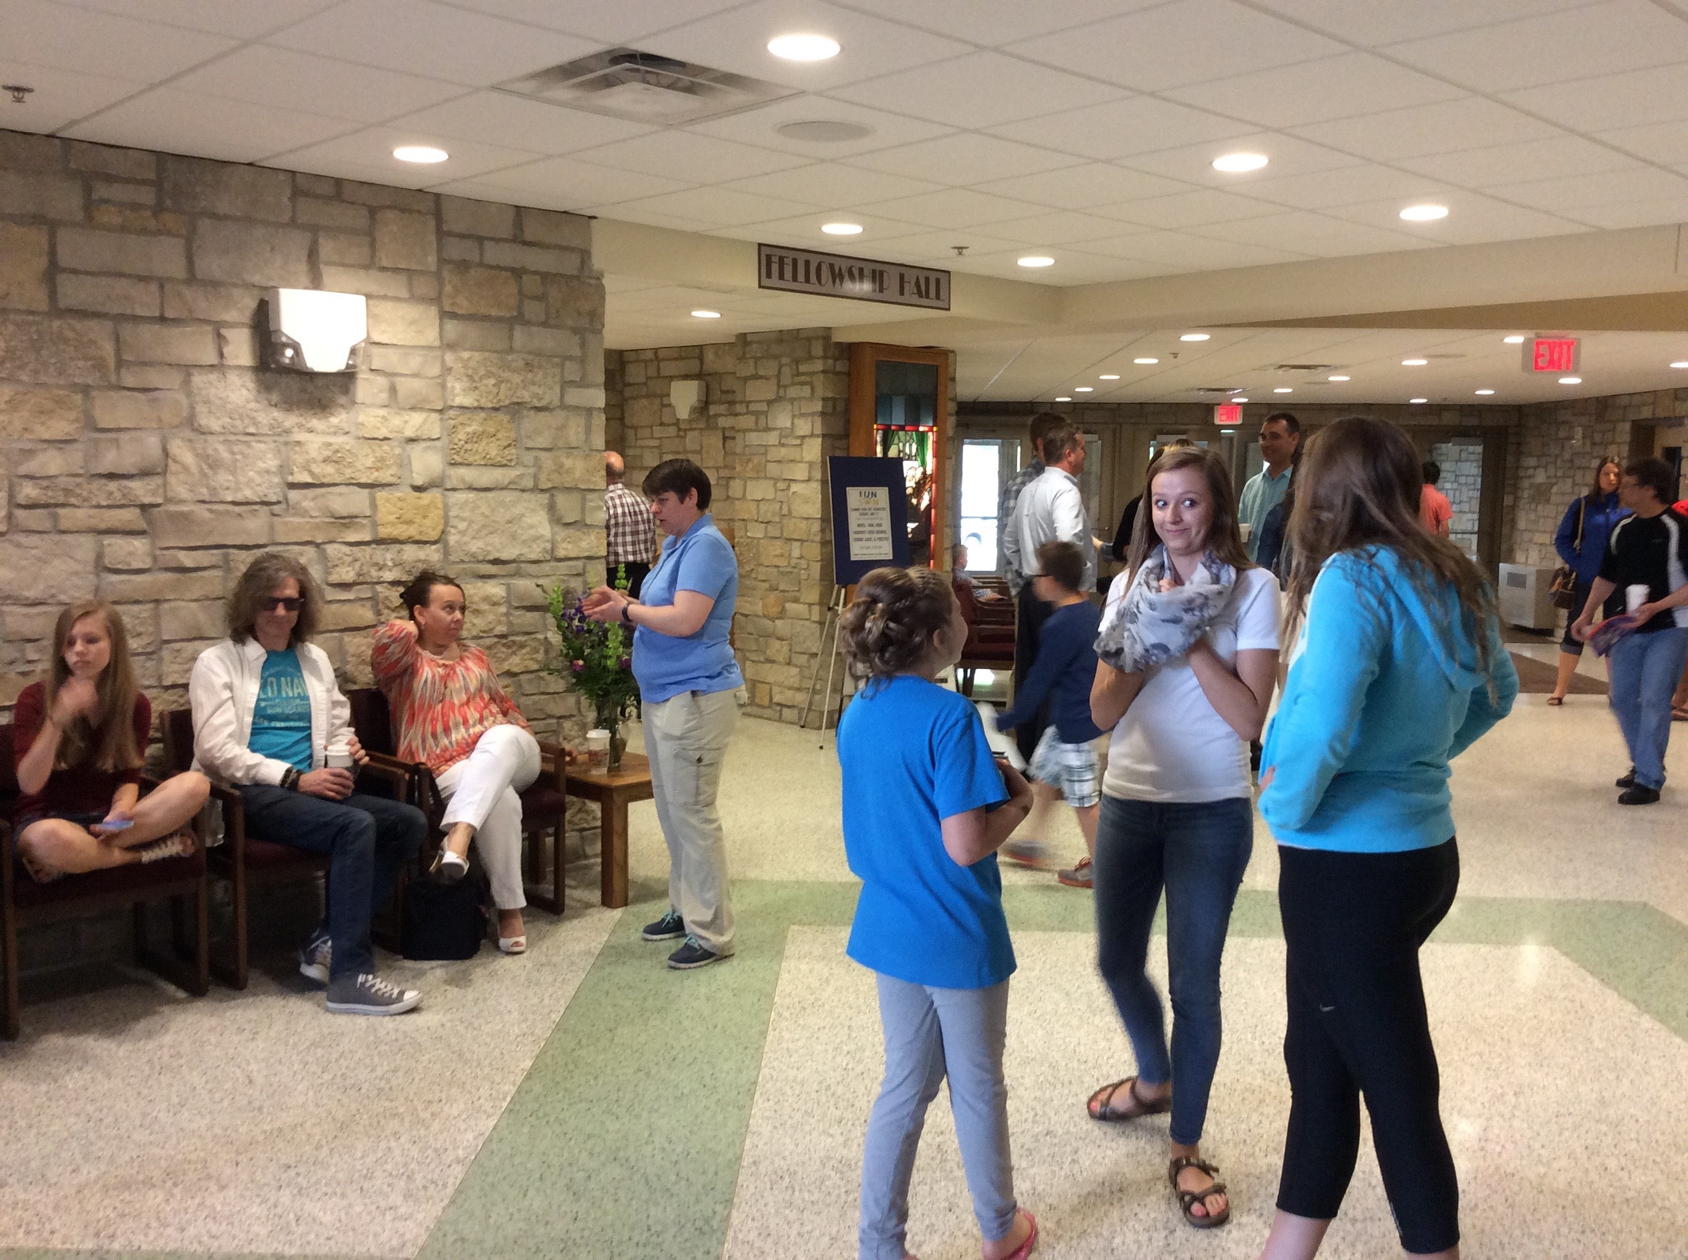
Trinity Lutheran, Owatonna, MN
Trinity U intergenerational learning

Slide 8
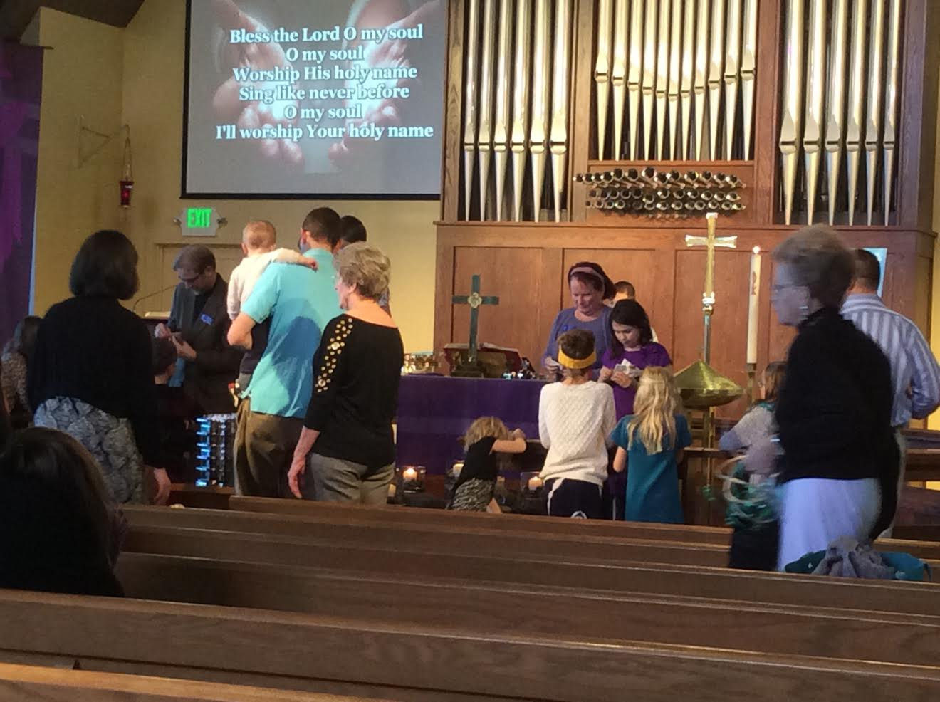
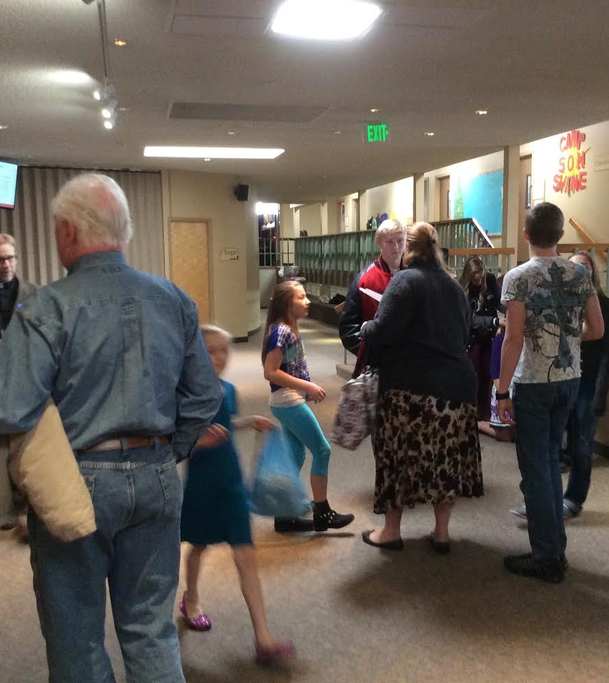
Zion Lutheran, Loveland, CO
Lenten Services
Mentoring
Faith 5
Worship

Slide 9

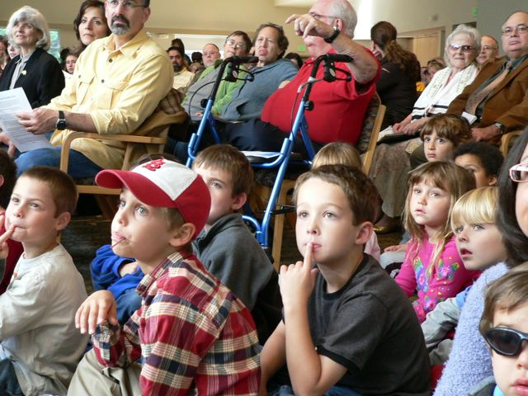
Practices – current and imaged
Fostering Christian Communities and Relationships
  Congregation-wide
  With Peers
  One-to-One
  Within households
What do you do well?
What could you try?

Slide 10

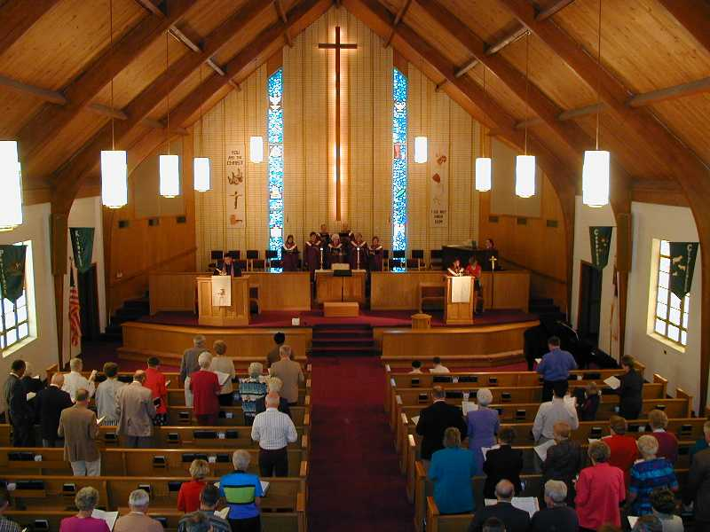
Practices – current and imaged
Foster Christian practices
  Engaging Scripture
  Prayer
  Worship
  Learning about and talking about faith
  Service
What do you do well?
What could you try?

Slide 11


Practices – current and imaged
Empower and Equip
  Active participation
  Discover gifts and explore passions
  Opportunities to lead
  Places to exercise one’s voice
What do you do well?
What could you try?

Slide 12
Leading on purpose and
engaged and connected includes
being attentive to all generations.

