Slide 1
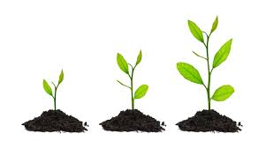
Faith Formation in a
Missional Age
Terri Martinson Elton, Phd

Slide 2
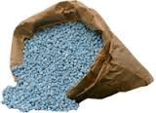
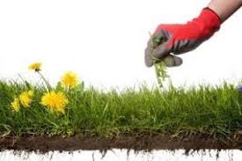

Summer – the season to…
grow
fertilize
water
weed

Slide 3
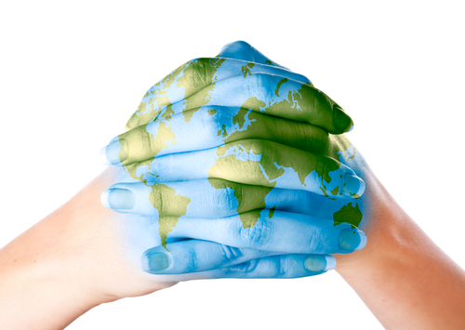
What does faith formation entail in this missional age?

Slide 4
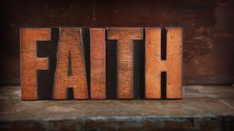
WHAT DO WE KNOW ABOUT FAITH?

Slide 5

FAITH IS A GIFT
Faith is a gift from God, and gives Christians their identity.
Faith is the foundational for a Christian way of life and informs and shapes who we are as Christians.
Faith, and being Christian, is dynamic. Just like our personal identity, our Christian identity is nurtured and fostered over time as people of faith explore what it means to live Christian.
Faith forms us, informs our way of life, and transforms us into children of God.

Slide 6
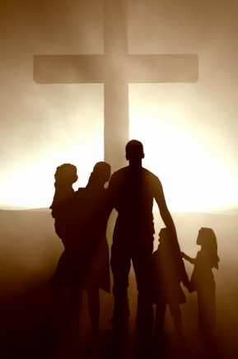
CHRISTIAN FAITH IS AN
EMBODIED FAITH
Christian faith is not an abstract idea; it is an embodied faith, a faith which takes on flesh as people live in God’s world. This reality is most evident in the incarnation – in God coming to earth in the person of Jesus. In Jesus’ life, death and resurrection, where God’s love and promises broke into the world in the flesh.
Jesus’ life centered on sharing God’s love by inviting people into a relationship with God and announcing the kingdom of God was near.
Christians bring to life God’s mission as they live in the world.

Slide 7
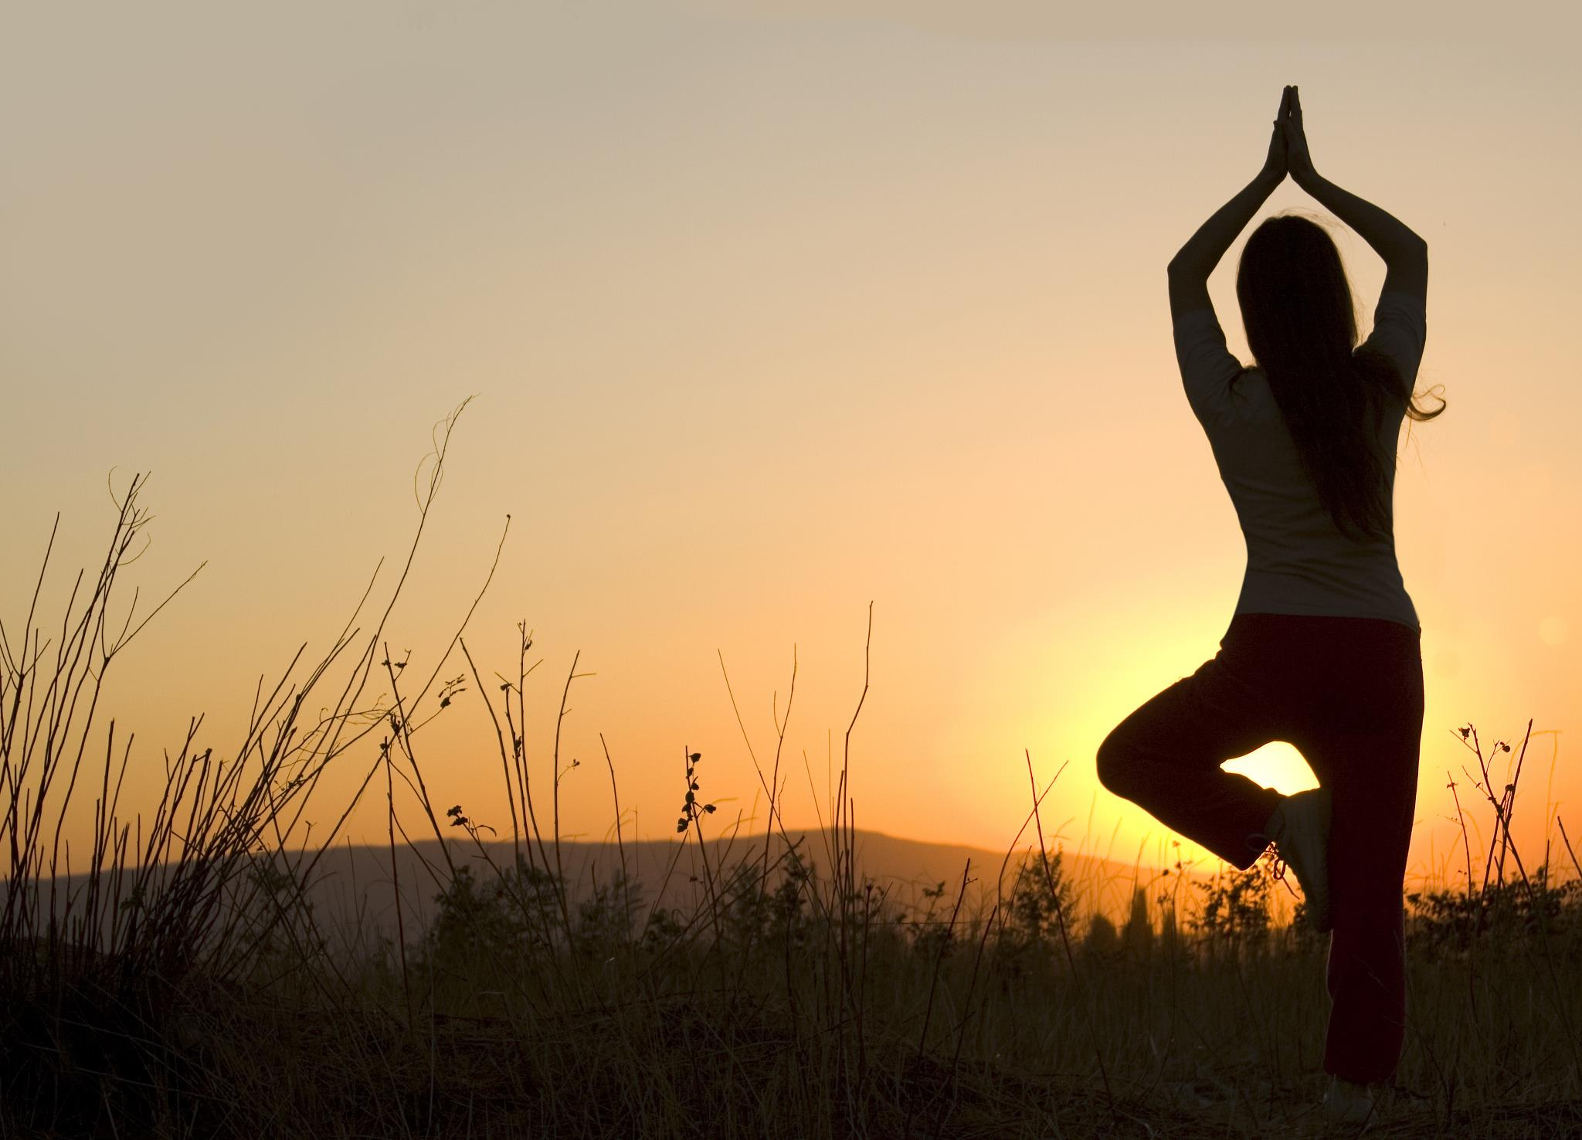
FAITH IS PASSIVE,
YET ACTIVE
Faith is passive, yet active. God freely offers faith to all people, and in this way, Christians are passive in faith. There is nothing humans do to receive faith, it is a free gift.
Yet faith is more than passive reception. Faith also summons a response, which overtime becomes a lifestyle. In this way, Christians are active in faith.
Through faith God’s people join God’s work in the world as they actively participate in God’s ongoing creative and redemptive mission of love.

Slide 8
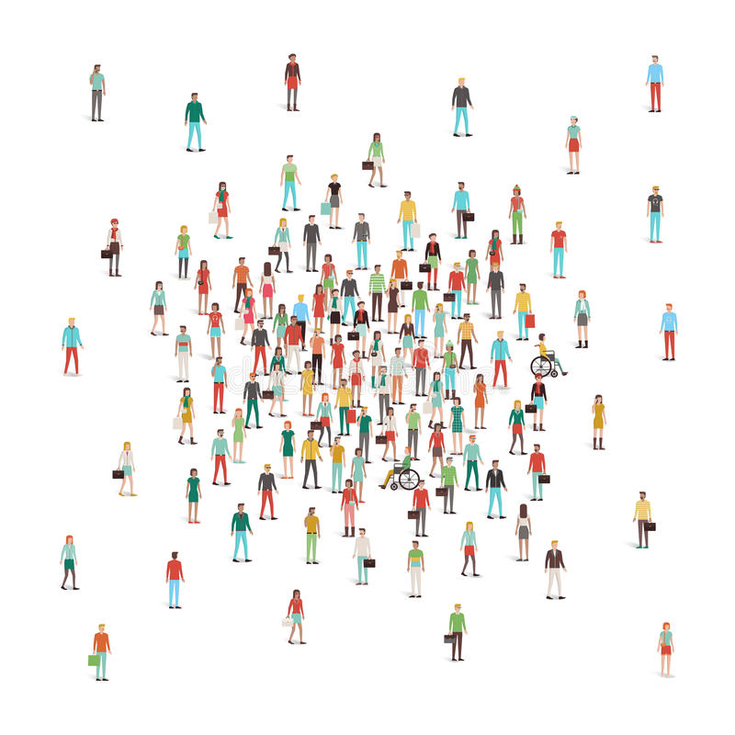
two movements
gathering
scattering

Slide 9
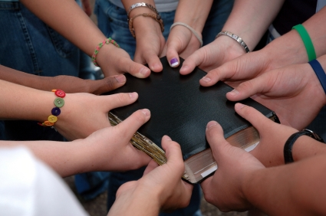
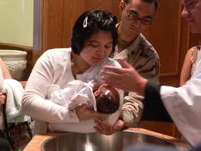
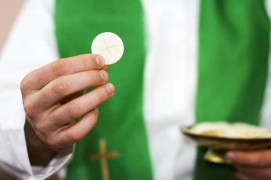
WHEN TWO OR MORE GATHER IN GOD'S NAME, GOD PROMISES TO BE PRESENT
THESE TIMES ARE PLANNED, AND UNPLANNED.
THEY INCLUDE UNIVERSAL PRACTICES, AND PRACTICES UNIQUE TO ONES TIME AND PLACE.
IN COMMUNITY, CHRISTIANS DISCOVER WHAT IT IS TO BE CHRISTIAN.

Slide 10
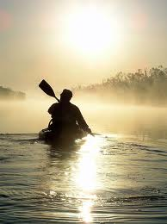

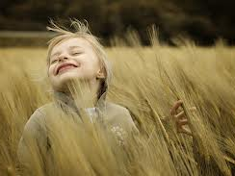
AWAY FROM CHRISTIAN COMMUNITY OUR CHRISTIAN IDENTITY IS TEST AND CHALLENGED.
YET OUR CHRISTIAN IDENTITY IS SHAPED AS MUCH BY OUR TIMES APART AS IT IS WHEN GATHERED TOGETHER.
LIVING CHRISTIAN MEANS BEING GOD'S LOVE IN THE WORLD - CREATIVELY AND REDEMPTIVELY.

Slide 11
two movements
gathering
Are we tending both movements?
scattering

Slide 12
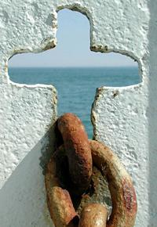
How has the gathered community of faith helped you discover your identity as a child of God?
How has the gathered community embodied the faith for you at a critical time in your life?
What practices have been most impactful for you living your faith in your everyday life?
What is most challenging for you as you seek to discover a Christian way of life scattered in the world? How could a community of faith help you?

Slide 13
What stands out for you in the pattern of gathering and scattering? What's similar and different from the current practices of your congregation?
How would this pattern help you, personally, discover a Christian way of life? What, if anything, would be different than your patterns in the past?
How might this pattern be a 'curriculum' for helping people in your context discover a Christian way of life? How would this change your current practices?

Slide 14
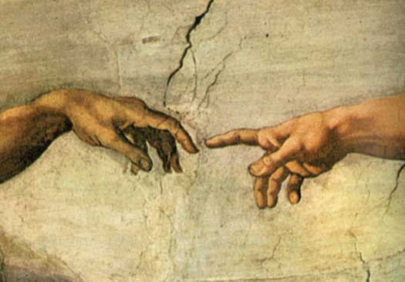
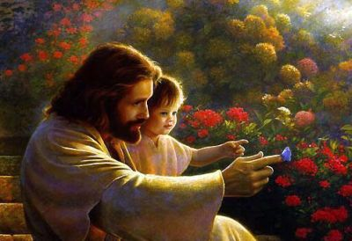
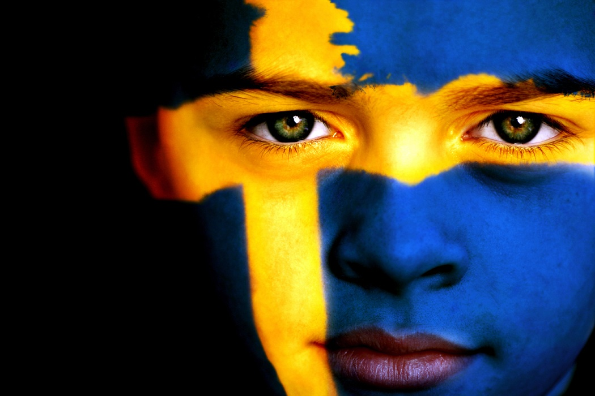
From objects
Faith formation
Identity as Child of God
Witness to God’s love
to subjects
to agents
Compass for daily life
Agent of God’s love

Slide 15
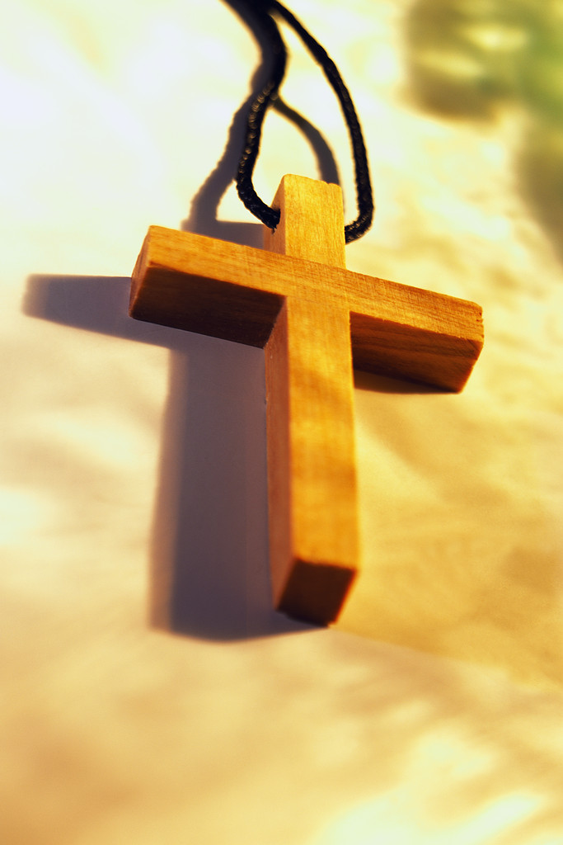
How has the gift of faith informed your life?
How has God’s love for you impacted how you love others?
How has the community of faith helped you discover a Christian way of life?
How have you experienced congregations witnessing to God's love?
How has faith empowered you to be an agent of God's love in the world?

Slide 16

|What are people longing for?|
As structures of family, work, religion, and leisure are changing, we are rarely on familiar ground.
In a 24/7, globally connected world, most of us are always “on” and our work (at the office or at home) is never done.
Notes:
Said another way, living in a networked society leaves ample opportunity for bridging relationships and not enough opportunities for cultivating bonding relationships.

Slide 17
|What are people longing for?|
Managing life requires switching off “non-essential functions, subordinate social groups, and devalued territories.” And the result of living within this new meta-network world is an infinite number of social ties, many of which are weak, yet without a rudder or guide.
Notes:
Said another way, living in a networked society leaves ample opportunity for bridging relationships and not enough opportunities for cultivating bonding relationships.

Slide 18
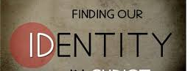
|What are people longing for?|
It use to be that meaning was made,
and our identity cultivated, within a few primary communities that often overlapped.
Such communities provided roots and stability.

Slide 19
|What are people longing for?|
Today, cultivating identity and making meaning take place while navigating an array of disconnected “primary” communities. This reality is new, and exhausting.
Navigating meaning without being rooted in centers of meaning leaves people floating amidst what feels like disorderly chaos.

Slide 20
People have a need for
making meaning

Slide 21
Because society promotes compartmentalizing life,
and making meaning requires integration around purpose,
Congregations can help people deal with the intersections of our lives by asking different questions.
In this way, congregations offer people another way, and the potential of a rudder for living.

Slide 22
Sandra Selby recognizes “The church is called to participate in God’s transforming work of reconciling love by embodying an alternative vision for the world:
one of welcome, wholeness, compassion, and hope.”
Notes:
Selby, “Religious Leaders as Facilitators of Meaning Making,” 41-65.

Slide 23
“Central to this calling is facilitating the process of meaning making, helping others to make sense of their experience by connecting it to a deeper purpose.”
“Strained by the very mad pace of our daily outer burden, we are further strained by our inward uneasiness, because we have hints that there is a way of life vastly richer and deeper than all this hurried existence . . . Life is meant to be lived from a Center, a divine Center.”
Notes:
Selby, “Religious Leaders as Facilitators of Meaning Making,” 41-65.

Slide 24
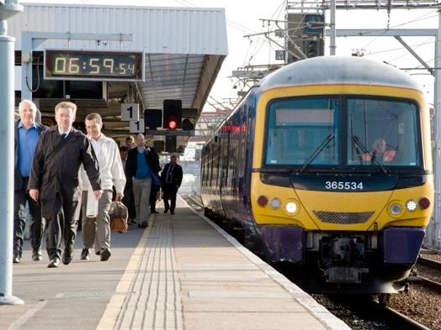
Congregations as Platforms

Slide 25

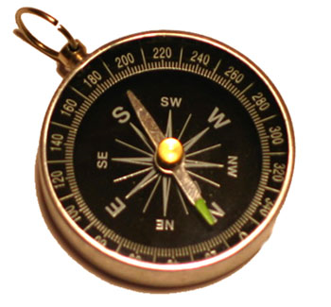
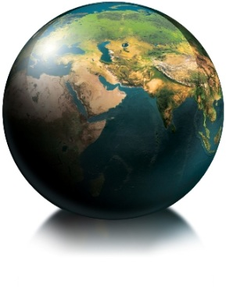
|Congregations as Platforms|
Meaning –
  Purpose - Baptism – Christian Identity
Relationships –
  Bonding and bridging relationships - Christian Community – Centered on GOD’s Love
Impact –
  Making a difference personally
  and communally - Vocation –
  Call to the World

Slide 26
|Congregations as Platforms|
Meaning – Role of INTERPRETER
  Purpose - Baptism – Christian Identity
Relationships – Role of CONNECTOR
  Bonding and bridging Relationships - Christian Community – Centered on GOD’s Love
Impact – Role of CONDUIT
  Make a difference - Vocation –
  Call to the World

Slide 27
Summer – the season to…
grow
fertilize
water
weed

