Slide 1

How is the Church Today? new things are emerging
Terri Martinson Elton
Luther Seminary

Slide 2

2 Corinthians 5:14-18
14 For the love of Christ urges us on, because we are convinced that one has died for all; therefore all have died. 15 And he died for all, so that those who live might live no longer for themselves, but for him who died and was raised for them.
16 From now on, therefore, we regard no one from a human point of view; even though we once knew Christ from a human point of view, we know him no longer in that way. 17 So if anyone is in Christ, there is a new creation: everything old has passed away; see, everything has become new!

Slide 3
Five Themes. Many Stories.
Contextualization and Building on Congregational Assets
Exploring Questions and Seeking Meaningful Engagement
Cultivate Christian Community and Intentional Relationships
Focus on Faith Formation and Learning for all ages
Clear Identity and Open to Experimenting

Slide 4
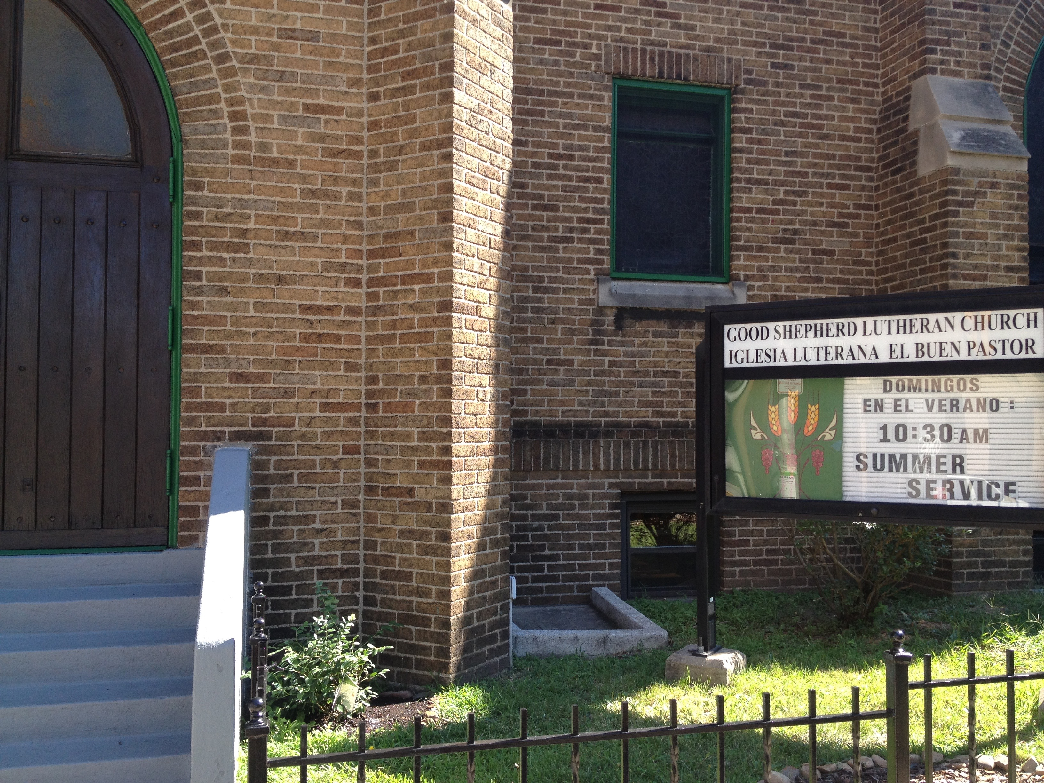
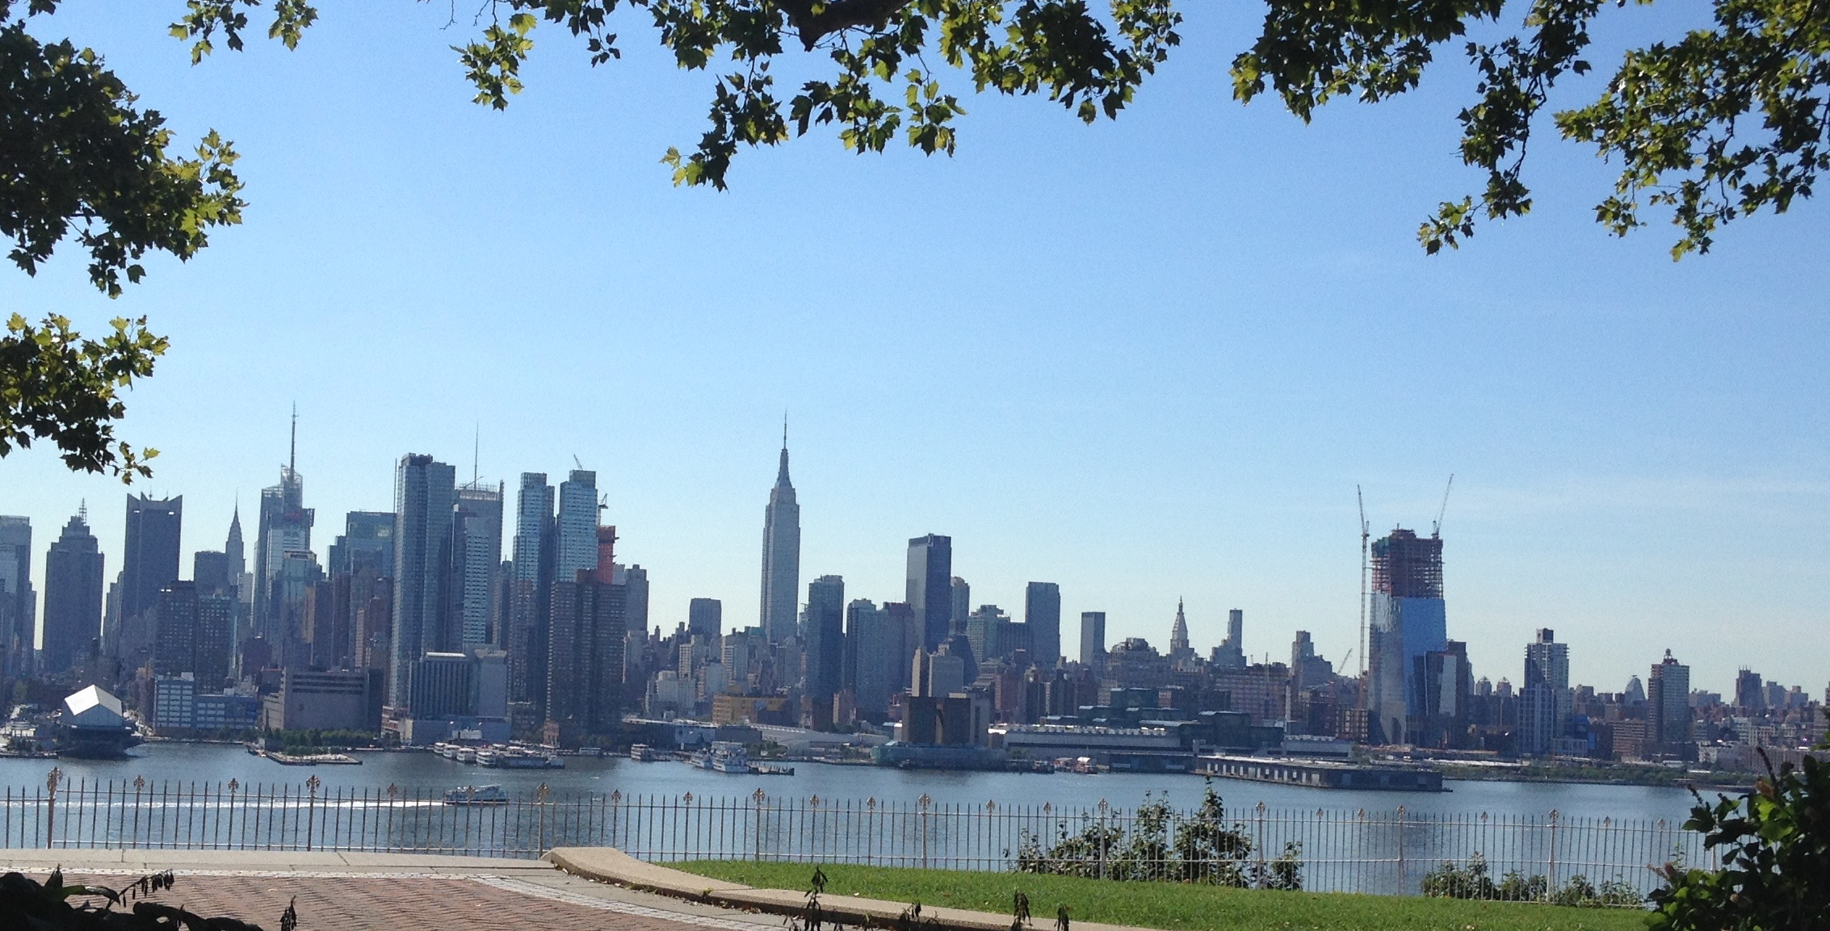
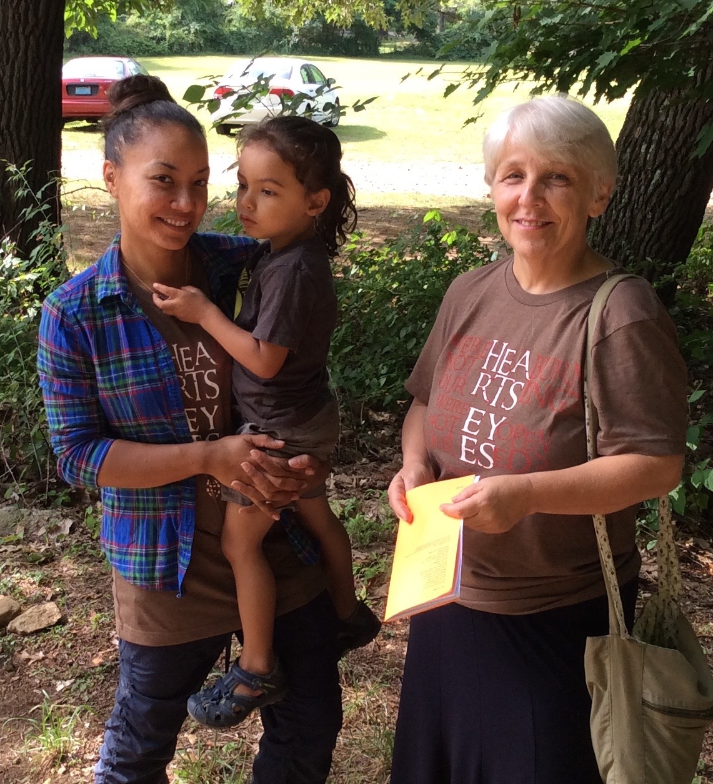
Contextualization
Building on Assets
Good Shepherd
Weehawken, NJ
Organized in 1905, The Evangelical Lutheran Church of the Good Shepherd began as the only Lutheran Church in the North Hudson to conduct worship in English rather then the languages of the Norwegian, Swedish, and German immigrants. Sixty years later they were the first congregation to offer a worship services in Spanish. A commitment to speaking the language of the neighborhood demonstrates that this congregation is concerned about speaking and listening to its context.

Slide 5
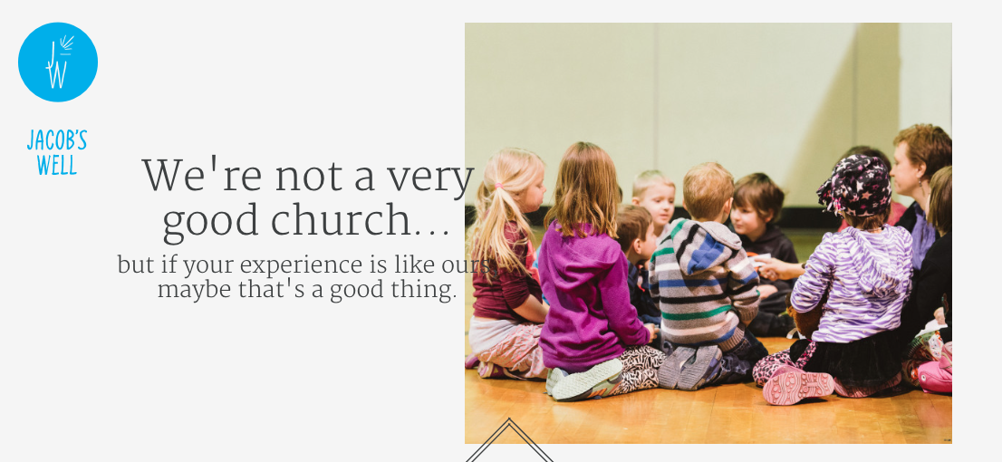
Exploring Questions
Seeking Engagement
This unique church thinks we all are hypocrites, doesn’t believe church should be boring, works hard to create a comfortable atmosphere, and is more concerned about good questions than easy answers. And it’s hard to find Jacob’s Well on a map since they don’t have a building and never have.
Jacob’s Well
Minneapolis, MN

Slide 6
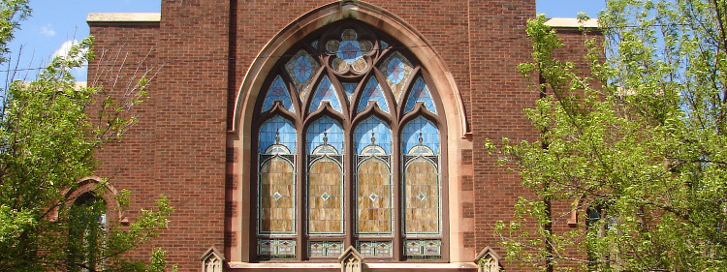
Cultivate Christian Community Intentional about Relationships
Greetings from Pastor Mueller
Holy Trinity Chicago, IL
Holy Trinity is unlike the churches most of us grew up in. Because it is fluid and ever-changing, the congregation has a remarkable spirit of openness and vitality. Yes, we value our Lutheran heritage and the ancient roots of our liturgy, yet we delight in a faith that is ever new and infused with a message for the needs and concerns of our contemporary world. As somebody recently put it: Our faith is two thousand years old, but our thinking is not.

Slide 7
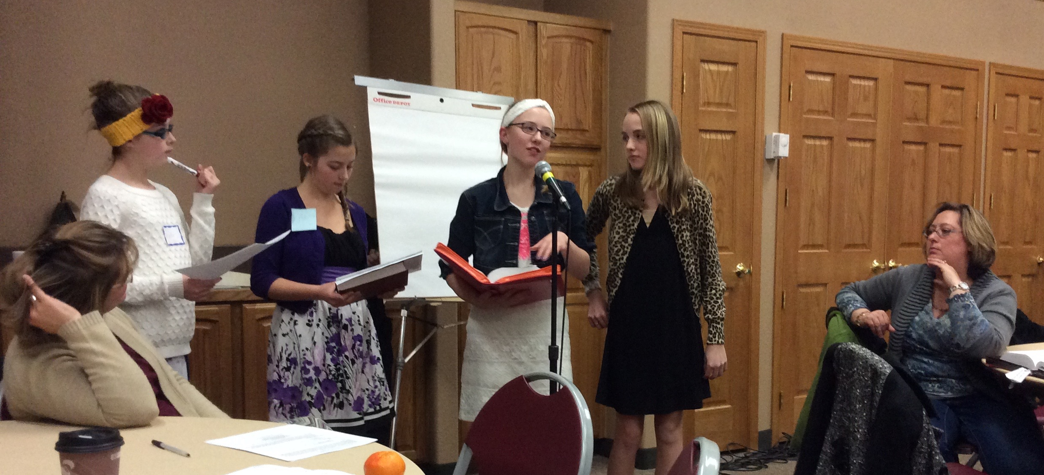
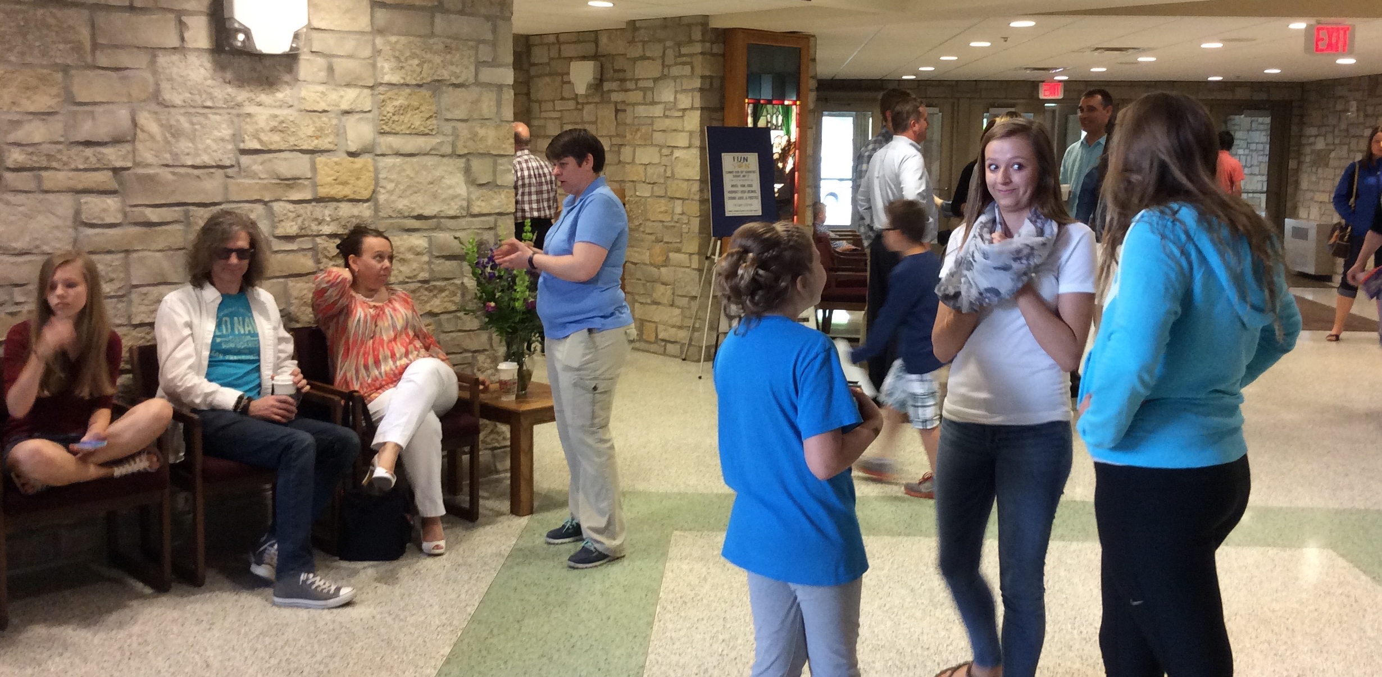
Focus on Faith Formation and Learning for All Ages
Zion
Loveland, CO
Trinity
Owatonna, MN

Slide 8
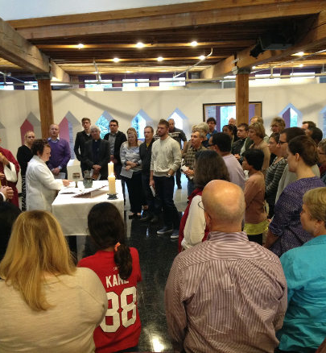
Clear Identity
Open to Experimenting
Holy Trinity Chicago, IL
South Loop – Second Site
Saturday night services are held in the South Loop Grace Place (home of Grace Episcopal Church), one block north of Dearborn Station. The Saturday services reflect Holy Trinity’s commitment to worship that is user-friendly, multisensory, and contemplative, with preaching that is relevant to contemporary issues and struggles. Holy Trinity is known for meaningful liturgy, radical inclusivity, social justice, and spirituality.
We are one congregation that worships in two sites: Saturday evening in the South Loop and Sunday morning in Lakeview.

Slide 9

Clear Identity
Open to Experimenting
GPS – Rockford,, IL Food Truck and Farmer’s Market

Slide 10
Five Themes.
Contextualization and Congregational Assets
Exploring Questions and Seeking Meaningful Engagement
Cultivate Christian Community and Intentional Relationships
Focus on Faith Formation and Learning for all ages
Clear Identity and Open to Experimenting
What assets do you have? What is unique about your context?
What questions are people asking?
How can Sotv meaningfully engage people?
How is community being cultivated?
What is the culture of learning at Sotv?
Is it time for Sotv to engage in experiments? If so, what might they be?

