Slide 1
How is the Church Doing Today?
The good and bad news of national studies
Terri Martinson Elton, PhD
Luther Seminary

Slide 2
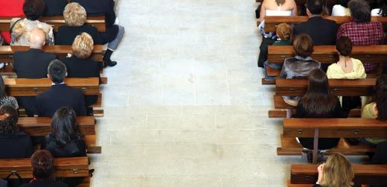
Why?
Notes:
I’m assuming those of us gathered here have a wide range of experience with church – maybe we’ve been Lutheran all of our life, maybe even been a member here at Shepherd all your life. Maybe some of us here are new the Christian faith, and the enterprise we call church. And maybe some of us here have had good and bad experience with organized religious – and wonder the connect of church and living as a follower of Jesus. No matter where you are today, I invite you to join me on a journey – both today and for the rest of the month of January – to explore this thing we call “church” from various angles and perspective. Why? Because I believe three things about church:
The church is in a time of transition
The church – nationally and locally – is struggling to figure out it’s place in people’s lives.
I believe local communities of faith matter – for individuals, for communities and in society.
I actually think it’s a great time to be church, and …
I hope, over the next few weeks, you can gain some clarity on where the church is today, the issues it faces, and the role it has to place today.

Slide 3
Good News needs Bad News
“Theology is that ongoing activity of the whole church that aims at clarifying what "gospel" must mean here and now.” (127)
The ‘”gospel” is the “good news” or news that is good. (128) “The good news is good because it challenges and displaces bad news.” (129)
So knowing the bad news lets us discover the good news, “And the bad news is always changing!” (129)
Therefore, the gospel is something to be discovered, it is responsive and is contextual.
Douglas John Hall, “What is Theology?”
Notes:
Hall, D. J. (2003). What is theology?. Brethren Life And Thought, 48(3-4), 121-134.
Part of what a church community is called to do it communicate the gospel for the people it encounters and in the time it lives.
So let’s try to figure out the bad news so we might be able to discover the good news.

Slide 4
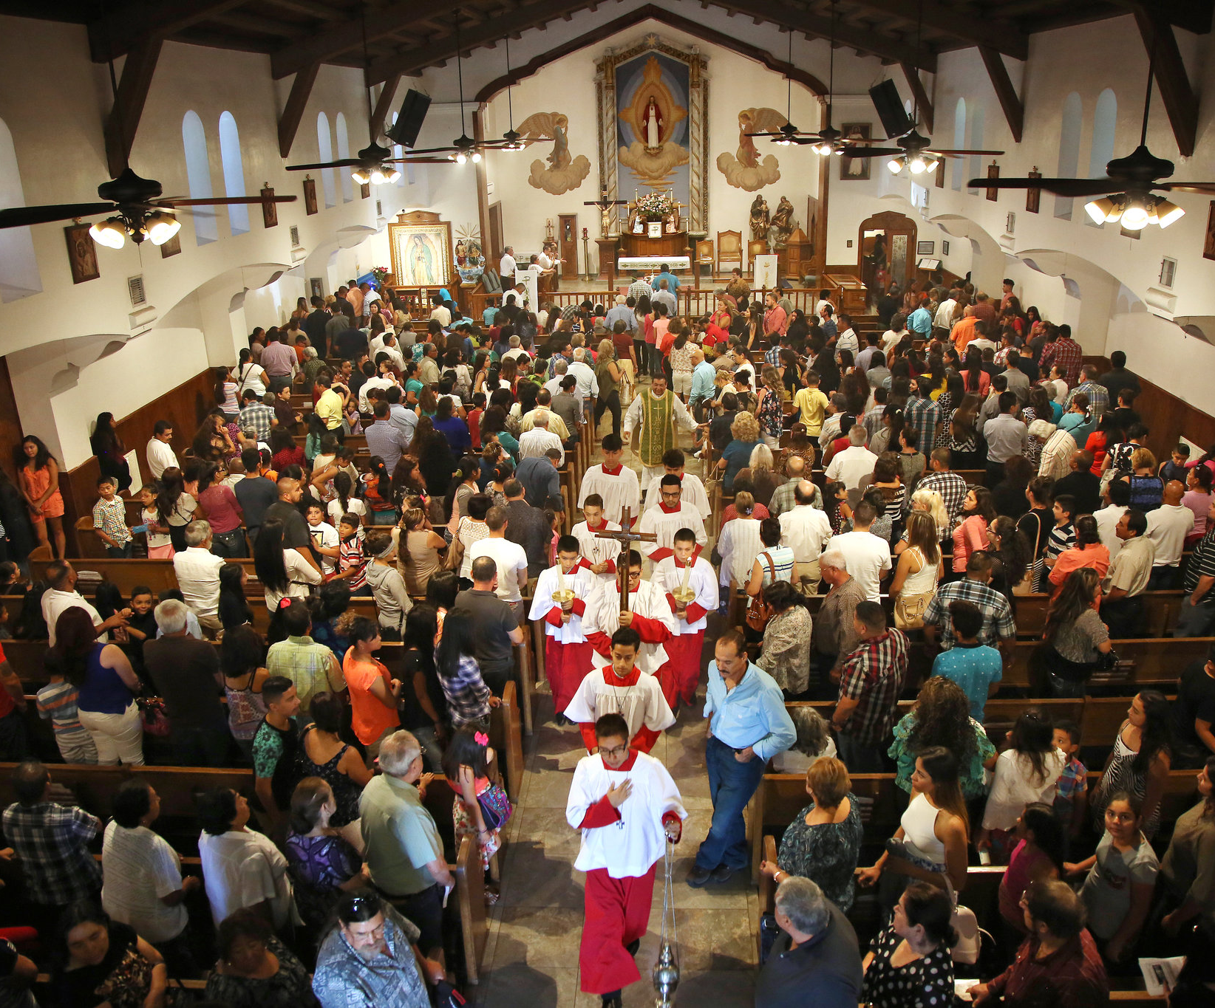
NY Times September 21, 2015
Pope Francis to Find a Church in Upheaval
Some U.S. churches are bursting with immigrant parishioners, while others struggle to stay open.
The Catholic Church has lost members of all ages who say they have been alienated by the sexual abuse scandals, the exclusion of women and married men from the priesthood, the rejection of gay relationships and birth control, and the denial of communion to Catholics who have divorces and remarried without an annulment.
… two decades ago, about one of every four Americans identified as Catholic, today it is about one of every five.
Notes:
http://www.nytimes.com/2015/09/22/us/pope-francis-to-find-a-church-in-upheaval.html
The state of the Roman Catholic Church.

Slide 6
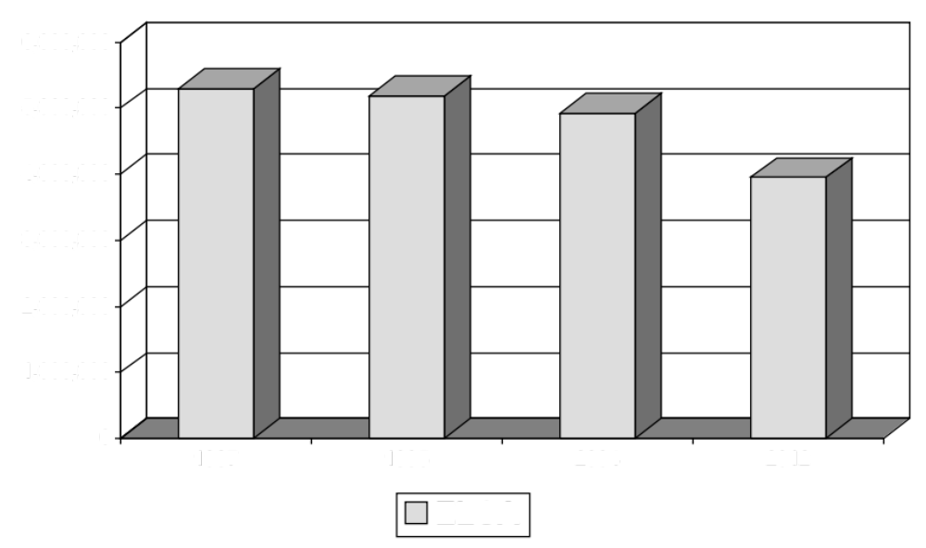
elca
Notes:
http://www.elca.org/research/
From 2000 to 2006, the ELCA has decreased 3.2% in the number of congregations (10,816 to 10,470) and decreased 6.8% in baptized membership. In addition, average weekly worship has decreased 10%. This synod is reflective of the ELCA as a whole – the number of congregations decreased 6.8% between 200- and 2006 and the baptized membership also decreased 9.6% (from 70,678 to 63,868). It is also worth noting that fewer children are being baptized and confirmed (decrease of 23.2% in baptized youth confirmed), so the future isn’t necessarily brighter!
From 2005 to 2012 2005 2006 2007 2008 2009 2010 2011 2012 2005-12
Number of Congregations 10,549 10,470 10,448 10,396 10,348 10,008 9,638 9,533 -9.6%
Baptized Membership 4,850,776 4,774,203 4,709,956 4,633,887 4,542,868 4,272,688 4,059,785 3,950,924 -18.6%

Slide 7
Survey Says… “less Christian”
ARIS 2008
The American population self-identifies as predominantly Christian but Americans are slowly becoming less Christian.
86% of American adults identified as Christians in 1990 and 76% in 2008.
The historic Mainline churches and denominations have experienced the steepest declines while the non- denominational Christian identity has been trending upward particularly since 2001.
The challenge to Christianity in the U.S. does not come from other religions but rather from a rejection of all forms of organized religion.
Based on their stated beliefs rather than their religious identification in 2008, 70% of Americans believe in a personal God, roughly 12% of Americans are atheist (no God) or agnostic (unknowable or unsure), and another 12% are deistic (a higher power but no personal God).
Notes:
http://commons.trincoll.edu/aris/files/2011/08/ARIS_Report_2008.pdf

Slide 8
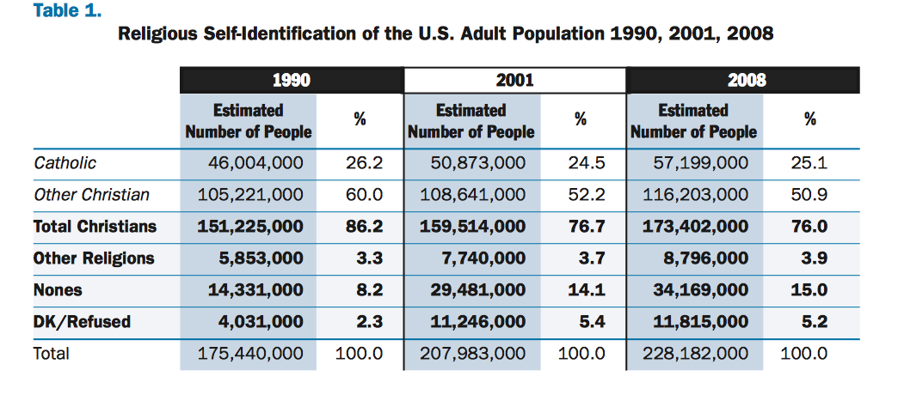
The Numbers
ARIS 2008
Christian – 86.2% to 76%
Other Religions – 3.3% to 3.9%
Nones – 8.2% to 15%
Notes:
http://commons.trincoll.edu/aris/files/2011/08/ARIS_Report_2008.pdf

Slide 9
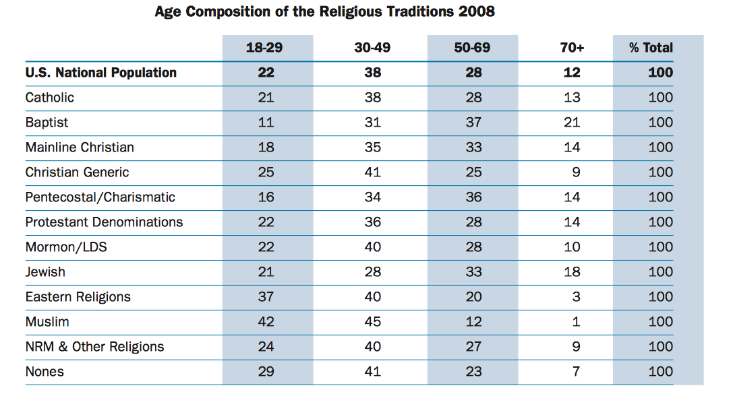
The Numbers
ARIS 2008
The Roman Catholic and Mainline Church are older.
Muslim and Eastern Religions are younger.
The Nones are younger.
Notes:
http://commons.trincoll.edu/aris/files/2011/08/ARIS_Report_2008.pdf

Slide 10
The Numbers
ARIS 2008
Geography matters –
Catholic numbers increased in the South and West. (1/3 in CA and TX and ¼ in FL)
Other Christians dropped overall, but dropped more significantly in the West. (to 51% overall; to 42% in West)
Nones doubled overall (8 to 15%) and increased across all regions. However the largest concentrations use to be in the Pacific NW (1/4 of pop) and now are in the NE (with /4 to 1/3), with significant increases in CO, ID, NV, and WY.
Notes:
http://commons.trincoll.edu/aris/files/2011/08/ARIS_Report_2008.pdf

Slide 11
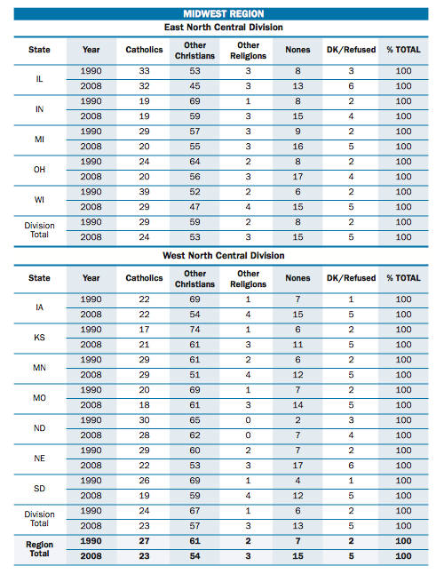
The Numbers
ARIS 2008
National =
Christian – 76%
Other Religions – 3.9%
Nones – 15%
Regional =
Christian – 77% (80% MN)
Other Religions – 3% (4% MN)
Nones – 15% (12% MN)

Slide 12
What is the Bad News?
Notes:
What is the Bad News?
And what might the good news be?

Slide 13
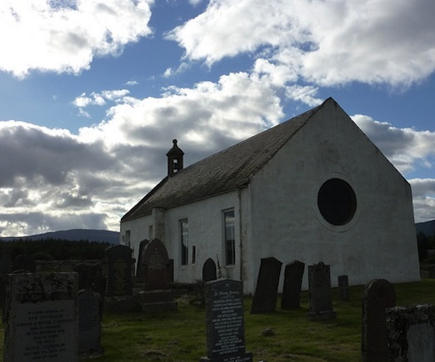
Christianity Today - OCT 1, 2013
The State of the Church In America: Hint:
It's Not Dying by Ed Stetzer
“The church is not dying.
Yes, the church in the West—the United States included—is in transition right now. But transitioning is not the same as dying, particuarly if you hold the belief that Christianity is represented by people who live for Christ, not check ‘Christian’ on a survey form…
Actually, no serious researcher believes Christianity in America is dying. Not one.
Instead, I believe this current cultural shift is bringing clarity that will assist in defining who we are as Christians, and that is a good thing in some ways.”
Notes:
http://www.christianitytoday.com/edstetzer/2013/october/state-of-american-church.html

Slide 14
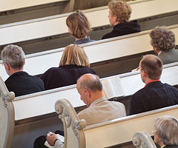
Cultural Christians
“The first category–Cultural Christians–is made up of people who believe themselves to be Christians simply because their culture tells them they are.”
Notes:
They are Christian by heritage. They may have religious roots in their family or may come from a people group tied to a certain religion, e.g., Southern Evangelicals or Irish Catholics. Inside the church, we would say they are Christians in name only. They are not practicing a vibrant faith. This group makes up around one-third of the 75 percent who self-identify as Christians—or about a quarter of all Americans.

Slide 15
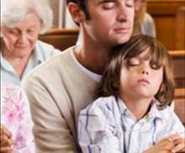
Congregational Christians
“The second category–Congregational Christians–is similar to the first group, except these individuals at least have some connection to congregational life.”
Notes:
They have a "home church" they grew up in and perhaps where they were married. They might even visit occasionally. Here again though, we would say that these people are not practicing any sort of real, vibrant faith. They are attendees. This group makes up another third of the 75 percent—or about a quarter of all Americans.

Slide 16

Convictional Christians
“The final group–Convictional Christians–is made up of people who are actually living according to their faith.”
Notes:
These are the people who would say that they have met Jesus, He changed their lives, and since that time their lives have been increasingly oriented around their faith in Him. Convictional Christians make up the final third of the 75 percent—or about a quarter of all Americans.

Slide 17
What does this mean?

