Slide 1



Re-Imagining Youth Confirmation:
Themes, Shifts, and Practices
Terri Elton
Luther Seminary
Notes:
Introduce ourselves – conversion
Why interested!

Slide 2
Our View Matters
Hope or despair?
Opportunity or Chore?
Place amidst a larger ecology?

Slide 3
Areas of Interest
Interests and Questions of Youth
Theological Pedagogies
Creative Pedagogies
Church is BORING!
Ministerial (Dis)satisfaction

Slide 4
Areas of Interest
Confirmation as an “Institution”
Camp and Future Leaders, Mentoring
Big Party, Big Presents
Confirmation in Ecology of Youth Ministry
Making disciples of Jesus Christ
Intensification and Integration

Slide 5
Our View Matters
Opportune Moment – need for intensified catechetical ministry
Mindset shift – move from apology to missional urgency
One among many – not SS and Conf, but an ecology of discipleship

Slide 6

Research Question
What is the state of confirmation and equivalent practices within five denominations that practice infant baptism?

Slide 7
Themes
Resilient
Contextual and owned by congregation
Adaptive and responsive
Committed leadership and resources
High parental investment
Bridge, not graduation

Slide 8
Practices
Building on congregation’s strengths
Tending relationships
Mentoring
Exploring beliefs
Making public affirmation of faith

Slide 9

Three Hopeful Shifts
Purpose
Pedagogy
Context
Notes:
Together, these themes and practices are suggesting significant shifts in the PURPOSE, PEDAGOGY & CONTEXT of confirmation. These shifts are not independent of one another. Rather they are interrelated.
We will talk about the specifics of each, but know the others always “in the conversation” as well.

Slide 10

Purpose
Shift from focus on rite to focus on youth engagement
Engagement first, doctrine second.
Shift from focus on equipping for church membership and denominational loyalty to lifelong journeys as followers of Jesus
Lifelong followers of Jesus first, Christian community second.

Slide 11
Purpose
Confirmation as an intensive, focused time of learning the practices and beliefs of the Christian faith.
Question - How is confirmation meeting the spiritual hungers of youth AND teaching the beliefs and practices of the church?
Notes:
Sturderier faith
Expectation matters -

Slide 12
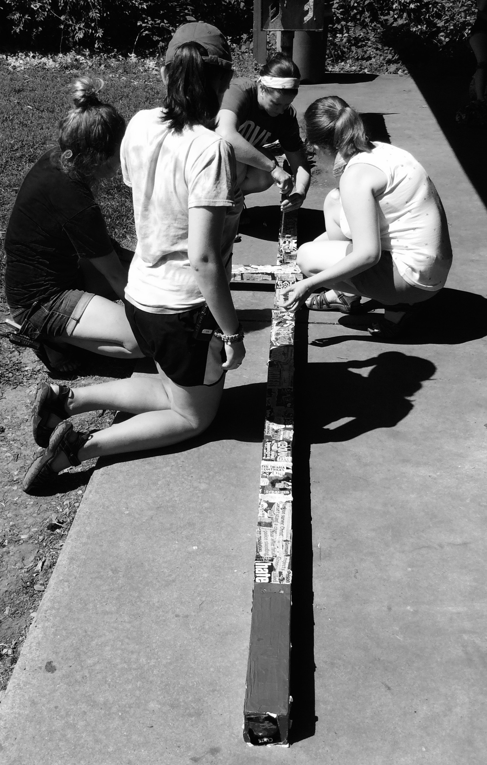
Pedagogy
Shift from traditional, didactic instruction to resource-rich learning environment
Freedom & Accountability
Shift from cognitive learning about Christianity to active engagement with it
Life-wide, relationally-rich
Notes:
- Relationally rich learning (Content in the midst of community.)
Honors questions and curiosity of young people – lets the world be an integral part of the curriculum.
Sees the agency of young people (in learning, caring, serving, worshipping, leading) Draws out the gifts of young people. Formally and informally.
Integrating multiple pedagogical strategies – intentionally designed (time separate, regular time, time away, time in the world, time with the congregation) parts and whole.
Intergeneration opportunities. – this points to the congregation deepening and widening their faith formation as well.
Expectations – of students, community, and God it be part of this transformative work.
Why? Wider cultural shifts in expectations about teaching and learning. Democratization of learning.

Slide 13
Pedagogy
Confirmation as transformational learning and vocational discernment
Question - In what ways is confirmation ministry drawing youth into a vibrant learning community?
Notes:
Multi-faceted with many teachers addressing many learning styles
Address the whole person – life-wide piece

Slide 14
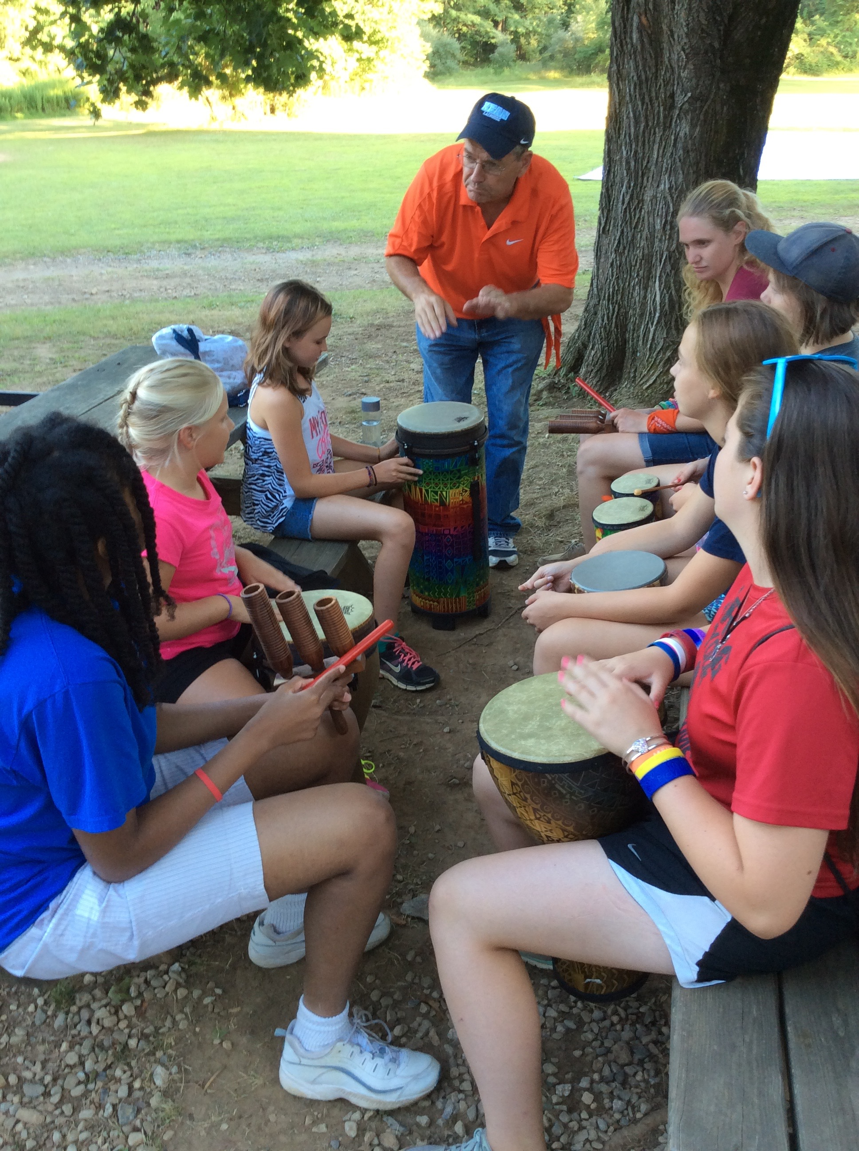
Context
Shift from uniform practice to working with congregational and contextual assets and challenges
Local & Organic
Shift from separate ministry/event to process owned by congregations and connected to the wider church/community
Congregation-wide
Notes:
CONTEXT – American religious landscape has changed forever. Post-denominational world. Confirmation in our 5 denominations must be relevant and local.
Confirmation is not “the pastor’s” job (one person), not a “have to” ministry. Connected to a deeper commitment to faith formation and lifelong discipleship, confirmation is ONE PIECE of a larger puzzle.
Healthiest congregations ministry reflect the character and dynamism of their context and community. It is not about size, but about relationships, wider ownership of ministry, and understanding of the shifting understanding of the role of church and everyday life.
Two stories:
Lisa - St, John’s
Terri – Trinity (problem and made it useful)

Slide 15
Context
Confirmation as adaptive and resilient faith formation ministry
Question - How is confirmation ministry taking into account the particularities of your setting?

Slide 16
Three Shifts
Purpose
Pedagogy
Context

Slide 17
Lived Tensions
Accommodation – “Orthodox” doctrine
Gospel as status quo – Gospel as disruption
Quick and easy – Slower and deeper
Need mentors – Spiritual maturity of mentors
Focus on confirmation – What’s next?

Slide 18
Re-imagining Confirmation
It matters
It takes a team
Builds intergenerational learning community
Claiming the Way of Jesus
Practitioners need to talk with each other

Slide 19
www.theconfirmationproject.com
See resources and webinars
Rethinking Confirmation videos
Luther Seminary – YouTube channel
Wonder about Confirmation – Practice Discipleship Curriculum

