Slide 1

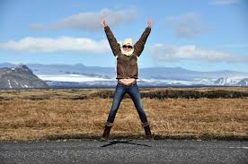
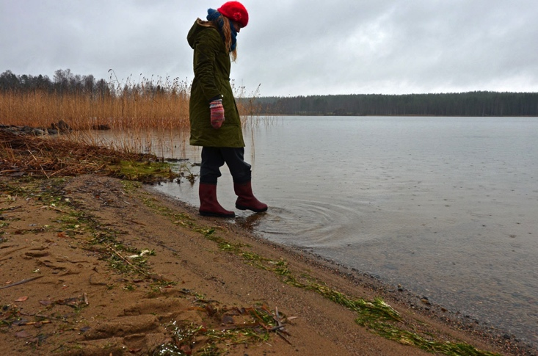
How will you lead?
YOU ARE A LEADER:
Terri Elton

Slide 2

Did you know? Have you not heard?
You are called, by God, to lead!

Slide 3

Believe it!

Slide 4
Practicing the Truths about Leadership – adapted from Kouzes and Posner
1 – You Can Make A Difference
2 – Credibility is the Foundation of Leadership
3 – You can’t do it Alone – Team
4 – Trust Rules
5 – You either Lead by Example or You Don’t Lead
6 – The Best Leaders are the Best Learners
7 – Leadership is an Affair of the Heart

Slide 5

Discuss
Share examples of how you have witnessed or experienced these Truths?
Which truths are easy for you? Which truths are hard? Why?
If you were to pick one truth to work on this summer, what would it be?

Slide 6
Believe it!
Values

Slide 7

Values
What Really Matters - Luke 12:1, 13-21
Find 5 things in your backpack, pocket or around the room that could represent what is important to you.
Find a partner and share what the 5 things represent, why they are important, and what value they represent to you.
How do these core values related to your leadership? How are they present in ministry?

Slide 8
Believe it!
Values
Anchor

Slide 9
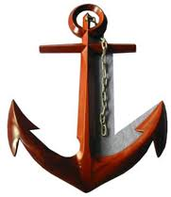
Anchor Yourself
“To anchor ourselves in the midst of turbulent seas of the various roles we take in life, professionally and personally, we have found it profoundly important to distinguish between the self, which we can anchor, and our roles, which we cannot.” (Leadership on the Line, 187)
You are not your role!
Who are you? (right now)
What is a hope you have for this summer?
What do you need most right now?
What will keep you anchored this summer?

Slide 10
Believe it!
Values
Hunger
Anchor

Slide 11
Manage your Hungers
“…sometimes we bring ourselves down by forgetting to pay attention to ourselves. We get caught up in the cause and forget that exercising leadership is, at heart, a personal activity. It challenges us intellectually, emotionally, spiritually, and physically.” (Leadership on the Line, 164)
“We are, all of us, vulnerable to falling prey to our own hungers. Self-knowledge and self-discipline form the foundation for staying alive.” (Leadership on the Line, 165)
Power and Control
Affirmation and Importance
Intimacy and Belonging

Slide 12

Manage your Hungers
Dee Hock -
“It is the management of self that should occupy 50% of our time and the best of our ability.”
What hungers do you need to manage this summer?

Slide 13
Believe it!
Team
Values
Hunger
Anchor

Slide 14
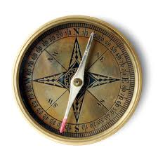
Team
Leading the self - a 360-leader
N – S – E – W
North – leading people over you
South – leading people under one’s care
East and West – leading people around you
(Courageous Leadership, 183)

Slide 15
Team
Key Questions:
North - What do you have to offer people in leadership over you? What do you need from these leaders?
South – What do you have to give people in your care? What do you need from them?
East and West – What do you have to give others leading around you? What do you need from them?
Work independently and then share with a partner.

Slide 16
Believe it!
Team
Values
Spiritual
Hunger
Anchor

Slide 17
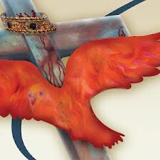
Spiritual Pathways
Relational
Intellectual
Serving
Contemplative
Activist
Creation
Worship
(Courageous Leadership - Ch 11)
Identify your pathway
Lean into it
Appreciate all
Help others discover theirs!

Slide 18
Believe it!
Team
Values
Spiritual
Hunger
Anchor

