Slide 1
Leading CHANGE
Dr. Terri Elton

Slide 2
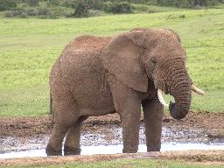
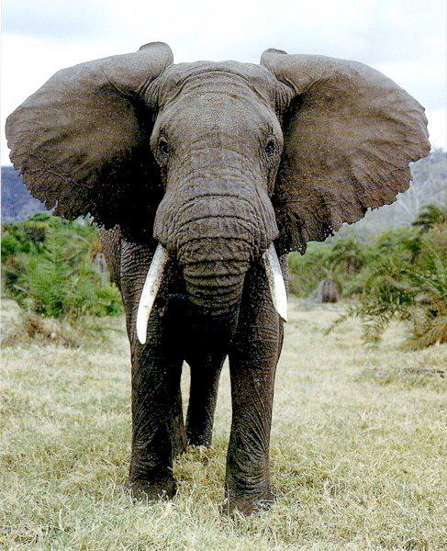
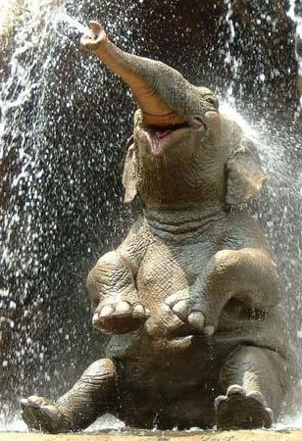
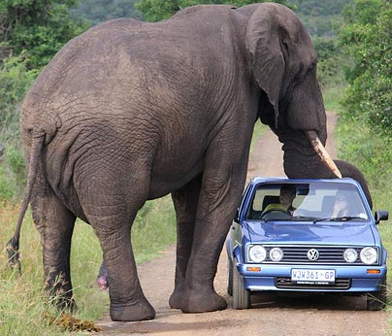
Folk tale

Slide 3
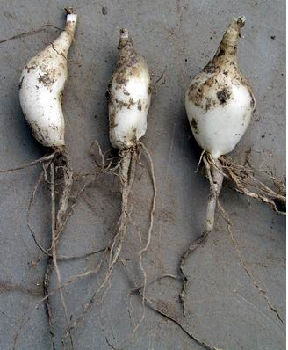
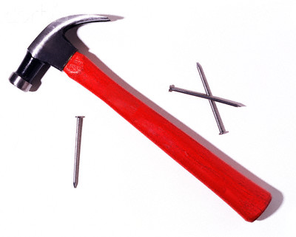
VIEW OF CHANGE

Slide 4
Every Season - Nichole Nordeman
http://www.youtube.com/watch?v=-dwpdZdvCl8

Slide 5
Every Season - Nichole Nordeman
http://www.youtube.com/watch?v=-dwpdZdvCl8

Slide 6

Why study change?
Change is a normal part of our world. CHANGE HAPPENS!
Change takes place IN THE CHURCH!
Leadership always involves change.
Yet there are different types of change!

Slide 7
Leading change…
Personal dimension of change
What do we mean by Change?
Systems Approach to Change
Drawing on Theoretical Resources
  re:Developmental view –lifecycle theory
  re:Cultural view – changing the DNA
  re:Innovation – diffusion of innovation

Slide 8

|let’s get personal|
Leading change starts with
looking at one’s self.

Slide 9
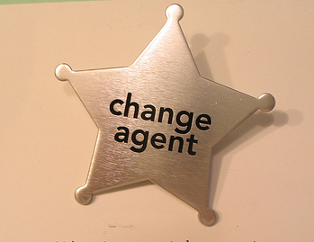
|personal|
  There is a personal dimension to change that can never to taken away.
    Think about a time you dealt very well with leading a change process, as well as a time you did not deal very well with a change process.
    What do these scenarios say about your perspective of change?

Slide 10
|personal|
  How do you deal with change?
    What is your experience both with change in general and in leading change?
    What skills do you have for leading change?
    What’s your change temperament?
  What about those around you?

Slide 11





|personal|
Some Resources:
What is your Change Style?
  Discovery Learning’s
  ChangeStyle Indicator
What is your conflict management style?
  Speed Leas
Family-systems view
  The Leader’s Journey by Herrinton, Creech,
  and Taylor
How are you gifted?
  LifeKeys by Stark, Kise, and Krebs
  Strengths Finder by Tom Rath
Notes:
While there are various profiling or temperment tools available that can help one discover their natural orientation toward leading in times of change – here are a few that are aimed specifically at change and conflict.

Slide 12
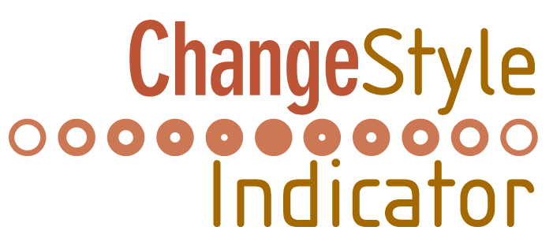
A Discovery Learning Product
®

Slide 13
CHANGE STYLE PREFERENCE
CONSERVERS
Accept the structure
Prefer change that is incremental
S-3

Slide 14
Dealing with Change
Conserver
      Place high value on structure.
      Prefer current situation over unknown.
      Goal: better utilize resources while preserving structure.
      Like change to be gradual and within current reality.
      Enjoy predictability and honor tradition.
      Know the rules and follow them.
      See details.
      Prefer tested/proven solutions.

Slide 15
CHANGE STYLE PREFERENCE
CONSERVERS
Accept the structure
Prefer change that is incremental
ORIGINATORS
Challenge the structure
Prefer change that is expansive
S-3

Slide 16
Dealing with Change
Originator
      Reengineering.
      Prefer fast and radical approach to change.
      Goal: challenge structure and open to fast, fundamentally different, even systematic change.
      Appear undisciplined and unconventional.
      Enjoy risk and uncertainty.
      Appear to be visionary and systematic in their thinking.
      Make up the rules as they go and value future possibilities.
      Promoters of innovation.

Slide 17
CHANGE STYLE PREFERENCE
CONSERVERS
Accept the structure
Prefer change that is incremental
PRAGMATISTS
Explore the structure
Prefer change that is
functional
ORIGINATORS
Challenge the structure
Prefer change that is expansive
S-3

Slide 18
Dealing with Change
Pragmatist
  Functional change.
  Prefer to explore existing paradigm.
  Goal: practical, workable outcomes.
  Appear practical, agreeable and flexible.
  More focused on results than structure.
  Appear more team oriented and are often mediators.
  Will change assumptions if assumptions are blocking outcomes.

Slide 19
Dealing with Change
What is your Change Style?
  Conserver
  Pragmatist
  Originator

Slide 20
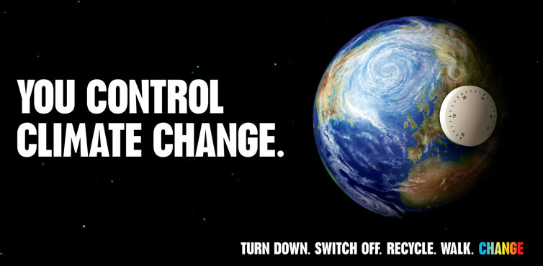
What do we mean by change?
Change is both an event and a process!
Change is about the way we think and the way we act.

Slide 21
All change is not the same!
Continuous
Discontinous
Transition
Growth
Adaptive
Technical
Conflict
Individual
Organizational
Systemic
Paradigm shifts
????

Slide 22

|two basic types of change|
adaptive
and
technical

Slide 23
|adaptive vs technical change|
Ronald Heifetz…
Technical situations are when “a problem can be clearly defined and a solution can be clearly applied.”
Adaptive situations require learning and arise when our deeply held beliefs are challenged.
Leading Change in the Congregation, p. 42-43.

Slide 24
|adaptive vs technical change|
One of the questions leaders need to ask when facing change and conflict is
What type of situation is this…
adaptive or technical?
List issues that are adaptive.
List issues that are technical.

Slide 25
The Missional Leader
“Change rarely happens in a straight line!” (79)

Slide 26
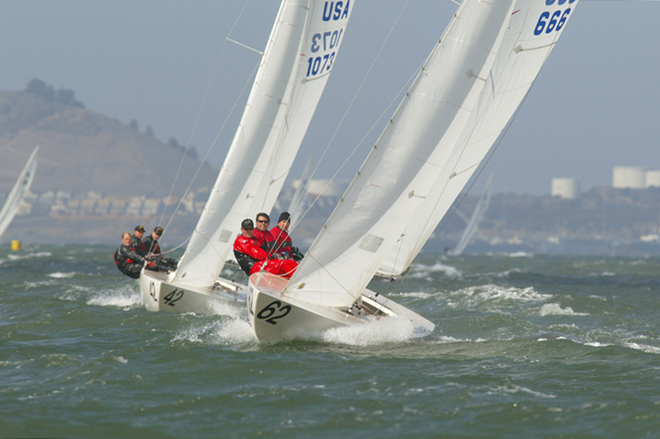
The missional leader
Difference:
Target is not always where we think
We will make a lot of mistakes
The target keeps moving

Slide 27
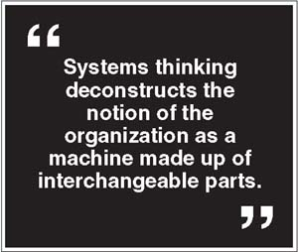
|systems|

Slide 28


Closed systems Vs Open systems
Has all it needs vs. Needs the environment

Slide 29
|open systems|
Inputs Outputs
Those things that The influences and resources
Influence and resource the organization wants to put
The organization – into the environment – in
Known or unknown, order to carry out its mission
Wanted or unwanted and contribution to society.
Feedback
Information generated within an organization by the mere fact it’s operating. Much information is lost,
because people do not pay attention to it. But much
can be gained from created feedback loops.
Leading the Congregation by Norman Shawchuck and Roger Heuser. Pages 209 and 214.

Slide 30
Discussion:
Congregations are systems!
Name some of the inputs.
Name some of the outputs.
What are some feedback loops?

Slide 31
question:
How does an organization attend to the changing nature of its environment?
become a learning organization!

Slide 32
Systems Views of Organizations
Learning organization – drawing from the outside
Developmental –lifecycle theory
Cultural – changing the DNA
Innovation – diffusion of innovation

Slide 33
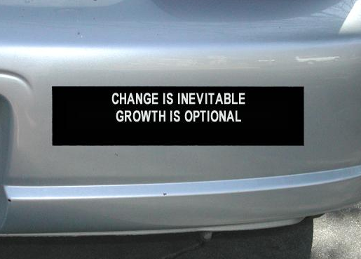
|developmental view|
Organizations go through stages – they are born, grow, age, and die. At each stage of development, certain challenges must be overcome if the organization is to survive and thrive.
Thriving as an organization depends not only upon how it deals with its internal change, but also how the organization deals with the external change around it.

Slide 34
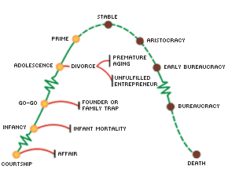

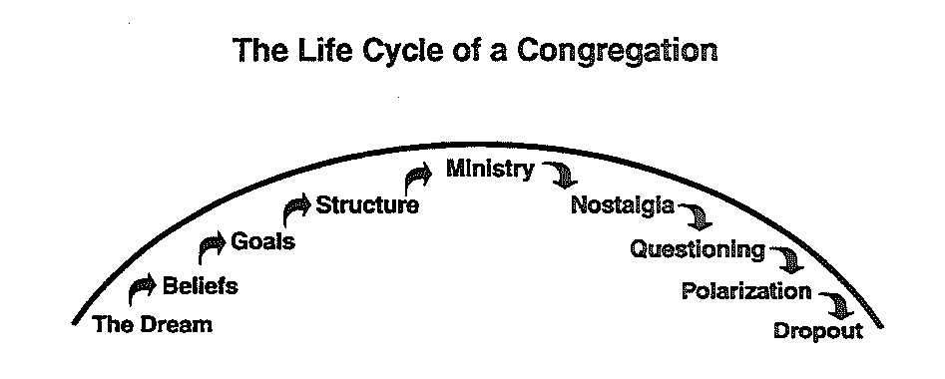


|lifecycle theory|
Effectiveness
Ichak Adizes, Managing Corporate Lifecycles
Rendle, Gil, Leading Change in the Congregation: Spiritual and Organizational Tools for Leaders
Notes:
How can this help? Exactly the strengths of one stage, are the hinderances of the next. While we live in a discontinuous world, there still is some change that is developmental!

Slide 35
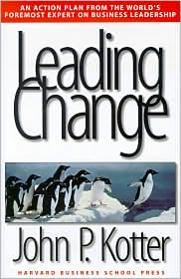
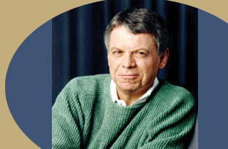
|changing culture|
John Kotter
Harvard Business School
The 8 stage process of change

Slide 36
|changing culture|
The 8 mistakes of working the process of change:
Allowing too much complacency.
Failing to create a sufficiently powerful guiding coalition.
Underestimating the power of the vision.
Undercommunicating the vision by a factor of 10 (or perhaps 100 or more).
Permitting obstacles to block the new vision.
Failing to create short-term wins.
Declaring victory too soon.
Neglecting to anchor changes firmly in the corporate culture.
John Kotter

Slide 37
Leading Cultural Change
The 8 stage process of change:
Establishing a sense of Urgency.
Creating a guiding coalition.
Developing a vision and strategy.
Communicating the change vision.
Empowering Broad-based Action.
Generating Short-term wins.
Consolidating Gains and producing more change.
Anchoring new approaches in the culture.
John Kotter

Slide 38
Gil Rendle
 | Stage 1 Feeling Unsettled | Stage 2 Denying/ Resisting | Stage 3 Facing the Present Situation | Stage 4 Letting Go into the Unknown | Stage 5 Envisioning the Desired Future | Stage 6 Exploring New Options | Stage 7 Committing to Action | Stage 8 Integrating the Change
Task | Allow myself to feel unsettled; admit dissatisfaction | Recognize my resistance or denial for what it is | Face my situation realistically; see what it is | Grieve the issues associated with saying goodbye, including what I lost by hanging on too long | Visualize what I want or how I want to be in the future | Explorations of the new options I have envisioned for myself; experimenting with new behaviors | Commit to action; choose the options that seem most appropriate | Integrating the new quality/behavior into the rest of my life so I operate at a higher level of complexity
Skills | Ability to feel unpleasant feelings | Ability to overcome or manage my fears | Nonjudgmental, non-blaming attitude | Ability to feel sadness, ability to tolerate uncertainty | Ability to feel wants | Ability to take risks | Ability to make decisions and eliminate options | Ability to feel and act on more than one impulse at a time
Let Go | My attachment to always feeling fine or in control | My denial or resistance | Old picture of who I am or how things should be | The need to know what I want and where I’m going | Safety of sticking with what is familiar | Having to be good at everything | Other alternatives; the need to keep all options open | The sense of loss associated with choosing this instead of that
Learn | I can handle pain/ discomfort | I understand how my denial/resistance is an attempt to protect myself | I can move ahead into the unknown without triggering more denial | I can handle not knowing where I’m heading or how things will turn out | I trust that something new emerges out of the chaos | I am open to new ways of being and doing things | I can envision something new and make it a reality | I can continue to learn and grow

Slide 39

|innovation|
Everett Rogers…
“Diffusion of innovation is ‘the process by which an innovation is communicated through certain channels over time among the members of a social system.”
see website print out, Diffusion of Innovation, accessed 5.24.06 www.ciaadvertising.org/studies/student/99_fall/theory/millman/Diffusion.htm

Slide 40

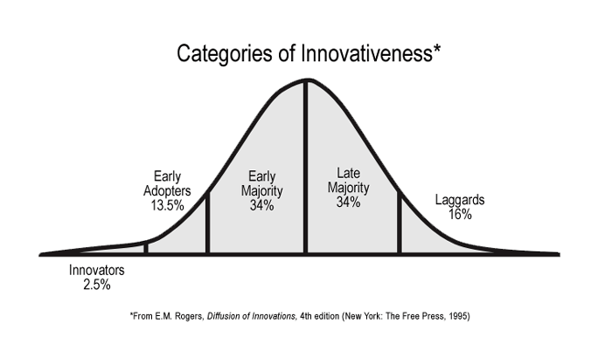
|Innovation|
Innovation is used generally to mean “an item, thought, or process that is new.”
Diffusion “is the process by which innovations spread from one locale or one social group to another.”
Ibid.

Slide 41
The missional leader
commit
Sailing the Winds of Change
trial
evaluation
understand
awareness
based on Everett Roger’s Diffusion of Innovation (83)

Slide 42
The Missional Change Model
commitment
experiment
evaluate
understanding
awareness

Slide 43
The Missional Change Model
Awareness - spending time, listening, discerning. Framed within Scripture/theology. Comes from opening and finding language. As words are given to feelings and experiences…understanding emerges.
Understanding – using dialogue to integrate thinking and feelings. Practice using the new language. With this new understanding, new questions are asked. Begin to test a framework.

Slide 44
The Missional Change Model
Evaluate – applying awareness and understanding. Examine current actions and practices in light of new understandings.
Experiment – Risk some change - This leads to experimenting of new actions/behaviors. Experimenting around the edges. Adaptive type of change as the goal.
Commitment – signing on to a new way of life. Confidence grows. Internalized the change and the understanding.
The Missional Leader, 84-102

Slide 45
The Missional Leader
Getting Ready to Lead Missional Change
Take stock of what you know
Know yourself as a Leader
Listen
Focus on key areas and issues
Develop an action place
Commit
(105-108)

