Slide 1
Markers of Adulthood and the
Dreams of Young Adulthood
terri martinson elton, phd

Slide 2

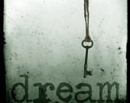
|dreams |
Share a story about a young adult in your life…
In their 20s
In their 30s
In their 40s
What are their issues?
What are their joys?
Notes:
Age – As the life expectancy extends, so does the mid-point of our life. Hence, extending the “close” of young adulthood from 30, something to 45.
Maturation process – Most young adults are postponing some of the developmental tasks of adulthood. Statistics that compare 2000 to 1960, that major transitions (like leaving home, finishing school, becoming financially independent, getting married, and having children) was achieved by only 46% of women and 31% OF MEN AT AGE 30 in 200 compared to 77% of women and 65% of men in 1960. (Wuthrow, 11)

Slide 3
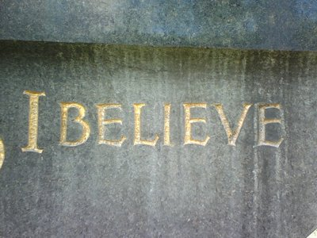
What’s a Robust Faith?
8 facets (Parks)
That can handle challenges (Parks)
Worked out in the three pillars of our identity (Arnett)

Slide 4
Facets of Faith
Faith as Primal Force of Promise – for all of life,. Rituals, in all cultures and religions, mark entry into a social world of meaning and purpose. “…meaning-making that frames, colors, provides tone and texture, and relativizes the activity of the everyday.” (Parks, 21)
A Center of Power, Value and Affection – Whatever the center, the center serves as “god.” Fowler sees “the activity of faith as ‘intuiting life as a whole’ – a wholeness that is felt as a sense of relatedness among self, other, and ‘a center of power and value’ that some would name God.” (Parks, 21)
Many and Lesser Gods – many people have multiple gods and live fragmented lives. Some have one god, but it is not sufficient. The question: Does this center hold in this complex world? “The challenge that drives the motive toward mature adult faith is grounded in the question, Is there a pattern of meaning, a faith, that can survive the defeat of finite centers of power, value, and affection?” (Parks, 22)
The One Embracing the Many – “When we speak of faith as the composing of meaning in these most comprehensive dimensions, we mean a sensibility of life that not only transcends (is beyond us) but also permeates and undergirds our very existence (is within, among, and beneath us). To speak of God as the gifts of faith is to seek to name an orienting consciousness that is both transcendent and immanent, both ultimate and intimate.” (Parks, 23)
8

Slide 5
Facets of Faith
Faith as Trust and Trust – Faith, trust and trust are intimately connected with one another. “A worthy faith must bear the test of lived experience in the real world – our discoveries and disappointments, expectations and betrayals, assumptions and surprises. It is an ongoing dialogue between self and world, between community and lived reality, that meaning – a faith – takes form.” (Parks,23)
To Set one’s Heart – “Faithing” is finding something to place one’s heart on. “’Faithing,’ then, is putting one’s heart upon that which one trusts as true.” (Parks, 24)
The Canopy of Faith – What is the warp of life’s tapestry OR the Canopy of Significance? Something outside one’s self that one’s meaning-making rests on or under. For some, they are aware of this canopy and for others it is only revealed when stressed (in crisis or when challenged). (Parks, 25)
Faith as Act – Faith not only centers the mind and provides a place for the heart to rest, but it also guides the hands or our actions. “Faith determines action.” (Parks,25)
8

Slide 6
Challenges of Faith
…that might have profound impact!
  Faith Betrayed – “Faith as a primal, elemental force of promise permeating the whole of life is manifest most inescapably and often treacherously in faith betrayed.” (Parks, Big Questions, Worthy Dreams, 26)
  Faith as a Suffering – “Any attempt to rethink the category of faith in relation to contemporary life is insufficient without faith as a ‘suffering’ as well as a virtue of reasoning and willing.” (Parks, 27)
  Shipwreck, Gladness, and Amazement – Richard R Neibuhr uses this metaphor for faith, highlighting the subjective, affective, dynamic, often bewildering, and transformative nature of the experience of faith.” (Parks, 28)
- Shipwreck – loss of relationship, property or naïveté. If we survive the shipwreck, there is
- gladness or a new knowing, and it is deeper than before which offers a new capacity to act.
- Living into this new awareness is accompanied by amazement, or the maturity that comes when one has to let go of assumptions and full trust in the faith one has…and when one survives (or even thrives) is has a new sense of confidence and meaning. (Parks,29-31)

Slide 7
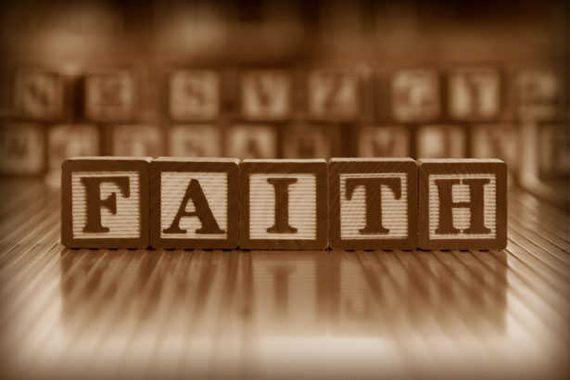
What results is a dynamics faith that allows for motion of life, is rational AND passional (or emotional), and faith is a noun AND a verb.
“Mature adult faith composes meaning in self-conscious engagement with the repeated dissolution and re-patterning of one’s perceptions of the fabric of life, in the dynamic reconceiving of the assumed connections among persons, things, ideas, events, symbols, the natural and social order, space, and time. The suffering of adult faith is located in learning how to hold on to, and when to let go of, the perceptions, patterns, and relationships that one experiences as partaking in ultimate value and truth.” (Parks, Big Questions, Worthy Dreams, 33)

Slide 8
pillars of identity
Arnett says the three pillars of identity exploration are centered on developing an ideology (or worldview that allows them to make sense of the world), along with love (or companionship) and work (or a way to meaningfully contribute to society).
Arnett, Emerging Adulthood, 165
3

Slide 9
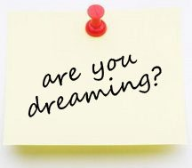
Dreams
What’s beyond us?

Slide 10

Faith and meaning-making is closely tied to what’s beyond us – out ahead or what we connect ourselves to that transcends us.
A “mature” faith “system”, one that weathers the storm, not only provides a scaffolding that’s trustworthy enough to handle difficult and complex realities of life, but it is also one that draws us into a “dream” that is worthy of both our living and our dying.

Slide 11
Foster Worthy Dreams means inviting humans into something that is beyond themselves.
I want to suggest that we invite young adult into a worthy dream - participating in the
missio Dei – God’s mission in the world.
And I want to suggest that that mission has two movements.
The first movement is a creative one.

Slide 12

What is the creative work of God in the World?

Slide 13
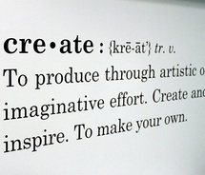
God creator and sustainer of life
The Apostle’s Creed reminds us of who we believe God to be.
God’s initial movement is creative…
God created, is creating and will continue to be about the work of creating.
This creating work is about bringing about life!
God is the creator of the universe. God created all that is and has life. Without God, there is no life, no breathe, no being.

Slide 14

God creator and sustainer of life
God is the creator of the universe.
God created us, and created us in God’s own image…as creative being.
We too have agency, we too can partake in the creative work of God and life abundant in this world.

Slide 15
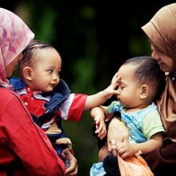
God creator and sustainer of life
God’s creative work continues in the world…
God continues to create…
and we, God’s people, are invited into being co-creators with God…participating in this ongoing creative movement in the world.
How do we do that?
…we create community
….we use and expand our gifts
….we multiple efforts
….we foster growth
….we seek life…and life abundant!

Slide 16
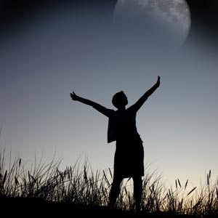
Young Adults - How is meaning being made?
And what are their dreams?
Choose a “point” within young adulthood and attend to the following questions:
What picture of the future do they have? What is driving it?
What elements of the past are present? How do you see them influencing the present?
How are the various views of culture mediating meaning?
  Globalization/diverse, pluralistic world
  Consumerism/capitalism/trends and fashion
  Virtual world/technology
  Pop culture/low culture
What is their sense of agency or ability to make a difference in their own lives/in the world?

