Slide 1
There is a simpler way to organize human endeavor.
I have declared this for many years and seen it to be true in many places.

Slide 2

This simpler way feels new,
yet it is the most ancient story there is.
It is the ancient story demonstrated to us daily by life

Slide 3
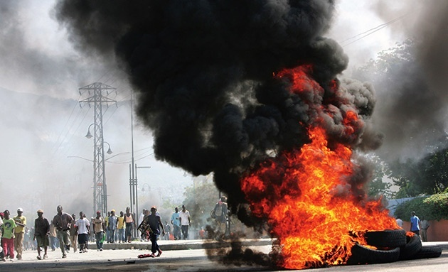
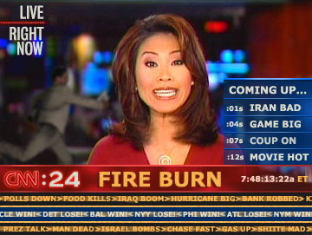
not the life we see on the news with its unending stories of human grief and horror,

Slide 4

but what we feel when we’re in nature, when we experience a sense of life’s deep harmony, beauty, and power.

Slide 5
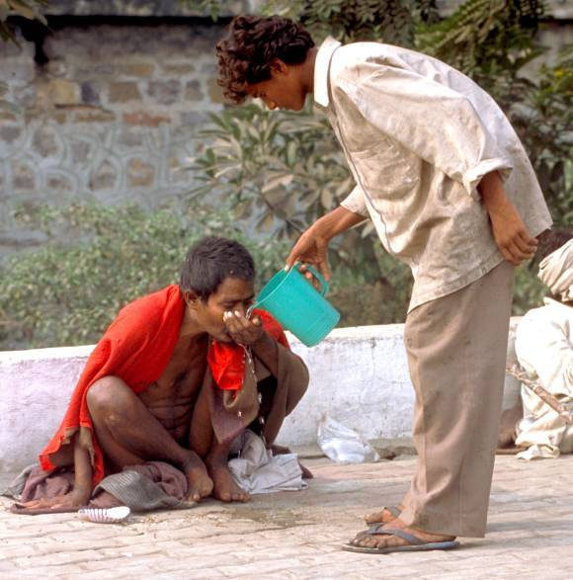
It is a story of how we feel when we see people helping each other, when we feel creative, when we know we’re making a difference,
when life feels purposeful.

Slide 6
For many years, I’ve written and spoken about this ancient new story, and how we might apply it in organizations and communities around the world.

Slide 7

I’ve learned that as we understand how living systems operate, we develop the skills we need:
resilient
we become
adaptive
aware
and creative.

Slide 8
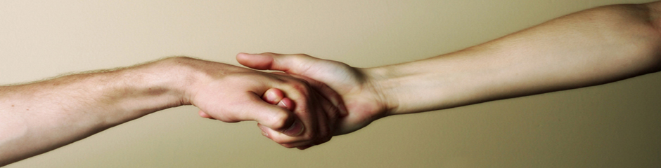
We enjoy working together.
And life’s processes work everywhere,
no matter the culture, group, or person,
because they are basic dynamics shared by all living beings.

Slide 9
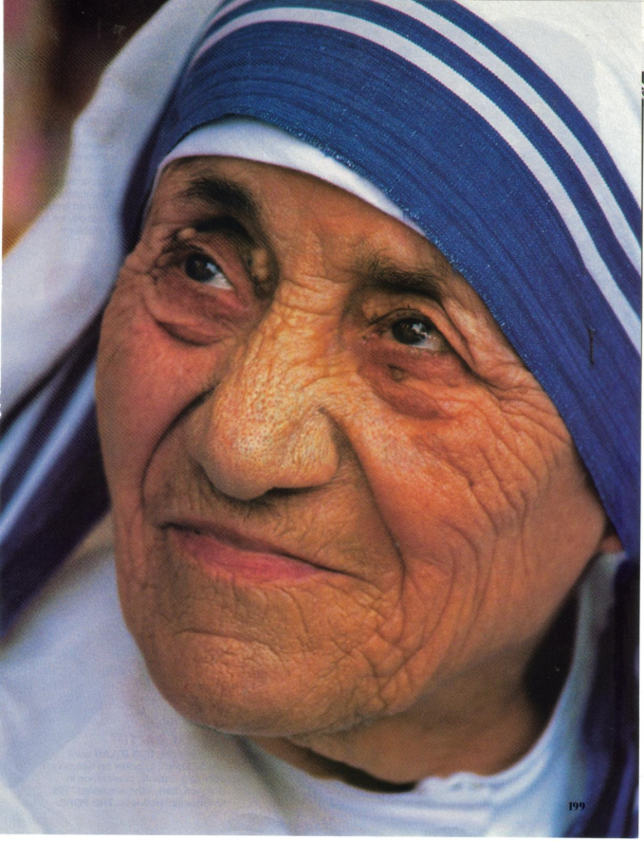
As we work with life, we also rediscover another gift, the great potential of the human spirit.
I’ve worked in many places in the world of extreme material poverty. But that challenge fades in comparison to those of us who have forgotten how resilient and vast the human spirit is.
Mother Teresa once said that the greatest poverty she saw was in the West because we suffer from spiritual poverty.

Slide 10

Western cultural views of how best to organize and lead
(the majority paradigm
in use in the world)
are contrary to what life teaches.
Western practices attempt to dominate life; we want life to comply when human needs rather than working as partners.
This disregard for life’s dynamics is alarmingly evident in today’s organizations.

Slide 11

Leaders use control and imposition rather than self-organizing processes. They react to uncertainty and chaos by tightening already feeble controls, rather than engaging our best capacities in the dance.

Slide 12
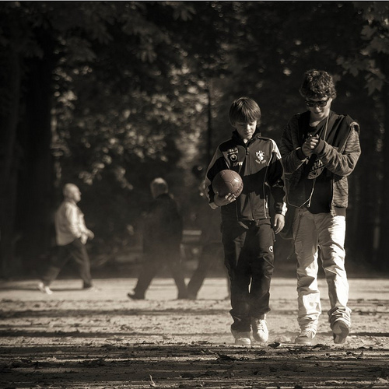
Leaders use primitive emotions of fear, scarcity, and self-interest to get people to do their work, rather than the more noble human traits of cooperation, caring, and generosity. This has led us to this difficult time, when nothing seems to work as we want it to, when too many of us feel frustrated, disengaged, and anxious.

Slide 13

It is important, periodically,
to ask people to step back
and try to see the big picture.

Slide 14

This is difficult to do when we’re stressed by so many pressures at work and at home.

Slide 15
But when we shift to fifty thousand feet, it’s easier to see that our impotence is not a result of personal failings. Instead, failing to achieve good results is a consequence of living in this time when we’ve reached the end of a paradigm. Many of our fundamental beliefs and practices no longer serve us or the greater world. Worse than that, too many are causing harm and distancing us from the very skills, knowledge, and wisdom that would help.

Slide 16
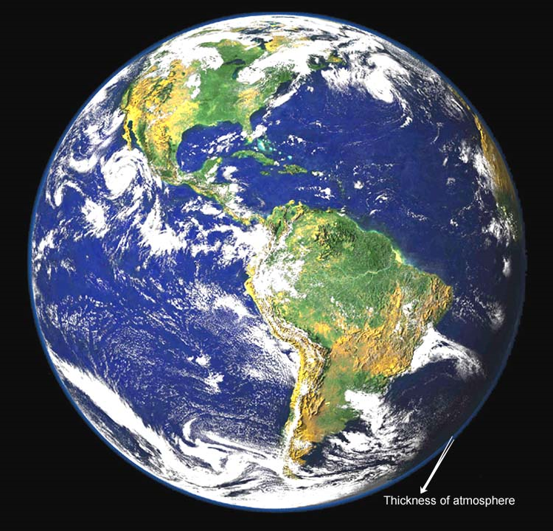
The new paradigm is a living system…
All living systems –
which include people –
self-organize, change, create,
learn, and adapt.

Slide 17
The fundamental questions of leadership are:
What motivates people?
How does change happen?
How do we evoke people’s innate creativity?
What are useful measurement systems?
How do we solve complex problems?
How do we create healthy communities?
How do we lead when change is out of our control?
How do we maintain our integrity and peace as leaders?
How do leaders shift from control to order?

Slide 18
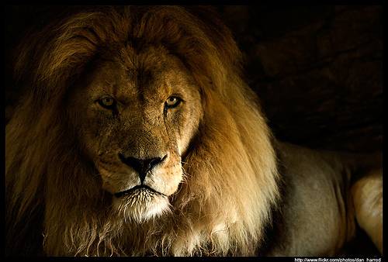
Life Dynamics for Self-Organization and Change
A living system forms from Shared Interests – the recognition that individuals need each other lies at the heart of every system.
All change results from a Change in Meaning – nothing changes until we interpret things differently. Change occurs when we let go of our certainty and develop a new understanding.
Every Living System is free to Choose whether it changes – it is impossible to impose anything
on people.
4. Systems Contain their own
Solutions – to find solutions,
the system needs to connect
more to itself.
Margaret Wheatley,
Finding Our Way

