Slide 1

leading in the midst of …
Change
Terri Martinson Elton

Slide 2

Practical Theology…
“….describes practices in order to discern the conflicting cultural and religious meanings that guide our action and provoke the questions that animate our practical thinking.”
Browning, A Fundamental Practical Theology, 48

Slide 3
developing a theology of leading in the midst of change
4
views of Browning’s Practical theology:
  Descriptive – WHERE is God in what is?
  Historical – WHAT do normative text say?
  Systematic – Coherent, congruent, and ethical
  Strategic – What languages, relationship, strategies, and practices best accomplish the mission and ministry?
  Browning, A Fundamental Practical Theology
These views play off and inform each other.
4

Slide 4
5 views of change
personal
descriptive
historical
systematic
strategic
Personal
Descriptive
Historical
Systematic
Strategic

Slide 5

Where is God in what is?
The Christian faith is embodied in the dynamic
nature of actual communities.
The descriptive dimension attends to the theological dimension of human action in community.

Slide 6
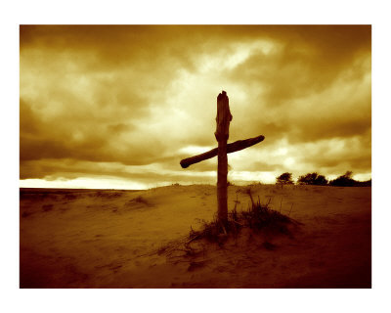
The
incarnation of
Jesus Christ
is the event that brings about the salvation of the world and establishes the mission of the church.

Slide 7
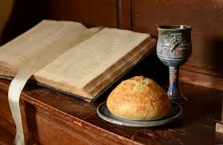
Where two or three gather in God’s name, God promises to be present.

Slide 8

The church has a call …
to translate the message into every human culture.
God’s Spirit empowers the church to be witnesses which carry, translate, communicate, and demonstrate the good news of God’s love in Christ to the ends of the earth.
(Guder, Continuing Conversion of the Church)

Slide 9

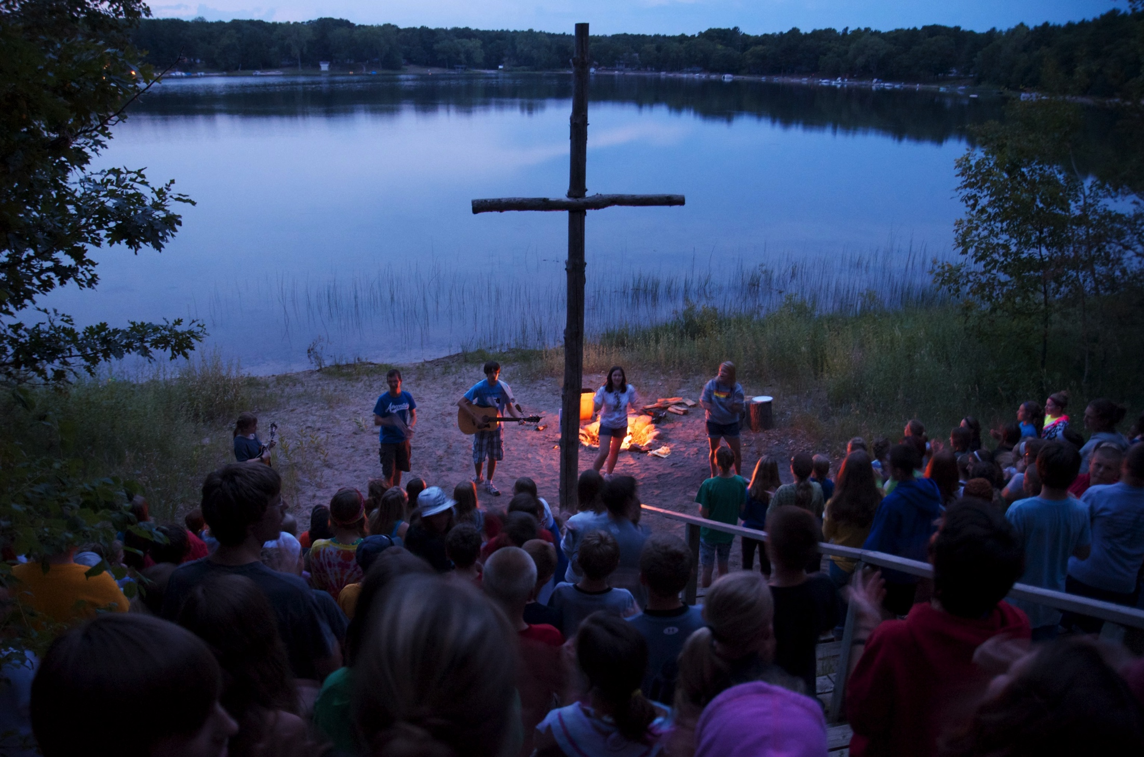
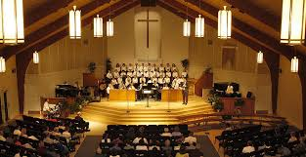
God is active and present in the midst of change.
Think back over the past year.
Name some ways God has been active and present in the midst of change.

Slide 10

“All changes, even the most longed for, have their melancholy; for what we leave behind is part of ourselves; we must die to one life before we can enter into another.”
Anatole France, French writer

Slide 11
God is active and present in the midst of change.
Where have you witnessed God’s creative love?
Where have you witnessed God’s redemptive love?
Where have you longed for God’s presence and have not witnessed it?

Slide 12

Discernment is Key!
How does your community discern God’s presence in your midst?
God’s people are simultaneously saint and sinner.

Slide 13
Where is God in what is?
Reflect on your ministry setting today
Where is God in the midst of your rituals, traditions and contextual realities?
What meaning do these rituals, traditions, and contextual realities hold for your community?
How do you unearth what gives meaning to your community of faith? What aspects are shared and what have different meanings? Are some understandings in conflict with each other?

Slide 14
Where is God in what is?
Reflect on your ministry setting today
Think of a particular practice, what are you trying to communicate? What are the ways it is actually being understood? How do you know? Who might you ask for feedback?
What reasons, ideas, and symbols do you use to interpret what is happening in your community? What metaphor or symbol would you use to describe God’s presence in your community right now?

Slide 15
Descriptive dimension
  In developing a theology of leading in the midst of change, how might attending to the descriptive dimension impact your theology? What habits or practices would help your congregation attend to this dimension?
  From a leadership perspective, what insights surfaced for you as thought about leading in the midst of change from this dimension? How can others in your community participate in this dimension? How welcome would this dimension be in your ministry setting? What tensions might you face?

