Slide 1
Framing Ministry with Young Adults
Terri Martinson Elton
Luther Seminary

Slide 2
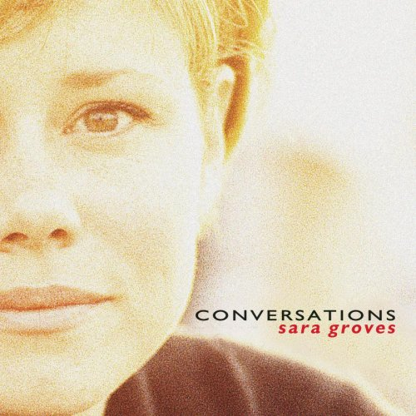
Painting Picture of Egypt
It’s not about losing faith
It’s not about trust
It’s all about comfortable
When you move so much
The place I was wasn’t perfect
But I had found a way to live
It wasn’t milk or honey
But then neither is this
CHORUS:
I’ve been painting pictures of Egypt
Leaving out what it lacked
The future seems so hard
And I want to go back
But the places that used to fit me
Cannot hold the things I’ve learned
And those roads closed off to me
While my back was turned
The past is so tangible
I know it by heart
Familiar things are never easy to discard
I was dying for some freedom
But now I hesitate to go
Caught between the promise
And the things I know
I don’t want to leave here
I don’t want to stay
It feels like pinching to me either way
The places I long for the most
Are the places where I’ve been
They are calling after me like a long lost friend
BRIDGE:
If it comes too quick
I may not recognize it
Is that the reason behind all this time and sand?
If it comes too quick
I may not appreciate it
Is that the reason behind all this time and sand?

Slide 3
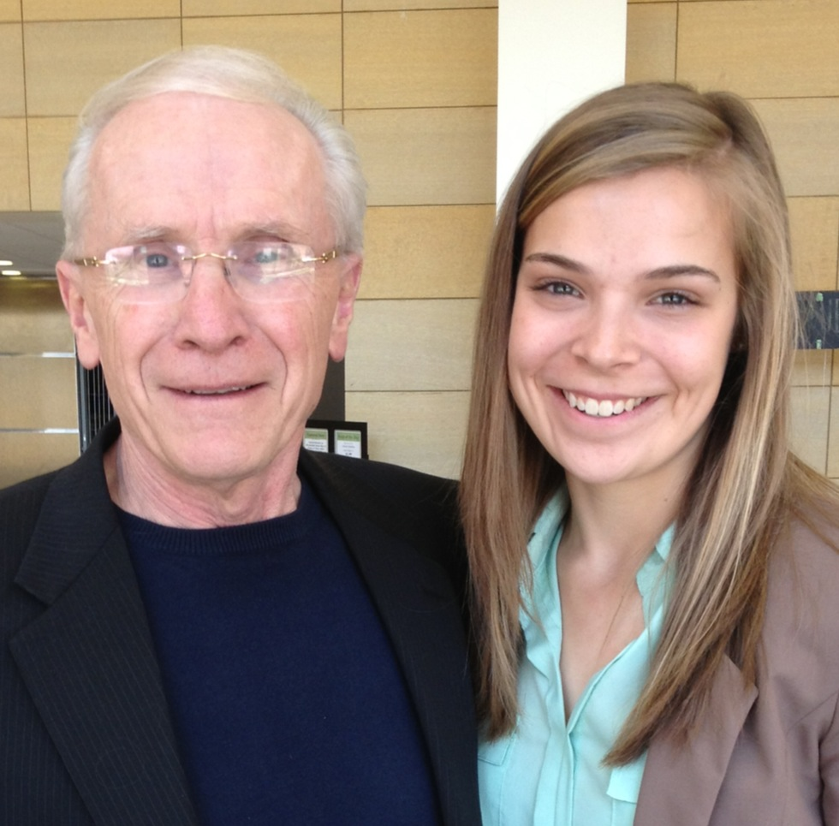
Name experiences you have had with
20-somethings

Slide 4

Ministry with, for and among young adults is not an extension of (or the same as) ministry with, for and among adolescents!

Slide 5

Two Approaches:
Ministry TO Young Adults
Partnering WITH Young Adults

Slide 6

What should we know?
Young Adults make up a significant percent of population
Adulthood is changing
Changing the Religious Landscape
Role in Social Change

Slide 7

Young Adults make up a significant percent of population
The numbers – they are sizable:
In 2002, there were 105.3 million between ages 20 and 44 (compared with 68.6 million in 1972).
In 2002, 36.5% of the population was between the ages of 20 and 44 (compared to 32.7% IN 1972).
    (Wuthnow, After the Baby Boomers, 8)

Slide 8
Young Adults make up a significant percent of population
  Today - Emerging Adults =
  46 million people in the United States
  (Smith, Souls in Transition, 33)

Slide 9
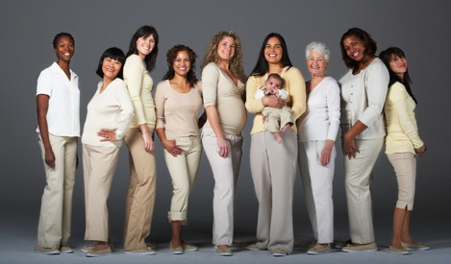
Adulthood is changing
Life Expectancy Changing! People are living longer!
Today the first half of adulthood= ages 21 to 45.
  In 1950, midpoint was 44. Today it’s 49.
5 Markers of Adulthood have been: leaving home, finishing school, becoming financially independent, getting married, and having a child.
In 1960 77% of women and 65% of men – these markers completed by age 30.
In 2000 46% of women and 31% if men by age 30. (Wuthnow, After the Baby Boomers,11)

Slide 10

Young Adults are Changing the Religious Landscape
“young adults are not only the future of American religion; they are already a very significant part of it and because they have been overshadowed by the baby boomers, this current generation of younger adults is not very well understood, either by religious leaders or by scholars. The need for better information about young adults is thus urgent for the present as well as the future.”
Wuthnow, After the Baby Boomers, 2

Slide 11
Young Adults are Changing the Religious Landscape
“The future of American religion is in the hands of adults now in their twenties and thirties.”
Wuthnow, After the Baby Boomers, 2

Slide 12

Young Adults have a Role in Social Change

Slide 13

Society, as a whole, provides almost nothing “for the developmental tasks that are accomplished when people are in their twenties and thirties.”
“It means that younger adults are having to invent their own ways of making decisions and seeking support for those decisions.”
  This is a huge problem…and it is a place that the church, and in particular congregations, COULD be a valuable support!
Wuthnow, After the Baby Boomers, 12.

Slide 14

A Proposal
What if ministry with young adults is simply accompanying them in their work?

Slide 15

The Work?
“young adulthood is the birthplace of adult vision”
Parks, Big Questions, Worthy Dreams, 8

Slide 16
The Work?
Without special attention to young adulthood, these adult visions will be shaped in a vacuum without guidance of larger societal institutions and/or will be overly influenced by the particular aspects of the culture that are paying attention to young adults.

Slide 17

“There is something particularly powerful and poignant about the ‘twenty-something’ years, harboring, as they do, both promise and vulnerability. Young adults embody critical strengths and yet remain dependent in distinctive ways, upon recognition, support, challenge, and inspiration. Not only the quality of individual young adult lives but also our future as a culture depends in no small measure upon our capacity to recognize the emerging competence of young adults, to initiate them into big questions, and to give them access to worthy dreams.”
Parks, Big Questions, Worthy Dreams, xi

Slide 18


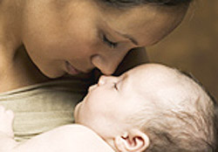
The Work?
Arnett’s 5 Characteristics
Age of identity explorations
Age of instability
Most self-focused age of life
Age of feeling in-between
Age of possibilities

Slide 19
8
Facets of Faith
Faith as Primal Force of Promise – for all of life.
A Center of Power, Value and Affection – Whatever the center, the center serves as “god.”
Many and Lesser Gods – many people have multiple gods and live fragmented lives. Some have one god, but it is not sufficient. The question: Does this center hold in this complex world? “
The One Embracing the Many – To speak of God as the gifts of faith is to seek to name an orienting consciousness that is both transcendent and immanent, both ultimate and intimate.” (Parks,21-23)
Faith as Trust and Trust – Faith, trust and trust are intimately connected with one another. It is an ongoing dialogue between self and world, between community and lived reality, that meaning – a faith – takes form.”
To Set one’s Heart – “Faithing” is finding something to place one’s heart on.
The Canopy of Faith – What is the warp of life’s tapestry OR the Canopy of Significance?
Faith as Act – Faith not only centers the mind and provides a place for the heart to rest, but it also guides the hands or our actions. “Faith determines action.” (Parks,23-25)

Slide 20
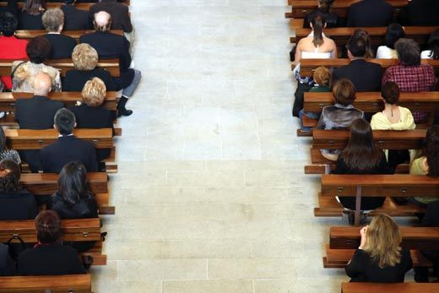
What is the call of the faith community?

Slide 21

- discover a Christian way of life
- participate in the creative and redemptive mission of God

Slide 22

elements
4
Identity Formation
  What does it means to be Christian?
Agency
  How shall I live? Gifted and empowered.
Vocation
  Call to love the neighbor and engage the world
Living in Community
  To be Christian (and human) is a communal affair

Slide 23

Not about programs
No easy response
No curriculum to buy
Not about coming to church
It’s about relationships
Opening up leadership
Space for authentic conversation
Discernment is central
Meeting in the world
Service

