Slide 1
Session 4
Brokenness, Seeing Beyond, and Belief

Slide 2
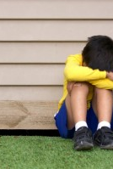
Brokenness
Jonah
God
Seeing beyond
Others

Slide 3
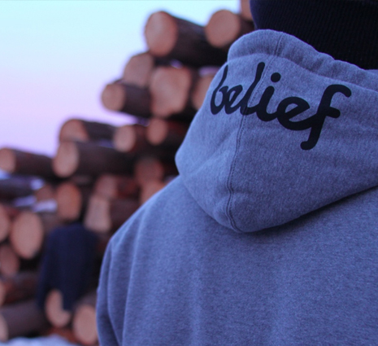
Jonah
Jonah was reluctant to follow God. He couldn’t believe the things God was inviting him to imagine.
Jonah is a sad case of leadership.

Slide 4
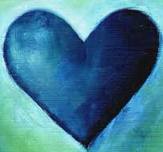
God
Yet the story of Jonah isn’t about Jonah, it’s about God.
God’s love and God’s grace. God’s love trumps everything.

Slide 5
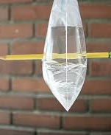
Seeing Beyond
God’s grace is God’s ability to see beyond our brokenness, our actions, our shortcomings, and see potential and new futures.
God offers us more than either/or categories. God offers us something bigger.

Slide 6

Others
And not only do we receive this love and grace, we are invited to share it with others.
Others near and far, friend and enemy, those we can imagine and those we can’t.
Love God, Love Neighbor

Slide 7
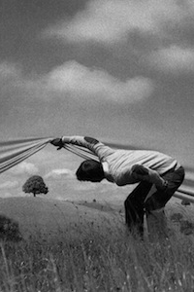
Seeing Beyond
We are called to “seeing beyond” in our primary relationships

Slide 8
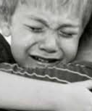
All relationships are broken
All families have pain.
All families have scars and wounds that remind them of the vulnerability of relationships.
We are called to see beyond, just as God sees beyond.

Slide 9
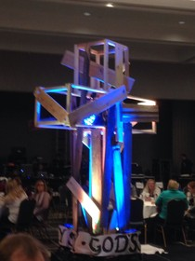
We cannot see beyond on our own
Living a “seeing beyond” kind of love is not possible on our own. But it is possible with God.
This “seeing beyond” kind of love is the messy – let your kingdom come on earth as it is in heaven – love.

Slide 10
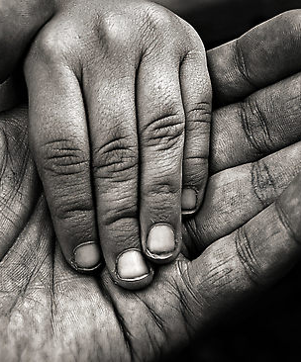
What about you?
What are times in your life you have experienced a “seeing beyond” kind of love?
Where have you exercised a “seeing beyond” kind of love?
How might a “seeing beyond” kind of love be practiced in your family?

Slide 11
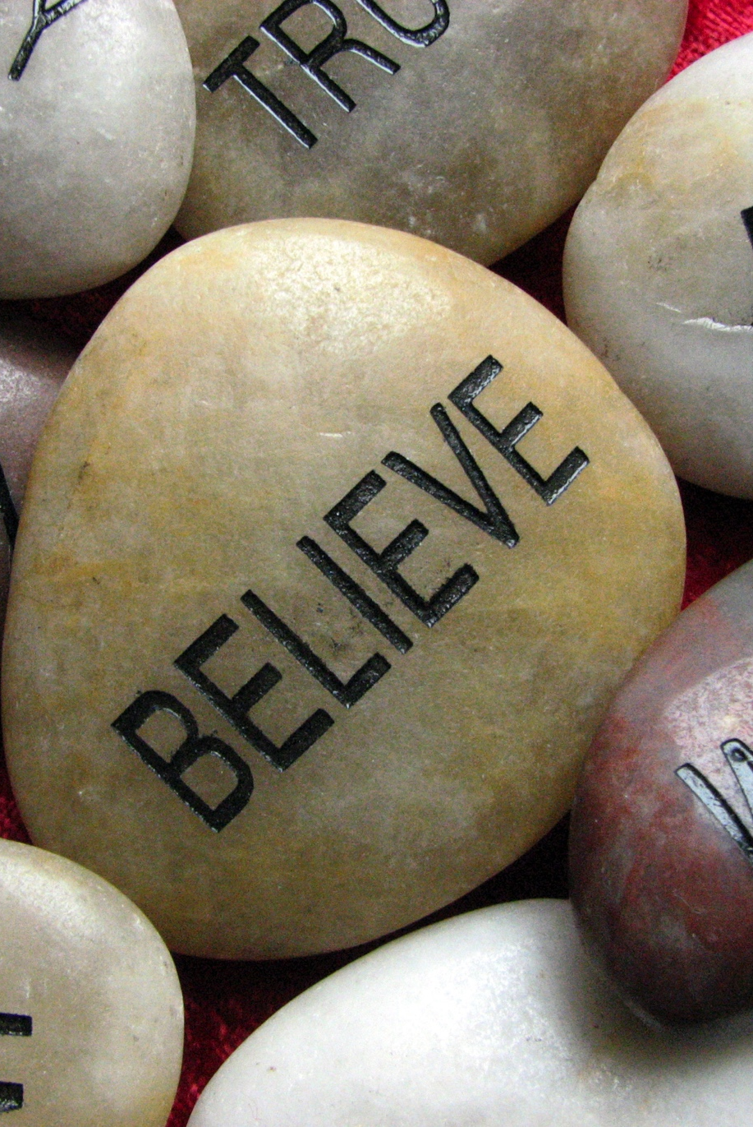
Belief
Do you believe?
Finding a community

Slide 12
All families have habits
Some families are thoughtful about their habits and others are not.
What would it mean to deliberately design your family habits from a place of forethought, creating a culture, and a future, you desire?
If habits make values clear and create a culture, and if habits become our automatic response (both in crisis and in times of stress and in everyday life), How might attending to keystone habits in your family impact your children long term?
How might habits help us tell our children about God’s love?

Slide 13
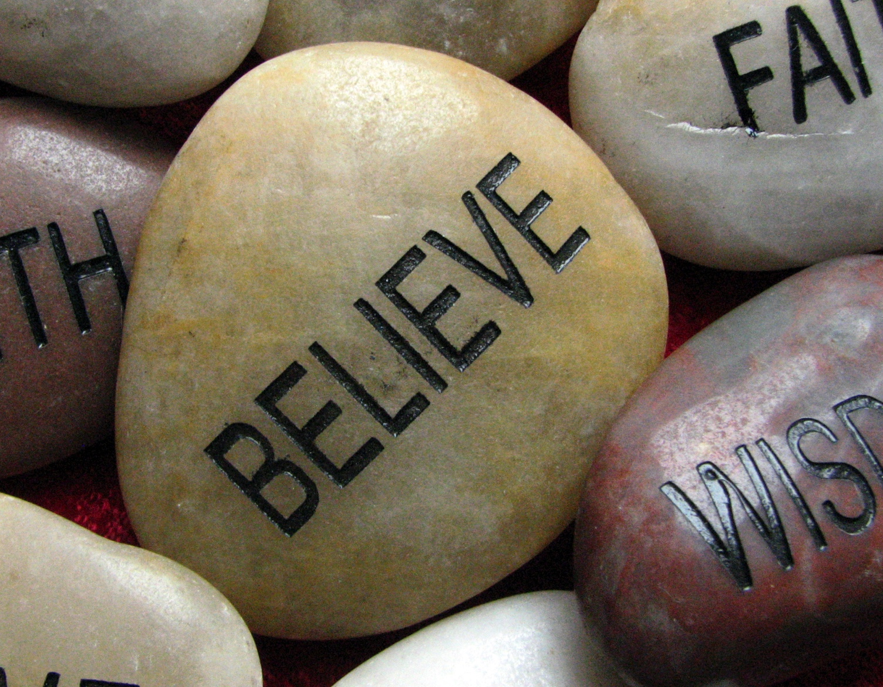
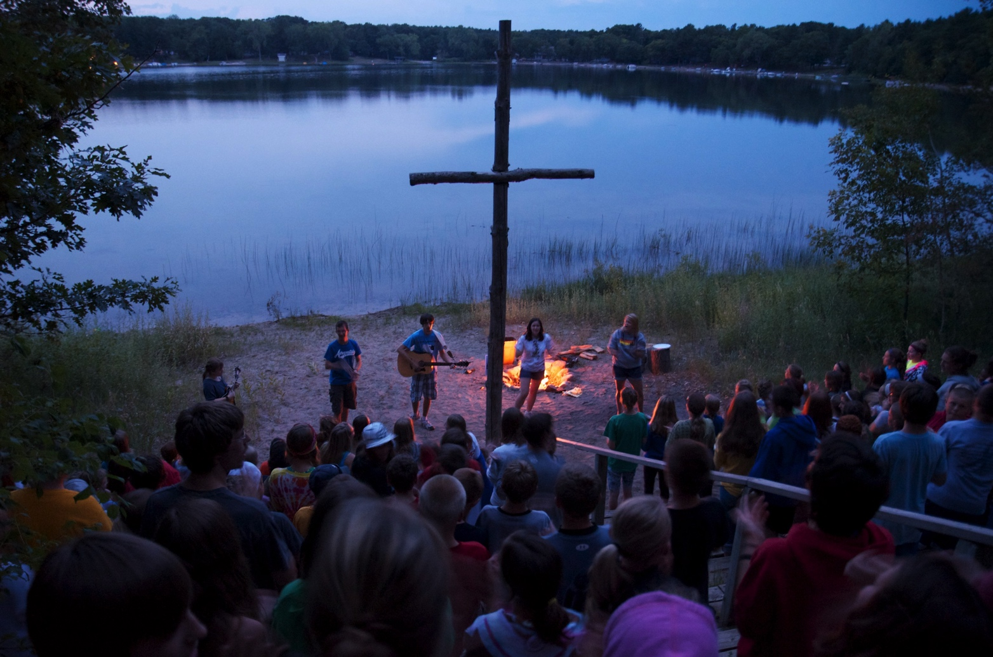
Remember the importance of belief?
A new routine is not enough to change habits – 2 more things are key.
1. a belief you can do it
2. a group to help.

Slide 14
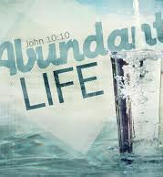
Abundant Life
Abundant life is
A grounded life,
A life lived in community,
Engaged in meaningful practices,
Extended to the other,
Where God is present.

Slide 15
Action
What does returning home mean?
  Is it time to change or add a habit?
    What did you learn from your three practices this week? Table conversation, family prayers, personal quiet time.
    What dream do you have for your family?
    What is a keystone habit that could move you in that direction?
  Do you believe you can change?
  Do you have community around?

Slide 16
Action
Will you continue one of the practices from camp and make it a habit?
  Think about when you will do it.
  What will be your cue? What is the reward?
  Create a plan – how many days a week? With whom? At what time?
  What obstacles might prevent you from following through? What strategies can you put into place to counter those obstacles?

Slide 17
Action
Spend time reflecting on your dream for you and your family of abundant living.
  Write it down.
  Imagine what you are doing 5 years from today. Be specific. Where are you? Who are you with? What are you doing?
  What is a short term goal that would get you moving toward that goal?

Slide 18
Action
Identify a Keystone Habit that would connect with your dream.
  Brainstorm ideas for changing the routine to go with the current cue and reward.
  Set a short-term goal.
  Write down what happens each day.
  Tell someone about the goal.
  Reflect periodically on how you are doing in moving toward the goal.
  Check-in with your accountability person

