Slide 1
Session 2
Abundance, Dreams, and Keystone

Slide 2

Abundance
From slavery and bondage to freedom and abundance
God interrupted the pattern
God gave them a sign
Give us this day our daily bread

Slide 3
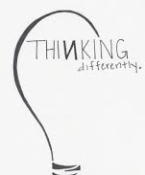
From slavery and bondage to freedom and abundance
the Hebrew people knew bondage.
They had little choice and there was no place to dream or imagine life different then what it was.
400 years the Hebrew people had been living this way – generation after generation was socialized into this pattern
life was bound to this way of being, thinking and living.

Slide 4
GOD interrupted the pattern
God introduced a new way of living. Who? GOD!
The people were freed from slavery, yet old patterns are hard to break and new memories hard to create.
The people wanted to go back…they were bound to what was known.
They could not imagine a new way and could not imagine abundant life outside what they knew.

Slide 5
So God gave them a sign
water from a rock, a great sign for people wandering in the desert. The sign had a tangible element to it, but it also pointed to a bigger reality.
Trust me, God says. I love you and I want the best for you. I want you to have abundant life. Do you believe me? Will you follow me ways?
Read Ex 17:1-7

Slide 6
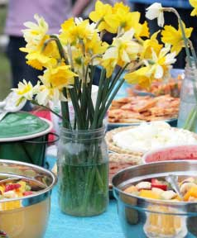
Give us this day our daily bread
Do you believe it?
Do you trust in the promise?
Are you open to receiving the gifts?
Are you able to be free?

Slide 7
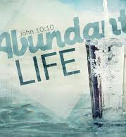
Abundant Life
Abundant life is
A grounded life,
A life lived in community,
Engaged in meaningful practices,
Extended to the other,
Where God is present.

Slide 8

Dreams
Are you ready?

Slide 9
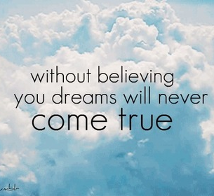
Dream
THINK BACK…
Your early days in life. What were some of your dreams?
Your early days in your family. What did you imagine family life would be like?

Slide 10
Dream
IMAGINE 10 YEARS from now…
What is one hope you have for your life?
What is one desire you have for your family?

Slide 11
Abundant Life
Journal time
Envision abundant life, given this description.

Slide 12

Keystone
Habits
What are they?
offer focus
small wins
create structures
open up new potential

Slide 13

What are Keystone Habits?
Not all habits are the same.
Keystone Habits are “the habits that matter the most because they are the ones that, when they start to shift, dislodge and remake other patterns.” (101)

Slide 14
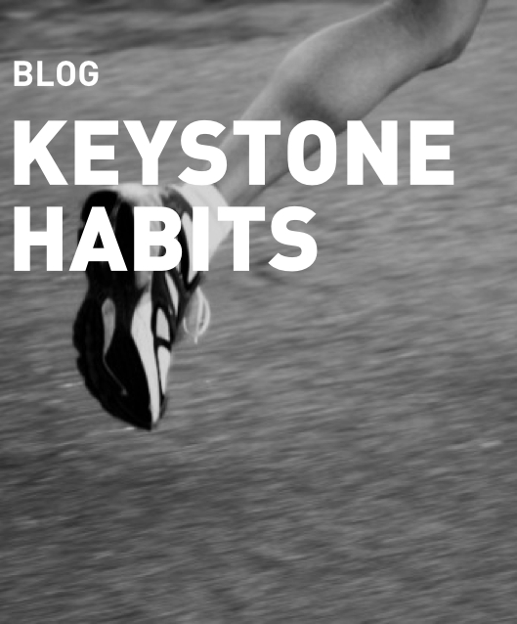
What are Keystone Habits?
Exercise is an example of a keystone habit.
People starting to exercise, even as infrequently as 1 time a week, start changing other, other unrelated patterns in their lives. (108-109)
Exercise triggers new eating patterns, sleeping patterns, smoke less and change social patterns.

Slide 15
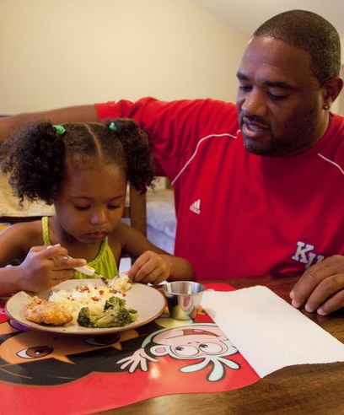
What are Keystone Habits?
Studies show families habitually eating dinner together is also a keystone habit.
In such families, children seem to have better homework skills, higher grades, greater emotional control and more confidence. (109)
This is not a cause and effect relationship, but keystone habits initial a chain reaction that help other “good” habits take hold.

Slide 16
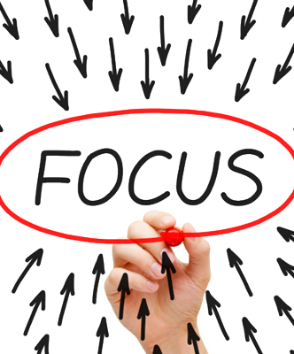
Focus
“If you focus on changing or cultivating keystone habits, you can cause widespread shifts.” (109)
They also allows us, as humans, a place to focus or put our attention.
We can’t focus on everything, but you can focus on 1 or 2 areas.

Slide 17
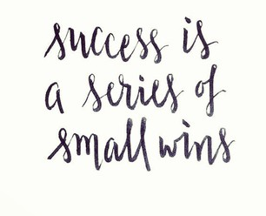
Small Wins
Keystone habits create small wins that help other habits flourish by “creating new structures” and “establishing cultures” where change becomes contagious. (109)
Small wins are a steady application of something that once accomplished momentum is created for another small win by motivating the person.
“Small wins fuel transformative change by leveraging tiny advantages into patterns that convince people that bigger achievements are within reach.” (112)
The process is not neat. It is not linear. But keystone habits help us feel some success and create mental triggers.
When worked out into a routine, they – like the habit loop – have power “beyond” our thinking.

Slide 18
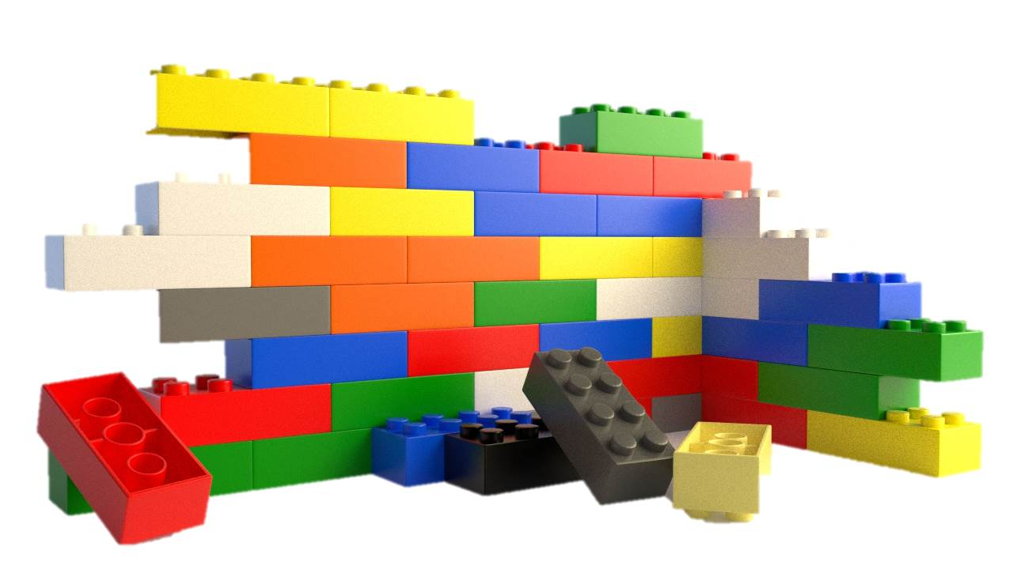
Create New Structures
Keystone habits create small wins that help other habits flourish by “creating new structures” and “establishing cultures” where change becomes contagious. (109)
Keystone habits dislodge our normal patterns therefore forcing new structures or patterns to be created. As these new structures are being created it helps other habits flourish.
Education is an example here – it can both create habits and provide an alternative structure.
An example of writing down what one ate while dieting offered more success then dieting alone. They could look back and see what they ate and find patterns and then change the patterns in the future. It wasn’t emotional, but tangible.
And just like small wins work to fuel creating structures, so structures fuel new cultures. (123)

Slide 19
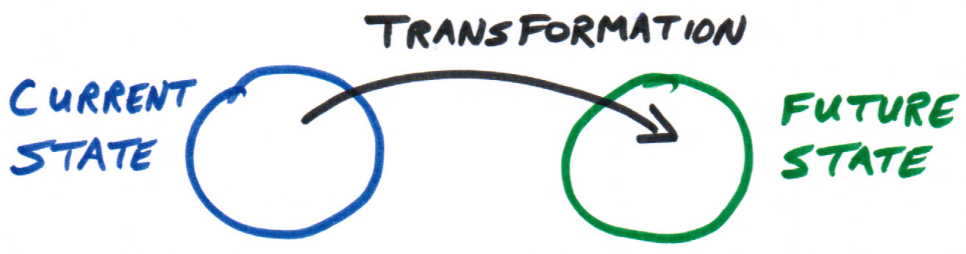
Establish Culture
Keystone habits create small wins that help other habits flourish by “creating new structures” and “establishing cultures” where change becomes contagious. (109)
Creating cultures where new values become ingrained – what emerges out of the small wins and new structures are a new set of values, networks and practices.
“Cultures grow out of the keystone habits in every organization, whether leaders are aware of them or not.” (124)

Slide 20

Open Potential
Keystone habits create small wins that help other habits flourish by “creating new structures” and “establishing cultures” where change becomes contagious. (109)
Keystone Habits are “the habits that matter the most because they are the ones that, when they start to shift, dislodge and remake other patterns.”
In this way, they open up space for new ways of being.

Slide 21
Transform
Keystone habits make tough choices easier – because they anchor a culture.
Changing the habit, changes the culture.
“Keystone habits transform us by creating cultures that make clear the values that, in the heat of a difficult decision or a moment of uncertainty, we might often forget.” (124-125) Why? Because habits come out of our “gut” not our brains!

Slide 22
Action
Identify a Keystone Habit that would connect with your dream.
  Brainstorm ideas for changing the routine to go with the current cue and reward.
  Set a short-term goal.
  Write down what happens each day.
  Tell someone about the goal.
  Reflect periodically on how you are doing in moving toward the goal.
  Check-in with your accountability person

