Slide 1
Youth, Mission and Worship|
What Does it Mean to be “Living Sacrifices”?
Terri Martinson Elton, PhD
Luther Seminary

Slide 2
Romans 12:1
Living Sacrifice
Therefore, I urge you, brothers and sisters, in view of God’s mercy, to offer your bodies as a living sacrifice, holy and pleasing to God – this is your true and proper worship.

Slide 3

Core Question:
How might mission and worship be connected?

Slide 4

Research|
young people and service

Slide 5
Young people and Service
Short-Term Mission Trips - Youth
Mainstay of YM today
A 2006 survey showed within Protestant mission organizations participation in STMs tripled between 1999-2001. (100,000 to 300,000).
A 2000 survey of American teenagers discovered 3.6 million youth had traveled on a STM. (Barna)
A 2002-2003 survey of American teenagers (13-17 year olds) discovered 5.5 million (or 29%) had traveled on a STM. (Smith)
(Priest, et al, 2006)
Youth Volunteer - 55 Percent of Youth Volunteer.
An estimated 15.5 million youth ages 12 to 18 participate in volunteer activities; the teen volunteering rate is nearly twice the adult volunteering rate of 29 percent. Youth contribute more than 1.3 billion hours of community service each year.
If Family Members Volunteer, Youth Will Too. A youth from a family where at least one parent volunteers is almost twice as likely to volunteer as a youth with no family members who volunteer – and nearly three times as likely to volunteer on a regular basis.
Religious Attendance has a strong link to volunteering. Youth who attend religious services regularly are nearly twice as likely to be regular volunteers as youth who do not attend religious services at all. Among teens who regularly attend religious services, 47 percent volunteer primarily with a religious congregation, 8 percent with a faith-based group that is not a religious congregation, and 45 percent with a secular organization.
http://www.nationalservice.gov/sites/default/files/documents/YHA.pdf
Notes:
Thirty percent of Protestant teens say they did organized volunteer work or community
service at least occasionally in the previous year, slightly less than the percent
of all teenagers reporting volunteering at least occasionally in the previous year.

Slide 6
Why Youth Serve
Increases young people's feelings of community connectedness, and reduces engagement in risky behavior.
Contributes to higher reported levels of academic success, graduation rates, positive civic behavior, and self-esteem.
Youth who participate in community service are 19% more likely to graduate than those who did not.
Volunteering at any age is associated with increased likelihood of finding employment. Among youth ages 16-24 (not in school, not working), studies showed an increased likelihood of 5%.
Volunteering in one's youth leads to a lifetime of service and philanthropy. Most adults involved in community service and/or philanthropy started as children.
The 2012 Volunteering in America report found that 22.5% of Young Adults (ages 16-24) volunteered in 2011.
In 2011, AmeriCorps received 582,000 applications for just 82,000 positions. This is up from 536,000 in 2010 for 85,000 spots.
YOUNG PEOPLE ARE MORE LIKELY TO VOLUNTEER WHEN ENGAGED THROUGH SCHOOLS, YOUTH ORGANIZATIONS, OR RELIGIOUS GROUPS.
The Search Institute identifies service to others as a “gateway asset” and finds that service and service-learning can have positive effects on at least 20 of the 40 developmental assets.
http://www.ysa.org/facts_on_youth_volunteering

Slide 7
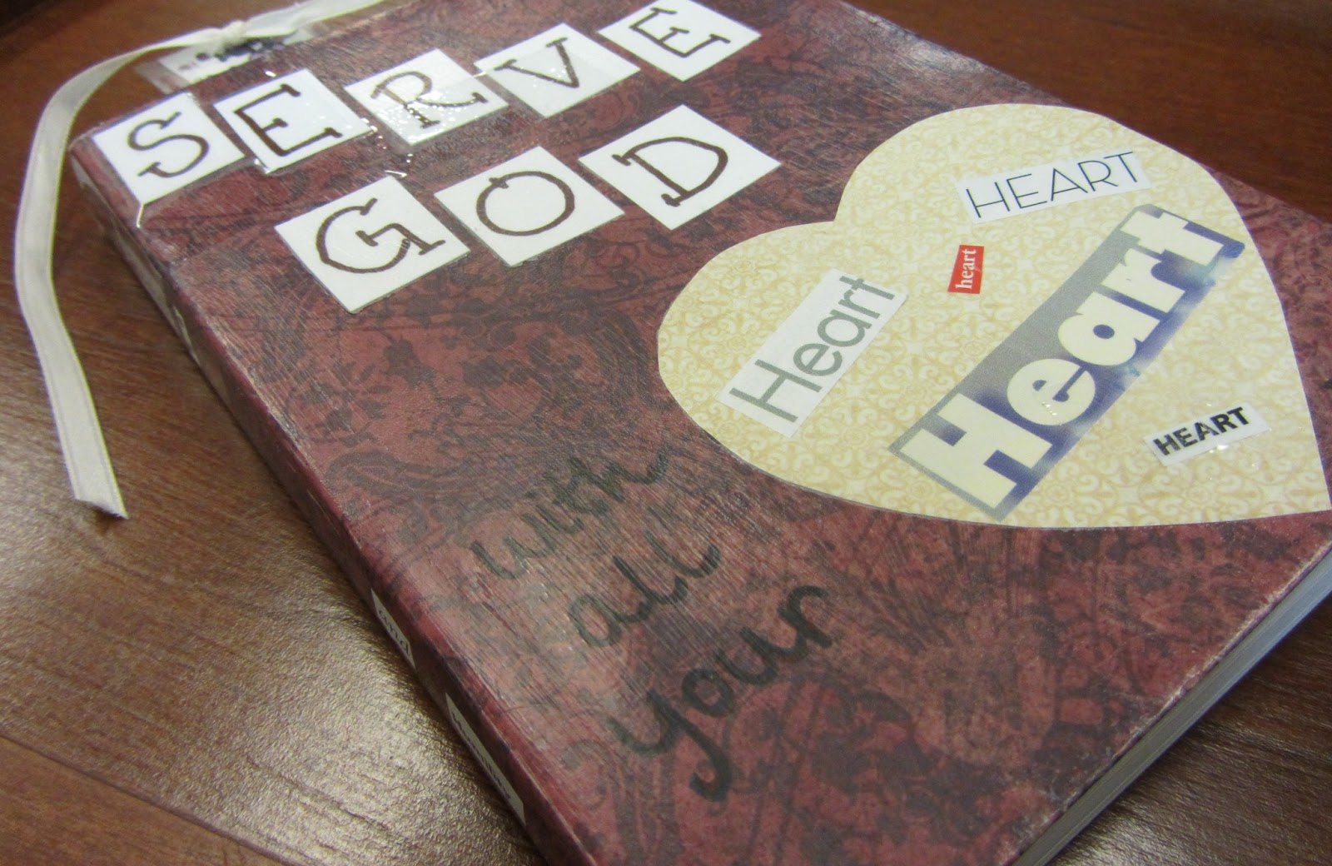
What makes service important to youth?
What do you think?

Slide 8
Research|
young people and church

Slide 9
Young People and Church
Teen are not rebellious about faith, rather they are open to religion – but their beliefs are not aligned with the traditional beliefs of denominations.
Moralistic Therapeutic Deism
Parents are important - Similar beliefs as parents
Teens could not speak the second language of faith
Except for a small percentage, faith was detached from everyday life.
What does this mean?
National Study of Youth and Religion

Slide 10

Exemplary Youth Ministry
Seeks Spiritual Growth: alone and with others pursues questions, guidance and commitment through conversation, study of faith, reading the bible, prayer, small groups, retreats
Possesses a Vital Faith: keenly aware of God present and active in one’s own life, the lives of others, and the life of the world
Practices Faith: actively practices faith in Jesus Christ privately and publicly through regular attendance at worship, participation in ministry and leadership in a congregation
Makes the Christian Faith a Way of Life: recognizes God’s “call” and integrates one’s beliefs into the conversation, decisions, and actions of daily life
Lives a Life of Service: involved in activities caring for others and addressing injustice and immorality
Reaches Out to Others: reaches out to others who are different or in need through prayer, hospitality, conversation and support
Exercises Moral Responsibility: lives with integrity utilizing faith in making considered moral decisions
Speaks Publicly about Faith: speaks openly about Jesus Christ and God’s participation in one’s own life and the life of the world
Possesses a Positive Spirit: reflects loving and hopeful attitudes toward others and life
Mature Christian Faith in Youth

Slide 11
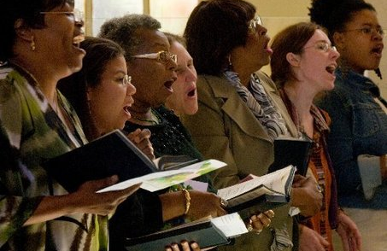
What makes church important to youth?
What do you think?

Slide 12
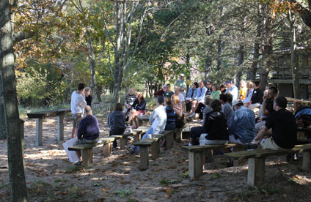
Getting Worship Outside the Building

Slide 13
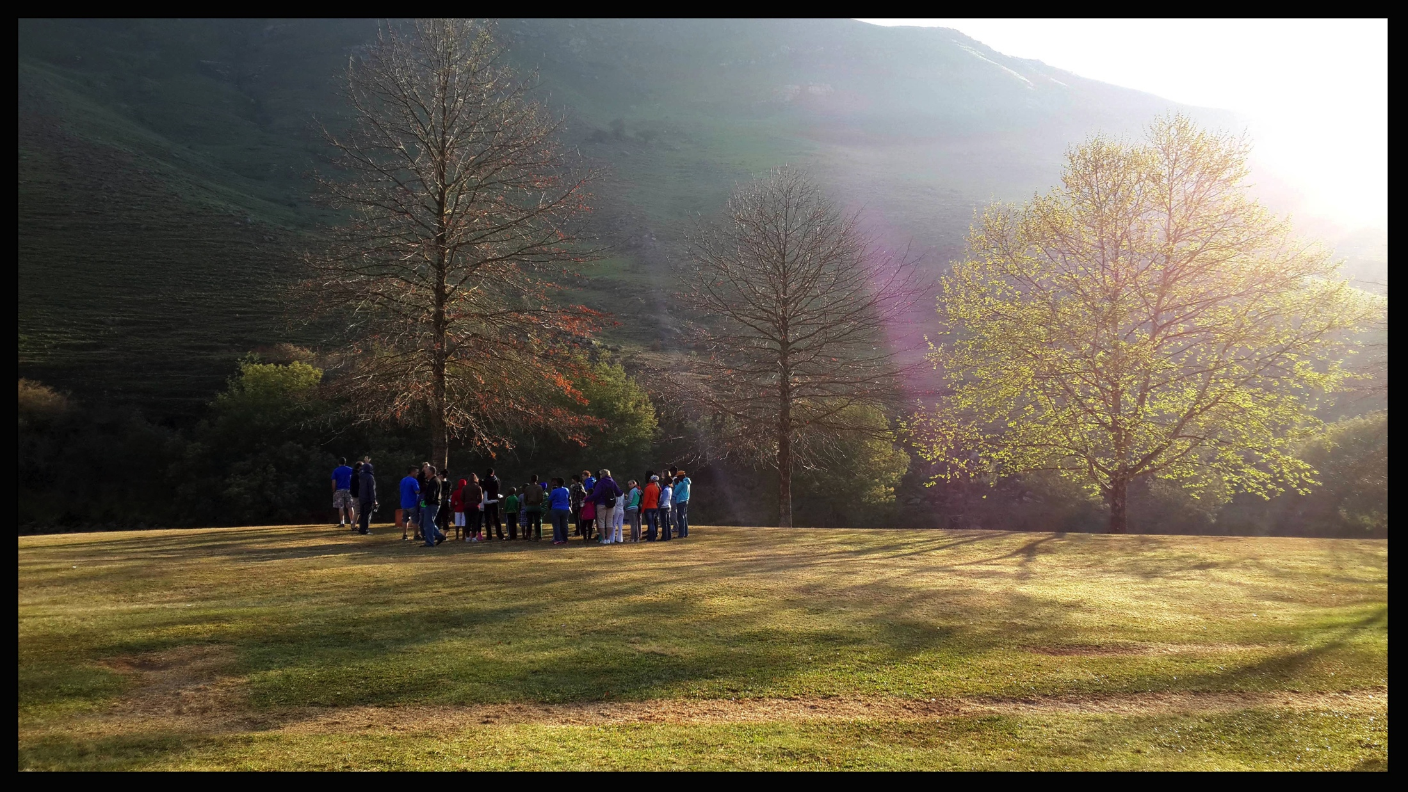
worship at camp
using the liturgy as a “framework” (invitation to worship, confession/absolution, proclamation, prayers of the people, blessing – communion)
praying the newspaper

Slide 14
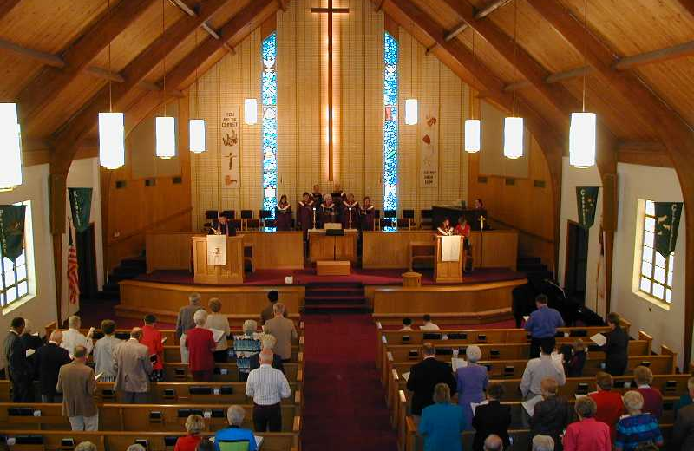
Bringing Service into Corporate Worship

Slide 15

bring the world into the sanctuary
weave issues of the world into worship life
Tie worship and service – for example, Lent as times to experiment (Share about Instagram) and surround with Social Media

Slide 16
Romans 12:1
Living Sacrifice
Therefore, I urge you, brothers and sisters, in view of God’s mercy, to offer your bodies as a living sacrifice, holy and pleasing to God – this is your true and proper worship.

Slide 17

Core Question:
How might mission and worship be connected?

